Slide 1
Data Parallel Frameworks
Ashvin Goel
Electrical and Computer Engineering University of Toronto
ECE 1724
Some of these slides are heavily modified slides from Prof. Ken Birman’s course on Cloud Computing

Slide 2
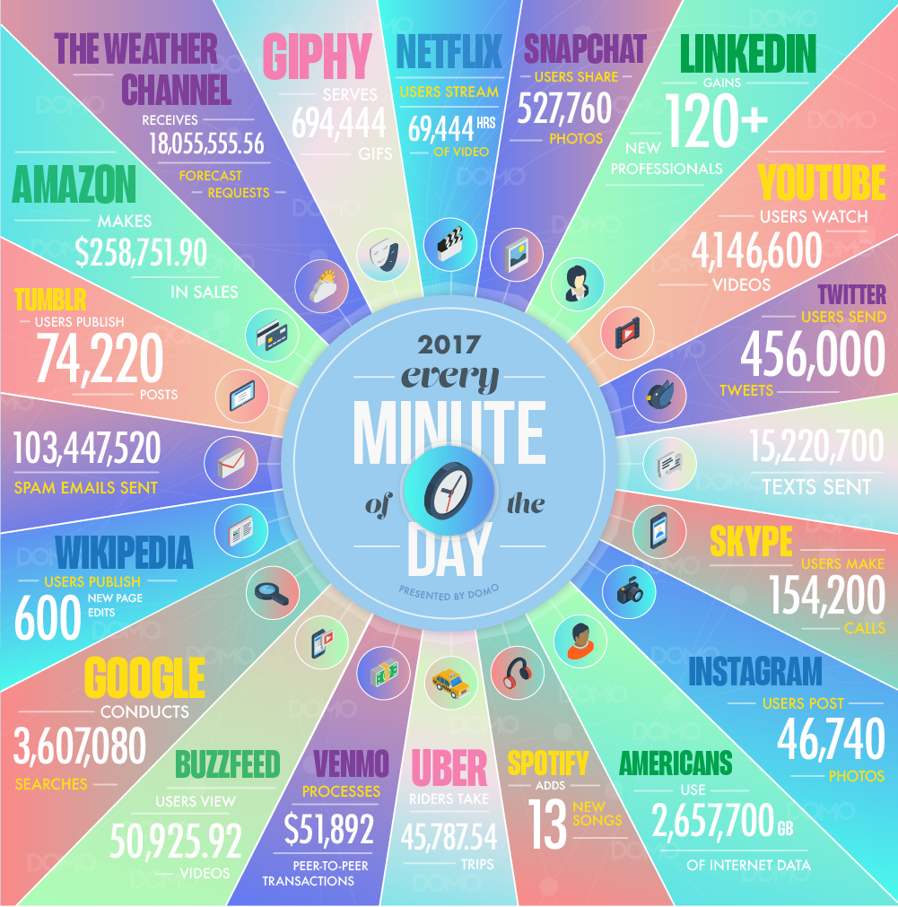
What are Web-Scale Apps?
Applications that are hosted in massive-scale computing infrastructures such as data centers
Used by millions of geographically distributed users
Via web browsers, mobile clients, etc.
Produce, store, consume massive amounts of data
Scale is hard to comprehend

Slide 3
What Kind of Data is Stored?
Companies store data based on their business model …
Google, e.g., daily snapshot of all the web pages in the world
Amazon, e.g., current product data & price for every product
Facebook, e.g., social networking graph
…
We have seen various types of storage systems for storing this data
Data is typically sharded across many machines
Sharded data is replicated for fault tolerance, fast read access
Much focus on scalability, data availability, consistency, etc.

Slide 4
How is the Data Used? i.e, What is “Big Data”?
Web search (e.g., Google) needs to analyze billions of web pages to determine the most relevant pages
Product search (e.g., Amazon) needs to analyze millions of products, who bought them, their reviews, etc.
Recommendation systems (e.g., LinkedIn, Facebooks) need to analyze massive social graphs
All the above can be used to generate massive revenue streams, e.g., smart ad placement, recommendations
These are restaurants you might like based on your tastes …
These stores have big Christmas sales for things you like …
Notes:
restaurants: replace with anything else, e.g., travel locations, shoes, people, …
All this occurred just as the machine learning community suddenly rediscovered neural networks (around 2004) and that model for learning completely took off. So we saw an industry-wide transformation that is still playing out today, but it centers on learning from huge data sets.

Slide 5
A Simple Example: Web Search
Data collection and storage
Collect web pages, store them
Data analytics
Extract words (or phases) from web pages
Associate each word with a ranked list of web pages that contain these words
Data serving
When user searches for word, serve associated list of pages

Slide 6
Data Analytics Requirements
Data analytics
Extract words (or phases) from web pages
Associate each word with a ranked list of web pages that contain these words
Massive computation needs
Parse all pages
Rank all pages, similar to sorting a very large data set
E.g., find the “most authoritative pages” by organizing web pages in a graph, then finding the graph nodes with highest weight (rank)

Slide 7
Data Analytics Challenges
Data is massive
Need sharding across large numbers of machines
Need storage on disk
Need to handle storage failures
Need to handle updates (later)
Computation is massive
Need scalable, parallel computation models
Need to handle massive intermediate, final results
Need to handle compute failures

Slide 8
Data Analytics Frameworks
These frameworks perform massively parallel (“always sharded”) computing efficiently
The data starts out sharded
Often the intermediary states and results are sharded
Final results are some human-useful output, e.g., charts
Notes:
The Apache platform is by far the most popular public big-data infrastructure, but companies like Google have elaborate non-public ones that might not look exactly like Apache

Slide 9
A Typical Big Data System
Batch Processing
Analytical SQL
Stream Processing
Machine Learning
Other Applications
Resource Manager (Workload Manager, Task Scheduler)
Data Storage (File System, Database)
Notes:
These layers show how one component might be built upon a different component.

Slide 10
Open-Source Apache Ecosystem
Apache Hadoop, Spark
Hive
Spark Streaming
Spark MLlib
Other Apps
Resource Manager (YARN, Mesos)
Hadoop NoSQL (Hbase)
Hadoop Distributed File System (HDFS)
Notes:
The Apache platform is by far the most popular public big-data infrastructure, but companies like Google have elaborate non-public ones that might not look exactly like Apache.

Slide 11
Data Ingestion
Apache Hadoop, Spark
Hive
Spark Streaming
Spark MLlib
Other Apps
Resource Manager (YARN, Mesos)
Data Ingest Systems
e.g., Kafka, Flume
Hadoop NoSQL (Hbase)
Hadoop Distributed File System (HDFS)

Slide 12
Coordination
Apache Hadoop, Spark
Hive
Spark Streaming
Spark MLlib
Other Apps
Resource Manager (YARN, Mesos)
Apache
Zookeeper
Hadoop NoSQL (Hbase)
Hadoop Distributed File System (HDFS)
Notes:
Zookeeper is the Apache solution for managing complex systems. Keep in mind that each “box” might have tens or hundreds of processes participating in it, as a pool. But that pool needs to be internally coordinated and fault-tolerance. Zookeeper is used for these aspects, as a powerful and universal configuration manager.

Slide 13
Batch Processing Frameworks
Focus on simplifying the complexity of distributed programming
Developer focuses on logic for processing data
Framework takes care of parallelization, fault tolerance, scheduling, caching, …
Hadoop (MapReduce)
Suited for individual batch (long running) jobs
Spark
Also suited for iterative and interactive batch jobs

Slide 14
History of Hadoop and Spark

Slide 15
Map Reduce
MapReduce enables distributing (parallelizing) a job across multiple nodes of a cluster
Allows programmers to describe processing in terms of simple map and reduce functions on items
Framework takes care of scaling, scheduling, hardware and software failures

Slide 16
Spark
Same goal as Map Reduce, i.e., enable distributing (parallelizing) a job across multiple nodes of a cluster
Allows programmers to describe processing in terms of transformations on fault-tolerant, distributed datasets
Datasets are nodes, transformations are edges in a graph
Transformations are evaluated only when needed (lazily)
Framework takes care of caching, data locality, scaling, scheduling, hardware and software failures
Keep idea is to cache intermediate data that is reused

Slide 17
Challenges
Parallelization
Fault tolerance

Slide 18
Parallelization
Key intuition
Often same processing is required for all items
Processing is independent for each item
E.g., update count of the # of accesses to each website
Same operation is performed for each website
Operation (e.g., map) can be performed in parallel
Similar to a SIMD instruction
However, operation works on shards on different machines
Produces intermediate data that is also sharded across machines

Slide 19
Why Batching?
Shards are typically large, e.g., 16-64MB
Batch processing, i.e., processing all the data in a shard amortizes processing costs
Cost of processing each item is typically low, e.g., count++
Cost of accessing each item from storage is high
Batching reduces the latter cost
However, batching requires enough data (updates) to be available, so trades latency for efficiency
Notes:
we will discuss stream processing later in the course.

Slide 20
Fault Tolerance
Why is it really important for large computations?
Aim is to hide failures from applications
Provide behavior equivalent to fail-free operation
Sometimes described in terms of exactly-once operation
Both Map Reduce and Spark provide strong fault tolerance guarantees
Their behavior is equivalent to running a sequential computation, even in the presence of failures
We will discuss their fault tolerance techniques in detail

