Slide 1
FPGAs at 28nm: Meeting the Challenge of Modern Systems-on-a-Chip
Vaughn Betz
Senior Director, Software Engineering
Altera

Slide 2
Overview
Process scaling & FPGAs
  End user demand
  Technological challenges
FPGAs becoming SoCs
  Stratix V: more hard IP
  FPGA families targeted at more specific markets
Stratix V & 28 nm
  Challenges & features
  Partial reconfiguration
Designer productivity
  Challenges
  Possible software stack solutions

Slide 3
Demand and Scaling Trends

Slide 4




Broad End Market Demand
Communications
Broadcast
Military
Consumer/industrial
Mobile internet and video driving bandwidth at 50% annualized growth rate
Fixed footprints
Proliferation of HD/1080p
Move to digital cinema and 4k2k
Software defined radio
More sensors, higher precision
Advanced radar
Smart cars and appliances
Smart Grid
Need more processing in same footprint, power and cost
4
Notes:
4

Slide 5
Driving Factors—Mobility and Video
Mobile Bandwidth
Video Bandwidth
100
10,000,000
4K2K
1,000,000
100,000
Kb/s
1080p
10,000
Streaming Bandwidth (Mbps)
10
1,000
720p
1080i
100
10
480p
SD
1
1
1G 1983
2G 1991
3G 2001
4G 2009
(LTE)
5G ~2017
1970
1980
1990
2000
2010
2020
Minimum Bandwidth
Maximum Bandwidth

Slide 6


Evolution of Video-Conferencing
Today
Tomorrow
High end in 2000: 384 kbps
Cisco telepresence: 15 Mbps

Slide 7
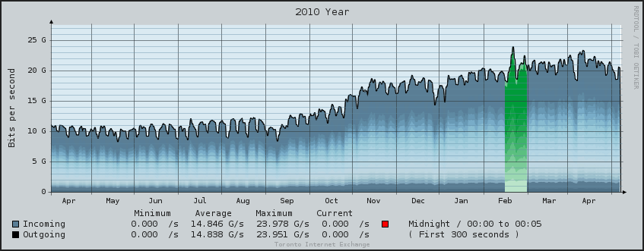
Communication Processing Needs
More bandwidth: CAGR of 25% to 131% / year [By domain, Cisco]
More data through fixed channel → more processing per symbol
Security and quality of service needs → deep packet inspection
Toronto Internet Exchange (TorIX), 2009-2010 [Courtesy W. Gross, McGill]

Slide 8
Moore’s Law: On-Chip Bandwidth
Datapath width * datapath speed
40% / year increase in transistor density
20% / year transistor speed until ~90 nm
  Total ~60% gain / year
40 nm and beyond:
  Little intrinsic transistor speed gain once power controlled
  ~40% gain / year from pure scaling
  Need to innovate to keep up with demand

Slide 9
Increasing I/O Bandwidth
1000
3D integration?
Optical?
26% increase / year per lane
Modest growth in # lanes / chip
PCIe 3
PCIe 2
100
100 GbE
RapidIO 3.0
Interlaken
OC 768
Bandwidth (Gbps) in Log Scale
PCIe
20G FC
10
RapidIO 2.0
10G FC
PCI-X
10 GbE
RapidIO 1.0
PCI-66
OC 48
3G SDI
1
PCI
1G FC
GbE
1990
1995
2000
2005
2010

Slide 10





Scaling Economics
$10,000
TSMC Fab 15: $9B
  40 & 28 nm
90’s fab cost →
fabless industry
Chip cost @ 28 nm
~$60M
Need big market →
go programmable
“Chipless” industry
emerging
$1,000
$100
Foundry Facility Costs ($M)
$10
$1
1965
1970
1975
1980
1985
1990
1995
2000
IP
ASSP
FPGA

Slide 11
FPGAs Becoming SoCs
Example: Stratix V

Slide 12
From Glue Logic to SoC
1992
1995
1999
2002
2008
2010
2003
Flex 8k
Flex 10k
APEX 20K
Stratix
Stratix GX
Stratix IV GX
Stratix V GX
LUTs
FFs
Basic I/Os
Block
RAM
PLLs
Complex I/Os
Hard
Processor
DSP
Blocks
Hard PCIe
Gen1/2
Serial
Transceivers
Hard PCIe
Gen1/2/3
Hard 40G / 100G Ethernet

Slide 13
Hard Block Evaluation
Specific
IP in soft
fabric
Develop
Parameterized
Soft IP
Area, Power,
Speed
Hard
PCIe?
Create Configurable
Hard IP
Estimate
Usage
& Dev. Cost
Gen1
Gen2
Gen3
Area, Power,
Speed
Include routing ports!
Net Win?

Slide 14
Stratix V Transceivers
Power
Down
Power
Down
Fractional PLLs (fPLL)
Clock networks
Embedded HardCopy Block)
Hard PCS
Transceiver PMA
I/O
Hard PCS
Transceiver PMA
I/O
Hard PCS
Transceiver PMA
I/O
Hard PCS
Transceiver PMA
I/O
FPGA
Fabric
Hard PCS
Transceiver PMA
I/O
LC Transmit PLLs
Hard PCS
Transceiver PMA
I/O
Hard PCS
Transceiver PMA
I/O
Hard PCS
Transceiver PMA
I/O
Hard PCS
Transceiver PMA
I/O
Hard PCS
Transceiver PMA
I/O
14

Slide 15

Embedded HardCopy Blocks
Metal programmed: reduces cost of adding device variants with new hard IP
700K equivalent LEs
14M ASIC gates
5X area reduction vs. soft logic
65% reduction in operating power
Very low leakage when unused
Embedded HardCopy Block
Embedded HardCopy Block
PCIe Gen3
40G/100G Ethernet
Other/Custom
Notes:
15

Slide 16
Hard IP Example: PCIe & Interlaken
Interlaken – PCI Express Switch/Bridge
Hard IP | LE Savings
Interlaken (24 Ch @ 5K LEs) | 120K LEs
PCIe Gen3 x8 (2 x 160K LEs) | 320K LEs
Total LE savings | 440K LEs
12 Ch @ 5G
Interlaken
12 Ch @ 5G
Interlaken
Stratix V FPGA
5SGXA7
~630K LEs
PCIe Gen3 x8
PCIe Gen3 x8
630K LEs + 440K LEs = 1,070K LEs
Lower power
Higher effective density
Guaranteed timing closure → ease of use
Notes:
16

Slide 17
Variable-Precision DSP Block
Efficiently supports 9x9, 18x18 and 27x27 multiplies
  27x27 well suited to floating point
Cascade blocks for
larger multiplies
Can store filter coefficients in register bank inside DSP

Slide 18
Stratix V Maximum Capacities
Feature | Stratix V
Logic Elements | 1.1 M
RAM bits | 52 Mb + 7.3 Mb
18x18 multipliers | 3680
High-speed serial links | GX: 66 full-duplex @ 12.5 Gb/s GT: 4 @ 28 Gb/s + 32 @ 12.5 Gb/s
Hard PCIe blocks | 4
Hard 40G / 100G PCS | Yes
Memory interfaces | 7 x 72-bit DDR3 DIMM @ 800 MHz
On-chip memory bandwidth | ~20,000 GB/s
I/O Bandwidth | ~300 GB/s
18x18 MACs | 1,840 GMAC/s

Slide 19

Altera’s Device Roadmap
HardCopy
Altera’s ASIC series
Stratix
High-end FPGAs
Arria
Mid-range FPGAs
Cyclone
Low-cost FPGAs
HardCopy V ASIC
Stratix V FPGA
Arria V FPGA
HardCopy IV ASIC
Stratix IV FPGA
Performance, features, and density
HardCopy III ASIC
Cyclone V FPGA
Stratix III FPGA
Arria II FPGA
Cyclone IV FPGA
Arria FPGA
Cyclone III LS FPGA
Cyclone III FPGA
MAX IIZ CPLD
2007
2008
2009
2010
2011
2012
19
19
19
Notes:
19
19
19

Slide 20
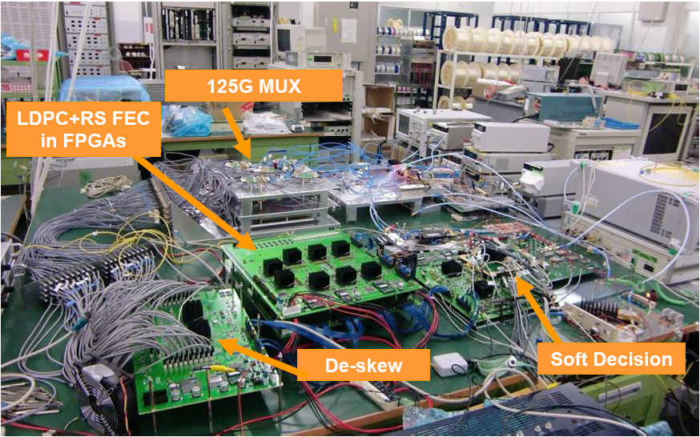
100G Optical System (Stratix II GX)
Ten 90 nm FPGAs
1 or 2 @ 28 nm
T. Mizuochi, et al, “Experimental demonstration of concatenated LDPC and RS codes by FPGAs emulation,” IEEE Photon Technol. Lett., 2009

Slide 21
Other Challenges & Enhancements @ 28 nm

Slide 22
Controlling Power
Stratix V FPGA Power Reduction (New techniques highlighted in yellow) | Lower Static Power | Lower Dynamic Power
28-nm process (high-k, more strain, small C) | ü | ü
Programmable Power Technology | ü
Lower core voltage (0.85 V) | ü | ü
Extensive hardening of IP, Embedded HardCopy Blocks | ü | ü
Hard power-down of more functional blocks | ü
More granular clock gating |  | ü
Selective use of high-speed transistors | ü
Dynamic on-chip termination | ü | ü
Quartus II software PowerPlay power optimization | ü | ü
Notes:
22

Slide 23
Fabric Performance
Low operating voltage key to reasonable power
  But costs speed
  Logic still speeding up, routing more challenging
  Optimize process for FPGA circuitry (e.g. pass gates)
  Trend to bigger blocks / more hard IP
Wire resistance rapidly increasing
  → Co-optimize metal stack & FPGA routing architecture
  Greater mix of wire types and metal layers (H3, H6, H20, V4, V12)
Delay to cross chip not scaling
  Above ~300 MHz, designers pipelining interconnect

Slide 24
Fabric: More Registers
MLAB
Wr Data
Reg
ALM1
Reg
Full
Full
Adder
Adder
ALM2
Reg
Reg
Adaptive
Adaptive
Wr Addr
Rd Data
LUT
LUT
Reg
Reg
Full
Full
Adder
Adder
ALM10
Reg
Reg
Memory mode: 5 registers
Re-uses 4 ALM registers
Adds extra register for write address
Easier timing
Double the logic registers (4 per ALM)
Faster registers
Aids deep pipelining & interconnect pipelining

Slide 25
Metastability Robustness
data
Metastable?
clka
clkb
clk
clk
data
~Vdd/2

Slide 26
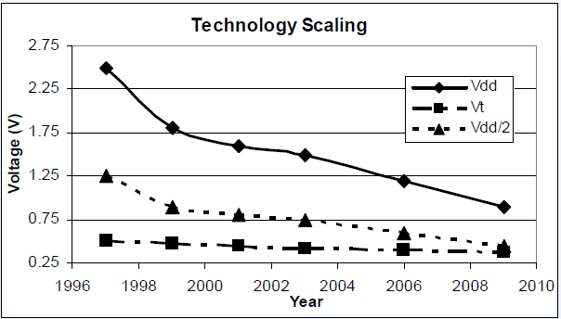
Metastability Robustness
Source: Chen, FPGA 2010
Loop gain at Vdd/2 dropping → τ_{met} increasing
Solution: register design (e.g. use lower Vt)
Solution: CAD system analyzes & optimizes
  20,000 to 200,000 increase in MTBF

Slide 27
Pass Transistors
Most area-efficient routing mux
But Vdd – Vt dropping
Vdd-Vt
Bias Temperature Instability (BTI) makes worse
  Increase / hysteresis in Vt due to Vgs state over time
  All circuits affected, but pass transistors more sensitive to Vt shift
Careful process and circuit design needed
Future scaling:
  Full CMOS?
  Opening for a new programmable switch?

Slide 28
Soft Errors
Block RAM: new M20K block has hard ECC
  MLAB: can implement ECC in soft logic
Configuration RAM: background ECC
  But could take up to 33 ms to detect
Config. RAM circuit design to minimize SEU
Trends with SRAM scaling:
  Smaller target → lower FIT rate / Mb (constant per die)
  Less charge → higher FIT for alpha, stable for neutron
  Will this stabilize at an acceptable rate?
  Known techniques to greatly reduce (at area cost) → does not threaten scaling

Slide 29
Stratix V Partial Reconfiguration
Very flexible HW
Reconfigure individual LABs, block RAMs, routing muxes, …
Without disrupting operation elsewhere

Slide 30
Partial Reconfiguration (PR) Overview
Software flow is key
  Build on existing incremental design & floorplanning tools
  Enter design intent, automate low-level details
  Simulation flow for operation, including reconfiguration
Partial reconfiguration can be controlled by soft logic, or an external device
  Load partial programming files while device operating
Target: multi-modal applications

Slide 31
Example System: 10*10Gbps→OTN4 Muxponder
Client Side
Line Side
MUXPonder
Channel 1
10Gbs
10GbE
Channel 2
100Gps
10Gbs
OTN2
OTN4
Channel 10
10Gbs
OTN2
10GbE
31
Notes:
31

Slide 32
Design Entry & Simulation
One set of HDL
Tools to simulate during reconfig
  module reconfig_channel (clk, in, out);
  input clk, in;
  output [7:0] out;
  parameter VER = 2; // 1 to select 10GbE, 2 to select OTN2
  generate
  case (VER)
  1: gige m_gige (.clk(clk), .in(in), .out(out));
  2: otn2 m_otn2 (.clk(clk), .in(in), .out(out));
  default: gige m_gige(.clk(clk), .in(in), .out(out));
  endcase
  endgenerate
  endmodule

Slide 33
Incremental Design Flow Background
Specify partitions in your design hierarchy
Can independently recompile any partition
  CAD optimizations across partitions prevented
  Can preserve synthesis, placement and routing of unchanged partitions
Top
…
Channel 1
Channel 2
MUXponder
OTN4
Notes:
33

Slide 34
Partial Reconfig Instances
Top
…
C1, OTN2
C2, OTN2
MUXponder
OTN4
C1, 10GbE
C2, 10GbE
Static partition
Partial Reconfig
Partition 2
Partial Reconfig
Partition 2
Notes:
34

Slide 35


Partial Reconfiguration: Floorplanning
Define partial reconfiguration regions
  Non-rectangular OK
  Any number OK
Works in conjunction with transceiver dynamic reconfiguration for dynamic protocol support
  “Double-buffered” partial reconfig
Partial Reconfiguration for Core
10GbE
OTN2
FPGA Core
Transceivers
OTN4
Dynamic Reconfiguration
for Transceivers
10GbE
FPGA Core
Transceivers
OTN4
Notes:
35

Slide 36
Physical: I/Os
PR region I/Os must stay in same spot
  So rest of design can communicate with any instance
Same wire?
  FPGAs not designed to route to/from specific wires
Solution: automatically insert “wire LUT”
  Automatically lock down in same spot for all instances
OTN2
MUXponder
10GbE

Slide 37
Physical: Route-Throughs
Can partially reconfigure individual routing muxes
Enables routing through partial reconfig regions
  Simplifies / removes many floorplanning restrictions
  Quartus II records routing reserved for top-level use
  Prevents PR instances from using it
OTN4
10GbE
OTN2
Transceivers

Slide 38
Extending & Improving the Software Stack

Slide 39
Design Flow Challenges
HDL: low-level parallel programming language
  RTL ~300 kLOCs, behavioural ~40 kLOCs [NEC, ASPDAC04]
Timing closure
  Fabric speed flattening, but processing needs growing
  Datapaths widening, device sizes growing exponentially
  4x28 Gbps → 336 bit datapath @ 333 MHz → need good P & R
  Need more latency? → may cause major HDL changes
Compile, test, debug cycle slower than SW
  And tools to observe HW state less mature
  Any timing closure issues exacerbate
Firmware development needs working HW

Slide 40

The Competition: Many Core
Tilera TILE64
DDR2 Memory Controller 0
DDR2 Memory Controller 1
PCIe 0
MAC
PHY
PROCESSOR
XAUI
MAC
PHY 0
CACHE
Reg File
L2 CACHE
P2
P1
P0
L1I
L1D
Serdes
ITLB
DTLB
Serdes
2D DMA
UART, HPI
JTAG, I2C,
SPI
GbE 0
MDN
TDN
UDN
STN
IDN
SWITCH
Flexible IO
GbE 1
PCIe 1
MAC
PHY
Flexible IO
XAUI
MAC
PHY 1
Serdes
Serdes
DDR2 Memory Controller 3
DDR2 Memory Controller 2
40

Slide 41
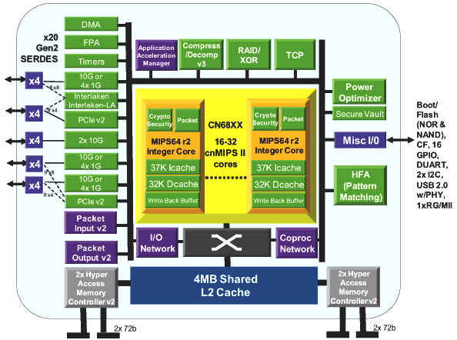
Competition: ASSP w/HW Accelerators
Ex. Cavium – Octeon CN68XX
85 application
accelerators
65 nm in Q4 2010
2 process generations behind FPGAs

Slide 42
“Bespoke” ASSPs in FPGAs
Processor (Master)
PCI Express
(Master)
Connect IP with SoPC Builder
  Integrates system & builds software headers
Next generation: general Network-on-a-Chip
  Topology, latency: selectable
  Scalable enough to form heart-of-the-system
Interface
Interface
Network
Interface
Network
Interface
Interconnect Network
Internal pipelining, arbitrary
topology, customizable arbitration
Network
Interface
Network
Interface
Interface
Interface
DDR3
Accel

Slide 43
High-Level Synthesis
Good results in some problem domains (e.g. DSP kernels)
Often difficult to scale to large programs
Debugging and timing closure difficult
  Unclear how the code relates to the synthesized solution
  How to change the ‘C’ code to make hardware run faster?
  Few tools to drive profiling data back to the high-level code
  Few tools to debug HW in a software-centric environment

Slide 44
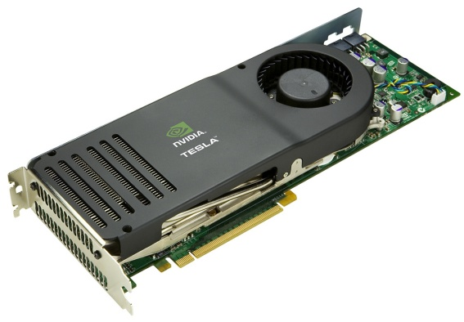
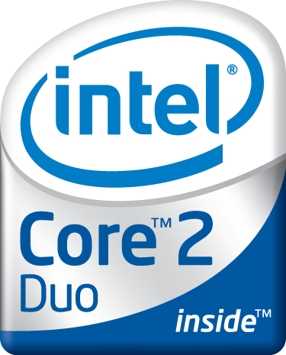


OpenCL: Explicitly Parallel C
The OpenCL programming model allows us to:
  Define Kernels
    Data-parallel computational units → can hardware accelerate
    Including communication mechanism to kernels
  Describe parallelism within & between kernels
  Manage Entire Systems
    Framework for mix of HW-accelerated and software tasks
Still C
Multi-target

Slide 45
OpenCL Structure
__kernel void sum { … }
__kernel void transpose {…}
float cross_product { … }
Program: kernels and functions
Task-level parallelism, overall framework
__kernel void sum
(__global const float *a,
__global const float *b,
__global float *answer)
{
int xid = get_global_id(0);
answer[xid] = a[xid] + b[xid];
}
Kernels: data-level parallelism
Suitable for HW or parallel SW implementation
Specify memory hierarchy

Slide 46
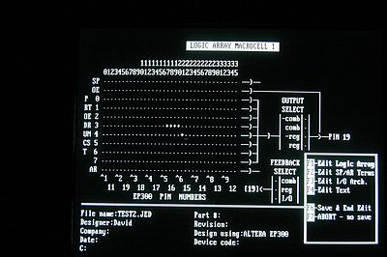
The Past (1984): Editing Switches

Slide 47
The Present: HDL Design Flow
Timing & Other
Constraints
Verilog,
VHDL
Synthesis
Timing and
Power Analyzer
Placement and
Routing
Timing, Power and Area Optimized Design

Slide 48
The Future?
OpenCL
Extract
Communication
Fast debug
Kernel
Compilers
Kernel
Compilers
Kernel
Compilers
SoPC Builder
Control
SW
Communication
Fabric
HW kernels or
SW kernels
RTL becomes assembly language
48

Slide 49
Summary

Slide 50
Summary
Huge demand for more processing
  Possibly outstripping Moore’s law & off-chip bandwidth
FPGAs becoming SoCs
  More heterogeous/hard function units
  FPGAs specializing to markets
28 nm & Stratix V
  -30 to -50% power, 1.5x I/O bandwidth, 1.5x – 2x more processing
  Partial reconfiguration
FPGA robustness with scaling
  Innovation overcoming issues → scaling continues
Tool innovation needed
  Higher-level, fast debug cycles, push-button timing closure

