Slide 1
High-Level Synthesis with Bluespec:
An FPGA Designer’s Perspective
Jeff Cassidy
University of Toronto
Jan 16, 2014

Slide 2
Disclaimer
I do applications: not an HLS expert
Have not used all tools mentioned; Sources: personal experience, reading, conversations
Opinions are my own
Discussion welcome

Slide 3
Outline
Introduction
  Quick overview of High-Level Synthesis
  Bluespec Features
Case study: FullMonte biophotonic simulator
From Verilog to BSV
Summary

Slide 4
Programming FPGAs is Hard!
Annual complaints at FCCM, FPGA, etc
How to fix?
  Overlay architectures
  Better CAD: P&R, latency-insensitive
  Better devices: NoC etc
  “Magic” C/Java/OpenCL/Matlab-to-gates
  Better hardware design language

Slide 5
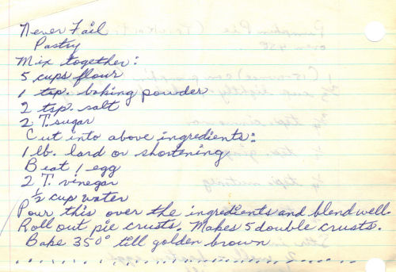
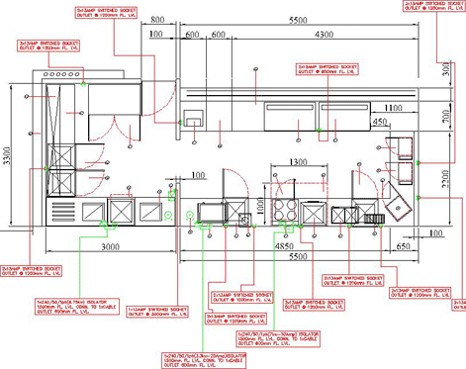

Software to Gates: The Problem
Inputs
Algorithm
Outputs
Semantic
Gap
Functional Units
Architecture (macro, micro)
Synchronization
Layout

Slide 6
High-Level Synthesis
Impulse-C, Catapult-C, …-C, Vivado HLS, LegUp
Maxeler MaxJ, IBM Lime
Matlab: Xilinx System Generator, Altera DSP Builder
Altera OpenCL

Slide 7
Can’t Have It All
Success requires specialization
  System Generator/DSP Builder: DSP apps (dataflow)
  Maxeler MaxJ: Data flow graphs from Java
  Altera OpenCL: Explicit parallelization (dataflow)
  LegUp & Vivado: Embedded acceleration

Slide 8
OK, we know how to do dataflow…
What about control?
Memory controllers, switches, NoC, I/O…
What about hardware designers?
Notes:
Legacy codebase
Existing programmers -> embedded -> multithreaded -> hardware

Slide 9
Bluespec
  …is not:
  an imperative language
  a way for software coders to make hardware
  a way out of designing architecture
  …is:
  a productive language for hardware designers
  a quick, clean way to explore architecture
  much more concise than Verilog/VHDL

Slide 10
Bluespec
Designing hardware
  Instantiate modules, not variables
  Aware of clocks & resets
  Anything possible in Verilog
  Fine-grained control over resources, latency, etc
Explore more microarchitectures faster
Can use same language to model & refine

Slide 11
Bluespec : RTL :: C++ : Assembly
Low-level
  Bit-hacking
  Design as hierarchy of modules
  Bit-/Cycle-accurate simulation
  Seamless integration of legacy Verilog
  No overhead; get the h/w you ask for and no more

Slide 12
Bluespec : RTL :: C++ : Assembly
High-level
  Concise
  Composable
  Abstraction & reuse, library development
  Correctness by design
  Fast simulation
  Helpful compiler

Slide 13

History of Bluespec
Research at MIT CSAIL late 90’s-2000s (Prof Arvind)
Origin: Haskell (functional programming)
Semiconductor startup Sandburst 2000
  Designing 10G Ethernet routers
  Early version used internally
Bluespec Inc founded 2003

Slide 14
Case Study: FullMonte Biophotonic Simulations

Slide 15
Timeline
2010 Learning Haskell for personal interest
2011 Applied for MASc
First heard of Bluespec
mid-2012 receive Bluespec license, start tinkering
Implement/optimize software model
March 2013 start writing code for thesis
Sep 2013 code complete, debugged, validated
Dec 2013 Thesis defense ☺

Slide 16
Case Study: My Research
Biophotonics: Interaction of light and living tissue
Clinical detection & treatment of disease
Medical research
Light scattered ~10¹-10³ times / cm of path traveled
Simulation of light distribution crucial & compute-intensive

Slide 17
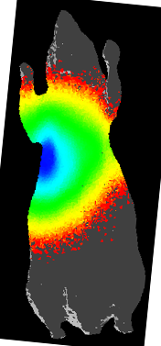
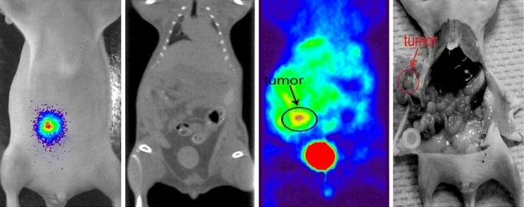
Case Study: My Research
Bioluminescence Imaging
Tag cancer cells with bioluminescent marker
Image using low-light camera
Watch spread or remission of disease
[Left] Dogdas, Stout, et al. Digimouse: a 3D whole body mouse atlas from CT and cryosection data. Phys Med Biol 52(3) 2007.

Slide 18
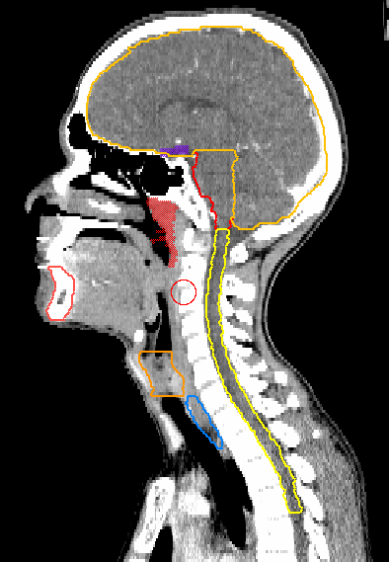
Case Study: My Research
Tumour
Brain
Photodynamic Therapy (PDT) of Head & Neck Cancers
Light + Drug + Tissue Oxygen = Cell death
Need to simulate light
Heterogeneous structure
Spine
Mandible
Larnyx
Esophagus
Courtesy R. Weersink
Princess Margaret Cancer Centre

Slide 19
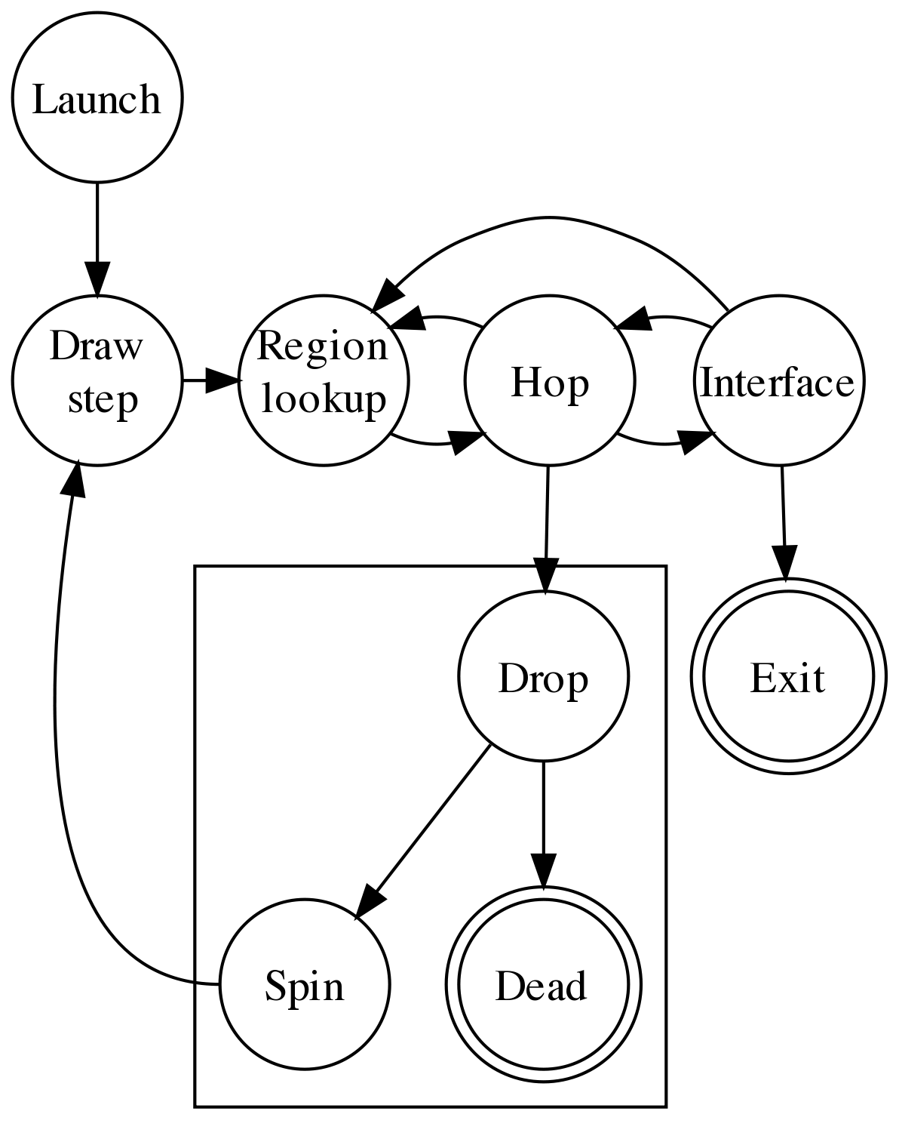
Case Study: My Research
Launch
~10⁸-10⁹ packets
Gold standard model
Monte Carlo ray-tracing of photon packets
  Absorption proportional, not discrete
Tetrahedral mesh geometry
Compute-intensive!
Inner loop
10²-10³ loops/packet
PDT: Outer loop
10¹-10³ times
PDT Plan Total
10¹¹-10¹⁵ loops
Notes:
Over 10^16 ops!! Sine, cosine, ray-tetrahedron intersection
10s of ops per loop: 10^16+ ops!! (CPU 3e9 per sec => 10^6-10^7 seconds = hundreds of hours)

Slide 20
Case Study: My Research
Aug-Dec 2012: FullMonte Software
Fastest MC tetrahedral mesh software available
  C++
  Multithreaded
  SIMD optimized
~30-60 min per simulation
  Not fast enough! Time to accelerate

Slide 21
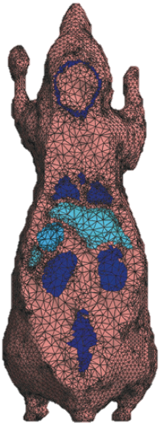

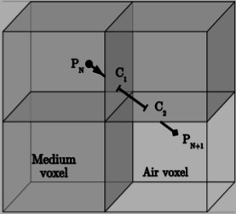
Acceleration
Tetrahedral mesh (300k elements)
Infinite planar layers
FPGA: William Lo “FBM” (U of T)
GPU: CUDAMCML, GPUMCML
Done in software (TIM-OS)
No prior GPU or FPGA acceleration
Voxels
GPU: MCX
[Right] Dogdas, Stout, et al. Digimouse: a 3D whole body mouse atlas from CT and cryosection data. Phys Med Biol 52(3) 2007.

Slide 22
Case Study: My Research
Fully unrolled, attempts 1 hop / clock
Multiple packets in flight
  Launch to prevent hop stall
  Queue where paths merge
100% utilization of hop core
  Most DSP-intensive
  Part of all cycles in flow
Random numbers queued for use when needed
  Scattering angle (Henyey-Greenstein)
  Step lengths (exponential)
  2D/3D unit vectors
Notes:
~75% of logic/ALM is for pipeline balancing
Large packet structure

Slide 23
Case Study: My Research
  FullMonte Hardware: First & Only Accelerated Tetrahedral MC
  TT800 Random Number Generator
  Logarithm
  CORDIC sine/cosine
  Henyey-Greenstein function
  Square-root
  3x3 Matrix multiply
  Ray-tetrahedron intersection test
  Divider
  Pipeline queuing and flow control
  Block RAM read and read-accumulate-write
4.5 KLOC BSV incl. testbenches
~6 months: learn BSV, implement, debug

Slide 24
Results
Simulated, Validated, Place & Route (Stratix V GX A7)
Slowest block 325 MHz, system clock 215 MHz
3x faster than quad-core Sandy Bridge @ 3.6GHz
  48k tetrahedral elements
  Single pipeline; can fit 4 on Stratix V A7
  60x power efficiency vs CPU
Next Steps
Tuning
Scale up to 4 instances on one Altera Stratix V A7
Handle larger meshes using custom memory hierarchy

Slide 25
From Verilog to
Bluespec SystemVerilog

Slide 26
From Verilog to BSV
What’s the same
Design as hierarchy of modules
Expression syntax, constants
Blocking/non-blocking assignments (but no assign stmt)
What’s different
Actions & rules
Separation of interface from module
Strong type system
Polymorphism

Slide 27
BSV 101: Making a Register
Verilog
reg r[7:0];
always(@posedge clk)
begin
if (rst)
r <= 0;
else if(ctr_en)
r <= r+1;
end
Explicit state instantiation, not behavioral inference
Better clarity (less boilerplate)
Bluespec
Reg#(UInt#(8)) r <- mkReg(0);
rule upcount if (ctr_en);
r <= r+1;
endrule
Identical function
8 lines -> 4
Notes:
Readability: it’s a reg!
Reset, clock implicit
Rule ~= always block

Slide 28
Actions
Fundamental concept: atomic actions
Idea similar to database transaction
All-or-nothing
Can ‘fire’ only if all side effects are conflict-free
// fires only if no one else writes to a and b
action
a <= a+1;
b <= b-1;
endaction
action
a <= 0;
endaction
Conflict
Notes:
Add compiler warning for conflicting actions
Mention explicit vs compiler-handled
“rule is like always block except compiler schedules for you”

Slide 29
Rules
Rule = action + condition
Similar to always block, but far more powerful
Rule fires when:
  Explicit conditions true
  Implicit conditions true
  Effects are compatible with other active rules
Compiler generates scheduler: chooses rules each clk
Notes:
Add compiler warning for conflicting actions
Mention explicit vs compiler-handled
“rule is like always block except compiler schedules for you”

Slide 30
Rules
Explicit condition
rule enqEveryFifth if (ctr % 5 == 0);
myFifo.enq(5);
endrule
rule enqEveryThird if (ctr % 3 == 0);
myFifo.enq(3);
endrule
Compiler says…
Warning: "FifoExample.bsv", line 26, column 8: (G0010)
Rule "enqEveryFifth" was treated as more urgent than
"enqEveryThird". Conflicts:
"enqEveryFifth" cannot fire before "enqEveryThird":
calls to myFifo.enq vs. myFifo.enq
"enqEveryThird" cannot fire before "enqEveryFifth":
calls to myFifo.enq vs. myFifo.enq
Verilog file created: mkFifoTest.v
Implicit conditions:
can’t enq a full FIFO
Can only enq one thing per clock
Notes:
Add compiler warning for conflicting actions
Mention explicit vs compiler-handled
“rule is like always block except compiler schedules for you”

Slide 31
Rules
(* descending_urgency=“enqEveryFifth,enqEveryThird” *)
rule enqEveryFifth if (ctr % 5 == 0);
myFifo.enq(5);
endrule
rule enqEveryThird if (ctr % 3 == 0);
myFifo.enq(3);
endrule
Compiler says… no problem
Verilog file created: mkFifoTest2.v
Notes:
Add compiler warning for conflicting actions
Mention explicit vs compiler-handled
“rule is like always block except compiler schedules for you”

Slide 32
Rules
rule enqEvens if (ctr % 2 == 0);
myFifo.enq(ctr);
endrule
rule enqOdds if (ctr % 2 == 1);
myFifo.enq(2*ctr);
endrule
Compiler says…
Verilog file created: mkFifoTest3.v
…no problem; it can prove the rules do not conflict
Notes:
Add compiler warning for conflicting actions
Mention explicit vs compiler-handled
“rule is like always block except compiler schedules for you”

Slide 33
Rules
(* fire_when_enabled *)
rule enqStuff if (en);
myFifo.enq(val);
endrule
method Action put(UInt#(8) i);
myFifo.enq(i);
endmethod
Compiler says…
Warning: "FifoExample.bsv", line 74, column 8: (G0010)
Rule "put" was treated as more urgent than "enqStuff". Conflicts:
"put" cannot fire before "enqStuff": calls to myFifo.enq vs. myFifo.enq
"enqStuff" cannot fire before "put": calls to myFifo.enq vs. myFifo.enq
Error: "FifoExample.bsv", line 82, column 6: (G0005)
The assertion `fire_when_enabled' failed for rule `RL_enqStuff'
because it is blocked by rule
put
in the scheduler
esposito: [put -> [], RL_enqStuff -> [put], RL_val__dreg_update -> []]
Notes:
Add compiler warning for conflicting actions
Mention explicit vs compiler-handled
“rule is like always block except compiler schedules for you”

Slide 34
Methods vs Ports
Ports replaced by method calls (like OOP) – 3 types:
  Function: returns a value (no side-effects)
    Can always fire
    Ex: querying (not altering) module state: isReady, etc.
  Action: changes state; may have a condition
    May have explicit or implicit conditions
    Ex: FIFO enq
  ActionValue: action that also returns a value
    May have conditions
    Ex: Output of calculation pipeline (value may not be there yet)

Slide 35
Methods vs Ports
Verilog
wire[7:0] val;
wire ivalid;
wire vFifo_ren, vFifo_wen;
wire vFifo_rdy;
wire[7:0] vFifo_din;
wire[7:0] vFifo_dout;
Fifo_inst#(16)(
.ren(vFifo_ren),
.wen(vFifo_wen),
.din(vFifo_din),
.dout(vFifo_dout),
.rdy(vFifo_rdy));
assign vFifo_wen = vFifo_rdy
and ivalid;
assign vFifo_val = val_in;
Wire#(Uint#(8)) val <- mkWire;
let bsvFifo <- mkSizedFIFO(16);
rule enqValueWhenValid;
bsvFifo.enq(val);
// … other stuff …
endrule
Notes:
Latency-insensitive design

Slide 36
Methods vs Ports
Method conditions are “pushed” upstream
Any action which calls a method (eg. FIFO enq) automatically gets that method’s conditions
  Implicit conditions
Conditions are formally enforced by compiler

Slide 37
Methods vs Ports
Hardware: Compiler makes handshaking signals
  ready output (when able to fire)
  enable input (to tell it to fire)
  Can also provide can_fire, will_fire outputs for debug
Not overhead; Verilog designer must do this too!
BSV Scheduler drives ready, enable, can_fire, will_fire
BSV compiler does it for you

Slide 38
Strong Typing
Concept inherited from Haskell
Type includes signed/unsigned, bit length
No implicit conversions; must request:
  Extend (sign-extend) / truncate
  Signed/unsigned
Can be “lazy” where type is “obvious”
let r <- myFIFO.first;

Slide 39
Typeclasses
Arith#(t) means t implements + - * /, others…
function t add3(t a,t b,t c) provisos (Arith#(t));
return a+b+c;
Endfunction
Can define modules & functions that accept any type in a given typeclass
  Eg FIFO, Reg require Bit#(t,nb)

Slide 40
Polymorphic Types
Maybe#(Tuple2#(t1,t2)) v; // data-valid signal
if isValid(v) ...
if (v matches tagged Valid {.v1,.v2}) ...
// can use v, v1, v2 as values here
Tuple2#(t1,t2) x =
fromMaybe(tuple2(default1,default2),v))
Notes:
Should simplify out Tuple2 – demonstrating 2 concepts at same time

Slide 41
Handy Bits
Default register (DReg)
  Resets to a default value each clk unless written to
Wire
  Physical wire with implicit data-valid signal
  Readable only if written within same clk (write-before-read)
RWire
  Like wire but returns a Maybe#(t)
  Always readable; returns Invalid if not written
  Returns Valid .v (a value) if written within same clk

Slide 42
Handy Bits
Wire#(Uint#(16)) val_in <- mkWire;
Reg#(Uint#(32)) accum <- mkReg(0);
rule accumulate;
accum <= accum + extend(val_in);
endrule
rule foo (…);
val_in <= 10;
Endrule
method Action put(UInt#(16) i);
val_in <= I;
endmethod
Implicit condition
val_in valid only when written
Conflict
Write to same element; method will override and compiler will warn

Slide 43
Handy Bits
Reg#(Maybe#(Int#(16)) val_in_q <- mkDReg(tagged Invalid);
Reg#(Bool) valid_d <- mkReg(False);
rule accum if (val_in_q matches tagged Valid .i);
accum <= accum + extend(i);
endrule
rule delay_ivalid_signal;
valid_d <= isValid(val_in_q);
Endrule
method Action put(Int#(16) i);
val_in_q <= i;
endmethod
Explicit condition
Always fires (Reg always readable)
Will be tagged Invalid if not written
Will be Valid .v if written

Slide 44
Libraries
FIFOs, BRAM, Gearbox, Fixpoint, synchronizers…
Gray counter
AXI4, TLM2, AHB
Handy stuff: DReg, DWire, RWire, common interfaces…
Sequential FSM sub-language with actions
  if-then
  while-do

Slide 45
Workflows
BSV + C → Native object file (.o) for Bluesim
  Assertions
  C testbench / modules
  Tcl-controlled interaction
  Verilog code must be replaced by BSV/C functional model
BSV + Verilog + C → Verilog + VPI → RTL Simulation
  Automatic VPI wrapper generation
BSV + Verilog → Synthesizable Verilog → Vendor synthesis
  Reasonably readable net/hierarchy identifiers

Slide 46
Summary

Slide 47
Strengths
Variable level of abstraction
Fast simulation (>10x over RTL w ModelSim)
Concise code
Minimal new syntax vs Verilog
Clean integration with C++
Verilog output code relatively readable

Slide 48
Weaknesses
Some issues inferring signed multipliers (Altera S5)
  Workaround
Built-in file I/O library weak
  Wrote my own in C++ - fairly easy
Support for fixed-point, still a lot of manual effort
Can’t use Bluesim when Verilog code included
  Create functional model (BSV or C++) or use ModelSim

Slide 49
Summary
Learned language and wrote thesis project in ~6m
Performance/area comparable to hand-coded
Much more productive than Verilog/VHDL
  Write less code
  Compiler detects more errors
  Fast simulation

Slide 50
Summary
Great for control-intensive tasks
  Creating NoC
  Switches, routers
  Processor design
Good target for latency-insensitive techniques
Simulate quickly, then refine & explore architectures
Fast to learn - Rapid return on investment

Slide 51
Thank You
Questions?
Free books: www.bluespec.com; U of T has s/w license
For help setting up Bluespec, just ask!
jeffrey.cassidy@gmail.com

