Slide 1
Titan:
Large and Complex Benchmarks in Academic CAD
Kevin E. Murray, Scott Whitty, Suya Liu, Jason Luu, Vaughn Betz

Slide 2
Outline
  Motivation
  Hybrid CAD Flow & Benchmarks
  VPR and Quartus II Comparison
  Conclusion and Future Work

Slide 3
Motivation

Slide 4

Evaluating FPGA Architectures and CAD
  Must quantitatively compare:
    FPGA Architectures
    FPGA CAD Algorithms
  Benchmarks often neglected
  Good benchmarks:
    Exploit device characteristics (i.e. hard blocks)
    Comparable to modern device sizes
Benchmarks
FPGA Architecture
Modify
CAD Flow
Modify
Results
Notes:
Architecture comparison diagram (N4 vs N6?)

Slide 5
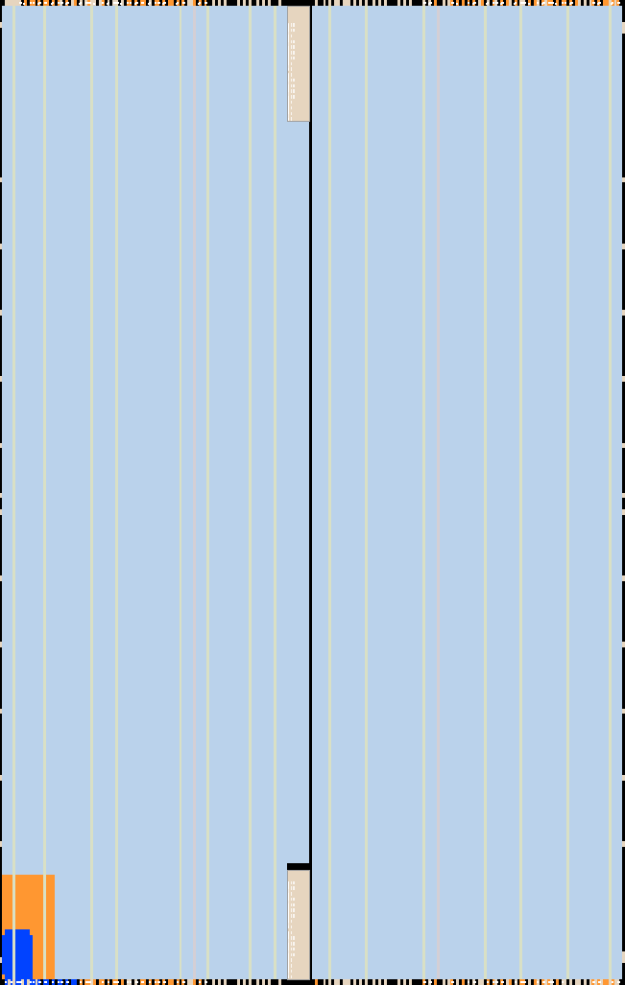
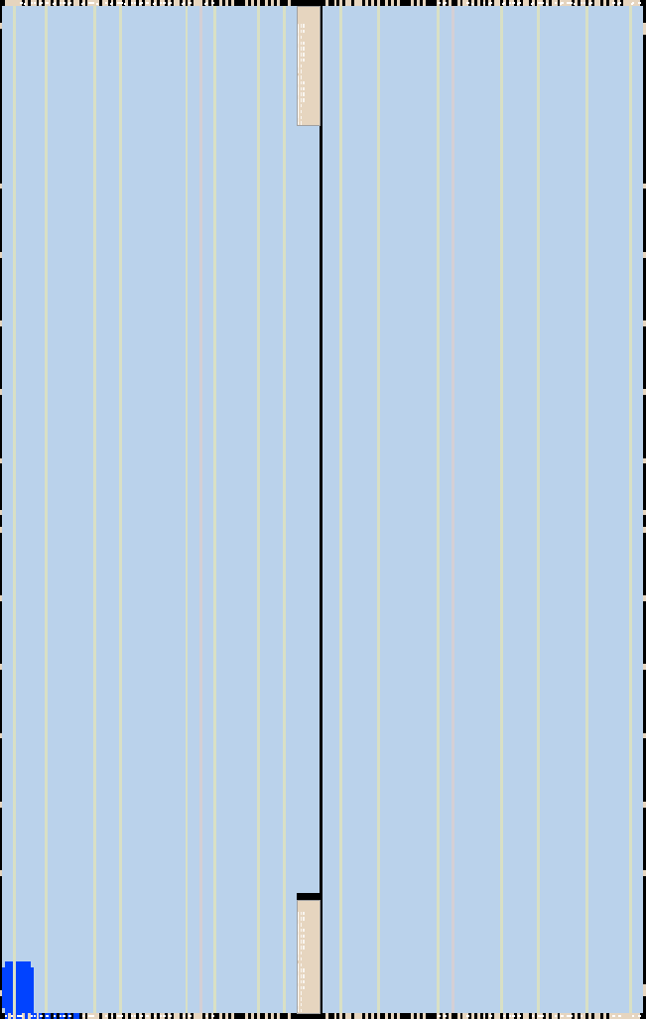
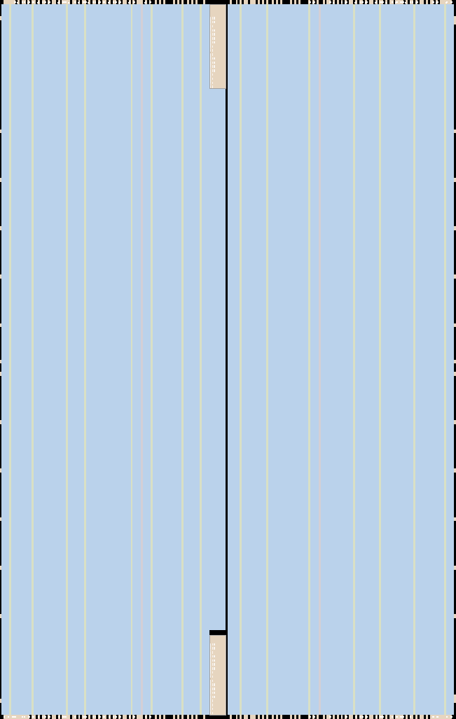
State of FPGA Benchmarks
14nm?
28nm
MCNC20 (1991)
    < 1% of Stratix V
    No Hard Blocks
VTR (2012)
    < 5% of Stratix V
    Few Hard Blocks
Even smaller on future devices
20nm?
Notes:
MCNC (1991):
* Comb Circuits
* Some Sequential Circuits
* No hard blocks
VTR (2012):
* Sequential Circuits
* Few hard blocks

Slide 6
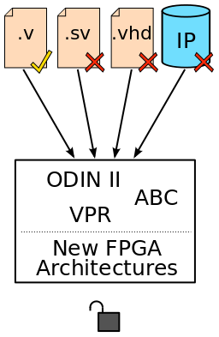
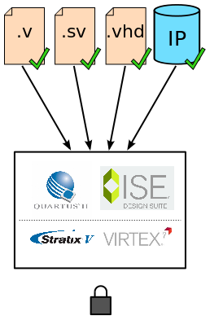

Why Don’t We Have Better Benchmarks?
  Academic tools cannot handle real designs
    Limited HDL support
    No IP Cores (Vendor, 3rd party)
  Vendor tools are too restrictive
    Limited to Vendor’s Architectures
    Cannot modify CAD algorithms

Slide 7
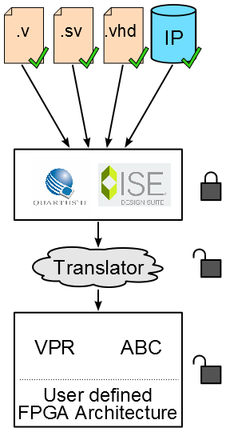
Options?
  Upgrade academic tools
    Add support for wide range of HDLs
    Create an IP library
    A huge investment!
Exploit vendor tool strengths?
    Hybrid CAD flow
Vendor
Academic
Notes:
High Level Diagram

Slide 8
Hybrid CAD Flow & Benchmarks

Slide 9
Building a Hybrid CAD Flow
Analysis & Elaboration
Quartus II
Technology Mapping
Quartus II
Post Technology Map Netlist:
    LUTs, Flip-Flops, Multipliers etc.
Packing
Placement
VPR
Routing

Slide 10
Titan Flow Capabilities & Limitations
Experiment Modification | VTR | Titan | Titan Flow Method
Device Floorplan | Yes | Yes | Architecture file
Inter-cluster Routing | Yes | Yes | Architecture file
Clustered Block Size / Configuration | Yes | Yes | Architecture file
Intra-cluster Routing | Yes | Yes | Architecture file
LUT size / Combinational Logic Element | Yes | Yes | ABC re-synthesis
New RAM Block | Yes | Yes | Architecture file (up to 16K depth*)
New DSP Block | Yes | Yes | Architecture file (up to 36 bit width*)
New Primitive Type | Yes | No | No method to pass black box through Quartus II
* Maximum for Stratix IV
Notes:
Table from Paper

Slide 11
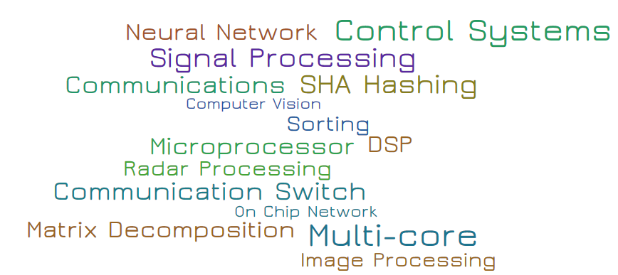
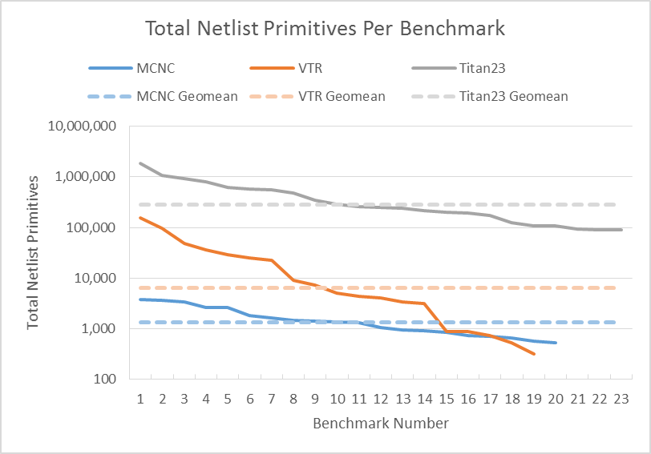
Titan 23 Benchmarks
  23 Benchmarks
  Wide range of application domains
  All make use of hard blocks (DSPs, RAMs)
  90K to 1.9M netlist primitives
44×
VTR
215×
MCNC

Slide 12
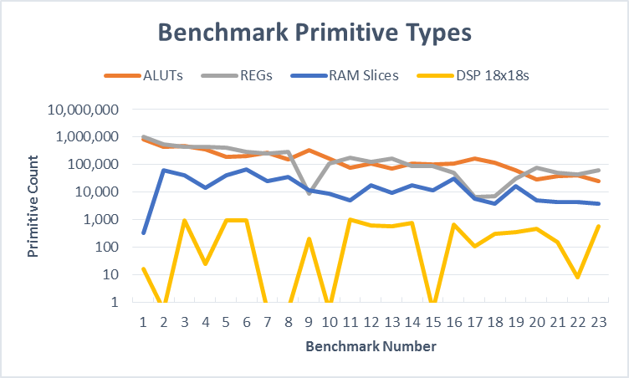
Benchmark Details
Logic Heavy
RAM Heavy
DSP Heavy

Slide 13
VPR and Quartus II Comparison

Slide 14

VPR and Quartus II Flows
HDL
Analysis & Elaboration
Quartus Map
Technology Mapping
User Defined FPGA Arch.
Packing
Packing
Quartus Fit
Placement
Placement
VPR
Routing
Routing

Slide 15
Titan Compatible Architecture
Primitive | Description
lcell_comb | LUT and Full Adder
dffeas | Register
mlab_cell | LUT RAM
mac_mult | Multiplier
mac_out | Accumulator
ram_block | RAM Slice
io_{i,o}buf | I/O Buffer
ddio_{in,out} | DDR I/O
pll | Phase Locked Loop
Architecture must use same primitives as logic synthesis
Can be grouped into arbitrary blocks

Slide 16
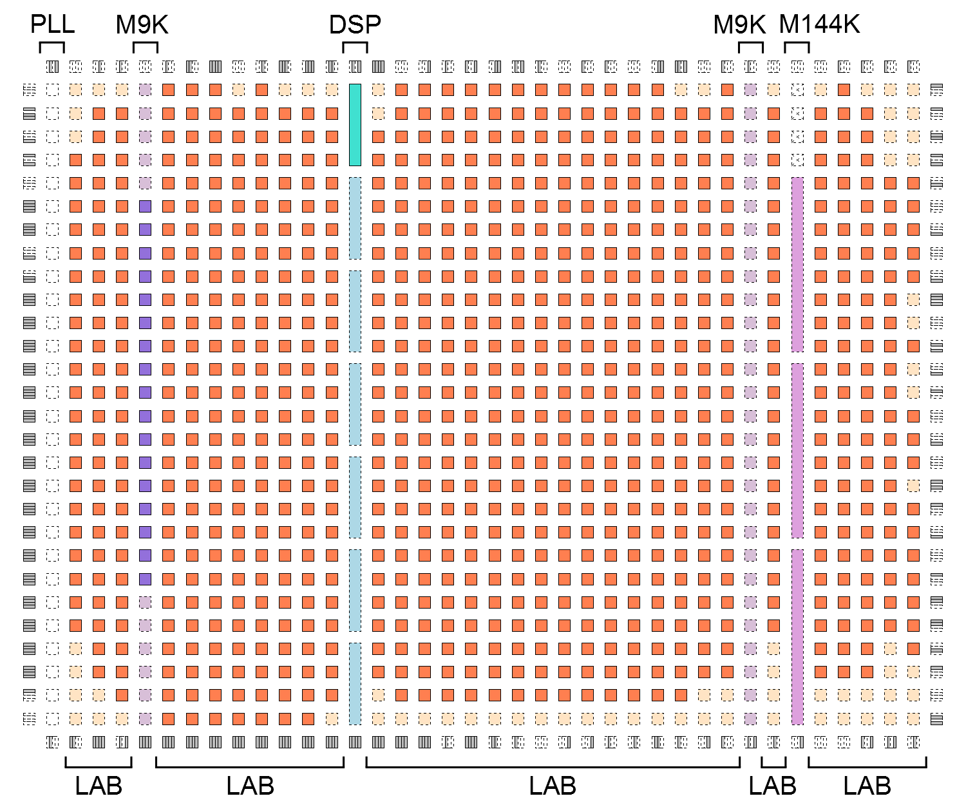
Stratix IV Architecture Capture
Floorplan:
    Based on EP4SE820
Fully Modeled Blocks:
    LAB
    DSP
    M9K
    M144K
Routing Network:
    Mixture of long and short wires

Slide 17
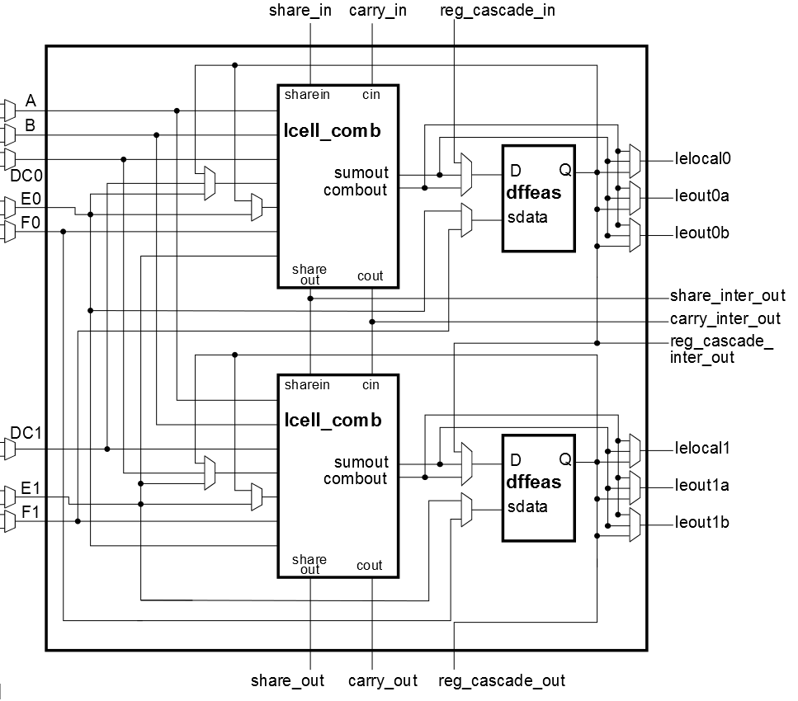
Architecture Details
LAB
    Detailed internal connectivity
    Full instead of partial crossbars
    Extra carry chain connectivity
M9K & M144K RAM Blocks
    All modes and sizes
    Approximated mixed-width modes
DSP Blocks
    All Stratix IV multiplier/accumulator modes
    Extra routing flexibility for packing
ALM Internal Connectivity

Slide 18
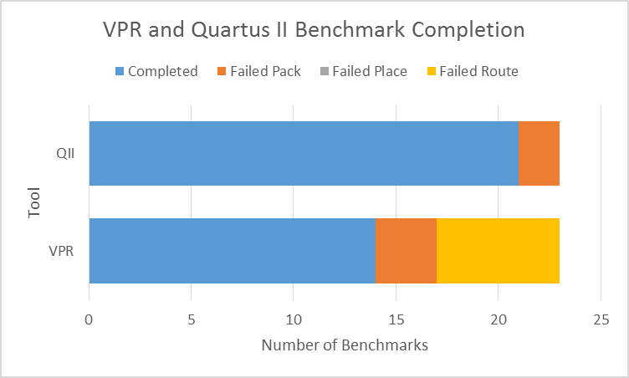
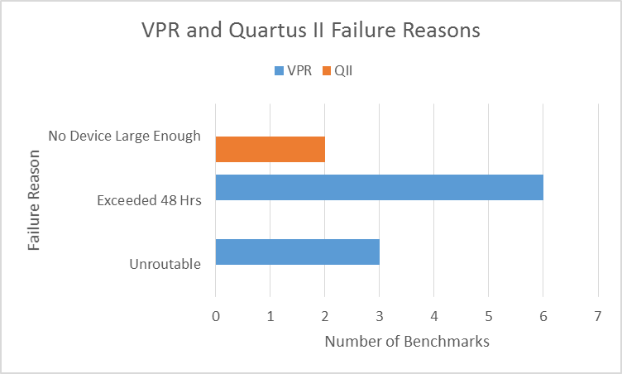
Benchmark Completion
Tool | Benchmarks Completed
Quartus II | 21/23
VPR | 14/23

Slide 19
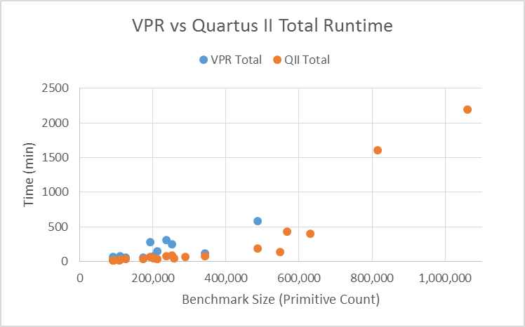
Tool Performance vs. Benchmark Size
36.5 Hours

Slide 20
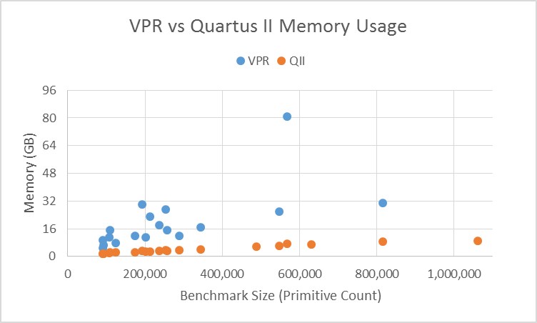
Tool Memory vs. Benchmark Size

Slide 21
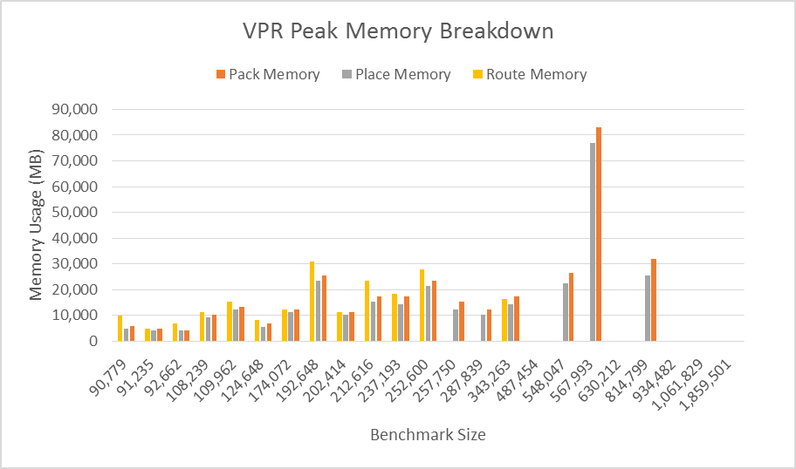
VPR Memory Breakdown

Slide 22
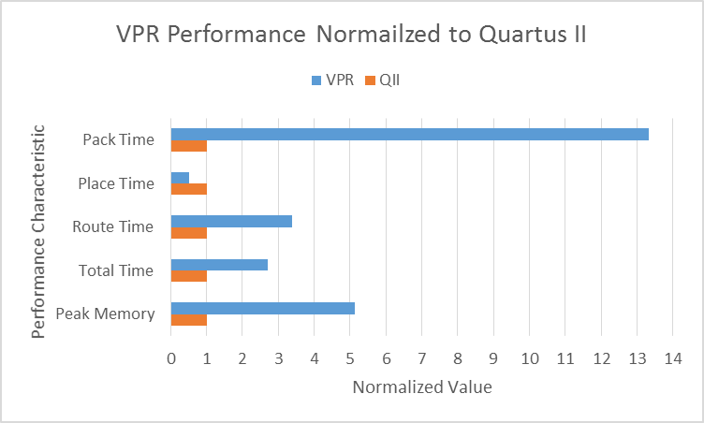
Normalized Performance
13.3×
slower
50% faster
3.4×slower
2.7×slower
5.1×higher memory

Slide 23
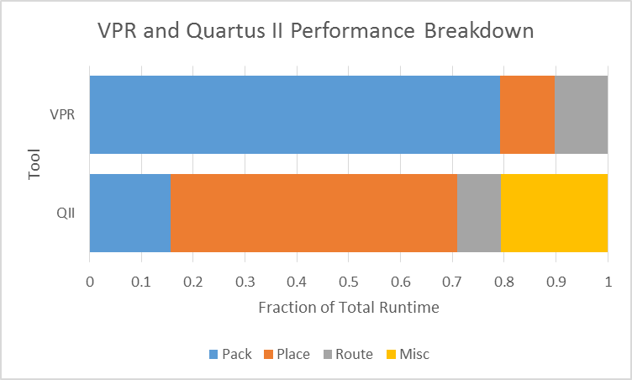
Performance Breakdown
79%
55%
21%

Slide 24
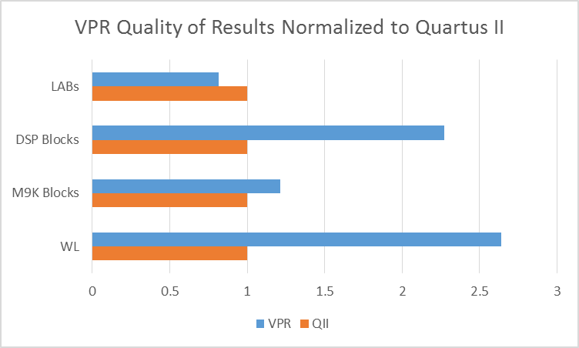
Normalized Quality of Results
30%
fewer
2.3×
more
1.2×
more
2.6×
more

Slide 25
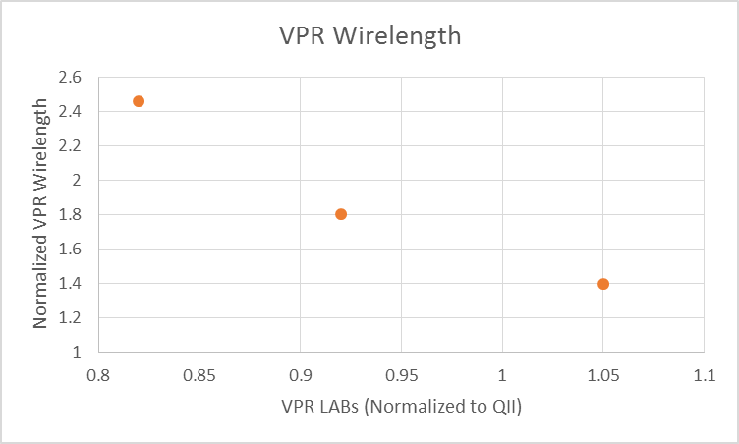
Impact of Clustering
23% area
1.8× WL reduction

Slide 26
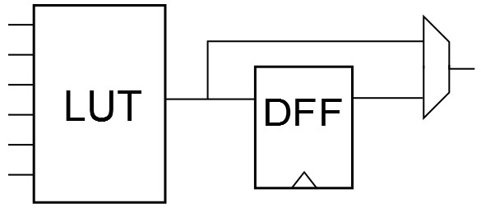
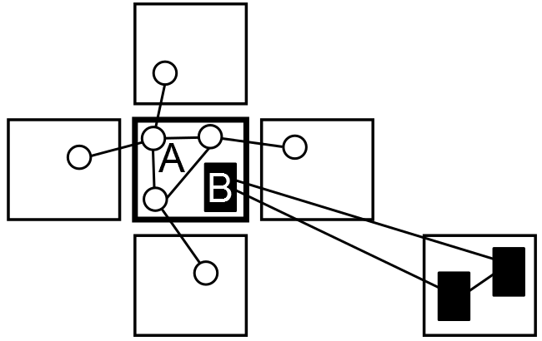
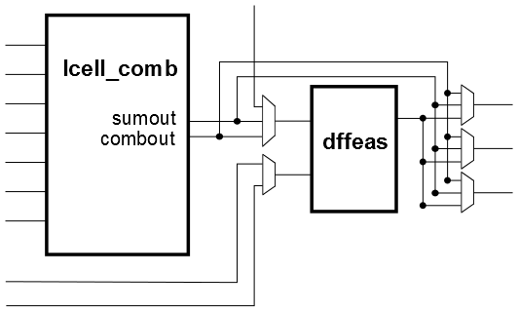
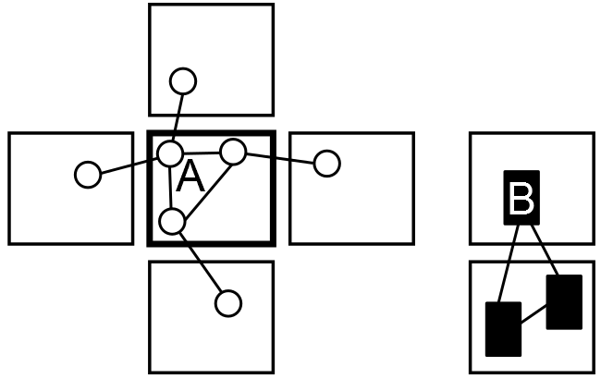
Stratix IV & Academic LUT/FF Flexibility
  Additional flexibility in Stratix IV architecture allows for denser packing
  Can be detrimental to Wirelength
Traditional Academic BLE
Tight Packing, Higher Wirelength
Stratix IV like Half-ALM
Loose Packing, Lower Wirelength

Slide 27
Conclusion and Future Work

Slide 28
Conclusion
  Titan Flow
    Hybrid CAD Flow
    Enables academic tools to use large benchmarks
  Titan23 Benchmark Suite
    Significantly improves open-source FPGA benchmarks
  Comparison of VPR and Quartus II
    Stratix IV architecture capture
    VPR: 2.7x slower, 5.1x more memory, 2.6x more wire
    Identified packing density as an important factor in wirelength

Slide 29
VPR: Areas for Improvement
    Performance:
    Packer run-time
    Peak memory usage
    Quality/Modeling:
    Adjustable packing density
    More flexible routing network description

Slide 30
Future Work
  Timing Driven Comparison
  Goal:
    Correlate VPR timing model with micro-benchmarks
    Evaluate timing optimization results on large benchmarks
  Initial Results:
    Carry chains supported
    Wire and logic delays roughly correlated to Stratix IV
Benchmark | Size (ALUT/REG) | VPR Critical Path (ps) | QII Critical Path (ps) | VPR/QII
8:1 Mux | 2/12 | 932 | 1498 | 0.62
subtractor | 11/15 | 1450 | 1381 | 1.05
32-bit Adder | 32/96 | 1674 | 1718 | 0.97
diffeq1 | 1434/193 | 9935 | 11289 | 0.88
sha | 772/893 | 6103 | 5416 | 1.13
ucsb_FIR | 5410/12340 | 3084 | 2289 | 1.35
wb_conmax | 11809/3326 | 5465 | 4066 | 1.34

Slide 31
Thanks!
Questions?
Email: kmurray@eecg.utoronto.ca
Titan Flow & Titan 23 Benchmarks:
http://uoft.me/titan

Slide 32
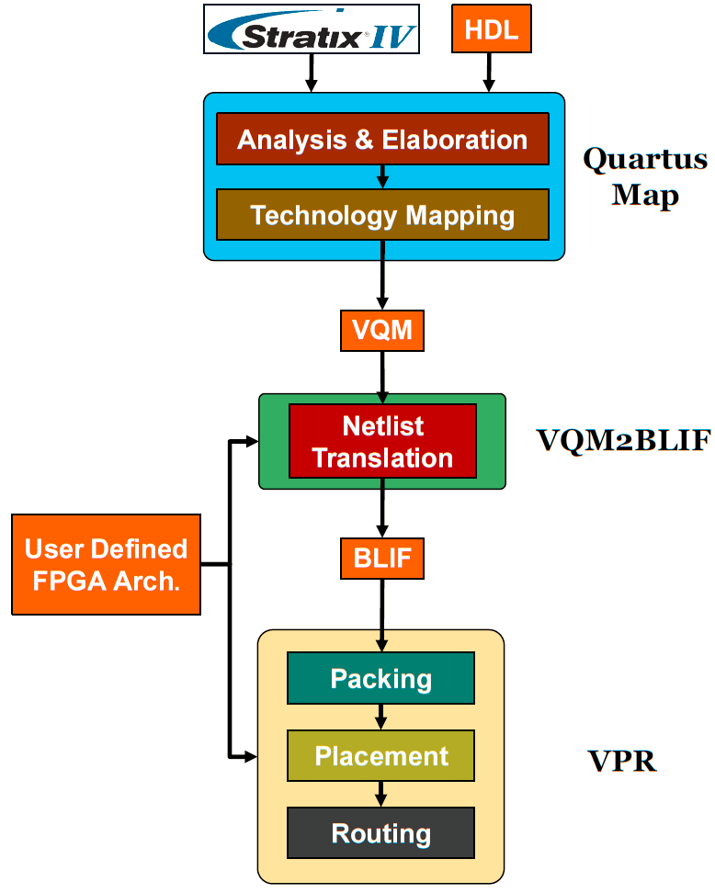
Detailed CAD Flow

Slide 33
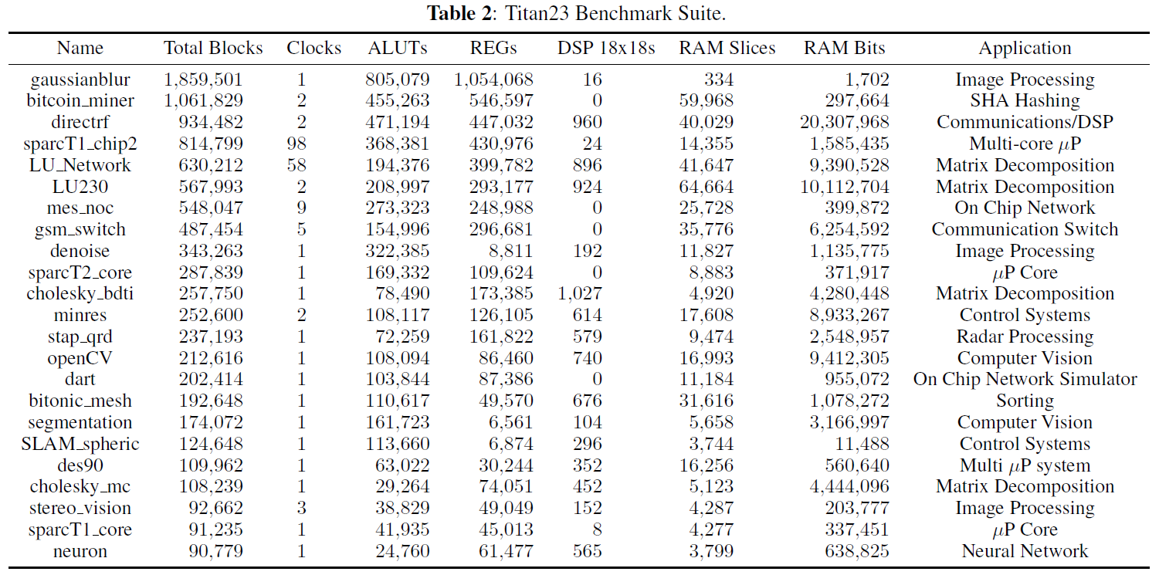
Titan 23 Benchmarks

Slide 34
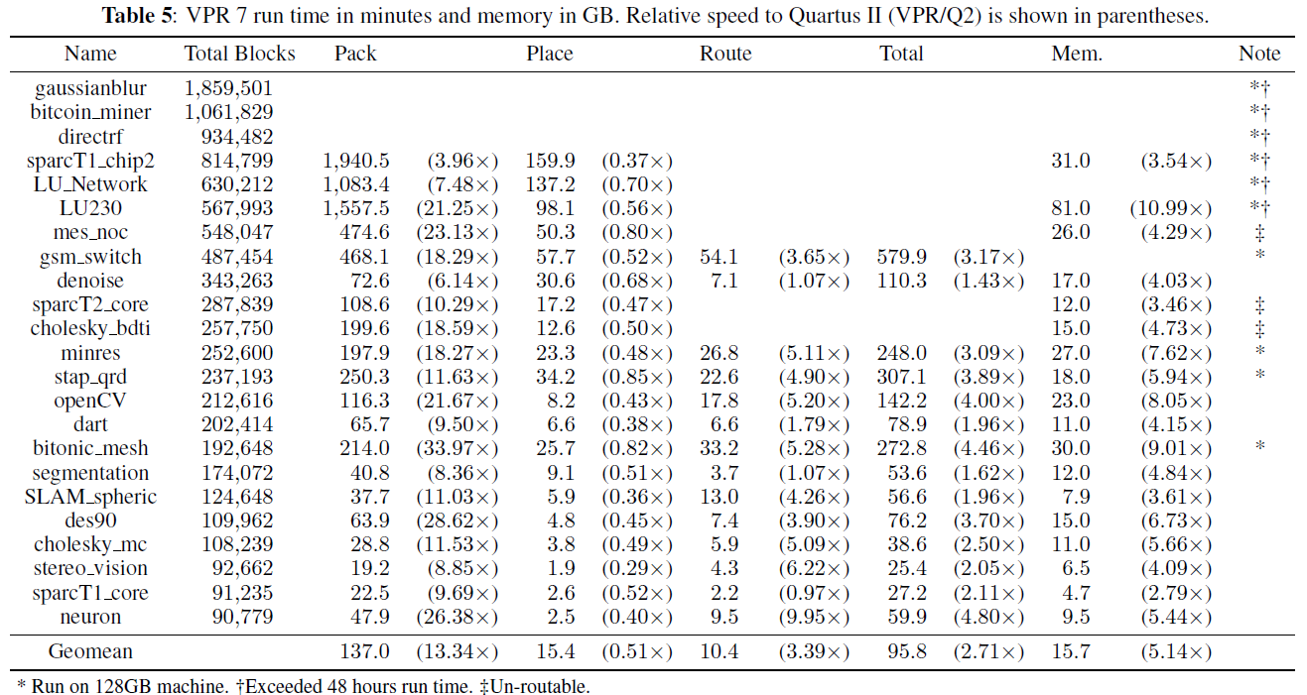
VPR Performance Relative to Quartus

Slide 35
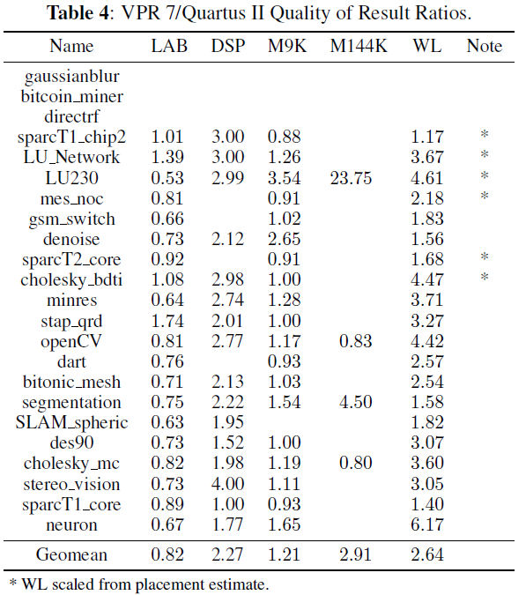
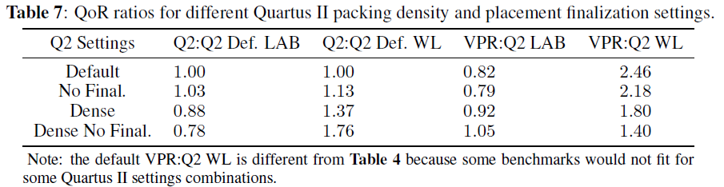
VPR QoR Relative to Quartus

