Slide 1
Virtualized FPGA accelerators in Cloud Computing Systems
Stuart Byma and Paul Chow
University of Toronto

Slide 2
What is this “Cloud Computing”?
?
Not everyone seems to be on the same page with this
Notes:
Term still seems to be flung around quite a bit in the business and IT world
means different things to different people

Slide 3
What is this “Cloud Computing”?
Some fundamental characteristics
On demand self service
I can provision new resources at any time, without human interaction
Rapid elasticity
I can rapidly expand or contract the amount of resources I have – on the fly
Resource pooling
The provider resources are abstracted into pools, to enable serving multiple users
http://csrc.nist.gov/publications/nistpubs/800-145/SP800-145.pdf
Notes:
- On Demand self service – the notion that end users can unilaterally provision resources on demand, without human interaction with the provider
- Rapid elasticity – computing or other resources can be rapidly deployed or released, automatically or otherwise. Essentially “scalability”. To the end user, the amount of resources available for provisioning appears infinite.
- Resource pooling – provider resources are abstracted into pools, to enable serving multiple users/tenants.

Slide 4
Cloud Resources
Meaning of “resources” depends on the Service Model
Software as a Service (Google Apps)
Provides application software, databases, support
Platform as a Service (Windows Azure)
OS, dev and execution framework, DB, web server
Infrastructure as a Service (Amazon EC2)
Virtual machines, storage, connectivity

Slide 5
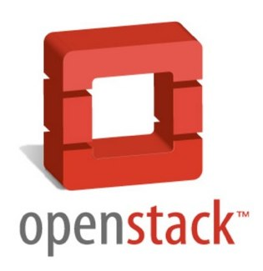
OpenStack – A Cloud Computing Platform
OpenStack – an open source cloud computing platform
Enabling infrastructure as a service
We use OpenStack as our base system (actually the SAVI Testbed, more to come …)
Notes:
OpenStack – open source framework that has the above characteristics
Enables infrastructure as a service – end user available resources are virtual machines whose base pool resources are CPUs and RAM
Openstack also has other resources – object storage, volume storage, VM image management,
Question – can we include FPGAs as pooled resources? And modify OpenStack to support and manage them like VMs?

Slide 6
The Point
We aim to “Virtualize” FPGAs, enable them as Cloud resources
How?
Well, how does OpenStack work?
And how does it manage resources?

Slide 7
It’s Complicated
Notes:
Quick transition slide

Slide 8
But basically:
VM
VM
. . .
Hypervisor
Agent
Server
OpenStack Controller
Resource DB
API
Notes:
To keep things ridiculously simple …
User: Give me VM
OpenStack: Scheduler, find me available resource
Scheduler: (Query DB) Here is agent with resource
OpenStack: Agent, boot VM with these parameters
Agent: (Agent boots via hypervisor) OK, done.
OpenStack: User, here is VM

Slide 9
VMs as OpenStack Cloud Resources
Virtual Machines
Run on top of hypervisors
One server = many VMs
For many users
Agent process
Interacts with Openstack controller
Instructs hypervisor to boot / destroy VMs
VM
VM
. . .
Hypervisor
Agent
Server
Can we do something like this for FPGAs?
Notes:
How does OpenStack boot/manage VMs?
Agent process runs on physical machine beside hypervisor
User requests VM (resource) from controller, controller finds available resources in pool, contacts appropriate Agent
Agent interprets command, instructs hypervisor to boot VM with user provided OS image
Openstack returns handle to user (usually a network address)

Slide 10
FPGAs as OpenStack Cloud Resources
FPGA
Hypervisor? Non existent
One FPGA = One user
Agent? Non existent
FPGA ??
Agent ??
Hypervisor ??
Server
Notes:
Compare a virtual machine as a cloud resource to an FPGA
There is no such thing as an FPGA hypervisor, therefore only one user can use one FPGA at a time
There is no agent software that supports offering FPGAs as resources to the openstack controller
Now we can think about how to enable FPGAs as an OpenStack controlled resource
We need an agent, of some sort, that talks to OpenStack controller – and we need think about what resources agent will control
A whole FPGA? This is not good for scalability - a lot of useful hardware accelerators don’t need a whole chip anyway
Pieces of an FPGA? This is closer to a VM like abstraction – how? Dynamic partial reconfiguration! Hypervisor = Agent + Static Logic
Also important – How will the FPGA resource communicate with users other resources?
May not be in same physical machine as VM – only option is over the network

Slide 11
FPGAs as OpenStack Cloud Resources
We want a way to make FPGAs analogous to VMs
So they can be managed directly by OpenStack
We need an agent
To manage the FPGA
Creating FPGA resources that the user can “boot”
With network connectivity
FPGA
Agent
Notes:
- We say bootable in analogy to Virtual Machines – also the OpenStack command used to get a VM or a VFR is “$nova boot”

Slide 12
Getting there …
Single FPGA is still single user - wasteful
Relatively slow to configure
Security vulnerabilities
Direct access to network
User could do nasty things!
FPGA
Agent
Server

Slide 13
Partial Reconfigurable Regions
Fix? Use PR!
Virtualized FPGA Resources
Multi-tenant
Static logic contains chip level IO, memory controllers, etc.
Allows us to police VFR interfaces (security)
FPGA
VFR
. . .
VFR
Agent
Server

Slide 14
VM
VM
FPGA(s)
. . .
VFR
. . .
VFR
Hypervisor
Agent
Agent
Server
Server
OpenStack Controller
Resource DB
API
Now we can “boot” a network connected FPGA accelerator on demand, in seconds!
Notes:
Virtual FPGA Resources are layer 2 network devices – accessible from users VMs

Slide 15
OpenStack Driver
How does OpenStack know how to communicate with our agent?
We also define a Driver: an object that implements OpenStack boot, release, and general resource management API calls
OpenStack
Controller
Driver
?
Agent

Slide 16
An Example – Consider:
A massive video web service (yootube.com?)
Running on top of ten thousand VMs
Number of VMs can scale according to current demand
Large amount of video transcoding / compression needs to be done
We have FPGA cloud resources now, do it in hardware
Offload VM workload – less x86 CPUs, save power!

Slide 17
Example
Outside
World
Data Center
VM Resource
VFR
Site Requests
Web Server
Video Transcode/ Compress
Internal Network
Uploads
x10 000
Dynamically scalable according to demand
Same OpenStack command to boot/release either resource!

Slide 18
Boot/Release Sequence
On boot, OpenStack sends request, image(bitstream), networking information to agent via driver
Agent configures bitstream into available region, programs MAC address
VFR is then network connected device belonging to the user
On release, agent configures black box – removes user IP, conserves power

Slide 19
Partial Bitstream as an Image
A Virtual Machine has an operating system image
A VFR has a partial bitstream as an image
In OpenStack infrastructure, users can upload their own images
Result – user designed custom hardware accelerators!
Template HDL file provided, compiles with already placed and routed static logic

Slide 20
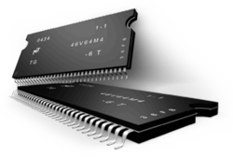
FPGA System-Level Architecture
JTAG
FPGA
Agent (Host PC)
Soft
Processor
Bus
MACs
DRAM
VFR
Stream Interface
Output Queues
Input Arbiter
VFR

Slide 21
Packet Forwarding and Interface Policing
Input arbiter uses a CAM to match incoming packet dst field to correct VFR – no match? Drop
CAM programmable by soft proc, which receives MAC from agent
Input Arbiter
CAM
MACs
Bus
to VFR_0
Pkt In Stream
. . .
to VFR_n

Slide 22
FPGA System-Level Architecture
JTAG
FPGA
Agent (Host PC)
Soft
Processor
Bus
MACs
DRAM
VFR
Stream Interface
Output Queues
Input Arbiter
VFR

Slide 23
System Partial Reconfiguration Control
Bus to Soft Proc, DRAM
MMap Register
PR Interface Enable
PR Reset
Stream Out
VFR – User Logic
Mem Op Queues
(Bus Master)
Stream In
Streams frozen after current transaction finishes – no fragmented pkts!

Slide 24
What else can we use this for?
Line rate packet processing
Custom firewalls
Rate limiters
Custom traffic classifiers
Any other type of accelerator
With data sent over Ethernet

Slide 25
SAVI
Smart Applications on Virtual Infrastructure
Canada-wide experimental research network
SAVI Testbed
OpenStack based cloud computing infrastructure
Linux KVM based Virtual Machines
Complete tenant isolation
GPUs + Reconfigurable Hardware
OpenFlow SDN + network virtualization

Slide 26
OpenFlow Network
VM
VM
FPGA(s)
. . .
VFR
. . .
VFR
Hypervisor
Agent
Agent
Server
Server
OpenStack Controller
Resource DB
API

Slide 27
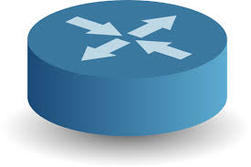
Software Defined Networking, OpenFlow
Separation of control plane and forwarding hardware
Control Plane (Software)
OpenFlow Protocol
Image Credit: Nick McKeown

Slide 28
Network 1
Network 2
App
App
API
Network OS
28
OpenFlow Protocol
Image Credit: Nick McKeown

Slide 29
Switches
Switches are now dumb forwarding logic
Rule tables are set by the controller software
Basic operation: pkt in, match, action
Now we have a complete view of the entire network
Which enables complete control

Slide 30
Accelerator Chaining
OpenFlow controls the flow of packets/data
Accelerators process normally, do not worry about forwarding
OpenFlow Network
Down
Sample
Transcode
Encrypt

Slide 31
Accelerator Chaining
Simpler hardware
Need not worry about forwarding
Complex forwarding control moved to software
Partitioned designs
Spread across multiple VFRs
Enabling large and complex processing pipelines
Maintaining high throughput
Easier debugging?
Downside – must design your own OpenFlow controller

Slide 32
Performance
Still under investigation
Boot latency
From command entry to point that accelerator can process packets
Approximately 2.6 seconds – much faster than a VM!
Overhead cost of virtualization (static logic)?
Simulations show 3 cycles latency difference from non-virtualized system

Slide 33
To Wrap Up
Virtualized FPGA resources in the cloud
Same boot command as a virtual machine
Dynamically scalable and flexible hardware acceleration
User designed, user controlled
Prototype implemented, work is ongoing

Slide 34
Thanks! Questions?

Slide 35
Research Applications with SAVI
SAVI Testbed is based on OpenStack
Our prototype is implemented within the SAVI Testbed
SAVI has virtualized networks
We can get our own isolated custom-controlled Ethernet network
Can enable testing of non-IP Internet-routing protocols
VFRs could provide line rate routing infrastructure for these non-IP networks
Facilitate wide area, large scale testing of future protocols in true Layer 3 – i.e. not on top of IP

Slide 36
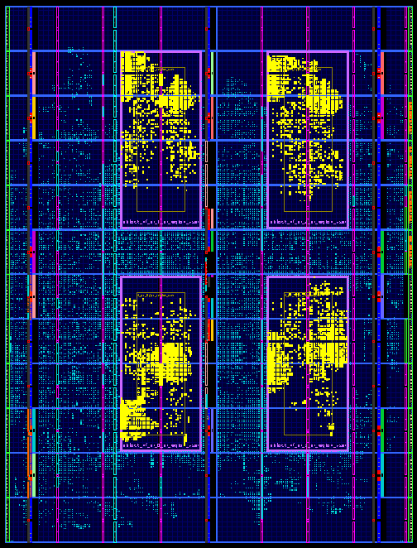
Virtex 5 VTX240T
1 Region:
~12,000 Slices

