Slide 1

The Case for
Hardware Transactional Memory
in
Software Packet Processing
Martin Labrecque
Prof. Gregory Steffan
University of Toronto
ANCS, October 26th 2010

Slide 2


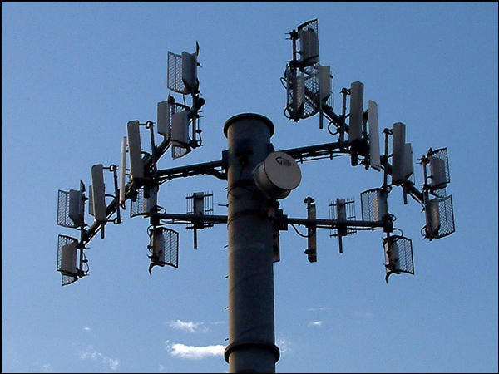


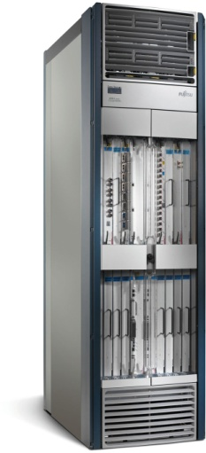
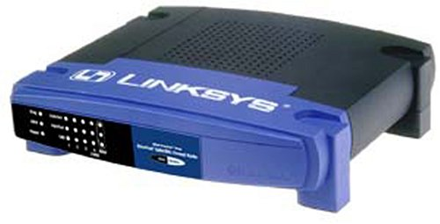
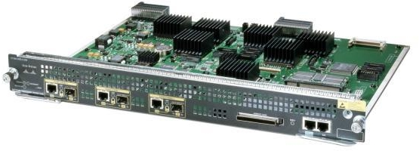
Packet Processing: Extremely Broad
Our Focus: Software Packet Processing
Where Does Software Come into Play?
Home networking
Edge routing
Core providers

Slide 3
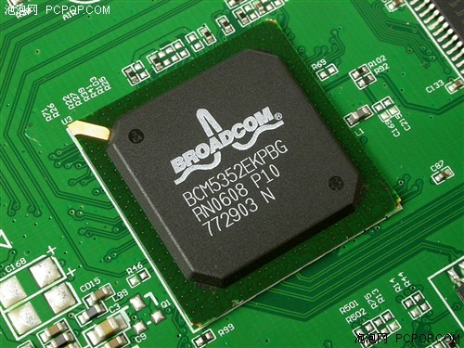


Types of Packet Processing
Basic
Byte-Manipulation
Control-Flow Intensive
Switching and routing, port forwarding, port and IP filtering
Cryptography, compression routines
deep packet inspection, virtualization, load balancing
P0
P1
P2
Crypto
Core
P3
P4
P5
P6
P7
P8
200 MHz MIPS CPU
5 port + wireless LAN
Many software
programmable cores
Key & Data
Control-flow intensive &
stateful applications

Slide 4


Parallelizing Stateful Applications
Most packets access and modify data structures
Map those applications to modern multicores: how?
Ideal scenario:
Thread1 Thread2 Thread3 Thread4
Packet1 Packet2 Packet3 Packet4
Packets are data-
independent and are
processed in parallel
TIME
Reality:
TIME
Programmers need
to insert locks in case
there is a dependence
wait
wait
wait
How often do packets encounter data dependences?

Slide 5
Fraction of Dependent Packets
Fraction of Conflicting Packets
Packet Window
UDHCP: parallelism still exist across different critical sections
Geomean: 15% of dependent packets for a window of 16 packets
Ratio generally decreases with higher window size / traffic aggregation

Slide 6
Stateful Software Packet Processing
1. Synchronizing threads with global locks: overly-conservative 80-90% of the time
2. Lots of potential for avoiding lock-based synchronization in the common case

Slide 7

Could We Avoid Synchronization?
Single Pipeline
Array of Pipelines
Application
Thread
Pipelining allows critical sections to execute in isolation
What is the effect on performance given a single pipeline?

Slide 8
Pipelining is not Straightforward
Normalized variability of processing per packet
(standard deviation/mean)
Difficult to pipeline a varying
latency task
Imbalance of pipeline stages
(max stage latency / mean)
after automated pipelining in 8 stages based on data and control flow affinity
High pipeline imbalance leads to low processor utilization

Slide 9

Run-to-Completion Model
Only one program for all threads
Programming and scaling is simplified
Challenge: requires synchronization across threads
        Flow affinity scheduling: could avoid some synchronization but not a 'silver bullet'

Slide 10
Run-to-Completion Programming
void main(void)
{
while(1) {
  char* pkt = get_next_packet();
process_pkt();
  send_pkt(pkt);
}
}
Many threads execute main()
Shared data is
protected by locks
Manageable, but must get locks right!
Notes:
Where does performance come from?

Slide 11
Getting Locks Right
SINGLE-THREADED
MULTI-THREADED
packet = get_packet();
…
connection = database->lookup(packet);
if(connection == NULL)‏
connection = database->add(packet);
connection->count++;
…
global_packet_count++;
packet = get_packet();
…
connection = database->lookup(packet);
if(connection == NULL)‏
connection = database->add(packet);
connection->count++;
…
global_packet_count++;
Atomic
Atomic
Challenges:
1- Must correctly protect all shared data accesses
2- More finer-grain locks → improved performance
Notes:
11
when speaking be sure to emphasize that these are the typical parallel
programming challenges, not new/specific to this architecture

Slide 12
Opportunity for Parallelism
MULTI-THREADED
packet = get_packet();
…
connection = database->lookup(packet);
if(connection == NULL)‏
connection = database->add(packet);
connection->count++;
…
global_packet_count++;
Optimisic Parallelism across Connections
Atomic
Atomic
No Parallelism
Control-flow intensive programs with shared state
→
Over-synchronized
Notes:
12

Slide 13
Stateful Software Packet Processing
1. synchronizing threads with global locks: overly-conservative 80-90% of the time
2. Lots of potential for avoiding lock-based synchronization in the common case
CONTROL FLOW
Lock(A);
if ( f(shared_v1) )
shared_v2 = 0;
Unlock(A);
POINTER ACCESS
Lock(B);
shared_v3[i] ++;
(*ptr)++;
Unlock(B);
e.g.:
Transactional Memory!

Slide 14
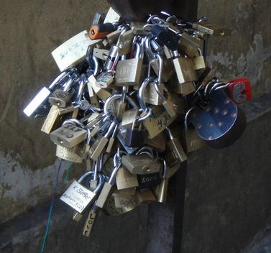
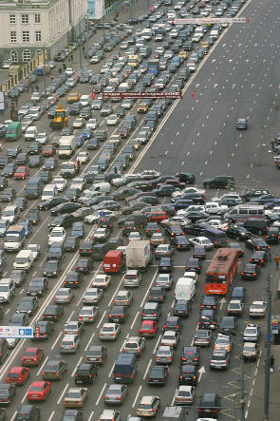
Improving Synchronization
Locks can over-synchronize parallelism across flows/connections
Transactional memory
  simplifies synchronization
  exploits optimistic parallelism
Notes:
stateful/control flow intensive applications
* problem:
* stateful/deep packet apps need multiprocessors
* multiprocessors suffer the parallel programming problem (PPP)
* opportunities:
* optimistic parallelism across flows/connections
* conventional locks over-synchronize
* FPGA is a custom-hardware environment
* solution:
* TM is gaining popularity to combat the PPP
* FPGA/soft-multicore can implement HTM!
* advantages:
* TM can exploit optimistic parallelism
* TM eases the PPP

Slide 15
Locks versus Transactions
Thread1 Thread2 Thread3 Thread4
USE FOR:
LOCKS
true/frequent sharing
TRANSACTIONS
Thread1 Thread2 Thread3 Thread4
infrequent sharing
x
Our approach:
Support locks & transactions with the same API!

Slide 16
Implementation

Slide 17
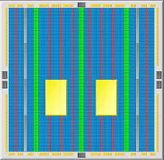
Our Implementation in FPGA
FPGA
Ethernet MAC
DDR controller
Processor(s)‏
Soft processors: processors in the FPGA fabric
Allows full-speed/in-system architectural prototyping
Many cores ➔ Must Support Parallel Programming

Slide 18
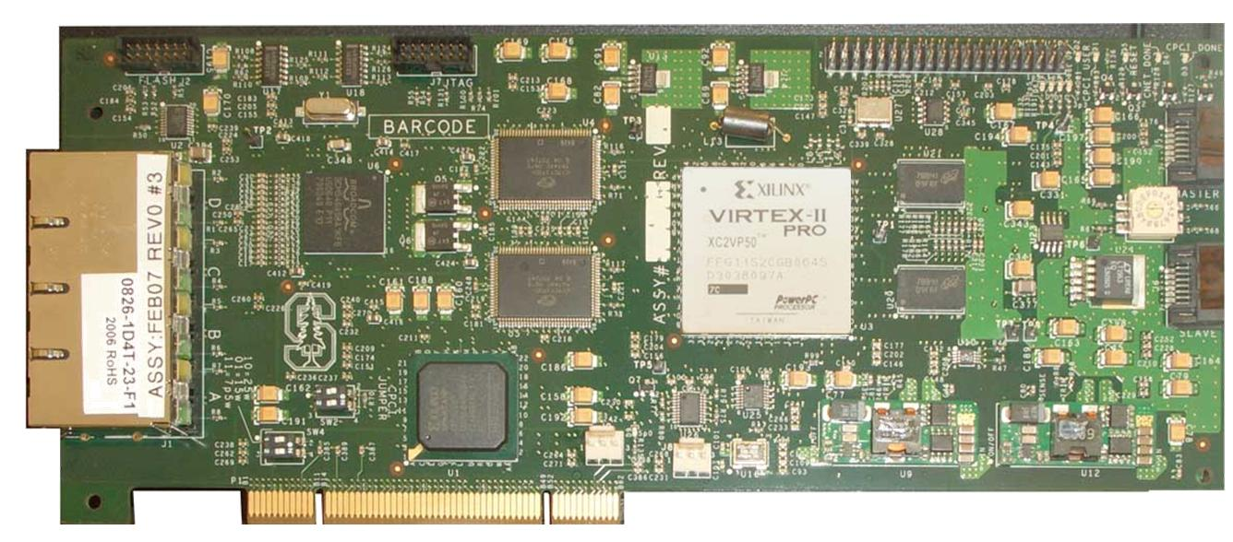
Our Target: NetFPGA Network Card
  Virtex II Pro 50 FPGA
  4 Gigabit Ethernet ports
  1 PCI interface @ 33 MHz
  64 MB DDR2 SDRAM @ 200 MHz
10x less baseline latency compared to high-end server

Slide 19
NetThreads: Our Base System
Synch. Unit
processor
processor
4-threads
I$
4-threads
I$
Instr.
Data
Input mem.
Output mem.
Input
Buffer
Data
Cache
Output
Buffer
packet
input
packet
output
Off-chip DDR2
Program 8 threads?
Write 1 program, run on all threads!
Released online: netfpga+netthreads

Slide 20
NetTM: extending NetThreads for TM
Synch. Unit
Conflict Detection
processor
processor
4-threads
I$
4-threads
I$
Instr.
Data
Input mem.
Output mem.
UndoLog
Input
Buffer
Data
Cache
Output
Buffer
packet
input
packet
output
Off-chip DDR2
- 1K words speculative writes buffer per thread
- 4-LUT: +21% 16K BRAMs: +25% Preserved 125 MHz
Notes:
undo-log is fairly straightforward, I only have time to
Tell you a little bit about how we implement conflict detction

Slide 21
Conflict Detection
Tracking speculative reads and writes
Compare accesses across transactions:
Transaction1
Transaction2
Read A
Read A
OK
Read B
Write B
CONFLICT
Write C
Read C
CONFLICT
Write D
Write D
CONFLICT
Must detect all conflicts for correctness
Reporting false conflicts is acceptable

Slide 22
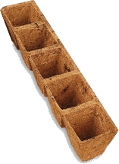

Implementing Conflict Detection
Allow more than 1 thread in a critical section
Will succeed if threads access different data
App-specific signatures for FPGAs
processor1
load
Hash
Function
Write
AND
Read
processor2
store
Hash of an address indexes into a bit vector
App-specific signatures: best resolution at a fixed frequency [ARC’10]

Slide 23
Evaluation

Slide 24
NetTM with Realistic Applications
Multithreaded, data sharing, synchronizing, control-flow intensive
Benchmark
Description
Avg. Mem. access / critical section
UDHCP
DHCP server
72
Classifier
Regular expression + QOS
2497
NAT
Network Address Translation+ Accounting
156
Intruder2
Network intrusion detection
111
Tool chain
  MIPS-I instruction set
  modified GCC, Binutils and Newlib

Slide 25


Experimental Execution Models
Packet
Input
Packet
Output
Per-CPU software flow
scheduling
Traditional Locks

Slide 26
NetThreads (locks-only)
Throughput normalized to locks only
Flow affinity scheduling is not always possible

Slide 27
Experimental Execution Models
Packet
Input
Packet
Output
Per-CPU software flow
scheduling
Per-Thread software flow
scheduling
Traditional Locks

Slide 28
NetThreads (locks-only)
Throughput normalized to locks only
Scheduling leads to load-imbalance

Slide 29

Experimental Execution Models
Packet
Input
Packet
Output
Per-CPU software flow
scheduling
Per-Thread software flow
scheduling
Transactional Memory
Traditional Locks

Slide 30
NetTM (TM+locks) vs
NetThreads (locks-only)
Throughput normalized to locks only
+57%
+54%
+6%
-8%
TM reduces wait time to acquire a lock
Little performance overhead for successful speculation

Slide 31
Summary
LOCKS
TRANSACTIONS
Thread1 Thread2 Thread3
Thread1 Thread2 Thread3
x
Pipelining: often impractical for control-flow intensive applications
Flow-affinity scheduling: inflexible, exposes load-imbalance
Transactional memory: allows flexible packet scheduling
Transactional Memory
  Improves throughput by 6%, 54%, 57%
  via optimistic parallelism across packets
  Simplifies programming
  via TM coarse-grained critical sections and deadlock avoidance

Slide 32
Questions and Discussion
NetThreads and NetThreads-RE
available online
: netfpga+netthreads
martinL@eecg.utoronto.ca

Slide 33
Backup

Slide 34
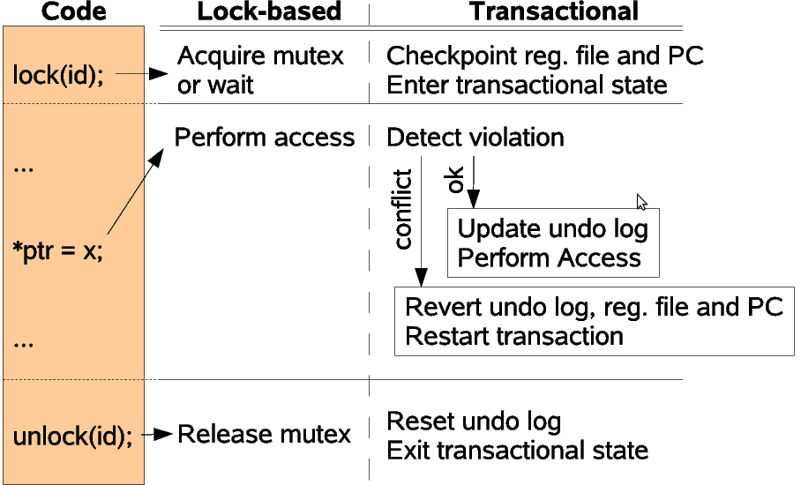
Execution Comparison

Slide 35
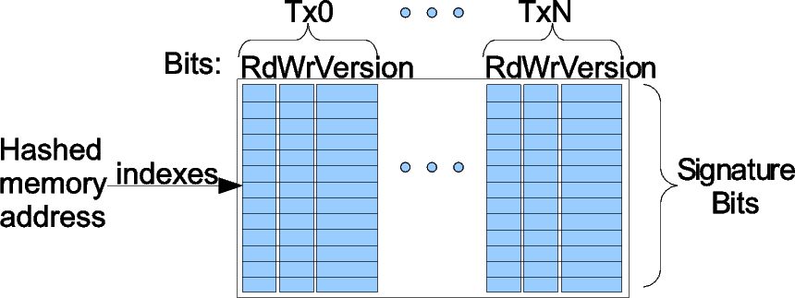
Signature Table

Slide 36
CAD Results
With Locks
With Transactions
Increase
4-LUT
18980
22936
21%
16K Block RAMs
129
161
25%
- Preserved 125 MHz operation
- 1K words speculative writes buffer per thread
- Modest logic and memory footprint

Slide 37
What if I don’t have a board?
The makefile allows you to:
  Compile and run directly on linux computer
  Run in a cycle-accurate simulator
  Can use printf() for debugging!
What about the packets?
  Process live packets on the network
  Process packets from a packet trace
Very convenient for testing/debugging!

Slide 38
Could We Avoid Locks?
Application
Thread
Single Pipeline
Array of Pipelines
Un-natural partitioning, need to re-write
Unbalanced pipeline → worst case performance

Slide 39
Speculative Execution (NetTM)‏
Optimistically consider locks
No program change required
Thread1 Thread2 Thread3 Thread4
nf_lock(lock_id);
if ( f( ) )‏
shared_1 = a();
else
shared_2 = b();
nf_unlock(lock_id);
LOCKS
TRANSACTIOAL
Thread1 Thread2 Thread3 Thread4
x
There must be enough parallelism for speculation to succeed most of the time

Slide 40

What happens with dependent tasks?
Need to synchronize accesses
But multithreaded processors take advantage of parallel threads to avoid stalls…
Use a fraction of the resources?
Adapt processor to have:
  The full issue capability of the single threaded processor
  The ability to choose between available threads
Notes:
http://stirlingfolkclub.co.uk/coinneachphotography/gallery/poland/
http://www.pinow.com/news/wp-content/uploads/2006/10/hand-cookie-jar.gif

Slide 41
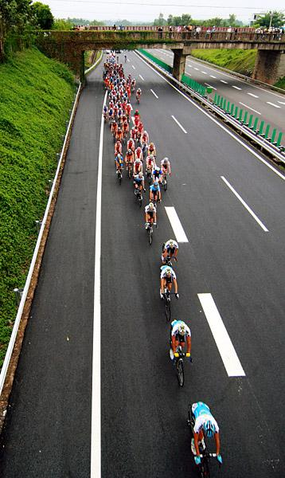
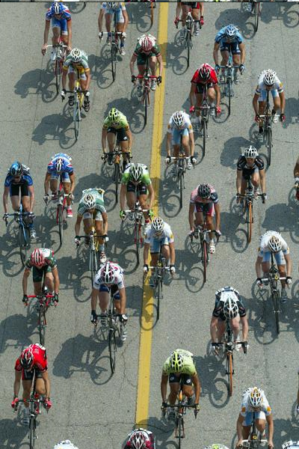
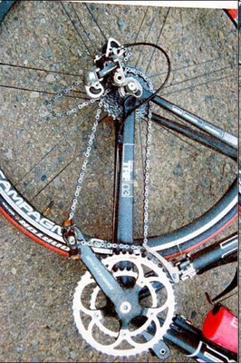
Efficient uses of parallelism
Detect
infrequent
accidents,
→
Abort and
retry
Threads divide the resources among the number of concurrent runners
Speculatively allow a greater number of runners
Notes:
http://www.bike-zone.com/photos.php?id=/photos/2008/nov08/hainan08/hainan082/0002_Ariel_Peloton_gcPhSpt

Slide 42
Realistic Goals
1 gigabit stream
2 processors running at 125 MHz
Cycle budget for back-to-back packets:
  152 cycles for minimally-sized 64B packets;
  3060 cycles for maximally-sized 1518B packets
Soft processors can perform non-trivial processing at 1gigE!

Slide 43
Multithreaded Multiprocessor
Legend: Thread1 Thread2 Thread3 Thread4
F
F
F
F
F
F
F
F
F
F
F
F
5 stages
D
D
D
D
D
D
D
D
D
D
D
D
E
E
E
E
E
E
E
E
E
E
E
E
M
M
M
M
M
M
M
M
M
M
M
M
W
W
W
W
W
W
W
W
W
W
W
W
Time
DESCHEDULED Thread3 Thread4
Hide pipeline and memory stalls
  Interleave instructions from 4 threads
Hide stalls on synchronization (locks):
  Thread scheduler improves performance of critical threads

