Slide 1


Fast & Accurate Biophotonic Simulation for Personalized Photodynamic Cancer Therapy Treatment Planning
Investigators: Vaughn Betz, University of Toronto
Lothar Lilge, University Health Network
Partner Organizations: IBM and Theralase

Slide 2
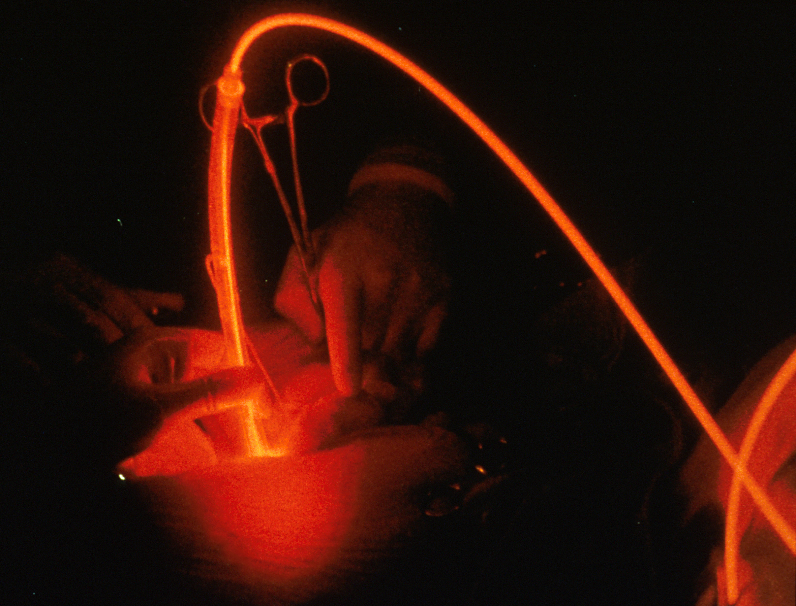
Photodynamic Cancer Therapy (PDT)
Minimally invasive, targeted cancer treatment
  Photosensitive catalyst via IV
  Activate with light
  Reactive oxygen production
  Tissue damage: localized to
  illuminated area
Benefits
  Faster recovery
  Better outcomes
Key enablers:
  Fast simulation of outcome
  Automatic optimization of patient specific treatment plan
Image courtesy of Robert Weersink
Princess Margaret Cancer Centre

Slide 3
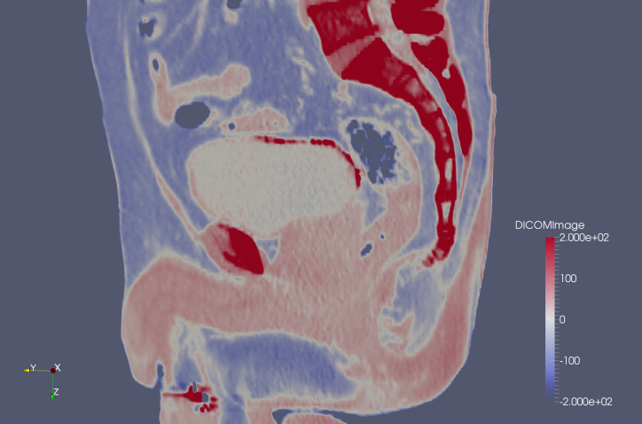
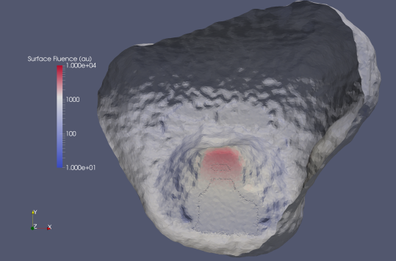
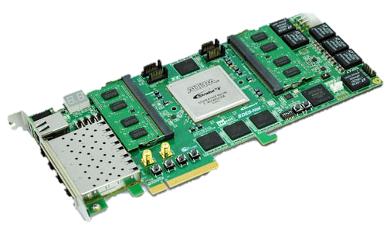
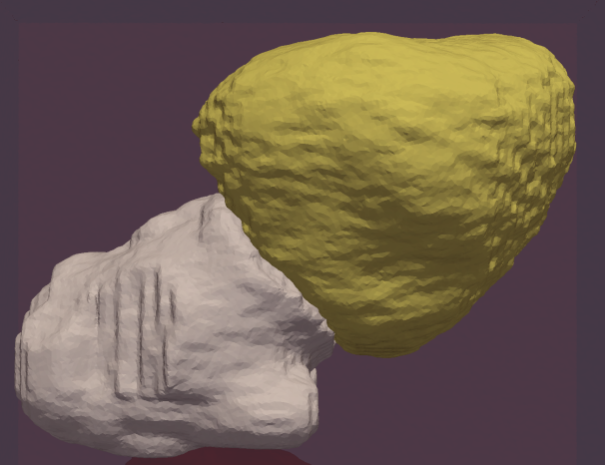
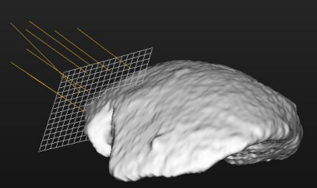
1. Predicting PDT Outcomes
Patient-specific
outcome prediction
Medical Imaging Data
Identify organs & tumour, create mesh
Simulate light propagation & tissue destruction
Monte Carlo Simulation:
Accurate but slow
Hardware accelerate:
16x speed, 60x energy-efficiency
Place light sources
Notes:
Delete “define dose” and make first bubble “MRI”
Animate: One appears at a atime
Emphasize need fast results

Slide 4
2. Automatic Optimization
Medical Imaging Data
Optimized
Treatment Plan
Software:
Try 1000’s of intelligent light probe locations
Identify organs & tumour, create mesh
Hardware: Simulate light propagation & tissue destruction
Notes:
Delete “define dose” and make first bubble “MRI”
Animate: One appears at a atime
Emphasize need fast results

Slide 5
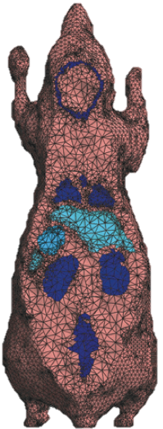
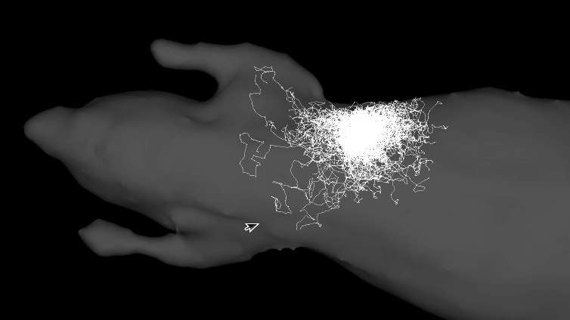
Simulation Algorithm: Monte Carlo (MC)
Tetrahedral mesh for arbitrary shapes
Trace photon packets as they scatter randomly and are absorbed
Compute-intensive
  10⁷-10⁹ packets
  10²-10³ steps each
  10-60 minutes with
  optimized software
Optimization: 1000’s of simulations x 1 hour each → high compute
Treatment analysis: sometimes needed in operating room → 1 hour too long
Notes:
Slow down here – explain biophotonics
Explain the light source
Note that MC includes all physics but time-confidence tradeoff

Slide 6
Hardware Accelerate with FPGA
Key computation: simulate photon paths through tissue (~100 million times)
Can deeply pipeline: 52 cycles in key loop
Fixed, low-precision numbers
  Range of numbers known in advance
  18 bit precision sufficient
  → small hardware
Custom / complex operators
  Random number gen, sqrt, sin, scattering function
  → Build special HW on FPGA
Lots of parallelism (between photon packets)
Memory access irregular → custom state / memory HW

Slide 7
Goals: Research Team
Make PDT simulation both fast and accurate
Leverage fast simulator to enable automatic optimization of plan, and robustness evaluation with tissue variation
Develop full flow from MRI data through simulation to visualization
Increase PDT efficacy, and broaden applicability to more cancer indications

Slide 8
Goals: Partners
IBM
  New application of IBM CAPI (agile) hardware in the medical space
  General utilities / APIs created by research team open-sourced → enable other agile computing users
Theralase
  Provider of PDT photosensitizers and lasers: better PDT treatment planning → larger market
  Evaluate a treatment plan in silico: can tell if PDT plan will lead to a good result before treatment
  Automatic optimization: create a better and more robust treatment plan, quickly

Slide 9
Achievements to Date
World’s fastest software simulator for general Monte Carlo simulation of light
Agile hardware implementation in progress
  Single compute pipeline functions in simulation
  4x performance of high-end, four-core CPU
  Expect ~16x performance and 60x power-efficiency for scaled-up full system
Complete MRI image → meshing → simulation → visualization flow
  Being used to plan / select patients for Theralase clinical trials
  To come: automatic optimization software

Slide 10
SOSCIP Role & Support
Hardware & great technical support
  Simpler and faster than setting up our own agile cloud
  CAPI hardware enables tight CPU-FPGA interaction
    Keep hardware pipeline fast & simple, while CPU handles relatively rare complex events
    Large (main memory) storage for mesh geometry
Support for funding applications, and direct funding
  Enabled the early research and seed funding
  Key to obtaining more funding (Theralase, OCE, NSERC) which is letting us realize our full vision
Linkages and introductions to other researchers

