Slide 1
The Computational Battle for Deep Learning
FPGA 2018 Panel Discussion

Slide 2

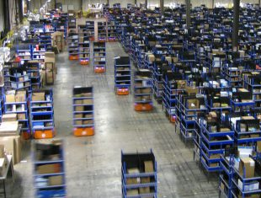

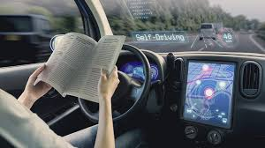
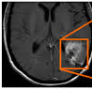

The Promise for Society

Slide 3


The Prize for Compute Innovators
AI investment in 2016: ~$26 to $39 billion
  McKinsey Consulting estimate, “Artificial Intelligence, The Next Digital Frontier,” June 2017
Deep learning
  More compute → better accuracy
  High computation/power demand
At least 45 chip start-ups
$1.5 billion venture capital raised in 2017
  New York Times, “Big Bets on AI Open a New Frontier for Chip Start-Ups Too”, Jan. 14, 2018

Slide 4
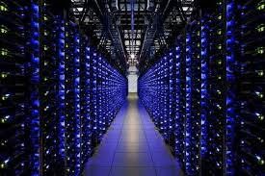
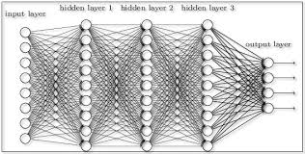
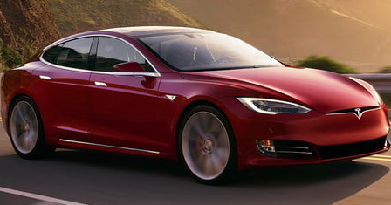
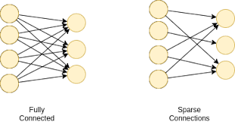
What Will Win?
Datacenter to deeply embedded
Throughput vs. latency optimized
Standard interfaces vs. custom sensors
Dense vs. Sparse
Precision?
New algorithm?
Diverse: Favours Programmability!

Slide 5
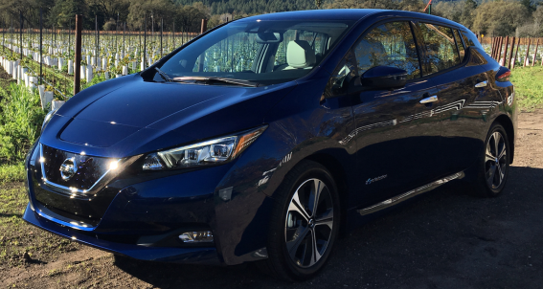
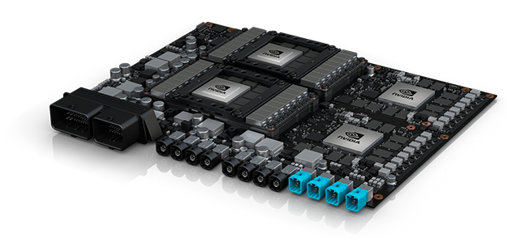
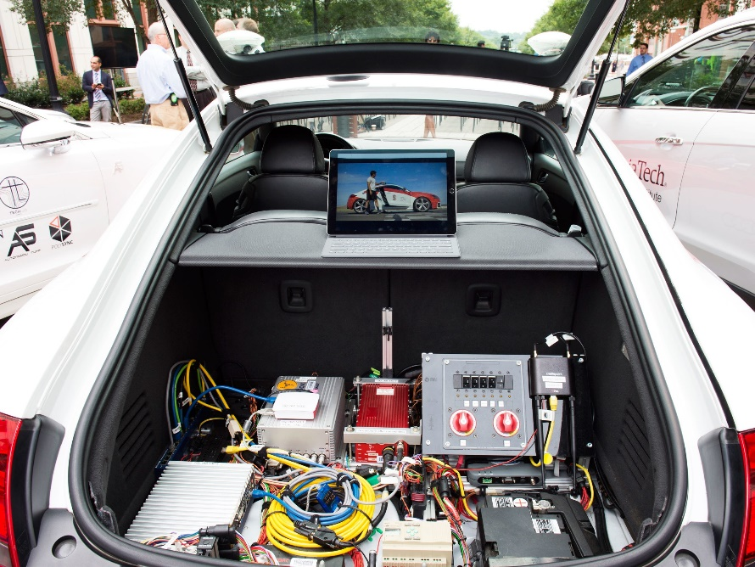
What Will Win?
Chevy Bolt: ~6 kW in city
Nvidia Pegasus: 500 W
Audi autonomous prototype, Wired, Feb. 2, 2018
Need Efficiency: Favours Fixed Function

Slide 6
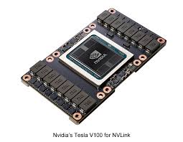
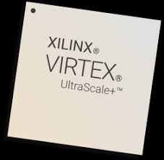
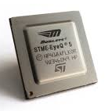

Can Deep Learning Developers Program It?
C → CUDA → HDL → ??
CPU
GPU
FPGA
ASIC

Slide 7
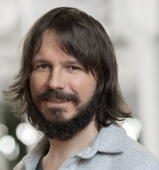
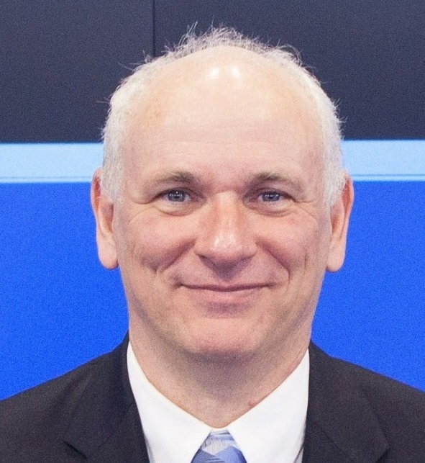
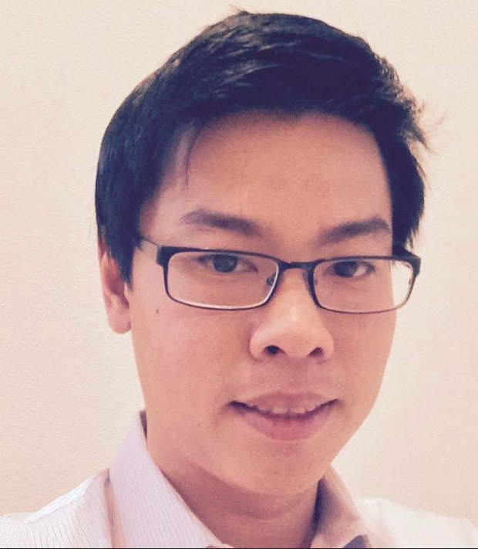
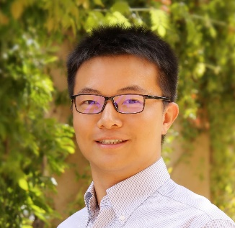
Debbie Marr,
Intel
Jeff Johnson,
Facebook
Kees Vissers,
Xilinx
Eric Chung,
Microsoft
Song Han,
Stanford/MIT

