Slide 1

The Case for Embedding Networks-on-Chip in FPGA Architectures
Vaughn Betz
University of Toronto
With special thanks to
Mohamed Abdelfattah, Andrew Bitar
and Kevin Murray

Slide 2
Overview
Why do we need a new system-level interconnect?
Why an embedded NoC?
How does it work?
How efficient is it?
Future trends and an embedded NoC
  Data center FPGAs
  Silicon interposers
  Registered routing
  Kernels → massively parallel accelerators

Slide 3
Why Do We Need a System Level Interconnect?
And Why a NoC?

Slide 4
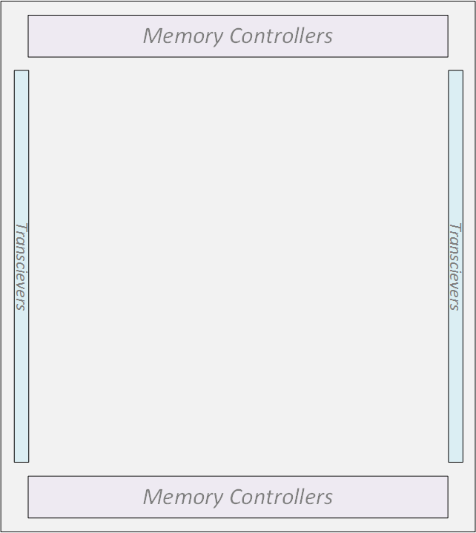
Challenge
Large Systems
High bandwidth hard blocks & compute modules
PCIe
Module 4
Module 3
High on-chip communication
Module 1
Module 2
PCIe

Slide 5
Today
Tough timing constraints
Design soft bus per set of connections
Physical distance affects frequency
100s of bits
PCIe
Module 4
Wide links from single bit-programmable interconnect
Bus 1
100’s of muxes
Muxing/arbitration/buffers on wide datapaths → big
Module 3
Bus 3
Somewhat unpredictable frequency → re-pipeline
Module 1
Module 2
Buses are unique to the application → design time
PCIe
System-level buses → costly
Bus 2
Notes:
Wide links:
FPGAs are good at doing things in parallel which compensates for their relatively low operating frequency
Wide functional units = wide connections to be able to transport the high bandwidth data
Only gets worse – need more data, more bandwidth, more issues
Harder to design the buses
Worse timing closure
Timing:
Physical distance affects timing: the farther you are, the more switches and wire segments you are using.
As a designer I can only know that timing information after placement and routing
Takes a long time
Must then go back and redesign the interconnect to meet constraints
Time/effort consuming!
Area:
Will show you some results that highlight how big buses are
Multiple clock domains require area-expensive asynchronous fifos
Why?
Do we really need all that flexibility in the system-level interconnect? No
Is there a better way? → this is the question that my research attempts to answer
We think an embedded NoC is the way to go

Slide 6
Hard Bus?
System-level interconnect in most designs?
✓
dedicated (hard) wires
✓
PCIe
Costly in area & power?
Module 4
Module 4
Bus 1
Muxing, arbitration
Bus
1
Usable by many designs?
Module 3
Module 3
Bus 3
Bus
3
Module 1
Module 2
Module 1
Module 2
PCIe
Bus
2
Bus 2
Notes:
Wide links:
FPGAs are good at doing things in parallel which compensates for their relatively low operating frequency
Wide functional units = wide connections to be able to transport the high bandwidth data
Only gets worse – need more data, more bandwidth, more issues
Harder to design the buses
Worse timing closure
Timing:
Physical distance affects timing: the farther you are, the more switches and wire segments you are using.
As a designer I can only know that timing information after placement and routing
Takes a long time
Must then go back and redesign the interconnect to meet constraints
Time/effort consuming!
Area:
Will show you some results that highlight how big buses are
Multiple clock domains require area-expensive asynchronous fifos
Why?
Do we really need all that flexibility in the system-level interconnect? No
Is there a better way? → this is the question that my research attempts to answer
We think an embedded NoC is the way to go

Slide 7
Hard Bus?
Module 3
System-level interconnect in most designs?
✓
✓
PCIe
Costly in area & power?
Module 4
Module 1
✗
Bus
1
Usable by many designs?
Module 4
Module 3
Not Reusable!
Too design specific
Bus
3
Module 2
Module 1
Module 2
Module 5
PCIe
Bus
2
Notes:
Wide links:
FPGAs are good at doing things in parallel which compensates for their relatively low operating frequency
Wide functional units = wide connections to be able to transport the high bandwidth data
Only gets worse – need more data, more bandwidth, more issues
Harder to design the buses
Worse timing closure
Timing:
Physical distance affects timing: the farther you are, the more switches and wire segments you are using.
As a designer I can only know that timing information after placement and routing
Takes a long time
Must then go back and redesign the interconnect to meet constraints
Time/effort consuming!
Area:
Will show you some results that highlight how big buses are
Multiple clock domains require area-expensive asynchronous fifos
Why?
Do we really need all that flexibility in the system-level interconnect? No
Is there a better way? → this is the question that my research attempts to answer
We think an embedded NoC is the way to go

Slide 8
Needed: A More General System-Level Interconnect
Move data between arbitrary end-points
Area efficient
High bandwidth → match on-chip & I/O bandwidths
Network-on-Chip (NoC)

Slide 9
Embedded NoC
NoC=complete interconnect
  Data transport
  Switching
  Buffering
PCIe
Module 4
flit
flit
flit
Packet
Data
Module 3
Links
Routers
Data
Module 1
Module 2
PCIe
Notes:
We think the right answer is an embedded NoC
When fpga vendors realised that some functions were common enough they hardened them
Hardened DSP blocks are much more efficient than soft dsps
Blockram was much needed to build efficient memories
Same is true for IO transceivers and memory controllers
I believe we could make a similar case for interconnect:
Applications on fpgas are large and modular – inter-module communication (or sys-level communication) is significant in almost every design.
Take DDR memory for example: every sizable fpga application accesses off-chip memory – that immediately means wide buses with tough timing constraints and multiple clock domains.
For this precise piece of an application – access to ddr – our work shows that an embedded NoC can be quite a bit more efficient. (show micro results)
Someone could be wondering why harden an NoC, why not a bus: When we thought of hardening a bus, we couldn’t figure out where the endpoints should be – wherever they are placed it won’t be flexible enough
whereas NoCs on the other hand are the most distributed type of on-chip interconnect.
NoCs are a type of interconnect that are commonly used to connect cores in a multi-core or multiprocessor chip
We do not intend, nor are we trying to reinvent the wheel – we want to use the very same NoCs used in the multiprocessor field.
To transport data, we add some control information to form a packet (terminology we’ll be using)
That packet is then split up into flits.
Flits are transmitted to the specified destination.
The main thing here is that we want to adapt this NoC to work with conventional FPGA design – we aren’t trying to change how FPGA designers do their work. We’re just trying to make it easier for them.

Slide 10
Embedded NoC
Module 3
NoC=complete interconnect
  Data transport
  Switching
  Buffering
PCIe
Module 1
Data
Moves data between arbitrary end points?
Module 4
flit
flit
flit
✓
Module 2
Packet
Module 5
Data
PCIe
Notes:
We think the right answer is an embedded NoC
When fpga vendors realised that some functions were common enough they hardened them
Hardened DSP blocks are much more efficient than soft dsps
Blockram was much needed to build efficient memories
Same is true for IO transceivers and memory controllers
I believe we could make a similar case for interconnect:
Applications on fpgas are large and modular – inter-module communication (or sys-level communication) is significant in almost every design.
Take DDR memory for example: every sizable fpga application accesses off-chip memory – that immediately means wide buses with tough timing constraints and multiple clock domains.
For this precise piece of an application – access to ddr – our work shows that an embedded NoC can be quite a bit more efficient. (show micro results)
Someone could be wondering why harden an NoC, why not a bus: When we thought of hardening a bus, we couldn’t figure out where the endpoints should be – wherever they are placed it won’t be flexible enough
whereas NoCs on the other hand are the most distributed type of on-chip interconnect.
NoCs are a type of interconnect that are commonly used to connect cores in a multi-core or multiprocessor chip
We do not intend, nor are we trying to reinvent the wheel – we want to use the very same NoCs used in the multiprocessor field.
To transport data, we add some control information to form a packet (terminology we’ll be using)
That packet is then split up into flits.
Flits are transmitted to the specified destination.
The main thing here is that we want to adapt this NoC to work with conventional FPGA design – we aren’t trying to change how FPGA designers do their work. We’re just trying to make it easier for them.

Slide 11
Embedded NoC Architecture
How Do We Build It?

Slide 12
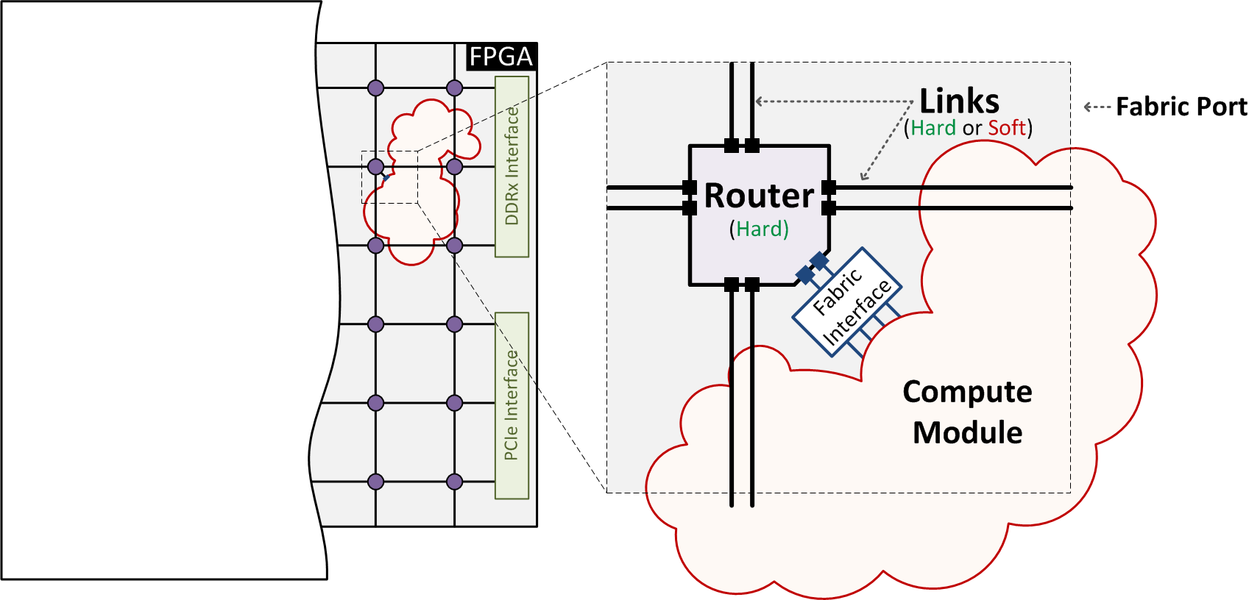
Routers, Links and Fabric Ports
No hard boundaries
  → Build any size compute modules in fabric
Fabric interface: flexible interface to compute modules

Slide 13
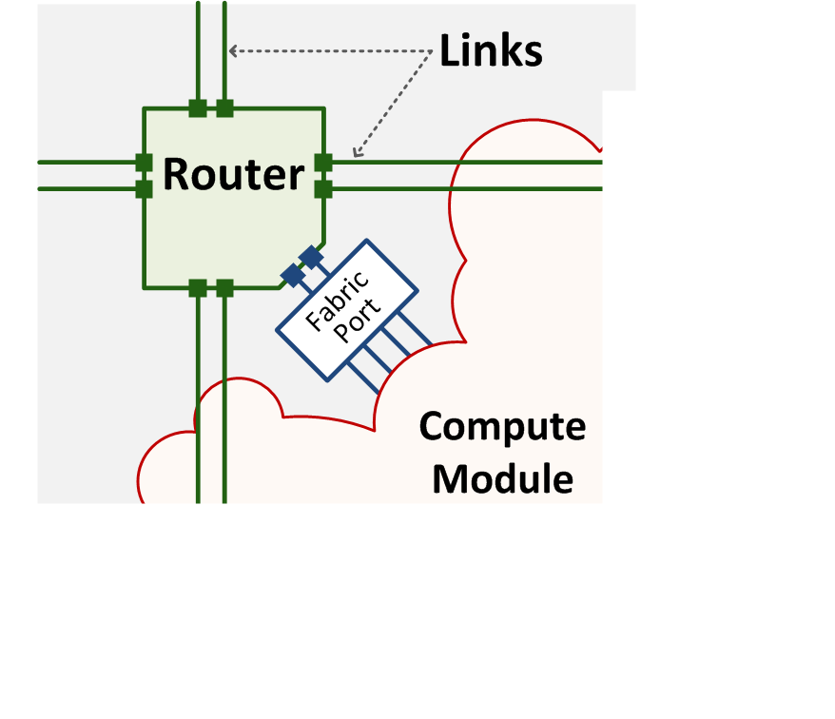
Router
Full featured virtual channel router [D. Becker, Stanford PhD, 2012]

Slide 14
Must We Harden the Router?
Tested: 32-bit wide ports, 2 VCs, 10 flit deep buffers
65 nm TSMC process standard cells vs. 65 nm Stratix III
Y | Soft | Hard
Area | 4.1 mm² (1X) | 0.14 mm² (30X)
Speed | 166 MHz (1X) | 943 MHz (5.7X)
Hard: 170X throughput per area!

Slide 15
Harden the Routers?
FPGA-optimized soft router?
  [CONNECT, Papamichale & Hoe, FPGA 2012] and
  [Split/Merge, Huan & Dehon, FPT 2012]
    ~2-3X throughput / area improvement with reduced feature set
  [Hoplite, Kapre & Gray, FPL 2015]
    Larger improvement with very reduced features / guarantees
Not enough to close 170X gap with hard
Want ease of use → full featured
Hard Routers

Slide 16
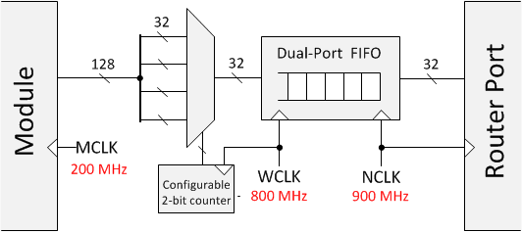
Fabric Interface
200 MHz module, 900 MHz router?
Configurable time-domain mux / demux: match bandwidth
Asynchronous FIFO: cross clock domains
→ Full NoC bandwidth, w/o clock restrictions on modules

Slide 17
Hard Routers/Soft Links
Logic clusters
FPGA
Router
Same I/O mux structure as a logic block – 9X the area
Conventional FPGA interconnect between routers

Slide 18



Hard Routers/Soft Links
FPGA
730 MHz
$$\frac{1}{9}th of FPGA vertically (\sim 2.5 mm)$$
Router
Faster, fewer wires (C12)
$$\frac{1}{5}th of FPGA vertically (\sim 4.5 mm)$$
Same I/O mux structure as a logic block – 9X the area
Conventional FPGA interconnect between routers

Slide 19
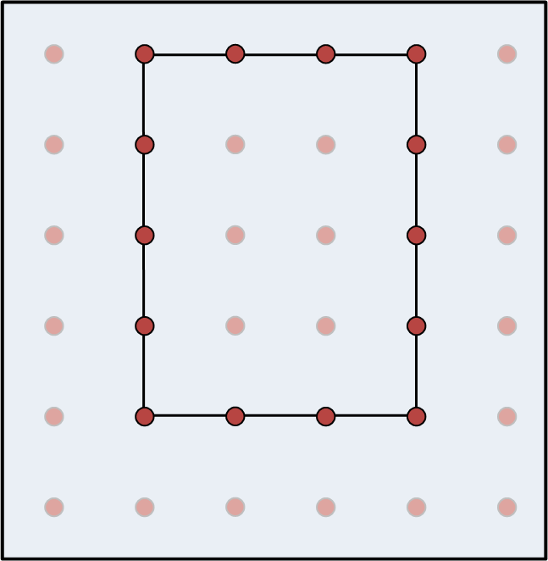
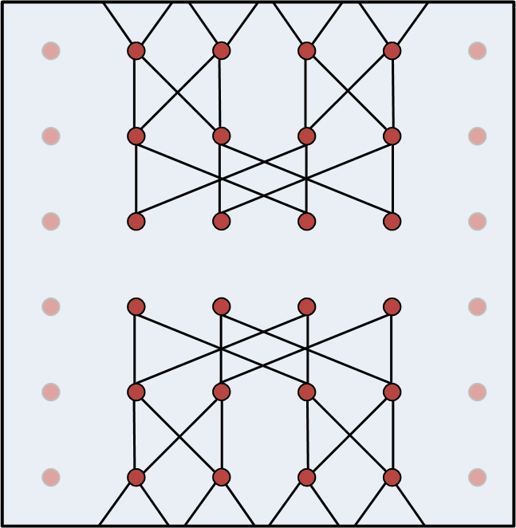
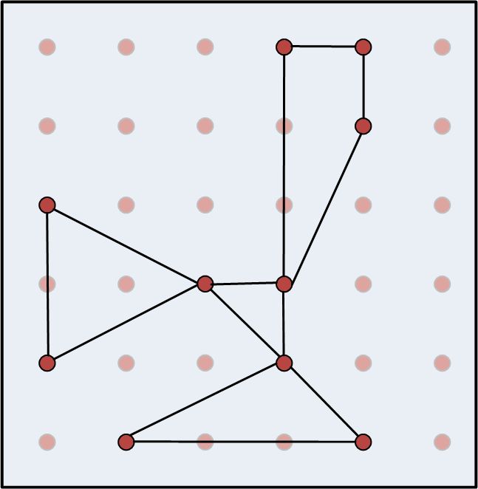
Hard Routers/Soft Links
FPGA
Router
Assumed a mesh → Can form any topology

Slide 20
Hard Routers/Hard Links
Logic blocks
FPGA
Router
Muxes on router-fabric interface only – 7X logic block area
Dedicated interconnect between routers → Faster/Fixed

Slide 21
Hard Routers/Hard Links
FPGA
900 MHz
Dedicated Interconnect (Hard Links)
Router
~ 9 mm at 1.1 V or ~ 7 mm at 0.9V
Muxes on router-fabric interface only – 7X logic block area
Dedicated interconnect between routers → Faster/Fixed

Slide 22
Hard NoCs
 | Soft | Hard (+ Soft Links) | Hard (+ Hard Links)
Area | 4.1 mm² (1X) | 0.18 mm² = 9 LABs (22X) | 0.15 mm² =7 LABs (27X)
Speed | 166 MHz (1X) | 730 MHz (4.4X) | 943 MHz (5.7X)
Power | -- | (9X less) | (11X – 15X)
Router

Slide 23
Hard NoCs
 | Soft | Hard (+ Soft Links) | Hard (+ Hard Links)
Area | 4.1 mm² (1X) | 0.18 mm² = 9 LABs (22X) | 0.15 mm² =7 LABs (27X)
Speed | 166 MHz (1X) | 730 MHz (4.4X) | 943 MHz (5.7X)
Power | -- | (9X less) | (11X – 15X less)
Router

Slide 24
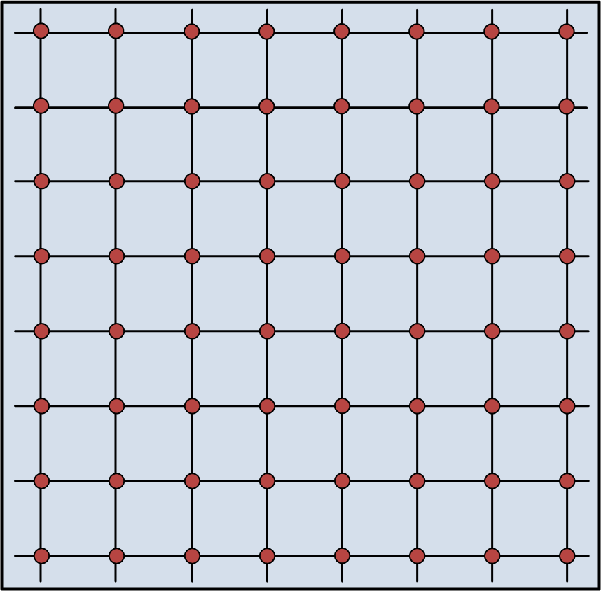
2. Area Efficient?
✓
64-node, 32-bit wide NoC on Stratix V
Very Cheap! Less than cost of 3 soft nodes
 | Soft | Hard (+ Soft Links) | Hard (+ Hard Links)
Area | ~12,500 LABs | 576 LABs | 448 LABs
%LABs | 33 % | 1.6 % | 1.3%
%FPGA | 12 % | 0.6 % | 0.45%

Slide 25
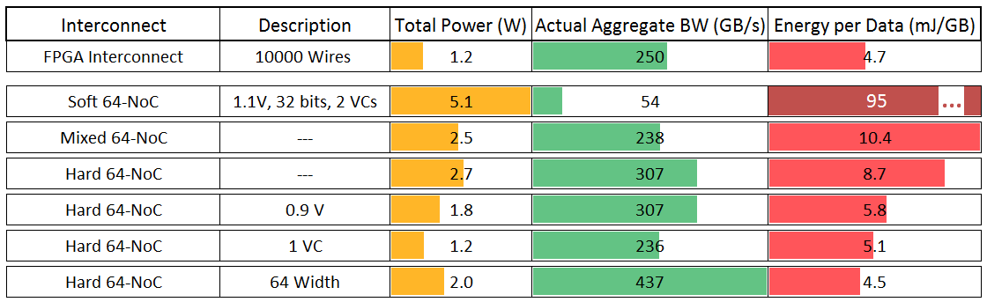
Power Efficient?
Length of 1 NoC Link
Compare to best case FPGA interconnect: point-to-point link
200 MHz
64 Width, 0.9 V, 1 VC
Hard and Mixed NoCs → Power Efficient

Slide 26
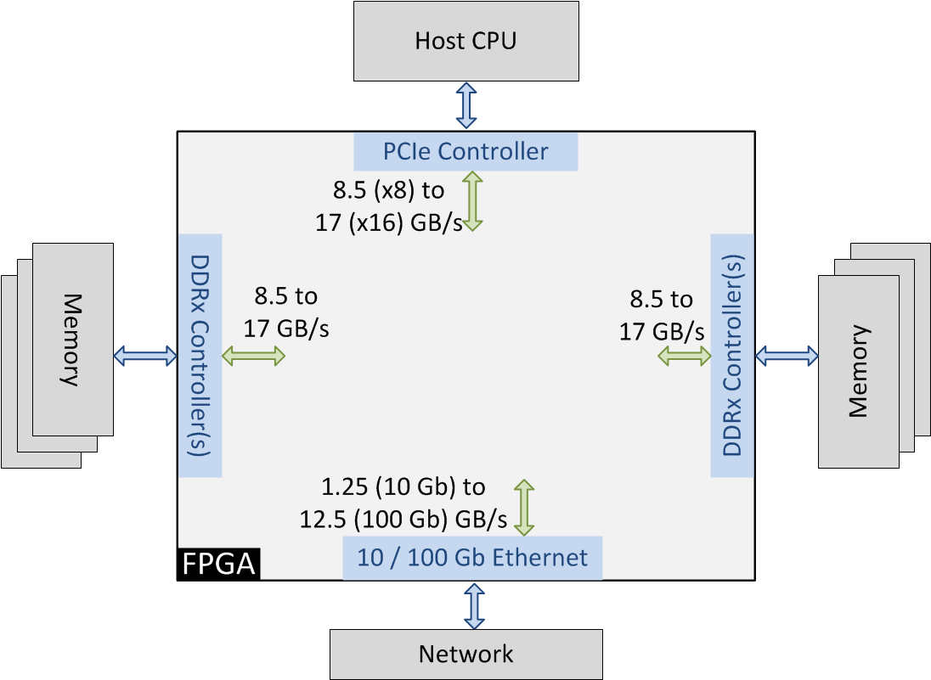
3. Match I/O Bandwidths?
32-bit wide NoC @ 28 nm
1.2 GHz → 4.8 GB/s per link
Too low for easy I/O use!

Slide 27
3. Match I/O Bandwidths?
✓
Need higher-bandwidth links
  150 bits wide @ 1.2 GHz
  22.5 GB/s per link
  Can carry full I/O bandwidth on one link
Want to keep cost low
  Much easier to justify adding to an FPGA if cheap
    E.g. Stratix I: 2% of die size for DSP blocks
    First generation: not used by most customers, but 2% cost OK
  Reduce number of nodes: 64 → 16
    1.3% of core area for a large Stratix V FPGA

Slide 28
NoC Usage & Application Efficiency Studies
How Do We Use It?

Slide 29
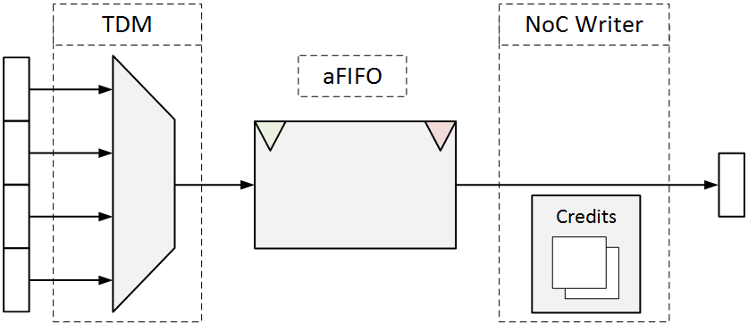
FabricPort In
FPGA Module
Embedded NoC
Frequency
100-400 MHz
Frequency
1.2 GHz
Any* width
0-600 bits
Fixed Width
150 bits
Ready/Valid
Credits
Width
# flits
0-150 bits
1
150-300 bits
2
300-450 bits
3
450-600 bits
4

Slide 30
FabricPort In
FPGA Module
Embedded NoC
Frequency
100-400 MHz
Frequency
1.2 GHz
Any* width
0-600 bits
Fixed Width
150 bits
Ready/Valid
3
Credits
Time-domain multiplexing:
Divide width by 4
Multiply frequency by 4

Slide 31
FabricPort In
FPGA Module
Embedded NoC
Frequency
100-400 MHz
Frequency
1.2 GHz
Any* width
0-600 bits
Fixed Width
150 bits
Ready/Valid
3
Credits
Time-domain multiplexing:
Divide width by 4
Multiply frequency by 4
Asynchronous FIFO:
Cross into NoC clock
No restriction on module frequency

Slide 32
FabricPort In
FPGA Module
Embedded NoC
Frequency
100-400 MHz
Frequency
1.2 GHz
Any* width
0-600 bits
Fixed Width
150 bits
Ready/Valid
3
Credits
2
1
0
Ready=0
Time-domain multiplexing:
Divide width by 4
Multiply frequency by 4
Asynchronous FIFO:
Cross into NoC clock
No restriction on module frequency
NoC Writer:
Track available buffers in NoC Router
Forward flits to NoC
Backpressure
Input interface: flexible & easy for designers → little soft logic

Slide 33
Designer Use
NoC has non-zero, usually variable latency
Use on latency-insensitive channels
Stallable modules
data
data
A
B
C
valid
ready
With restrictions, usable for fixed-latency communication
  Pre-establish and reserve paths
  “Permapaths”
Permapaths
A
A
B
C

Slide 34
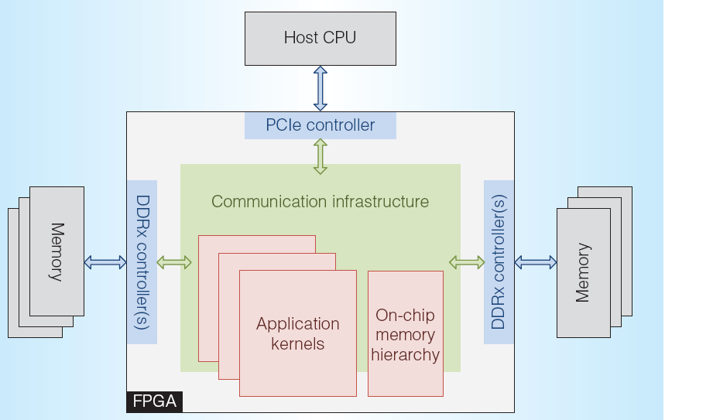
How Common Are Latency-Insensitive Channels?
Connections to I/O
  DDRx, PCIe, …
  Variable latency
Between HLS kernels
  OpenCL channels / pipes
  Bluespec SV
  …
Common design style between larger modules
  And any module can be converted to use [Carloni et al, TCAD, 2001]
Widely used at system level, and use likely to increase

Slide 35
Packet Ordering
Multiprocessors
Memory mapped
Packets arrive out-of-order
  Fine for cache lines
  Processors have re-order buffers
FPGA Designs
Mostly streaming
Cannot tolerate reordering
  Hardware expensive and difficult
All packets with same src/dst must take same NoC path
RULE
1
2
1
1
2
FULL
2
All packets with same src/dst must take same VC
RULE

Slide 36
Application Efficiency Studies
How Efficient Is It?

Slide 37
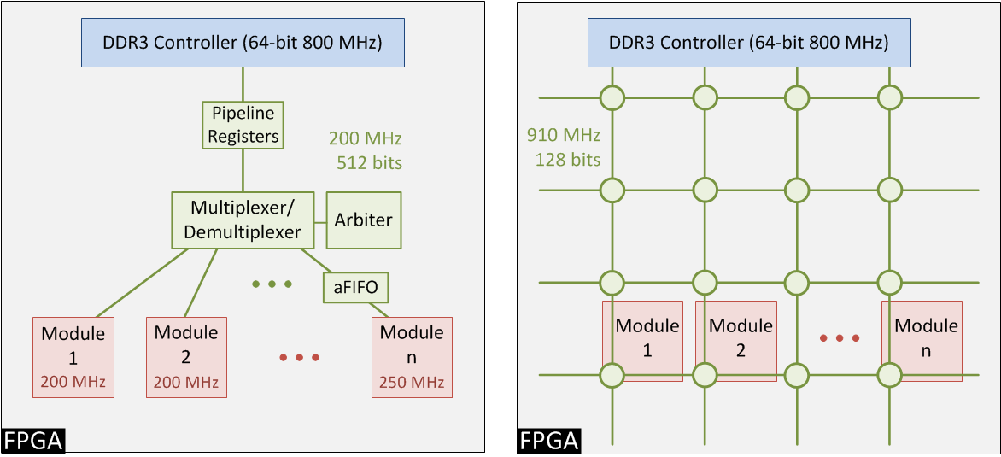
1. Qsys vs. NoC
qsys: build logical bus from fabric
NoC: 16-nodes, hard routers & links

Slide 38
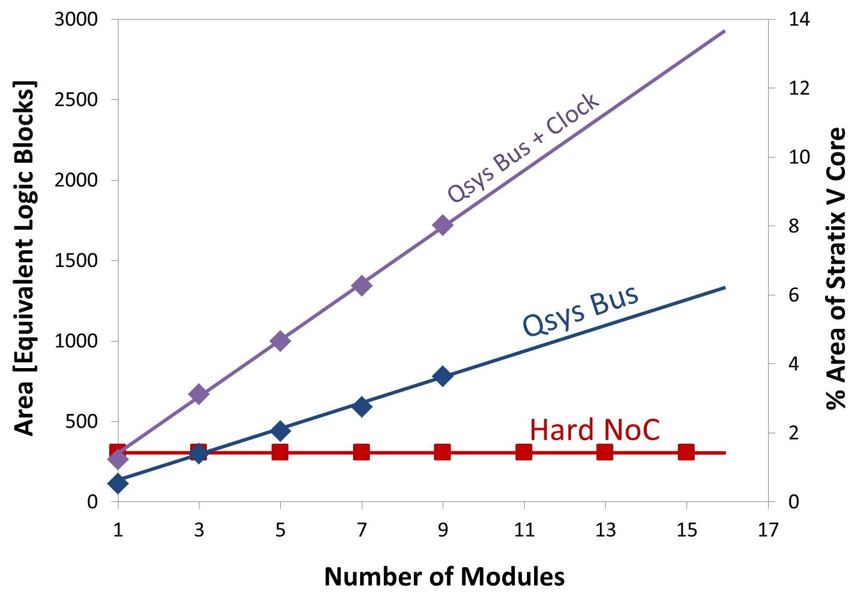
Area Comparison
Only 1/8 of Hard NoC BW used, but already less area for most systems

Slide 39
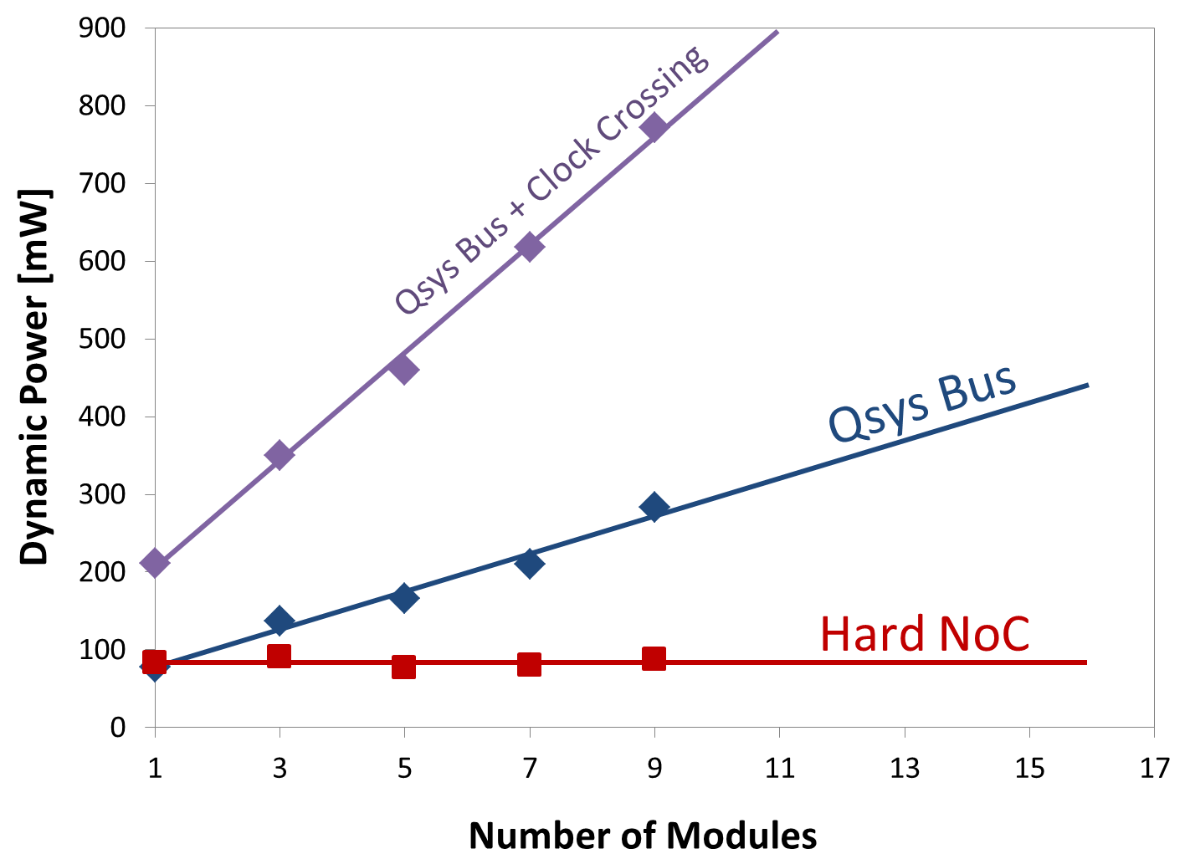
Power Comparison
Hard NoC saves power for
even simplest systems

Slide 40
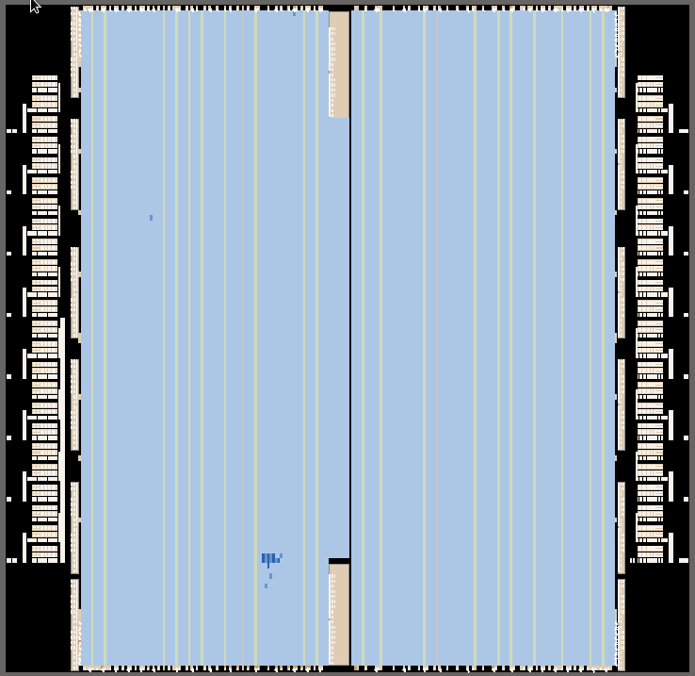
2. Ethernet Switch
FPGAs with transceivers: commonly manipulating / switching packets
e.g. 16x16 Ethernet switch, @ 10 Gb/s per channel
NoC is the crossbar
Plus buffering, distributed
arbitration &
back-pressure
Fabric inspects packet headers, performs
more buffering, …
NoC
Router
Transceiver

Slide 41
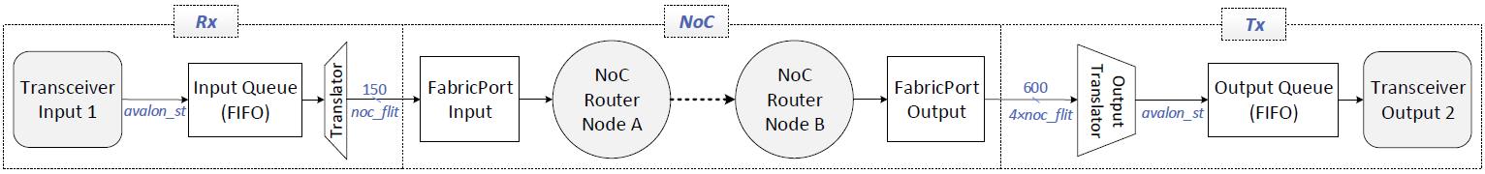
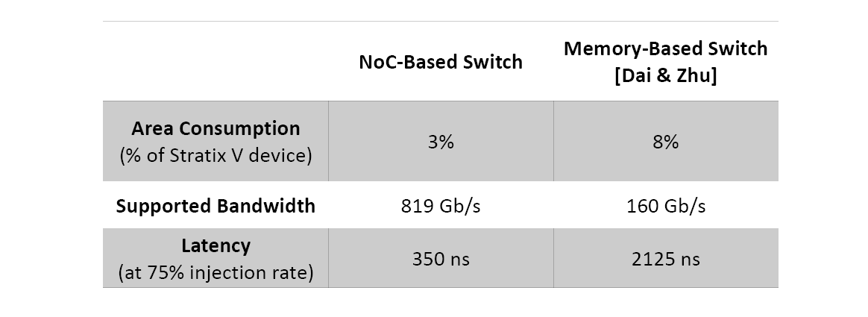
Ethernet Switch Efficiency
14X more efficient!
Latest FPGAs: ~2 Tb/s transceiver bandwidth → need good switches

Slide 42
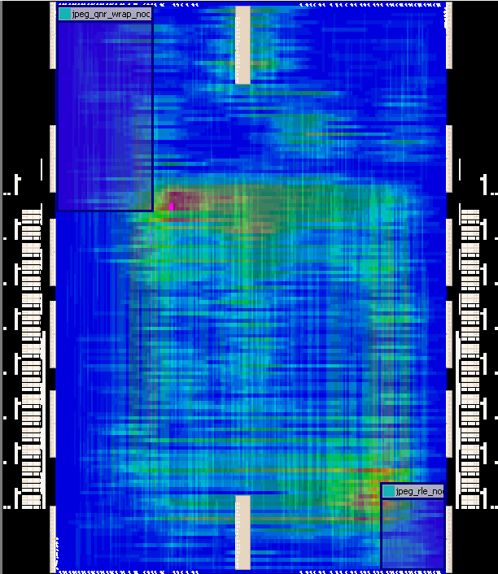
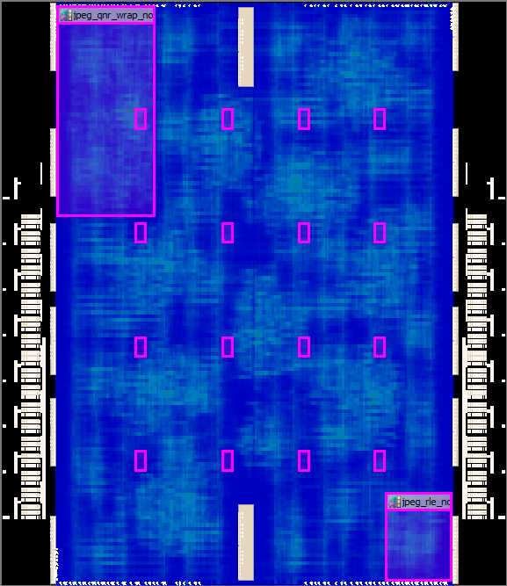
3. Parallel JPEG (Latency Sensitive)
Max 100%
[long wires]
Max 40%
NoC makes performance more predictable
NoC doesn’t produce wiring hotspots & saves long wires

Slide 43

Future Trends and Embedded NoCs
Speculation Ahead!

Slide 44
1. Embedded NoCs and the Datacenter

Slide 45
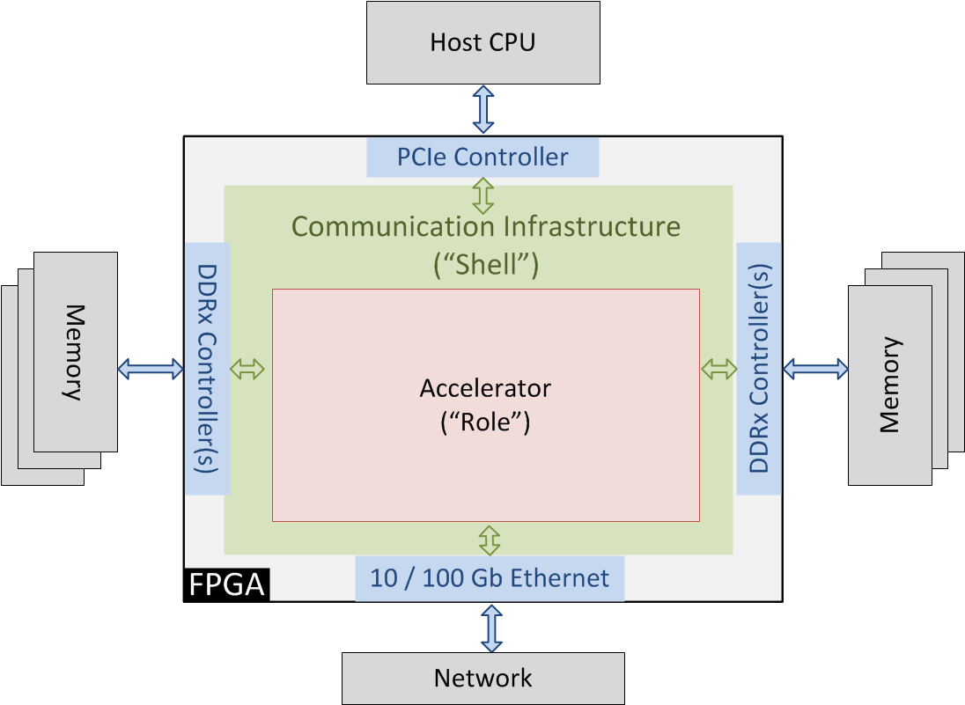
Datacenter Accelerators
Microsoft Catapult: Shell & Role to Ease Design
Shell: 23% of Stratix V FPGA [Putnam et al, ISCA 2014]

Slide 46
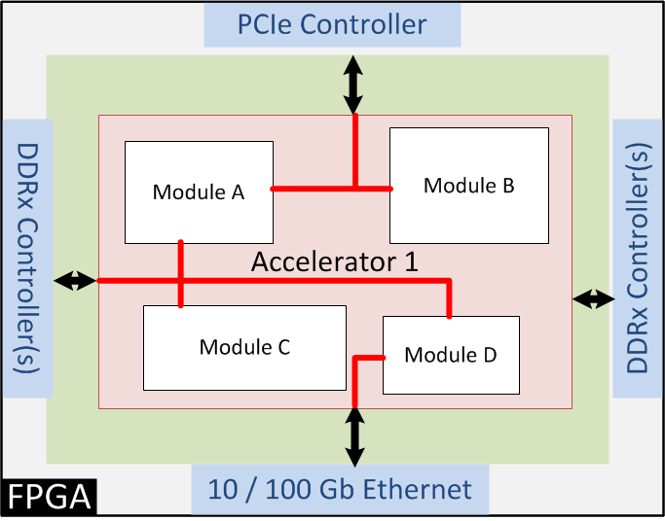
Datacenter “Shell”: Bus Overhead
Buses to I/Os in shell & role
Divided into two parts to ease compilation (shell portion locked down)

Slide 47
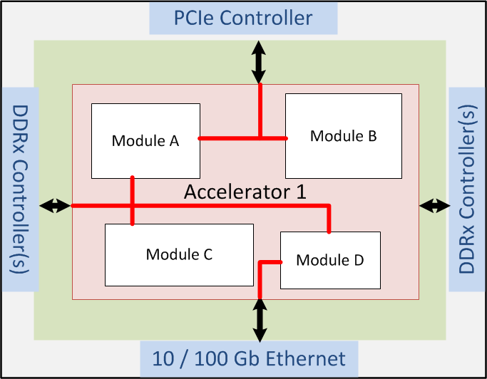
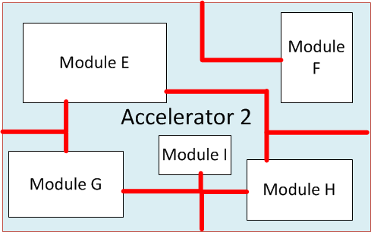
Datacenter “Shell”: Swapping Accelerators
Partial reconfig of role only → swap accelerator w/o taking down system
Overengineer shell buses for most demanding accelerator
Two separate compiles → lose some optimization of bus

Slide 48
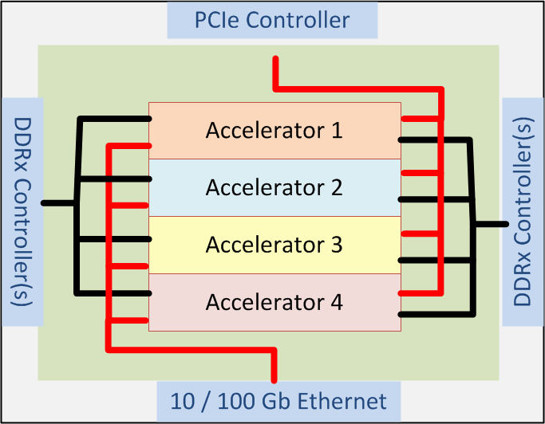
More Swappable Accelerators
Allows more virtualization
But shell complexity increases
Less efficient
Wasteful for one big accelerator
Accelerator 5
Big Accelerator
Accelerator 6

Slide 49
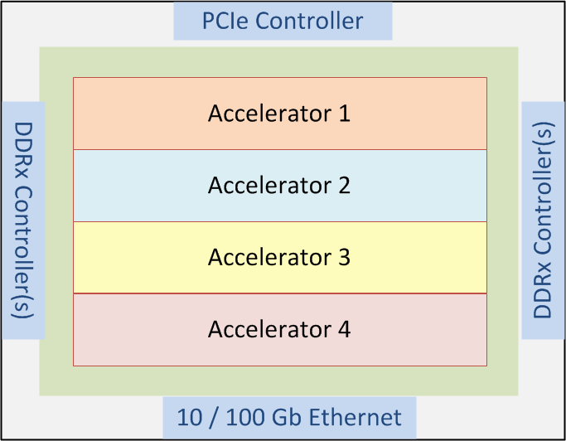
Shell with an Embedded NoC
Efficient for more cases (small or big accelerators)
Data brought into accelerator, not just to edge with locked bus
Accelerator 5
Big Accelerator
Accelerator 6

Slide 50
2. Interposer-Based FPGAs

Slide 51
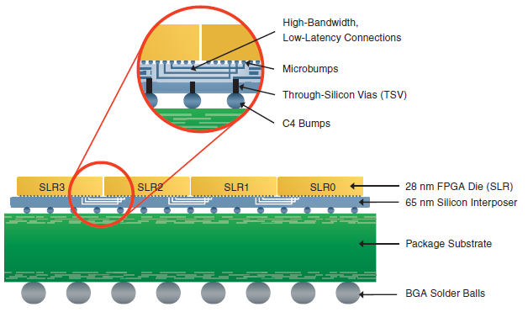
Xilinx: Larger Fabric with Interposers
Create a larger FPGA with interposers
10,000 connections between dice (23% of normal routing)
Routability good if > 20% of normal wiring cross interposer [Nasiri et al, TVLSI, to appear]
Figure: Xilinx, SSI Technology White Paper, 2012

Slide 52
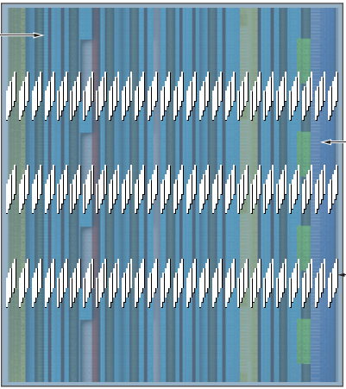
Interposer Scaling
Concerns about how well microbumps will scale
Will interposer routing bandwidth remain >20% of within-die bandwidth?
Embedded NoC: naturally multiplies routing bandwidth (higher clock rate on NoC wires crossing interposer)
Figure: Xilinx, SSI Technology White Paper, 2012

Slide 53
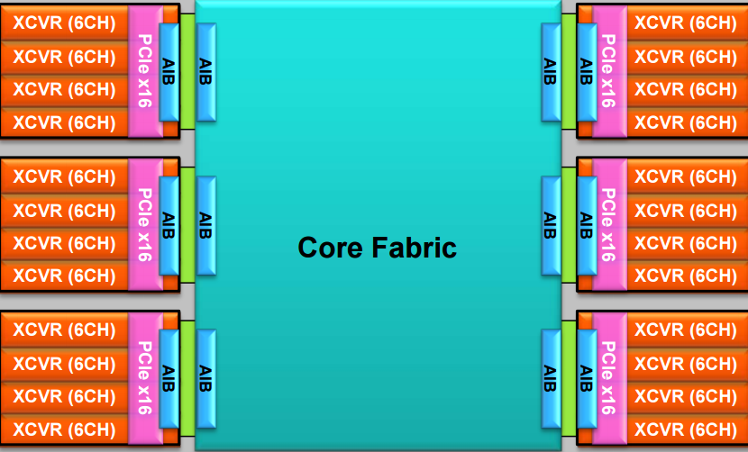
Altera: Heterogeneous Interposers
Figure: Mike Hutton, Altera Stratix 10, FPL 2015
Custom wiring interface to each unique die
  PCIe/transceiver, high-bandwidth memory
NoC: standardize interface, allow TDM-ing of wires
Extends system level interconnect beyond one die

Slide 54
3. Registered Routing

Slide 55
Registered Routing
Stratix 10 includes a pulse latch in each routing driver
  Enables deeper interconnect pipelining
  Obviates need for a new system-level interconnect?
I don’t think so
  Makes it easier to run wires faster
  But still not:
    Switching, buffering, arbitration (complete interconnect)
    Pre-timing closed
    Abstraction to compose & re-configure systems
Pushes more designers to latency-tolerant techniques
  Which helps match the main NoC programming model

Slide 56
4. Kernels → Massively Parallel Accelerators
Crossbars for Design Composition

Slide 57
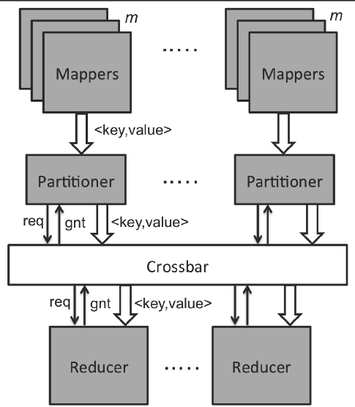
Map – Reduce and FPGAs
[Ghasemi & Chow, MASc thesis, 2015]
Write map & reduce kernel
Use Spark infrastructure to distribute data & kernels across many CPUs
Do same for FPGAs?
Between chips → network
Within a chip → soft logic
Consumes lots of soft logic and limits routable design to ~30% utilization!

Slide 58
Can We Remove the Crossbar?
Not without breaking Map-Reduce/Spark abstraction!
  The automatic partitioning / routing / merging of data is what makes Spark easy to program
  Need a crossbar to match the abstraction and make composability easy
NoC: efficient, distributed crossbar
  Allows us to efficiently compose kernels
  Can use crossbar abstraction within chips (NoC) and between chips (datacenter network)

Slide 59
Wrap Up

Slide 60
Wrap Up
Adding NoCs to FPGAs
  Enhances efficiency of system level interconnect
  Enables new abstractions (crossbar composability, easily-swappable accelerators)
NoC abstraction can cross interposer boundaries
  Interesting multi-die systems
My belief:
  Special purpose box → datacenter
  ASIC-like flow → composable flow
  Embedded NoCs help make this happen

Slide 61
Future Work
CAD System for Embedded NoCs
  Automatically create lightweight soft logic to connect to fabric port (translator)
    According to designer’s specified intent
  Choose best router to connect each compute module
  Choose when to use NoC vs. soft links
Then map more applications, using CAD

