Slide 1


Fast & Accurate Biophotonic Simulation for Personalized Photodynamic Cancer Therapy Treatment Planning
Investigators: Vaughn Betz, University of Toronto
Lothar Lilge, University Health Network
Partner Organizations: IBM and Theralase

Slide 2
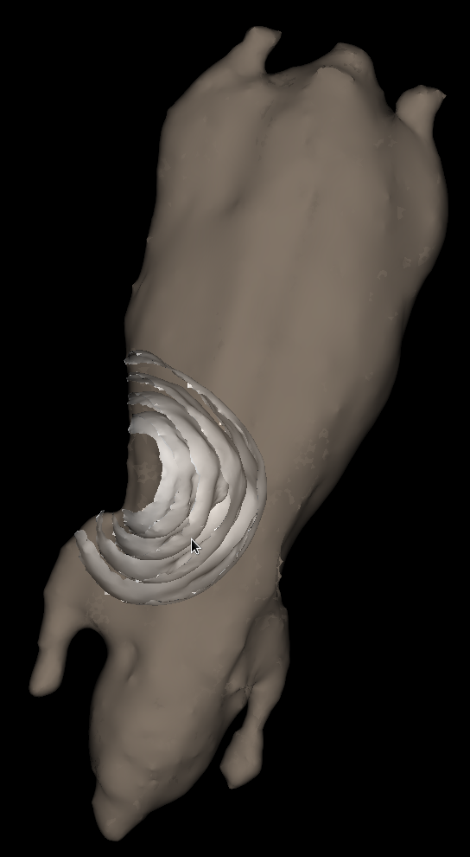
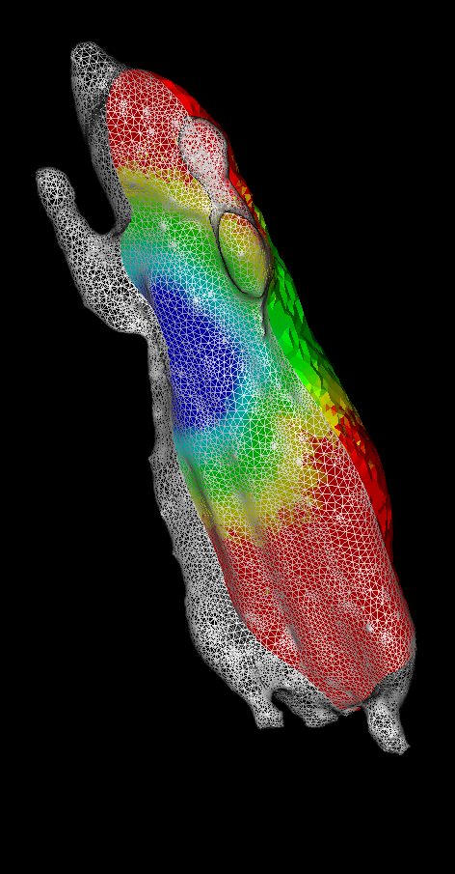
PDT Cancer Treatment Simulation
Light (fluence)
Distribution
Fiber light
source
Photosensitizer
absorption
Reactive oxygen production
Fluence map on planar cut
Tissue damage
Isofluence contours
(Lab mouse typically used for pre-clinical testing)
Notes:
Mouse as pre-clinical model for cancer treatment

Slide 3
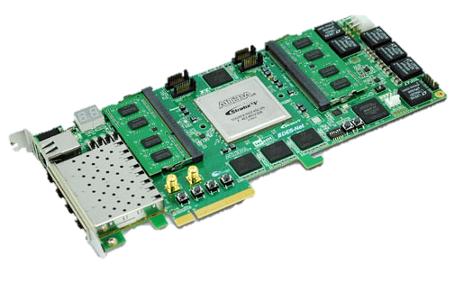
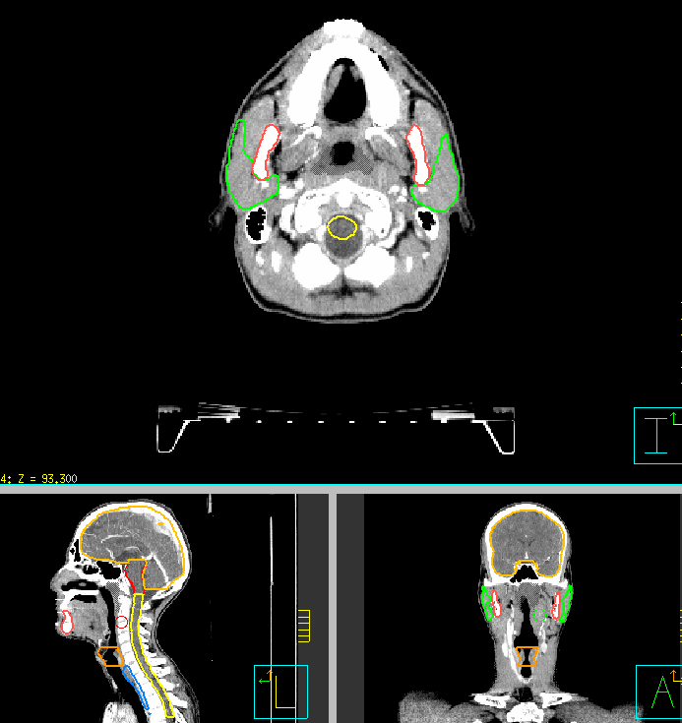
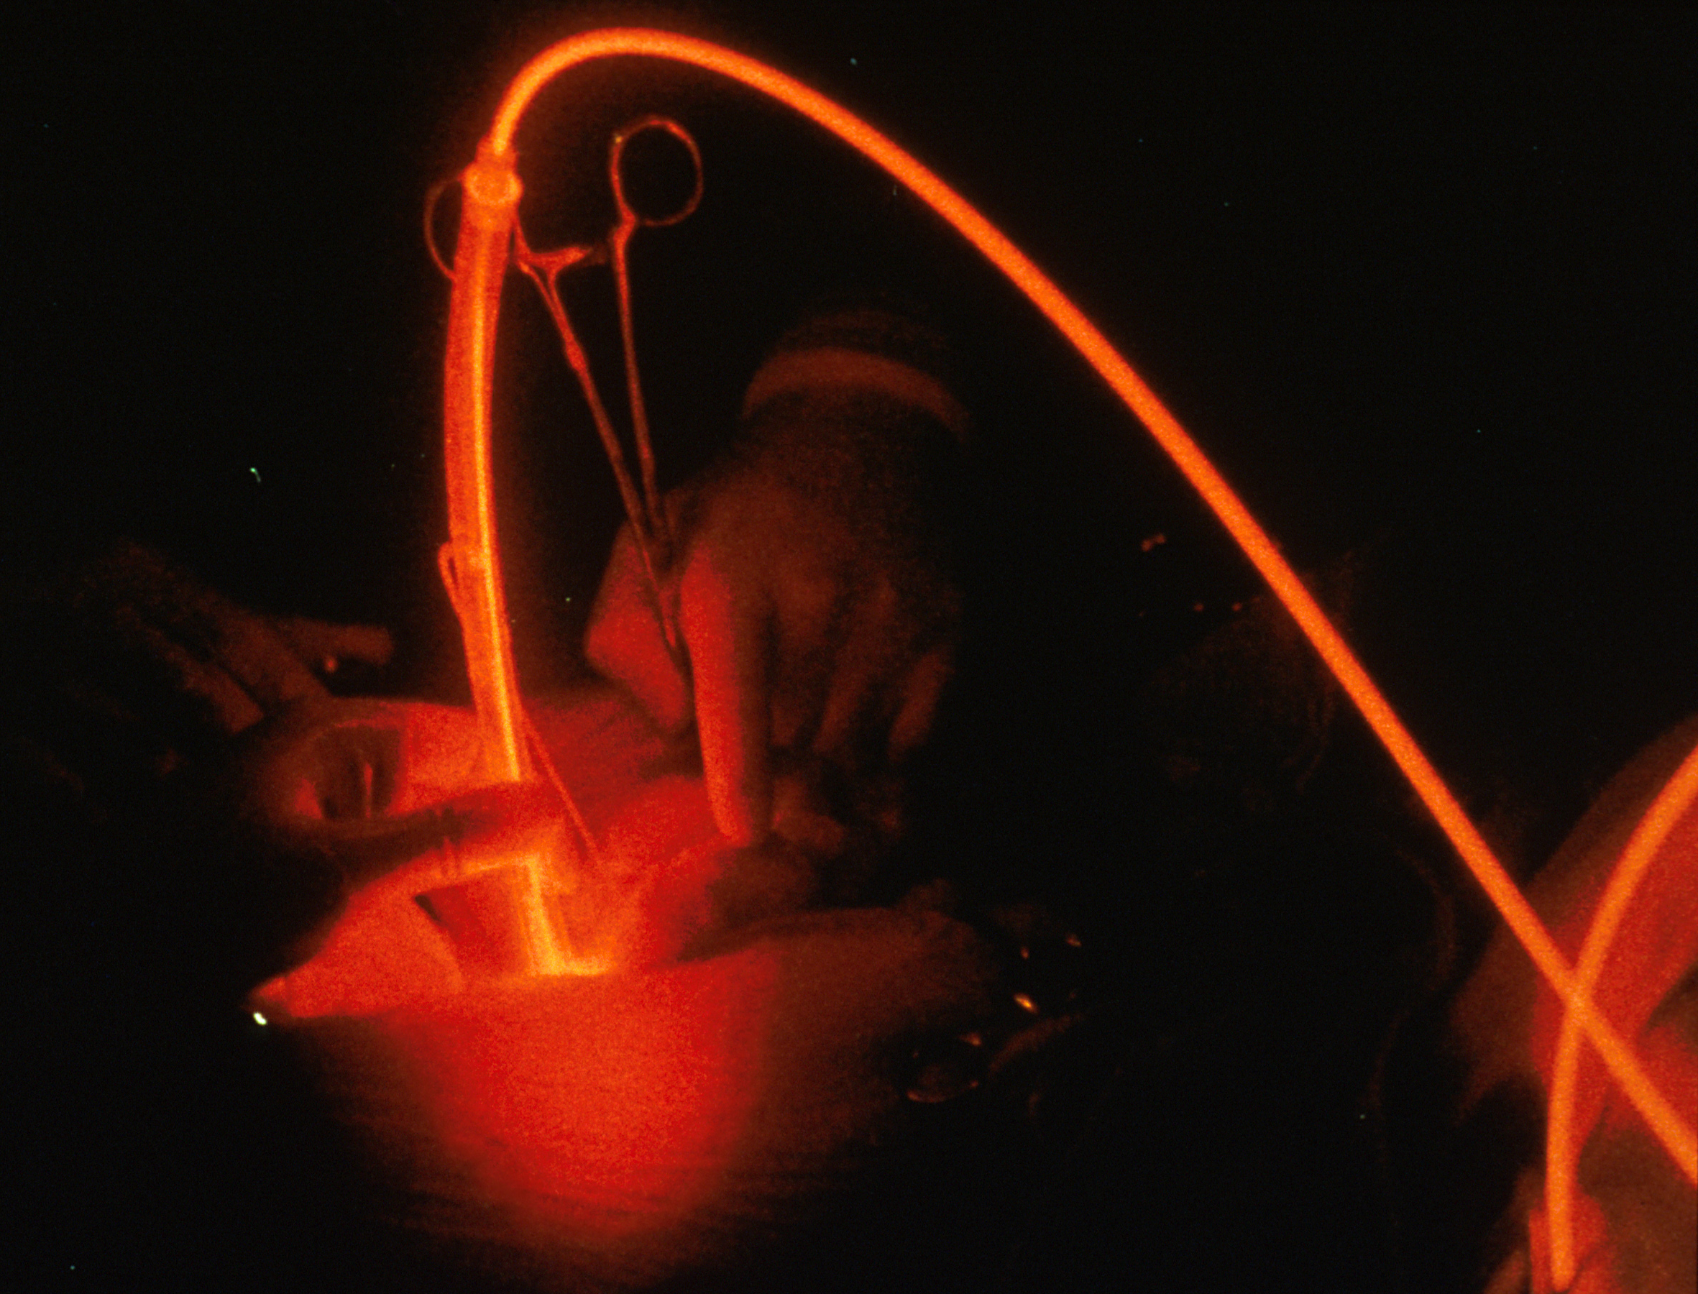
PDT Cancer Treatment Optimization
~100-1000 iterations
10-60 min each on CPU
1000 times -> 1-6 weeks
Images courtesy of Robert Weersink
Princess Margaret Cancer Centre
Notes:
Delete “define dose” and make first bubble “MRI”
Animate: One appears at a atime
Emphasize need fast results

Slide 4
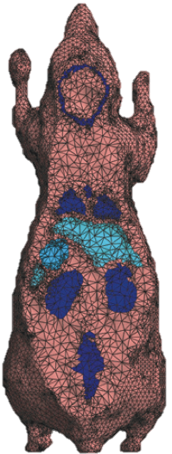
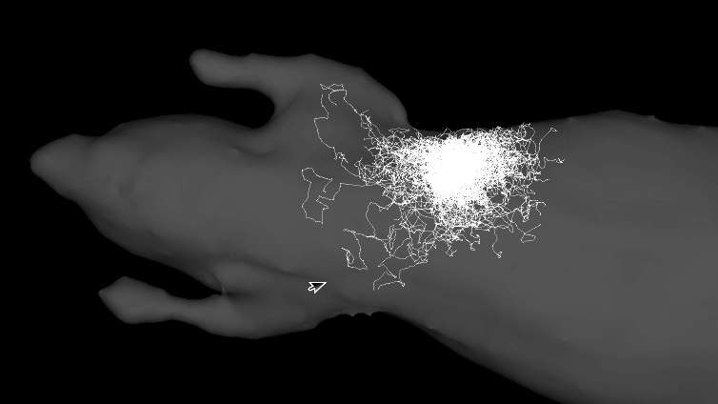
Simulation Algorithm: Monte Carlo (MC)
Trace photon packets as they scatter randomly and are absorbed
Tetrahedral mesh for arbitrary shapes
Compute-intensive
  10⁷-10⁹ packets
  10²-10³ steps each
  10-60s minutes with highly-optimized CPU code!
Notes:
Slow down here – explain biophotonics
Explain the light source
Note that MC includes all physics but time-confidence tradeoff

Slide 5
Goals: Research Team
Make PDT simulation both fast and accurate
Leverage fast simulator to enable automatic optimization of plan, and robustness evaluation with tissue variation
Develop full flow from MRI data through simulation to visualization
Increase PDT efficacy, and broaden applicability to more cancer indications

Slide 6
Goals: Partners
IBM
  New application of IBM CAPI (agile) hardware in the medical space
  General utilities / APIs created by research team open-sourced → enable other agile computing users
Theralase
  Provider of PDT photosensitizers and lasers: better PDT treatment planning → larger market
  Evaluate a treatment plan in silico: can tell if PDT plan will lead to a good result before treatment
  Automatic optimization: create a better and more robust treatment plan, quickly

Slide 7
Roles
Research team:
  Betz: compute acceleration, software development
  Lilge: medical physics modeling, PDT expertise
  Together: develop complete software + hardware flow
IBM
  Agile hardware, APIs, and simulation environments
  Technical support and expertise on agile platform
  Interaction with IBM researchers working on related medical simulation and imaging problems
Theralase
  PDT and optical measurement expertise
  Calibrate simulator against measured light / PDT results

Slide 8
Achievements to Date
World’s fastest software simulator for general Monte Carlo simulation of light
Agile hardware implementation in progress
  Single compute pipeline functions in simulation
  4x performance of high-end, four-core CPU
  Expect ~16x performance and 60x power-efficiency for scaled-up full system
Prototype components of most of MRI image → simulation → visualization flow

Slide 9
OCE and SOSCIP Role & Support
OCE very helpful through entire application process
  Suggested the VIA program
  Walked us through the rules and application procedure
  Answering questions and overcoming roadblocks
SOSCIP & IBM
  Hardware & great technical support
  Support for funding applications, and direct funding
  Linkages and introductions to other researchers
OCE and NSERC Funding
  Strong matching → expand goals & team
  Strong matching → encourages industrial support
    Broadens team expertise
  Key to realizing our larger vision!

