Slide 1
Critical Path Prediction
Focusing processor policies via critical-path prediction
B. Fields, S. Rubin and R. Bodik
ISCA 2001
some slides/content from the original presentation

Slide 2
Motivation
Identify the Critical Path
  Instructions that if accelerated would improve overall performance
Exploit to improve the processor
  This work seems to focus on performance?
  “Make processor policies sensitive to performance”

Slide 3
Applications Shown
Resource Arbitration
  Scheduler Priorities
  Give critical instructions priority for execution
Misspeculation Reduction
  Value prediction only for critical instructions

Slide 4
Instruction Slack
Slack of an instruction:
  How long can we delay the instruction before performance decreases?
It’s zero only for instructions on the critical path
Can be used to tolerate latencies

Slide 5
Determining slack is hard
Microprocessors are complex:
Sometimes slack is determined by resources (e.g. ROB)
“Probe the processor” approach: Delay and observe
  Delay dynamic instruction by n cycles
  See if execution time increased
    No, increase n; restart; go to step 1
Srinivasan and Lebeck approximation, for loads (MICRO ’98)
  heuristics to predict execution time increase

Slide 6
Using Data Dependency Analysis
Used in compilers
  Determine the data dependencies
  Observe the time of arrival for each value
  Find the longest path

Slide 7
Using Dependence Analysis
A: ld r1, 0(r2)
B: beq r1, r3, ELSE
C: ELSE: ld r4, 0(r1)
 | 1 | 2 | 3 | 4 | 5 | 6 | 7 | 8 | 9 | 10 | 11 | 12 | 13 | 14
A | F | D | S | E | M | M | W | C
B |  | F | D | S | S | S | E | M | W | C
C |  |  | F | D | S | S | E | M | W | C
A
3
C
3
0
B

Slide 8
Determining the critical path is hard
A: ld r1, 0(r2)
B: beq r1, r3, ELSE
C: ELSE: ld r4, 0(r1)
 | 1 | 2 | 3 | 4 | 5 | 6 | 7 | 8 | 9 | 10 | 11 | 12 | 13 | 14
A | F | D | S | E | M | M | W | C
B |  | F | D | S | S | S | E | M | W | C
w |  |  | F | D | S | E | M
w |  |  |  | F | D | S | E
w |  |  |  |  | F | D | S
w |  |  |  |  |  | F | D
w |  |  |  |  |  |  | F
C |  |  |  |  |  |  | F | D | S | E | M | W | C
A
3
C
3
0
B

Slide 9
Determining Slack is hard
Microprocessors are complex:
Sometimes slack is determined by resources (e.g., ROB)
“Probe the processor” approach: Delay and observe
  Delay dynamic instruction by n cycles
  See if execution time increased
    No, increase n; restart; go to step 1
Srinivasan and Lebeck approximation, for loads (MICRO ’98)
  heuristics to predict execution time increase

Slide 10
Determining slack
  Alternative approach: Dependence-graph analysis
  Build resource-sensitive dependence graph
  Analyze to find slack
  But, how to build resource-sensitive graph?
Casmira and Grunwald’s solution (Kool Chips Workshop ’00)
Graphs only with instructions in issue window

Slide 11
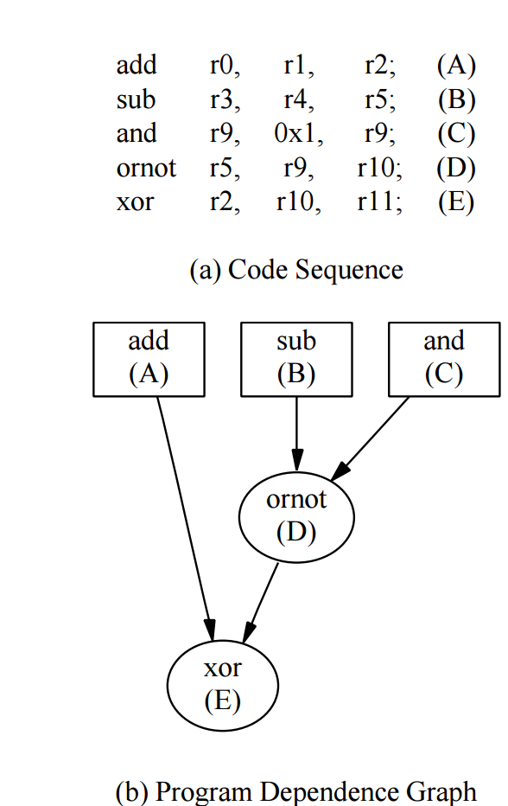
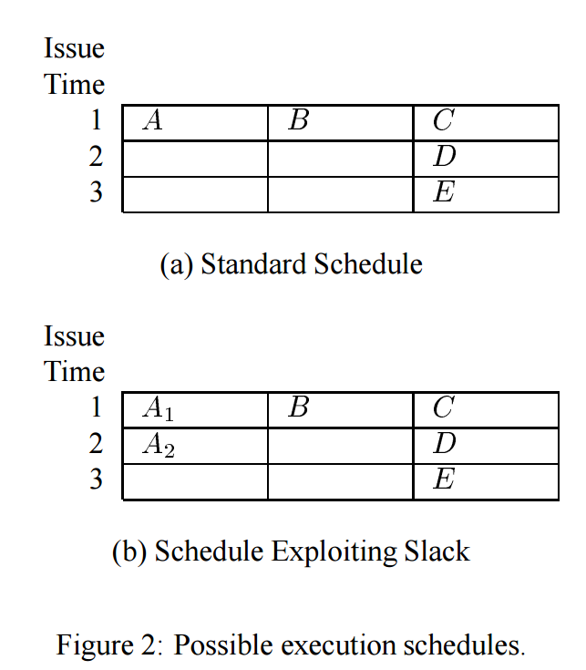
Casmira and Grunwald’s solution
A takes longer – performance
Stays the same

Slide 12
Data-Dependence Graph
Observe latency to produce a result
1
2
1
1
1
1
3
Slack = 0 cycles
Misses microarchitectural effects – limited window -- mispredictions

Slide 13
Data-Dependence Graph
Assume WS = 3
1. Can’t get to this
3.Or retiring this
2. Before fetching this
1
2
1
1
1
1
3
Slack = 0 cycles
Misses microarchitectural effects – limited window -- mispredictions

Slide 14
Our Dependence Graph Model (ISCA ‘01)
Three nodes: Fetch, Decode, Execute
Imperfect – Good enough → experimental result
F
F
F
F
F
E
E
E
E
E
C
C
C
C
C
Slack = 0 cycles
F = Fetch synonymous to D = Dispatch in the paper

Slide 15
Our Dependence Graph Model (ISCA ‘01)
0
10
0
1
F
F
F
F
F
1
1
1
1
1
1
2
1
1
1
1
E
E
E
E
E
1
1
3
1
1
1
C
0
C
1
C
0
C
1
C
Slack = 6 cycles
Modeling resources increases observable slack

Slide 16
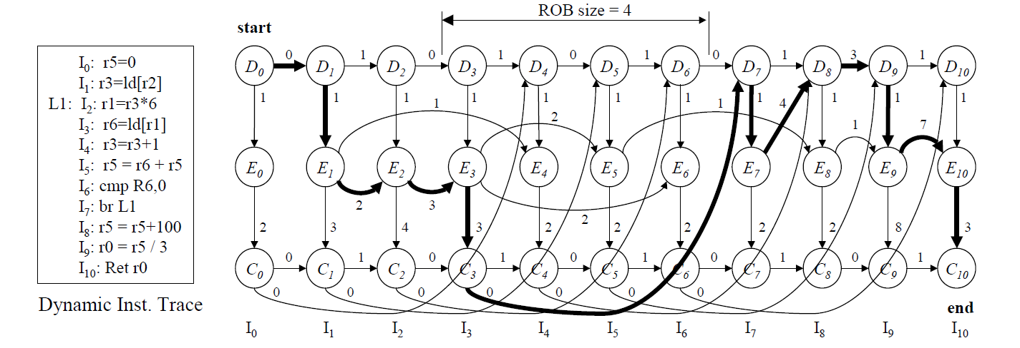
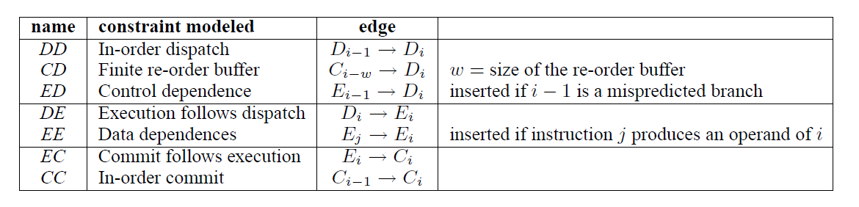
An Example
Wrong path not modeled → validation shows this is an OK approximation

Slide 17
An Example
Should it be 2? Yes
Given that I3 is also a load and
Takes 2 cycles
Wrong path not modeled → validation shows this is an OK approximation

Slide 18
Within Each Instruction: Execution Follows Dispatch
Execution Follows Dispatch: D_{i}→ E_{i}

Slide 19
Within Each Instruction: Commit Follows Execution
Commit Follows Execution: E_{i}→ C_{i}

Slide 20
Across Instructions: In-Order Dispatch
In-order Dispatch: D_{i-1}→ D_{i}
  Superscalar
  Program Order
  D0 → D1: latency 0? 2-way Superscalar

Slide 21
Across Instructuions: In-Order Commit
In-Order Commit: C_{i-1}→ C_{i}
  Program Order
  Superscalar
    Notice 0 and 1 alternating pattern across C→C edges

Slide 22
Across Instructions: True Data Dependencies
Data Dependencies: E_{i-1}→ E_{j}

Slide 23
Across Instructions: Finite Window
Finite Reorder Buffer: C_{i-w}→ D_{i}
  C0 → D4: ROB size = 4
  w = window size = 4

Slide 24
Across Instructions: Branch Mispredictions
Control Dependencies/Branch Mispredictions:
E_{i-1}→ D_{i}
  Instruction cannot be fetched before branch is resolved
  E7 → D8: 4 cycles

Slide 25
No Critical Edge Can Span More than Window Size Instructions
By construction only EE edges could
  D and C nodes are restricted by window size (ROB)
    Wrong path instructions are not included
An EE edge that spans more than WS insts?
  Producer and Consumer not concurrently in the processor
  Producer has committed by the time the consumer enters
  Consumer finds the values it needs in the RF
    Hence EE cannot be critical

Slide 26
Constructing the Model
Phase 1: Simulate:
Record latency per edge
  More on this on the next slide
Dump these out
Phase 2: Post Processing
Construct graph
Traverse – find longest path
May be able to do so on-the-fly
Impractical for implementation
This is for validation

Slide 27
Edge Latencty
Time to resolve the edge
  EE: time from decode to execute finish for producer
    FU latency + wait time after ready (structural hazard)
  CD: 0 commit takes no time
  DD: 0 if dispatched together, otherwise?
Why 3?

Slide 28
Why D8D9 is 3?
D8 got an instruction miss
  Took 3 cycles to get it from L2
  D9 had to wait for D8 hence the latency
  The miss is on D8

Slide 29
Validating the Model
If the critical instructions are correctly identified then reducing their latency should improve performance
Simulate baseline with +1 latency for all instructions
Two experiments:
  ExpA: Reduce latency to normal for “critical”
  ExpB: Reduce latency to normal for “non-critical”
Expected result
  Performance should improve for ExpA
  Ideally, not for ExpB
  But performance improvement should be higher for ExpA than for ExpB

Slide 30
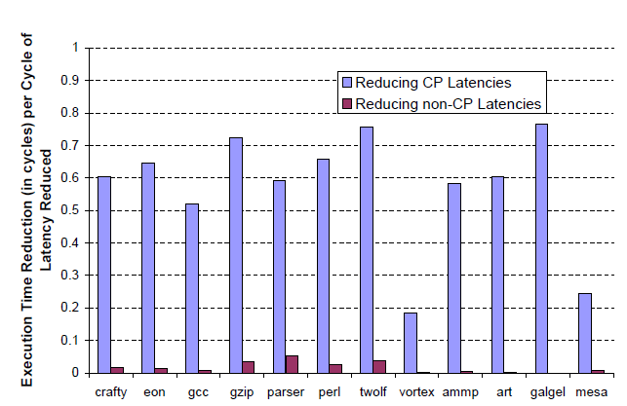
Validating the Model
Have 15 insts
Takes N cycles to execute
10 are critical
Run time reduces by 7 cycles
M,easurement will be 0.7

Slide 31
Discussion of Results
Why does performance improve for ExpB
  Model is incomplete/imperfect
    Prefetching down the wrong path
Why is the performance improvement different?
  Different programs have different behavior
    Could be closer to peak performance for some
  Near-Critical paths
    Eliminating one critical path exposes another
    Must eliminate both for maximum effect

Slide 32
Criticality Breakdown Per Instruction
Commit Critical
Execute Critical
Fetch Critical
Commit Non-Critical
Execute Non-Critical
Non critical instructions
No node is part of the CP

Slide 33
Criticality Breakdown Per Instruction
Execute Critical
  Execute node part of the critical path
    E2: result of ld needed by multiply

Slide 34
Criticality Breakdown Per Instruction
Dispatch Critical
  Dispatch node part of the critical path
    D8: I$ miss delays fetching I9

Slide 35
Criticality Breakdown Per Instruction
Commit Critical
  Window full
  Must commit to be able to fetch
  I3? CC or EC? Both → Instruction is critical
    How do they account? One of the two. May be the earliest? Other cases

Slide 36
Non-Critical Instruction
Commit Non-Critical
  Overlaps with a critical CD edge
  Window is full while they execute
  An earlier instruction holds up the window

Slide 37
Non-Critical Instruction
Execute Non-Critical
  Overlaps with a critical EE edge
  Even if it executed earlier the other instruction would take longer
  None in the example below

Slide 38
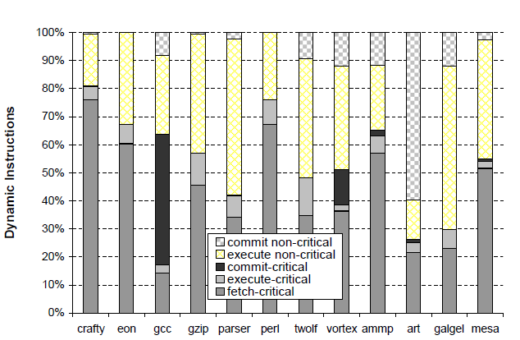
Criticality Breakdown

Slide 39
Determining the Critical Path
All we have to do is observe the order in which edges arrive
Last-arriving edge per instruction:
  Only these can be part of the critical path
What’s the critical path:
  Start at the last instruction
  Traverse backward following last-arriving edges
This is precise but requires keeping all instructions
How about an approximation?

Slide 40
Determining the last arriving edge
For each instruction
  For each node: D, E, and C
  Determine the last arriving edge
So, for each instruction there will be three last arriving edges one for each of its nodes

Slide 41
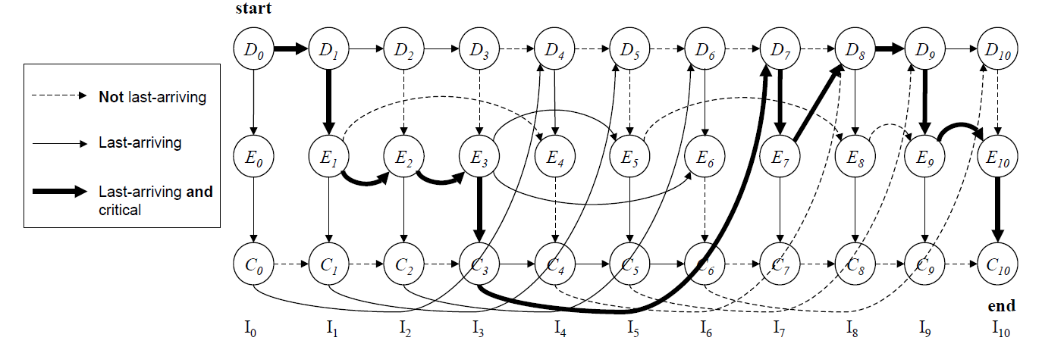
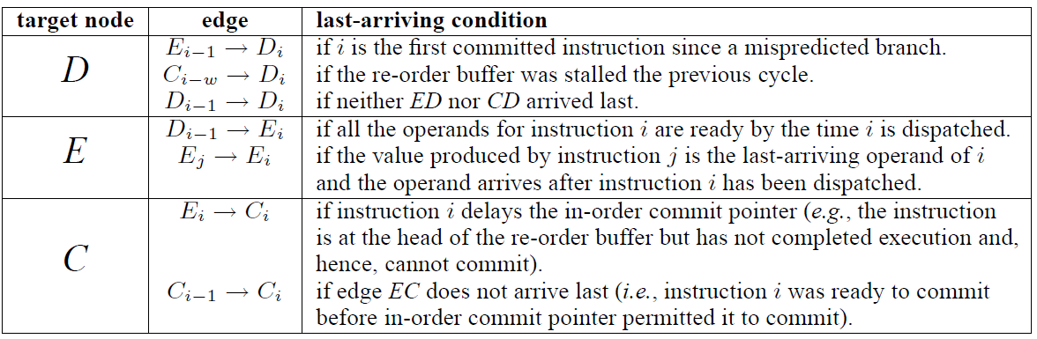
Determining the Last-Arriving Edge

Slide 42
Determining the Last-Arriving Edge

Slide 43
Determining the Last-Arriving Edge

Slide 44
Determining the Last-Arriving Edge

Slide 45
Determining the Last-Arriving Edge

Slide 46
Determining the Last-Arriving Edge

Slide 47
Determining the Last-Arriving Edge
Why not last arriving?

Slide 48
Determining the Last-Arriving Edge
Why not last arriving? E4 while waiting for C3

Slide 49
Determining the Last-Arriving Edge
Why not last arriving?

Slide 50
Need for Prediction
Method requires backward traversal
  Too expensive
How about an approximation
  Idea: sample each instruction for criticality
  Plant token
  Propagate token along last arriving edges → forward’
    If no outgoing last arriving edge token dies
  After a while check if token is alive
    Declare instruction as critical
    Approximation
    Forward propagation → easy

Slide 51
Determining the Last-Arriving Edge
Why not last arriving?

Slide 52
Determining the Last-Arriving Edge
Why not last arriving?

Slide 53
Determining the Last-Arriving Edge
Why not last arriving?

Slide 54
Determining the Last-Arriving Edge
Why not last arriving?

Slide 55
Determining the Last-Arriving Edge
Why not last arriving?

Slide 56
Determining the Last-Arriving Edge
Why not last arriving?

Slide 57
Determining the Last-Arriving Edge
Why not last arriving?

Slide 58
Determining the Last-Arriving Edge
Why not last arriving?

Slide 59
Determining the Last-Arriving Edge
Why not last arriving?

Slide 60
Determining the Last-Arriving Edge
Why not last arriving?

Slide 61
Determining the Last-Arriving Edge
Why not last arriving?

Slide 62
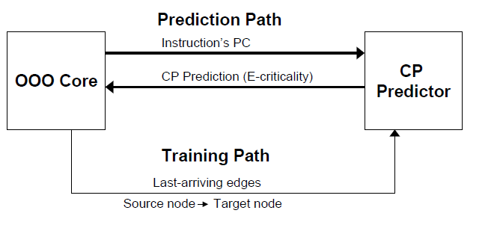
Predictor Organization

Slide 63
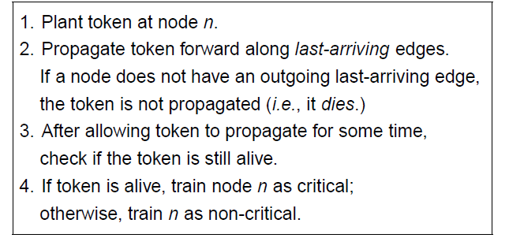
An Approximation

Slide 64
Plant Tokens at I4’s D, E, and C, propagate

Slide 65
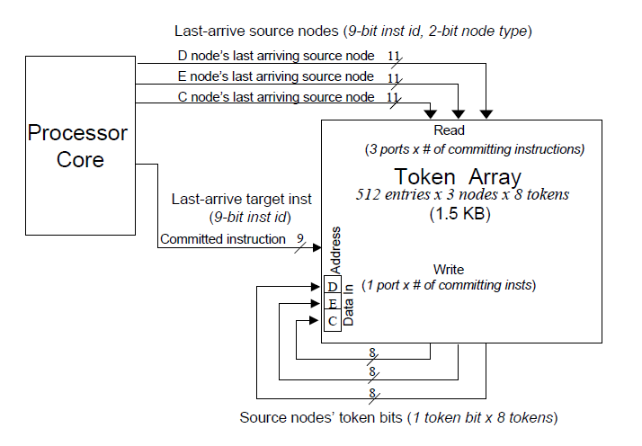
Implementation
2. Which were the last arriving
edges per node for the committed
Inst?
1. Inst commits
3. Read out the tokens from the
Source insts per node
4. Write them into this inst’s nodes

Slide 66
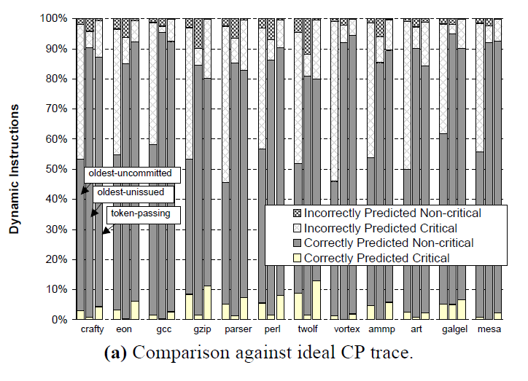
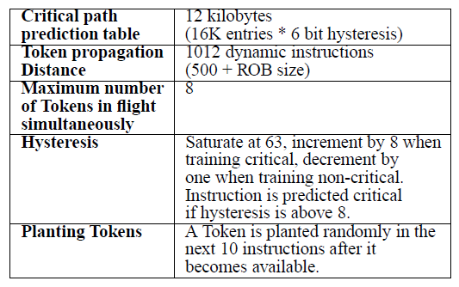
Accuracy

Slide 67
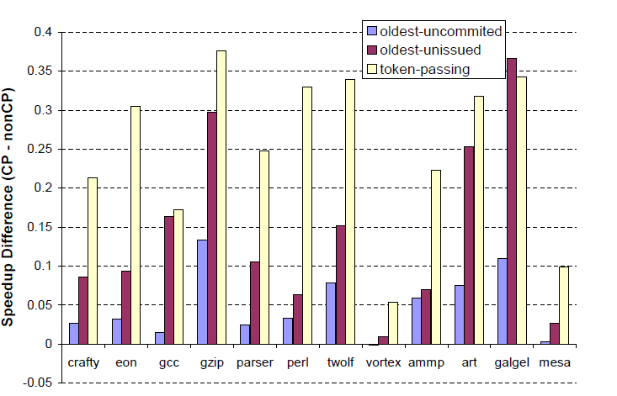
Performance
Assume originally all insts latencies + 1, reduce critical by 1

Slide 68
Application #1 – Focused Instruction Steering
Wire delays dominate – can’t build large windows
Solution: clusters
Cluster #1
FE
Cluster #2
Latency: 1 within cluster 2 inter-cluster
DEC’s Alpha 21264

Slide 69
Application #1 – Focused Instruction Steering
How would assign these?
Cluster #1
FE
Cluster #2
Latency: 1 within cluster 2 inter-cluster

Slide 70
Application #1 – Focused Instruction Steering
Clustering: no delay
Cluster #1
FE
Cluster #2
Latency: 1 within cluster 2 inter-cluster

Slide 71
Application #1 – Focused Instruction Steering
How about this? Assume not enough resources to place all in the same cluster
Cluster #1
FE
Cluster #2
Latency: 1 within cluster 2 inter-cluster

Slide 72
Application #1 – Focused Instruction Steering
Critical path matters
Cluster #1
FE
Cluster #2
Latency: 1 within cluster 2 inter-cluster

Slide 73
Application #1 – Focused Instruction Steering
Critical path matters
Cluster #1
FE
Cluster #2
Latency: 1 within cluster 2 inter-cluster

Slide 74
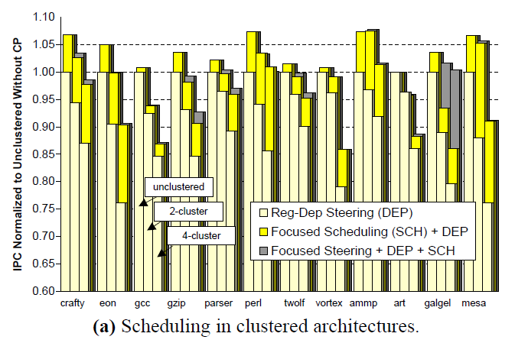
Focused Steering and Scheduling

Slide 75
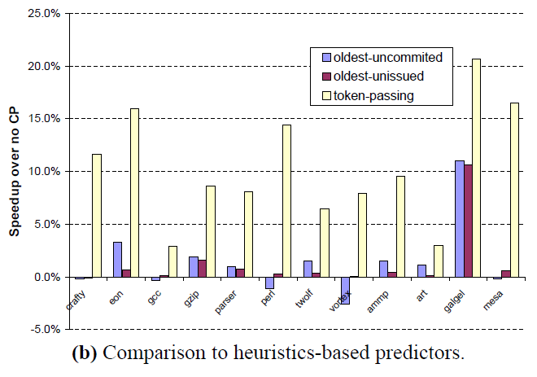
Comparison to heuristic-based Prediction

Slide 76
Value Prediction
Chain of dependent instructions
A
a
B
b
C
c
D
d
E
e

Slide 77
What if we predict outputs?
Chain of dependent instructions
A
a'
a
A
B
b
C
c
D
d
E
e

Slide 78
What if we predict outputs?
Chain of dependent instructions
A
a'
a
A
B
B
b
C
c
D
d
E
e

Slide 79
What if we predict outputs?
Chain of dependent instructions
A
a'
b'
d'
c'
a
A
B
C
D
E
B
b
C
c
D
d
E
e

Slide 80
What if we predict outputs?
Chain of dependent instructions
A
a'
b'
d'
c'
a
A
B
C
D
E
B
c''
e''
a
d''
b''
b
C
c
D
d
E
e

Slide 81
What if we predict outputs?
Chain of dependent instructions
A
a'
b'
d'
a
c'
A
B
C
D
E
B
a
d''
e''
b''
c''
b
C
==
==
==
==
c
D
d
E
e

Slide 82
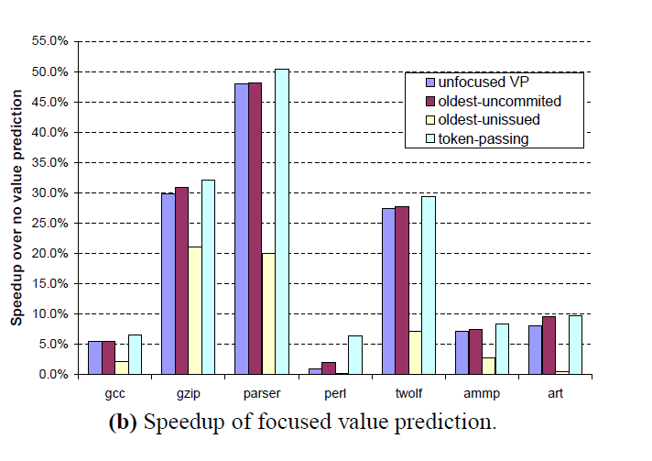
Application #2: Focusing Value Prediction

Slide 83
Virtual Physical Registers
Physical register names are used for two purposes
  Scheduling
  Communicating
A physical register is held much in advance than needed
  We need the register only after the value is produced
De-couple scheduling from communication names

Slide 84
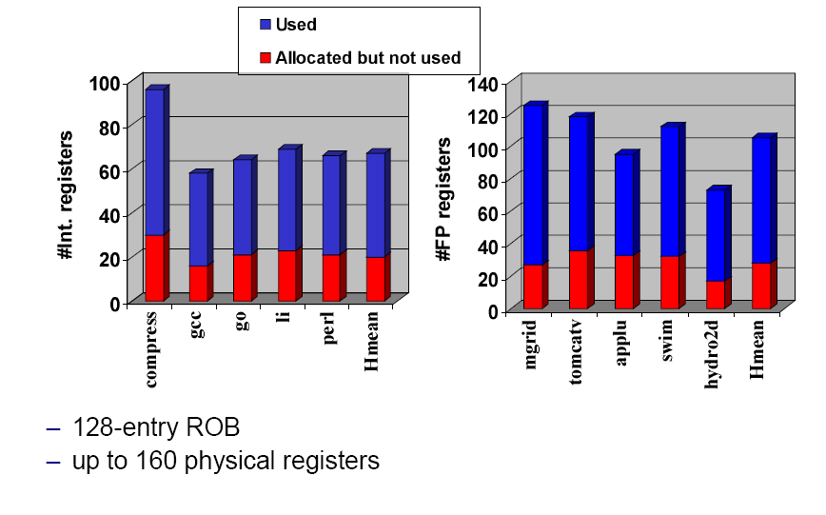
Used vs. Allocated Registers

Slide 85
Goal

Slide 86
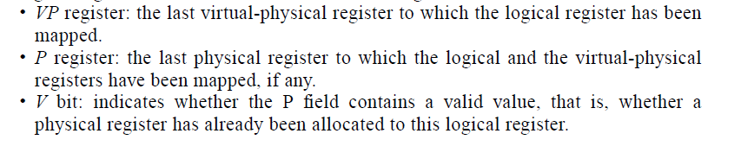
Virtual Physical Registers

Slide 87
Deadlock
Older instruction completes later than younger ones
  No registers available
Steal a register and re-execute

Slide 88
Performance vs. Physical Registers

