Slide 1
Out-of-Order Execution Structure
Optimizations

Slide 2
Tag Elimination

Slide 3
Conventional Schedulers are Overdesigned
For MIPS-like ISA
  Two source tags
  One destination tag
Not all instructions use two source operands
  E.g., addi $1, $2, 10
Not all instructions produce a result that is interesting for scheduling
  E.g., beq
Some operands are ready when the instruction enters the scheduler
Source: Efficient Dynamic Scheduling Through Tag Elimination, Dan Ernst and Todd Austin, ISCA 2002

Slide 4
Some Operands are Ready when the Instruction Enters the Scheduler

Slide 5
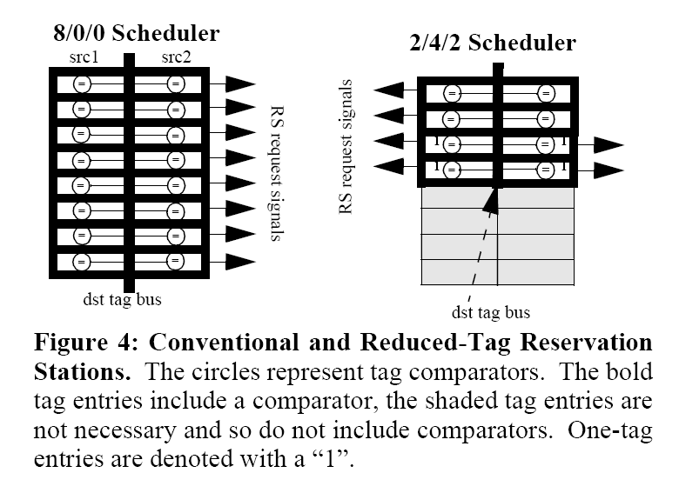
Window Specialization
Have reservation stations with different source operand wait capabilities

Slide 6
Window Specialization
At rename check how many source operands are not ready
If there is an appropriate slot proceed to schedule
If not, stall at rename
Advantages:
  Destination bus only runs over reservation stations with comparators
  Load on the destination bus is reduced
Disadvantages:
  Stalls due to unavailability of reservation stations
  Complexity of res. Station assignment

Slide 7
Window Specialization - Performance
Performance as IPC – Actual Clock Frequency not considered

Slide 8
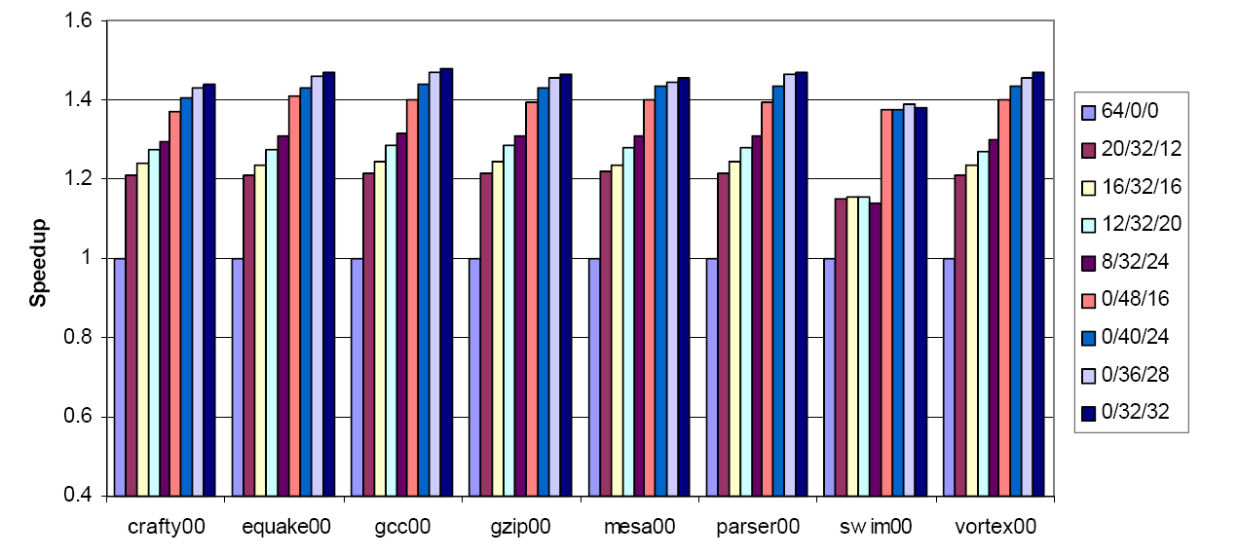
Window Specialization - Performance
Performance as IPC per ns

Slide 9
Last Tag Prediction
Observe:
  Instruction becomes ready after the last tag it waits for appears
Last Tag prediction
  Predict which of the two tags will that be
Speculatively execute
  Correct speculation: that was the last tag
  Incorrect speculation:
    Need to reschedule
    Detection? Try to read a value that is not available

Slide 10
GShare-Style Last Tag Prediction
Two-bit saturating counters

Slide 11
Accuracy
Over all instructions with two outstanding operands

Slide 12
Window Specialization - Performance
Predictive schedulers
Performance as IPC – Actual Clock Frequency not considered

Slide 13
Window Specialization - Performance
Performance as IPC per ns

Slide 14
Prescheduling
Data-flow prescheduling for large
instruction windows in out-of-order
processors
Pierre Michaud, André Seznec, HPCA 2001

Slide 15
Prescheduling
Predict latencies
Put scheduled instructions into a FIFO
Slide into a smaller window

Slide 16
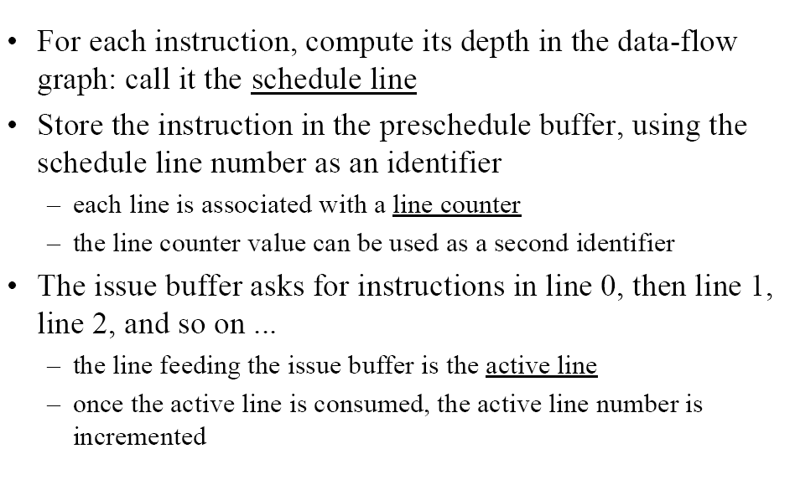
Prescheduling Method

Slide 17
Prescheduling Example

Slide 18
Latency Prediction

Slide 19
Latency Prediction Contd.

Slide 20
Broadcast Free Scheduler

Slide 21
Broadcast Free Scheduler
Cyclone design
  D. Ernst, A. Hamel, T. Austin
  ISCA 2003
Preschedule Instructions
Put them into a dual strip cyclical FIFO
Vertical paths allow for motion between the strips

Slide 22
Cyclone Architecture
Will be ready in cycle + 6

Slide 23
Cyclone Architecture – Cycle +1

Slide 24
Cyclone Architecture – Cycle + 2

Slide 25
Cyclone Architecture – Cycle + 3

Slide 26
Cyclone Architecture – Cycle + 4

Slide 27
Cyclone Architecture – Cycle + 5

Slide 28
Cyclone Architecture – Cycle + 6

Slide 29
Cyclone Architecture – Cycle + 6

Slide 30
Cyclone Architecture – Mis-scheduling
Estimate new latency

Slide 31
Pre-scheduler
Can only do two cascaded MAX calculations
Due to timing considerations
Insert instruction with predicted latency N at the front of the FIFO
Have it switch at N/2

Slide 32
Cyclone IPC Performance

Slide 33
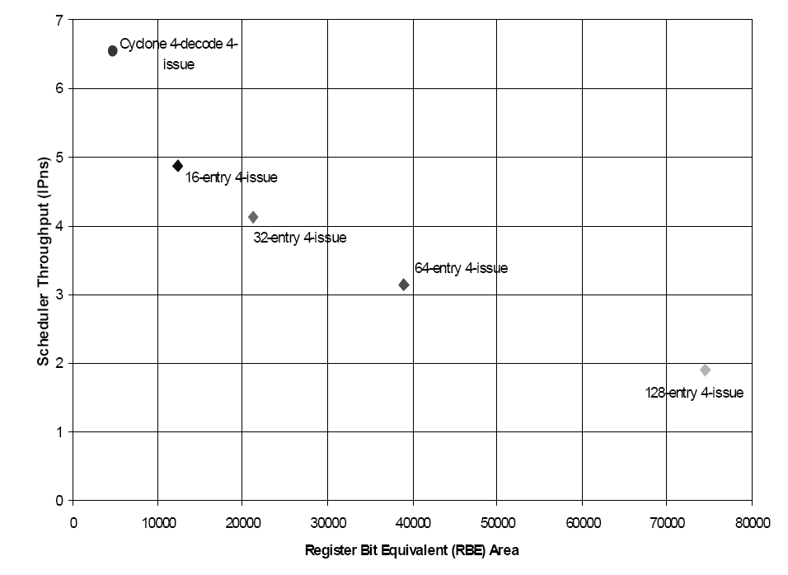
Cyclone True Performance and Area

Slide 34
Matrix Schedulers

Slide 35
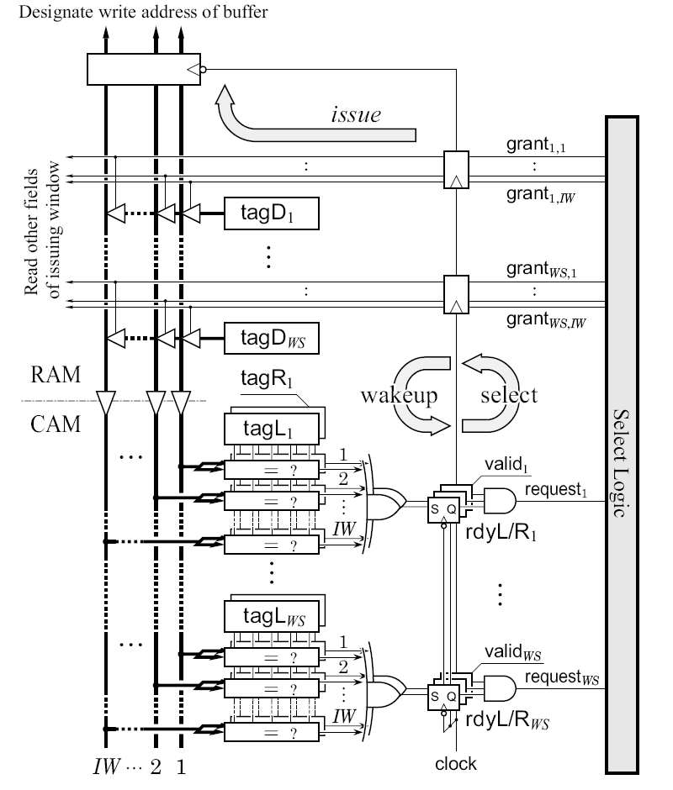
Conventional Scheduler
IW grants
WS requests

Slide 36
Conventional Scheduler Timing
A2
B1
B3
B1
Can’t pipeline without introducing
Bubbles between dependent
Instructions:
A2
Source: A High-Speed Dynamic Instruction Scheduling Scheme
for Superscalar Processors
Masahiro Goshima Kengo Nishino Yasuhiko Nakashima Shin-ichiro Mori
Toshiaki Kitamura Shinji Tomita
MICRO 2001
B3

Slide 37
Towards a Matrix Scheduler
Observe:
  In conventional scheduling dependences are discovered twice:
    Once at renaming
    Once during scheduling
  Why? Dependences are implicitly represented
    Producer and Consumer link via a name
    This is indirect
Matrix Scheduler idea:
  Represent dependences explicitly

Slide 38
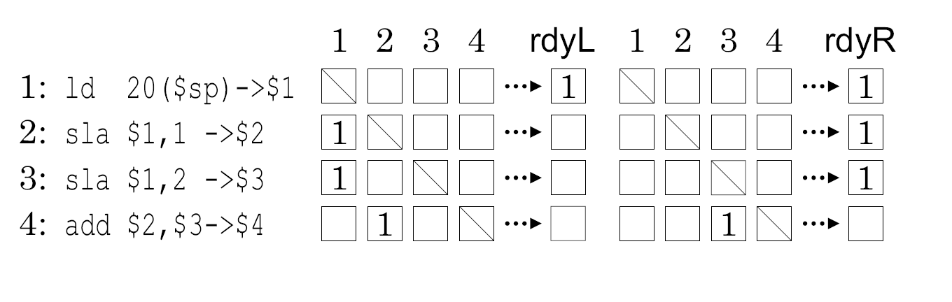
Dependence Matrix
Who do I depend upon?
Left source
Right source
Who am I

Slide 39
Matrix Scheduler
Write port
One cell
wakeup

Slide 40
Inserting an entry
Write port

Slide 41
Wakeup
wakeup

Slide 42
Mispeculation Recovery
Do not cleanup
Use external logic to inhibit request signals

Slide 43
Delay
0.18um
1.8V
85C
Partial wakeup lines

Slide 44
Delay measurement points

Slide 45
Scheduling Priorities

Slide 46
Conflict Resolution
More instructions ready than available issue slots
  Which get to go?
Age vs. Pseudo-Random Resolution
Age is important
Priority Enforcer picks the oldest
  Complex
Source:
Matrix Scheduler Reloaded
ISCA 2007

Slide 47
Compacting Scheduler
Implemented in the Alpha 21264
Physical order within scheduler corresponds to age
Entry freed:
  Shift up all younger entries

Slide 48
Critical Path Prediction
Focusing processor policies via critical-path prediction
B. Fields, S. Rubin and R. Bodik
ISCA 2001
some slides/content from the original presentation

Slide 49
Instruction Slack
Slack of an instruction:
  How long can we delay the instruction before performance decreases?
It’s zero only for instructions on the critical path
Can be used to tolerate latencies
Work motivation:
  Machines are non-uniform: time, power, etc.
  Need a control policy to tolerate the variance

Slide 50
Determining slack is hard
Microprocessors are complex:
Sometimes slack is determined by resources (e.g. ROB)
“Probe the processor” approach: Delay and observe
  Delay dynamic instruction by n cycles
  See if execution time increased
    No, increase n; restart; go to step 1
Srinivasan and Lebeck approximation, for loads (MICRO ’98)
  heuristics to predict execution time increase

Slide 51
Determining slack
  Alternative approach: Dependence-graph analysis
  Build resource-sensitive dependence graph
  Analyze to find slack
  But, how to build resource-sensitive graph?
Casmira and Grunwald’s solution (Kool Chips Workshop ’00)
Graphs only with instructions in issue window

Slide 52
Data-Dependence Graph
1
2
1
1
1
1
3
Slack = 0 cycles
Misses microarchitectural effects – limited window -- mispredictions

Slide 53
Data-Dependence Graph
Assume WS = 3
1. Can’t get to this
3.Or retiring this
2. Before fetching this
1
2
1
1
1
1
3
Slack = 0 cycles
Misses microarchitectural effects – limited window -- mispredictions

Slide 54
Our Dependence Graph Model (ISCA ‘01)
F
F
F
F
F
E
E
E
E
E
C
C
C
C
C
Slack = 0 cycles
F = Fetch synonymous to D = Dispatch in the paper

Slide 55
Our Dependence Graph Model (ISCA ‘01)
0
10
0
1
F
F
F
F
F
1
1
1
1
1
1
2
1
1
1
1
E
E
E
E
E
1
1
3
1
1
1
C
0
C
1
C
0
C
1
C
Slack = 6 cycles
Modeling resources increases observable slack

Slide 56
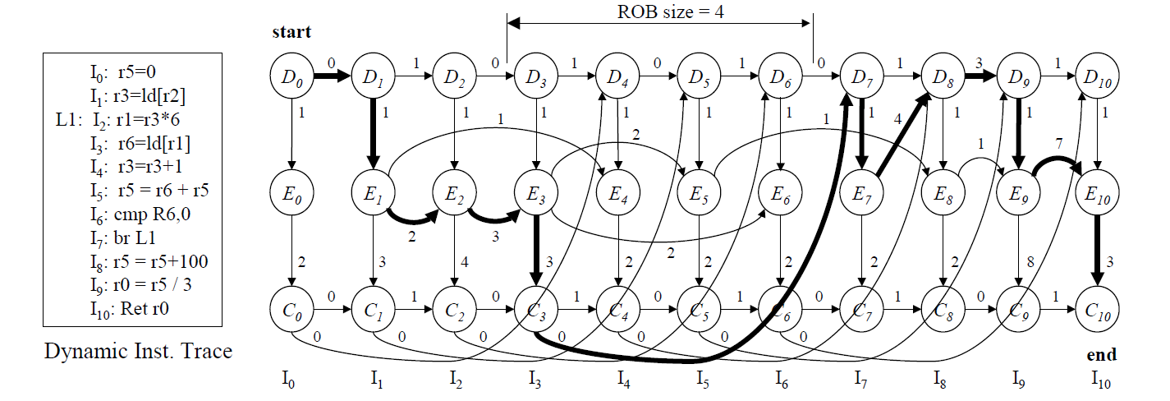
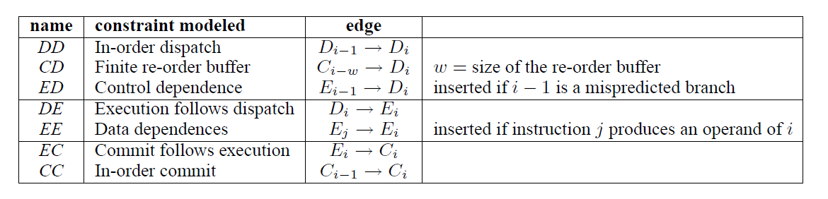
An Example
Wrong path not modeled → validation shows this is an OK approximation

Slide 57
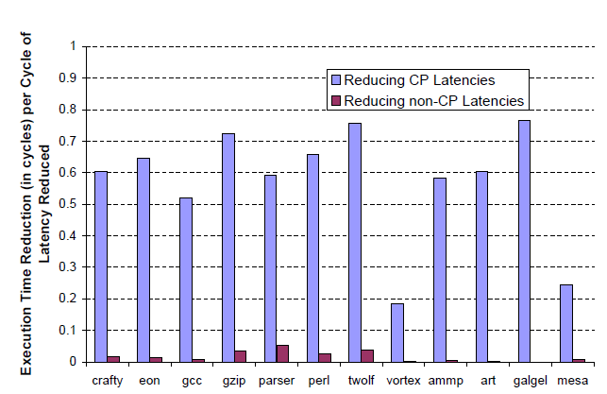
Validating the Model

Slide 58
Criticality Breakdown Cases
ROB full ROB Empty
  (1) Exec/Not Committed:
  (2) Executing:
I_(n)
oldest
I_(n-1)
I_(0)
I_(0)
fetching

Slide 59
Criticality Breakdown
Commit non-critical:
  sits in ROB while there is an ROB stall
  Some other CD edge is critical
  Even if this commits a younger instruction will keep the ROB full long enough to be in the critical path
Execute non-critical:
  Another EE edge is more critical

Slide 60
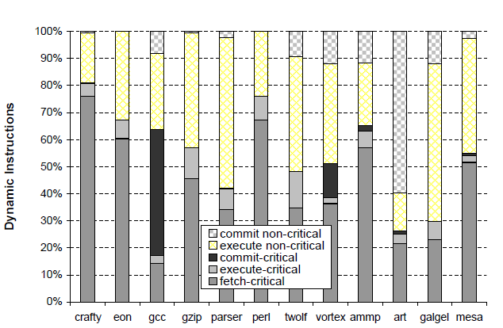
Criticality Breakdown

Slide 61
Determining the Critical Path
All we have to do is observe the order in which edges arrive
Last-arriving edge per instruction:
  Only these can be part of the critical path
What’s the critical path:
  Start at the last instruction
  Traverse backward following last-arriving edges
This is precise but requires keeping all instructions
How about an approximation?

Slide 62
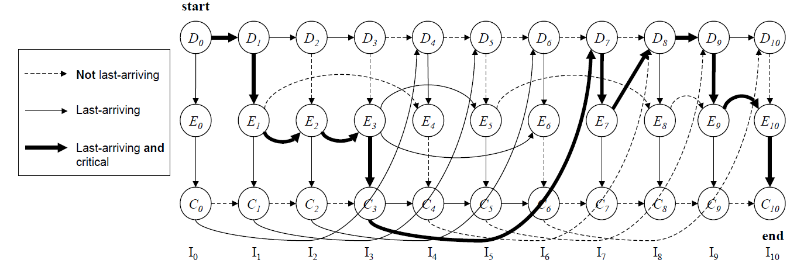
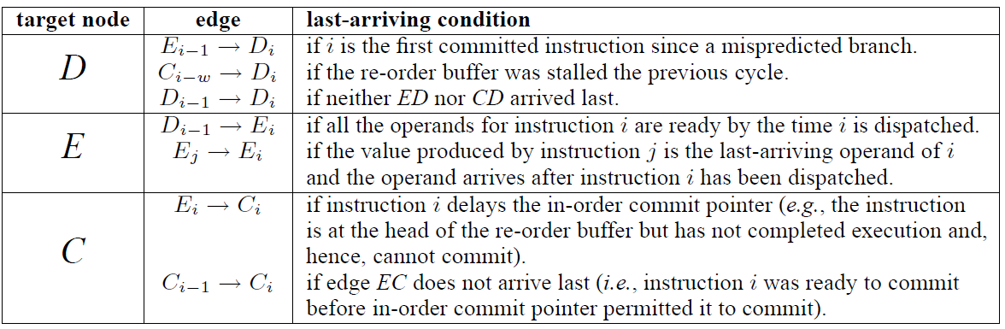
An Example

Slide 63
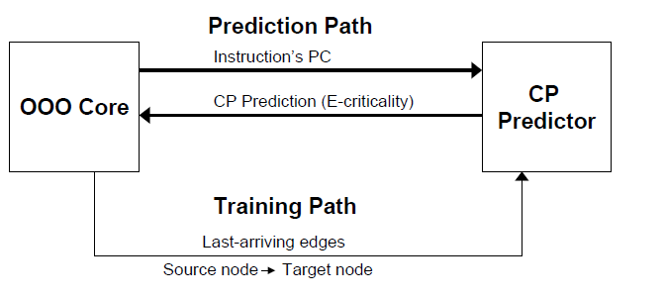
Organization

Slide 64
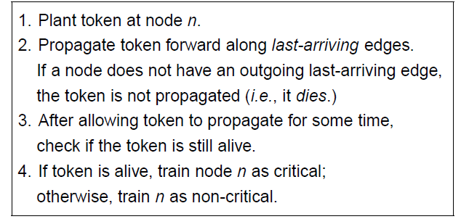
An Approximation

Slide 65
An Example

Slide 66
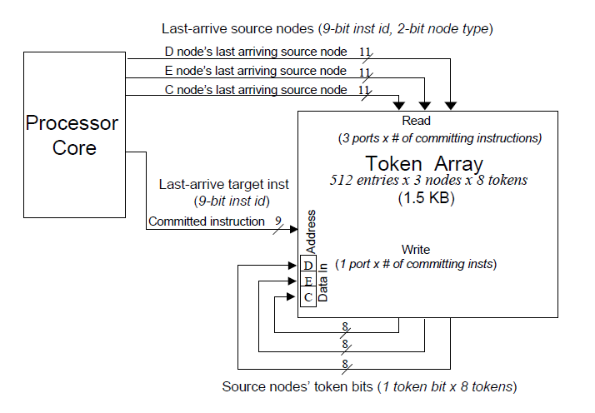
Implementation
2. Which were the last arriving
edges per node
1. Inst commits
3. Read out the tokens from the
Source insts per node
4. Write them into this inst’s nodes

Slide 67
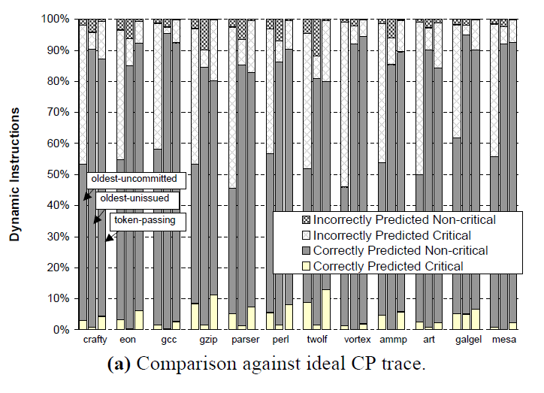
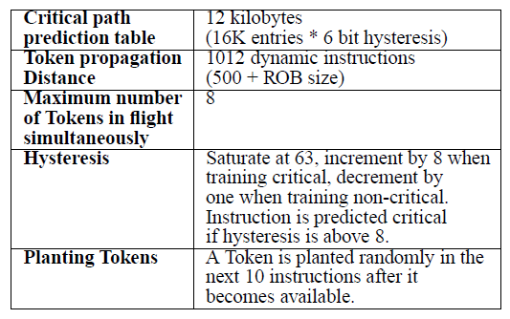
Accuracy

Slide 68
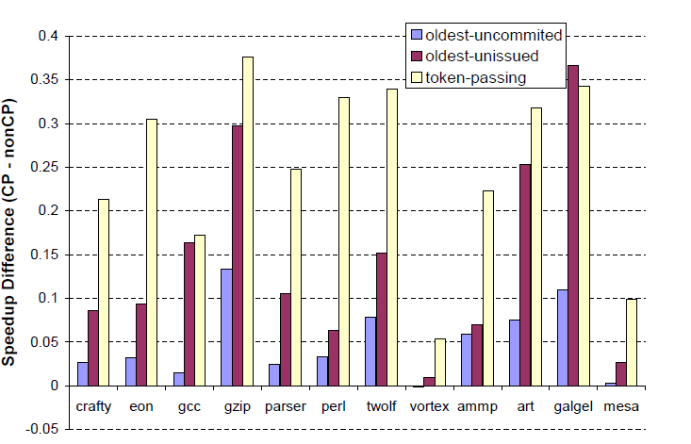
Performance
Assume originally all insts latencies + 1, reduce critical by 1

Slide 69
Application #1 – Focused Instruction Steering
Wire delays dominate – can’t build large windows
Solution: clusters
Cluster #1
FE
Cluster #2
Latency: 1 within cluster 2 inter-cluster
DEC’s Alpha 21264

Slide 70
Application #1 – Focused Instruction Steering
How would assign these?
Cluster #1
FE
Cluster #2
Latency: 1 within cluster 2 inter-cluster

Slide 71
Application #1 – Focused Instruction Steering
Clustering: no delay
Cluster #1
FE
Cluster #2
Latency: 1 within cluster 2 inter-cluster

Slide 72
Application #1 – Focused Instruction Steering
How about this? Assume not enough resources to place all in the same cluster
Cluster #1
FE
Cluster #2
Latency: 1 within cluster 2 inter-cluster

Slide 73
Application #1 – Focused Instruction Steering
Critical path matters
Cluster #1
FE
Cluster #2
Latency: 1 within cluster 2 inter-cluster

Slide 74
Application #1 – Focused Instruction Steering
Critical path matters
Cluster #1
FE
Cluster #2
Latency: 1 within cluster 2 inter-cluster

Slide 75
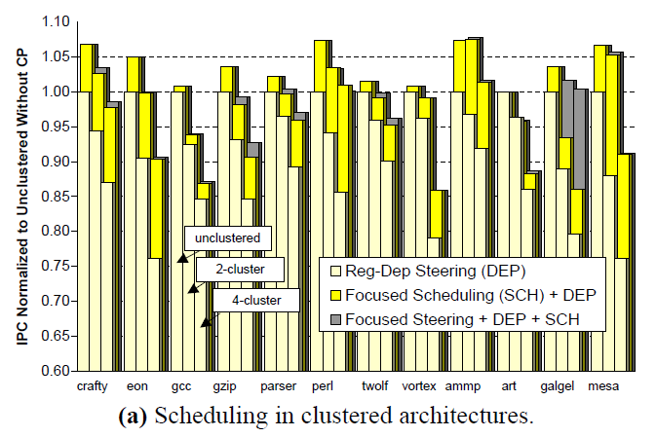
Focused Steering and Scheduling

Slide 76
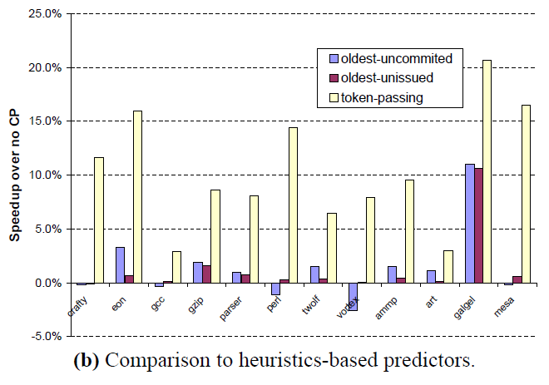
Comparison to heuristic-based Prediction

Slide 77
Value Prediction
Chain of dependent instructions
A
a
B
b
C
c
D
d
E
e

Slide 78
What if we predict outputs?
Chain of dependent instructions
A
a'
a
A
B
b
C
c
D
d
E
e

Slide 79
What if we predict outputs?
Chain of dependent instructions
A
a'
a
A
B
B
b
C
c
D
d
E
e

Slide 80
What if we predict outputs?
Chain of dependent instructions
A
a'
b'
d'
c'
a
A
B
C
D
E
B
b
C
c
D
d
E
e

Slide 81
What if we predict outputs?
Chain of dependent instructions
A
a'
b'
d'
c'
a
A
B
C
D
E
B
c''
e''
a
d''
b''
b
C
c
D
d
E
e

Slide 82
What if we predict outputs?
Chain of dependent instructions
A
a'
b'
d'
a
c'
A
B
C
D
E
B
a
d''
e''
b''
c''
b
C
==
==
==
==
c
D
d
E
e

Slide 83
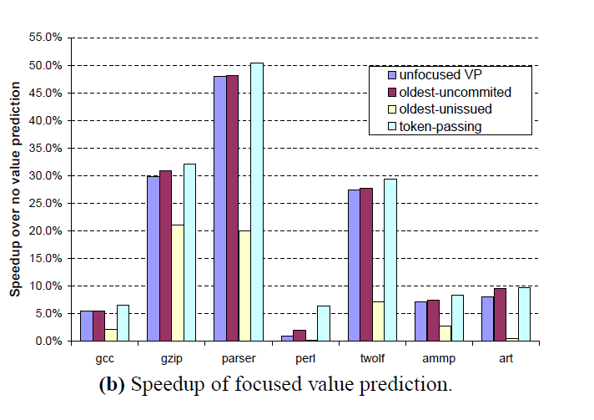
Application #2: Focusing Value Prediction

Slide 84
Virtual Physical Registers
Physical register names are used for two purposes
  Scheduling
  Communicating
A physical register is held much in advance than needed
  We need the register only after the value is produced
De-couple scheduling from communication names

Slide 85
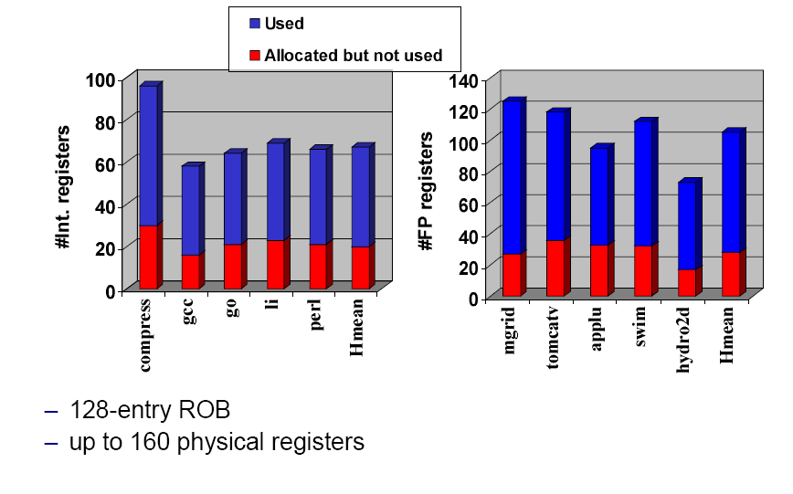
Used vs. Allocated Registers

Slide 86
Goal

Slide 87
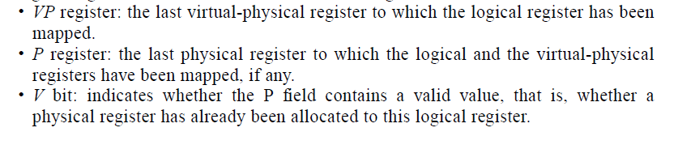
Virtual Physical Registers

Slide 88
Deadlock
Older instruction completes later than younger ones
  No registers available
Steal a register and re-execute

Slide 89
Performance vs. Physical Registers

