Slide 1

Introduction of CGRA and its Framework
DATE2024 ET03 Embedded Tutorial:
Coarse-Grained Reconfigurable Arrays: Modelling and Exploration
Using the Open-Source CGRA-ME Framework
Kentaro Sano
RIKEN Center for Computational Science, Japan

Slide 2
Coarse-Grained
Reconfigurable Array (CGRA)
Architecture for reconfigurable
data-flow computing
  Composed of an array of processing elements (PEs),
  where we can map DFGs for computing
  Provide a word-wise reconfigurability (e.g., 32-bit)
  Higher energy efficiency than FPGAs (of bit-level)
  Performance close to ASIC-based accelerators
Application area of CGRAs
  Traditionally, targeted for lower-power
  embedded apps, e.g., image processing
  Recently, expected for AI and HPC
Comparison with other architectures [1]
General structure of the CGRAs [2]
[1] Liu, Leibo, et al. "A survey of coarse-grained reconfigurable architecture and design: Taxonomy, challenges, and applications." ACM Computing Surveys (CSUR) 52.6 (2019): 1-39.
[2] Takuya Kojima, et al., "Exploration Framework for Synthesizable CGRAs Targeting HPC: Initial Design and Evaluation," Procs. CGRA4HPC, May 30-June 3, 2022.
Notes:
Coarse-Grained reconfigurable architecture, or CGRA, is a candidate for future architecture and gets a lot of attention from industry as well as academia.
That’s why today‘s workshop is held.
The main component is an array of processing elements, PEs.
The application of CGRAs is represented as a data flow graph like this figure.
It is mapped onto the array, and dependent PEs are routed using an interconnection network by a mapping tool.
We can say the CGRA has word-level reconfigurability like thirty-two bit, which is much coarser than the bit-level one of FPGAs.
So, the overheads for the reconfiguration are smaller, and also, the CGRA provides us a near-ASIC performance.

Slide 3
Why are CGRAs Promising?

Slide 4
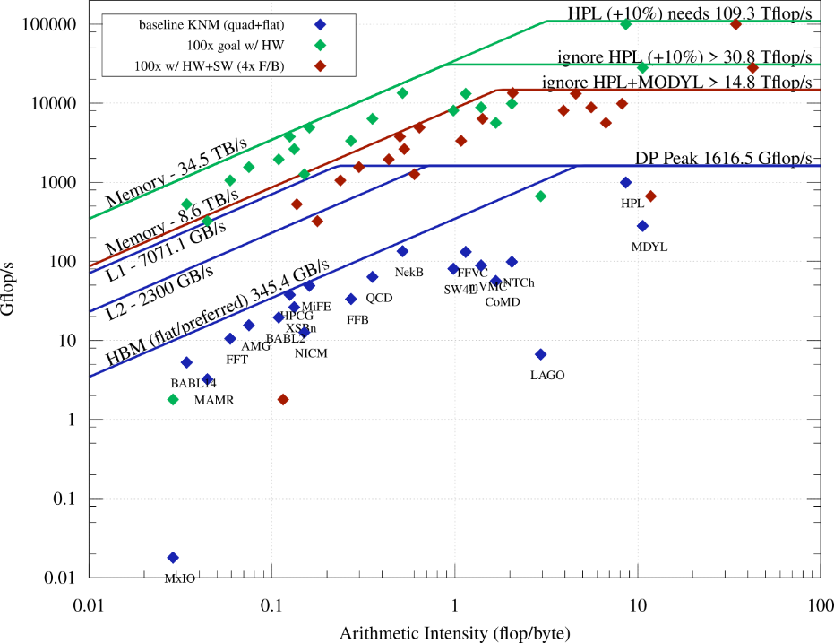
HPC Performance Requirement in Roofline Model
Roofline model
  Peak performance available
  according to operation-data ratio
  Memory-bound or
  Compute-bound
Performance [GFlop/s]
Some are
compute-bound.
Most of HPC applications
are memory-bound.
Arithmetic intensity [Flop/Byte]
Roofline mode of Intel Xeon Phi Knights Mill (KNM)

Slide 5
HPC Performance Requirement in Roofline Model
Roofline model
  Peak performance available
  according to operation-data ratio
  Memory-bound or
  Compute-bound
GPUs can cover
memory-bound applications.
What architecture should
be applied to compute-bound?
  Higher compute density
  Higher performance per power
Martix/
Tensor
???
100
Compute-bound
10
GPUs
Performance [TFlop/s]
HBM or 3D stacked memory
1
Memory-bound
LPDDR
High-end
CPUs
0.1
0.01
0.001
0.01
0.1
0.2~0.5
1
10
Arithmetic intensity [Flop/Byte]
Roofline model for different performance characteristics

Slide 6
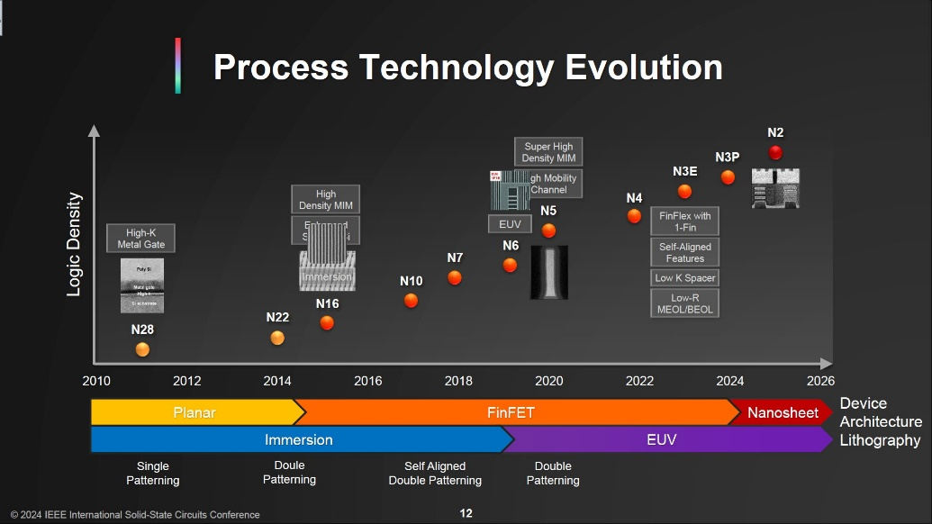
Semiconductor Scaling Continues...
TSMC,
ISSCC 2024
We’ll have more computing elements available on a chip.

Slide 7
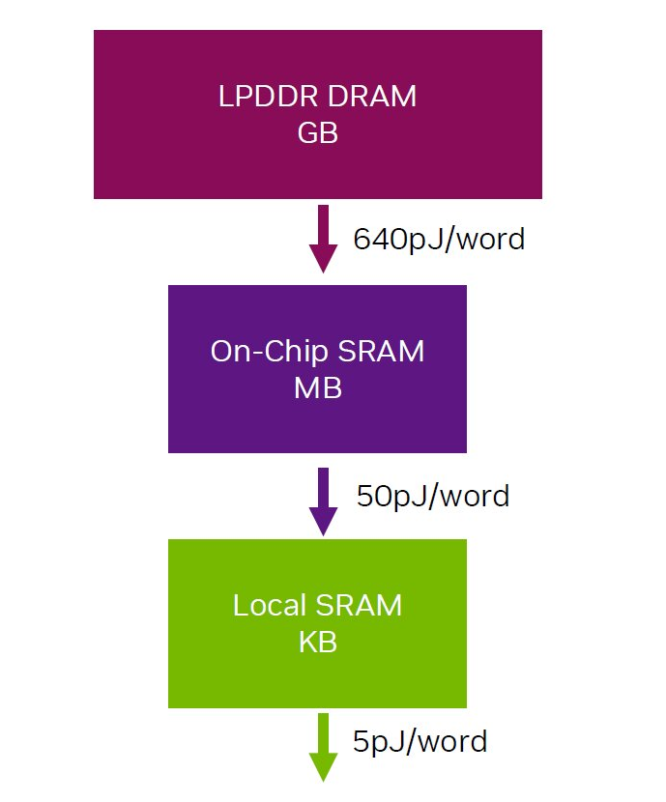
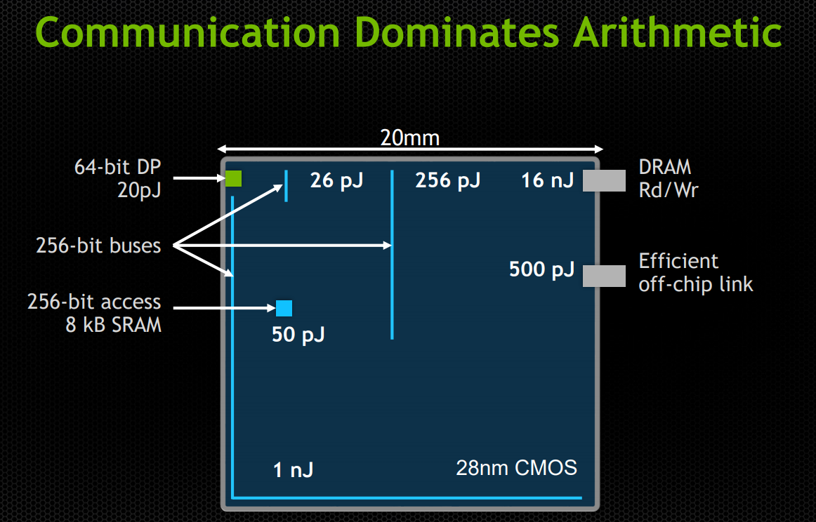
Data-movement Consumes More Power.
Bill Dally,
HotChips 2023
Source: NVIDIA
Need to reduce data-movement distance and off-chip memory accesses.

Slide 8
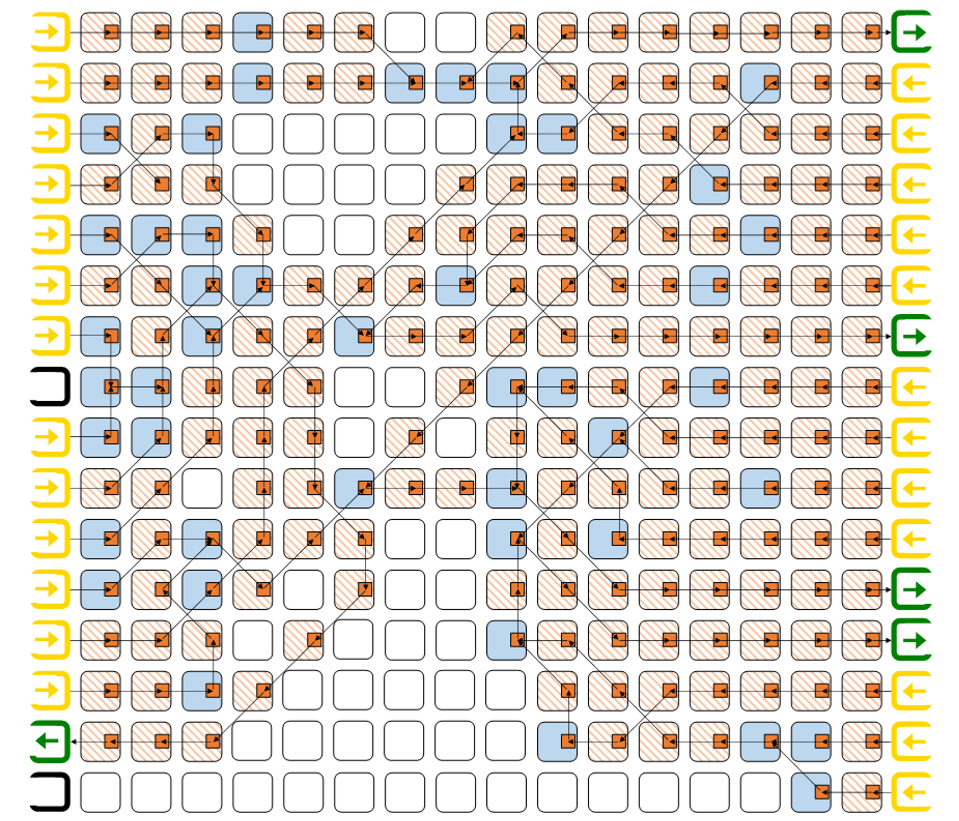
CGRA: Promising for Power-Efficient Dense Computing
Requirement
  High performance for Compute-bound workload
  High power efficiency w/ less data movement
  Programmable : More coverage of applications
CGRA can have:
  More operators by non-Neumann architecture
    Spatial parallelism
    Temporal parallelism (= pipelining)
  Localized data-movement
  by data-flow computing in an array
    And less off-chip memory access per compute
  Reconfigurability for various applications
Localized data-movement in data-flow graph
mapped onto CGRA

Slide 9
CGRA and CGRA-like Processors
Artur Podobas, Kentaro Sano, and Satoshi Matsuoka, "A Survey on Coarse-Grained Reconfigurable Architectures from a Performance Perspective," IEEE Access, Vol.8, pp.146719-146743, DOI:10.1109/ACCESS.2020.3012084, 2020.
https://ieeexplore.ieee.org/document/9149601
A. EARLY PIONEERING CGRAS (1997-2005)
  Garp, CHESS, Raw, REMARC, RaPiD, MATRIX, MorphoSys, Chimera, PipeRench, DReAM, Imagine,
B. MODERN COARSE-GRAINED RECONFIGURABLE ARCHITECTURES (2005-2015+)
  ADRES, SRP, UL-SRP, DRAA, DySER, TRIPS/EDGE, AMIDAR, MORA, CGRA Express, PPA, SIMD RA, SmartCell, Butter, SCREMA, BitRC, FloRA, TRANSPIRE, PRET-driven CGRA, SPU, Softbrain, Chameleon, SiLago
C. LARGER CGRAS
  eXtreme Processing Platform (XPP), HiPReP, WaveScalar, Tartan, EGRA, SGMF, REMUS, DRP-1, DAPDNA-2, IMAPCAR, RHyMe/REDEFINE, Plasticine, Riken High-Performance CGRA, Cereberas Wafer Scale Engine, SambaNova
D. LINEAR-ARRAYS AND LOOP-ACCELERATORS
  VEAL, BERET, SEED
E. DEEP LEARNING CGRAS
  DT-CGRA, SCNN, Eyeriss deep learning inference engine, Versal
F. LOW-POWER CGRAS
  Cool Mega-Array (CMA-1/2), SYSCORE, i-DPs, UL-SRP, IPA, X-CGRA
G. OVERLAYS: CGRAS ON-TOP OF FPGAS
  QUKU, ZUMA, vFPGA, CREMA, AVATAR, MIN overlay, VectorBlox MXP, READY, SALU, VDR, RALU, reMORPH, QuickDough, Mesh-of-FUs, TILT array, URUK, CGRA-ME,

Slide 10
CGRA-ME:
Framework for CGRA Exploration

Slide 11
Overview of CGRA-ME
CGRAs have various design choices to be widely explored.
CGRA-ME
  Open-source modelling and exploration framework for CGRA architecture and CAD exploration
  Developed by Jason Anderson’s group @ Toronto U – Original publication: ASAP’17
Objectives
  Allow an architect to model a wide range of CGRA architectures via a C++ API
  Allow an application, described in a high-level language, to be mapped onto the modelled CGRA
  Simulation and verification of application on modelled CGRA
  Physical realization of the CGRA as an ASIC or FPGA overlay
  High-level area, performance, and power modelling of the CGRA for an application

Slide 12
RIKEN CGRA Project using CGRA-ME

Slide 13
RIKEN CGRA Project
Objective:
Design-space exploration to find appropriate CGRA architecture for HPC
What we need to know/explore?
  Benchmarks
    Benchmarks selection & requirement analysis
    Performance evaluation
  Architecture Explorations
    Design & Architecture Exploration
    Compiler (Front-end & Mapper) support
  Evaluation
    Peak Theoretical performance
    Benchmark performance
    ASIC Implementation (area, power, frequency, etc.)
CGRA-ME to the rescue!

Slide 14
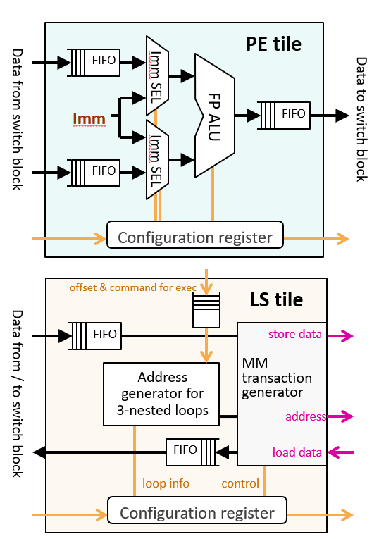
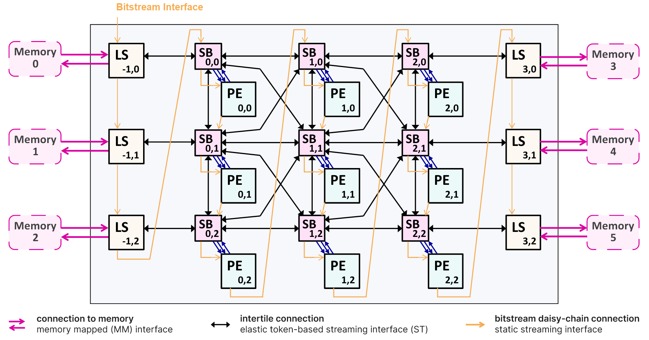
Baseline RIKEN CGRA Architecture Overview
HPC-oriented CGRA with the following design philosophy:
  Stream Computing Model: Isolation between computation in a PE array and memory access with load-and-store (LS) tiles
  Modular design for design space exploration with various architecture configuration and sizes
  Capability of floating-point operations and OpenMP support for HPC applications
B. Adhi, C. Cortes, Y. Tan, T. Kojima, A. Podobas and K. Sano, "The Cost of Flexibility: Embedded versus Discrete Routers in CGRAs for HPC," 2022 IEEE International Conference on Cluster Computing (CLUSTER), Heidelberg, Germany, 2022, pp. 347-356, doi: 10.1109/CLUSTER51413.2022.00046.
Notes:
For that purpose, we develop a CGRA architecture and also an evaluation framework for HPC-oriented CGRA design space exploration.
RIKEN CGRA is an architecture of HPC-oriented CGRA based on 3 key aspects.
3 aspects
With our framework we explored several CGRA design space such as >>>

Slide 15
CGRA Design-Choices Explored
Baseline Design
  Template based CGRA for HPC [ASAP 2020]
  Evaluation Framework [RECONF 2021, IPDPSW 2022 CGRA4HPC]
Intra-CGRA interconnect optimization
  Embedded router v.s. discrete router [CLUSTER 2022]
  Reduced-complexity interconnect [FPT 2022, IPDPSW 2023 CGRA4HPC]
  Compute vs. Connection density [HEART 2023]
CGRA-Memory interaction behavior
  CGRA on different memory type: HBM, DDR4, etc. [ASAP 2020]
  Pending reads vs. memory latency [IPDPSW 2022 CGRA4HPC]
Transcendental computation support on CGRA -> Today’s case study!
  Extending CGRA for Complex HPC Computations [IPDPS 2024]

Slide 16
Extending CGRA for Complex HPC Computations
Issue
  Only basic arithmetic operators available (such as FMA) in typical CGRA
  Some HPC kernels require complex functions, e.g., log, exp, sqrt, and sin/cos/tan (transcendental functions)
Possible solution
  Soft-core approach using in-fabric FMAs >> poor accuracy with limited resources
  Hard-macro IPs for complex functions in PEs >> such IP blocks are huge! some functions rarely utilized
Question: What is the best mix for FMAs and hard-macro IPs in Heterogenous CGRA?
Objective and approach
  To find it, we have designed and explored potential layout of heterogeneous CGRA.
  Evaluating mapping tolerance and PPA analysis of various layouts against HPC workloads
How CGRA-ME help us:
  Modelling various PEs (only FMA, mixed with complex hard-IP), and various heterogeneous layout of CGRA
  Allowing to map benchmarks to those CGRAs
  Check our presentation on IPDPS 2024, May 27-31!

Slide 17
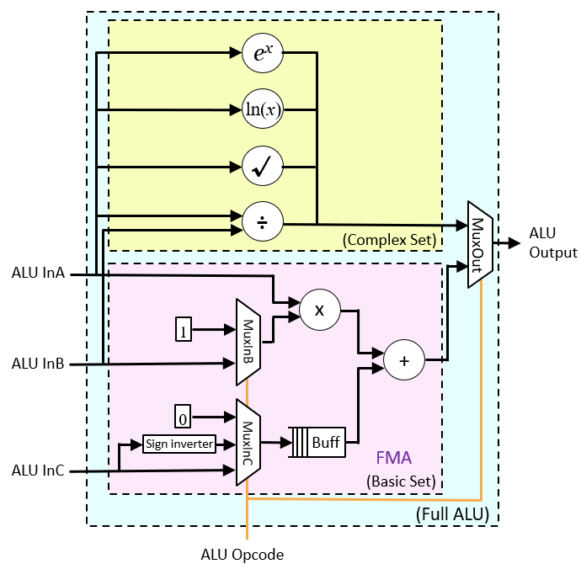
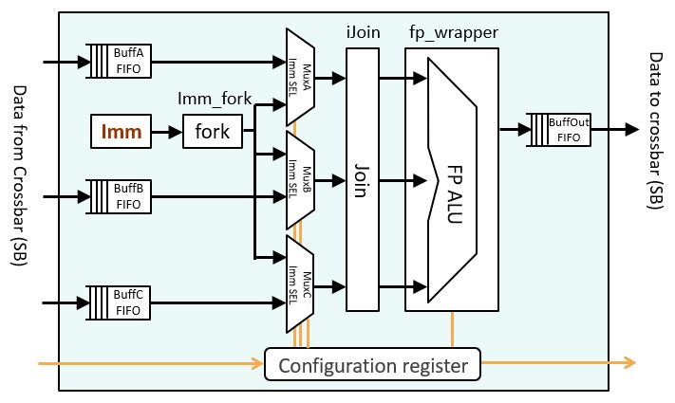
PE with Extended ALU
Implemented with:
  CGRA-ME Primitives
  Custom Logic
  FloPoCo IP cores
Elastic PE with FMA and Complex ALU
FP ALU with hard-macro IP cores

Slide 18
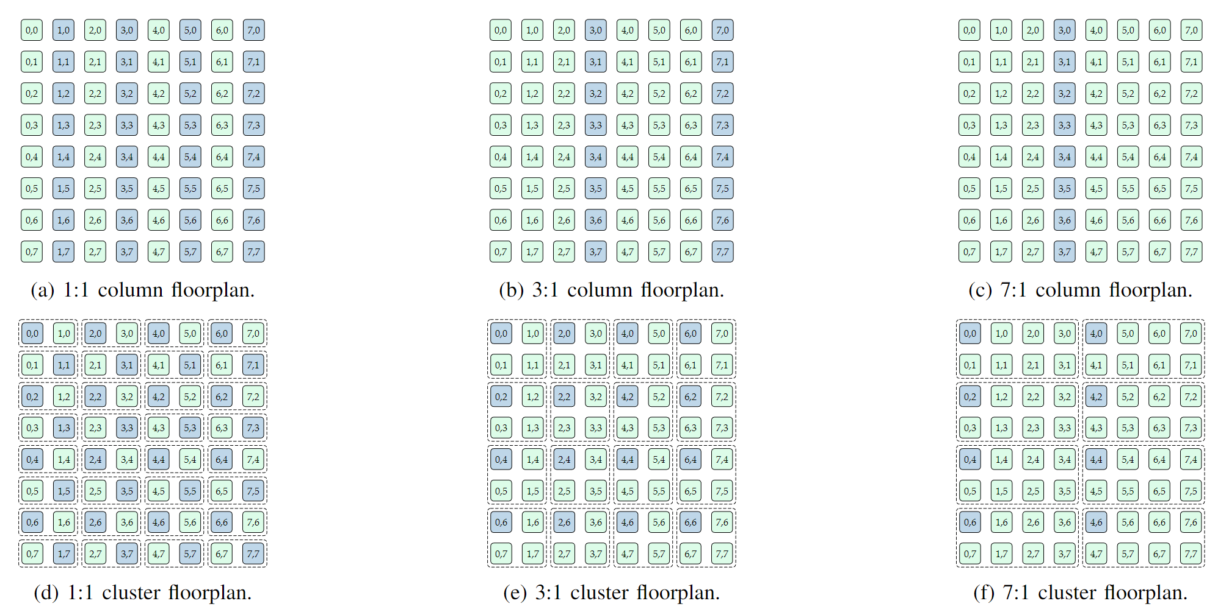
Heterogeneous CGRA Layout Evaluation
Various layouts with different ratios of normal and extended PEs are modelled by CGRA-ME.

Slide 19
Summary
CGRA: Reconfigurable data-flow computing
  Covering a wide range of applications by reconfigurability
  High performance per power for compute-bound applications with less data movement
    Spatial and temporal parallelism with pipelining
CGRA-ME: Open-source modelling and exploration framework for CGRA
  Verilog code generation of modelled CGRAs
  Mapper for modeled CGRAs – allowing rapid evaluation for benchmarks
  Rapid evaluation for various CGRA designs
RIKEN CGRA project using CGRA-ME
  Modeling CGRAs for HPC with various design choices
  Behavior simulation & verification for benchmark problems
  ASIC PPA evaluation with generated RTL codes
  FPGA based emulation

Slide 20
Backup slides

Slide 21
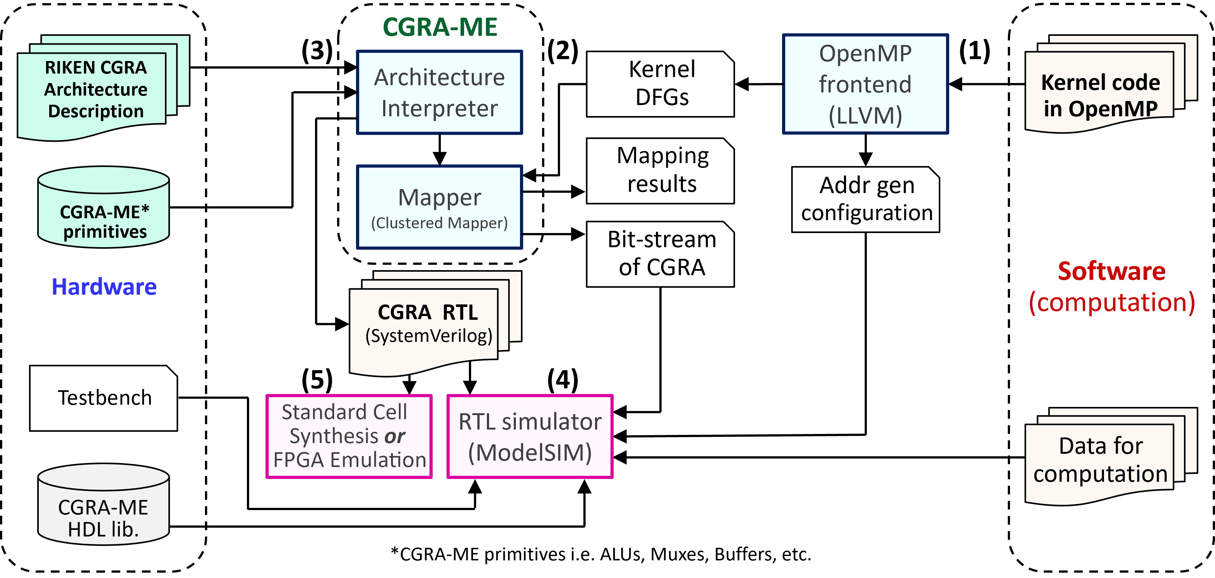
RIKEN CGRA Modelling in CGRA-ME

