Slide 1
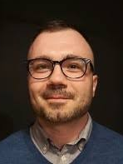
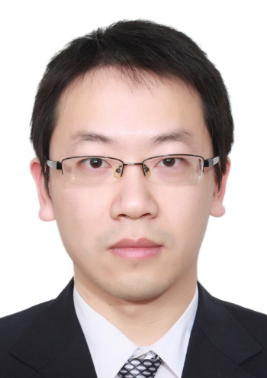
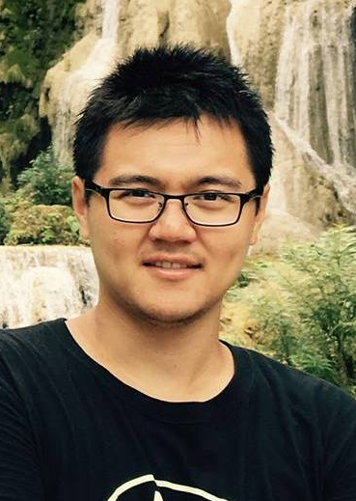
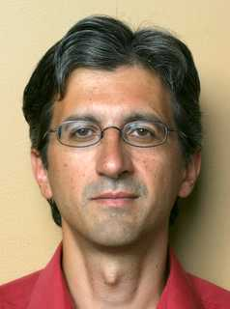
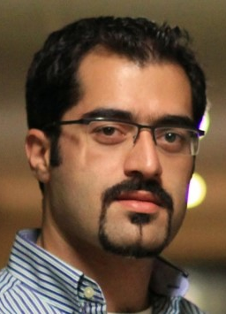
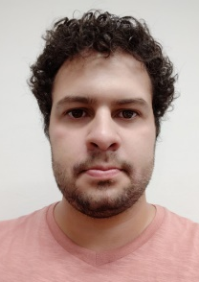
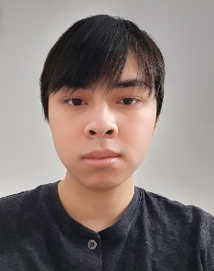
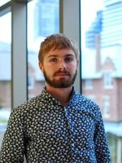
Extending the Impact of Computational Imaging Beyond Phone Cameras: Fast Pixel-Programmable Image Sensors - the “FPGAs” of the Image Sensors World
Roman
Genov
Kyros
Kutulakos
Rahul
Gulve
Navid
Sarhangnejad
N. Katic, Z. Xia, M. Wei, D. Ngyen, M. AlSakr, N. Gusev, R. Silva, F. Sun, A. Barman
… and many other team members
University of Toronto
Notes:
My name is Roman Genov and it is my pleasure to present some of the latest results of our work at the University of Toronto on

Slide 2
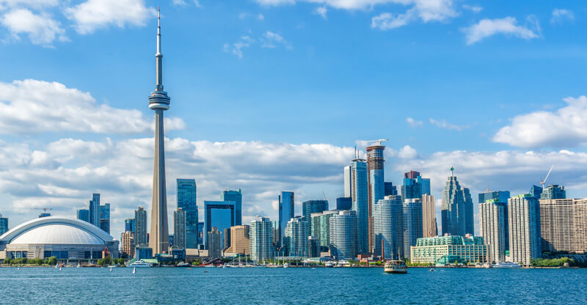
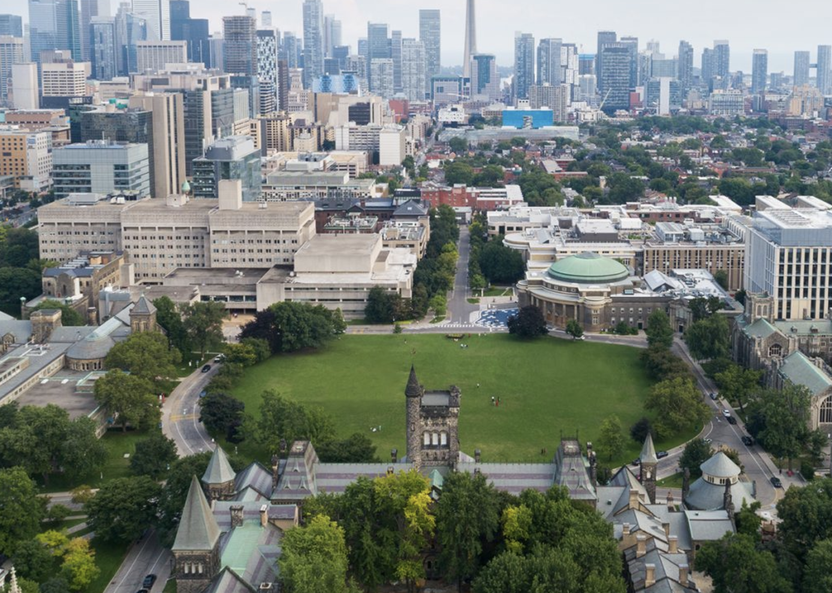
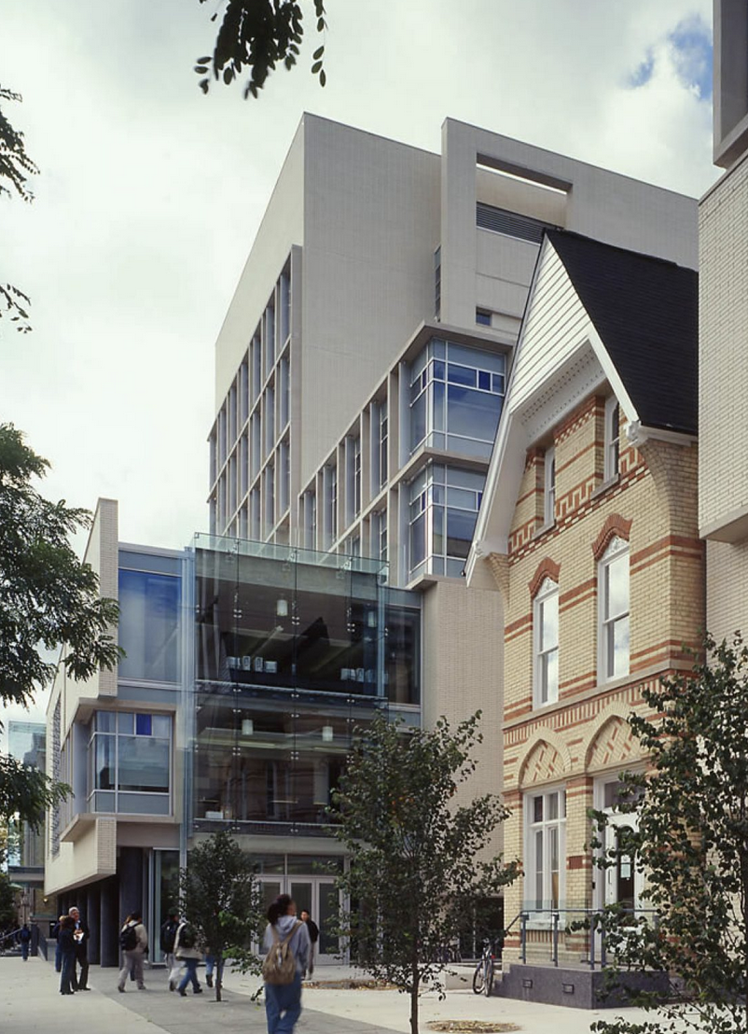
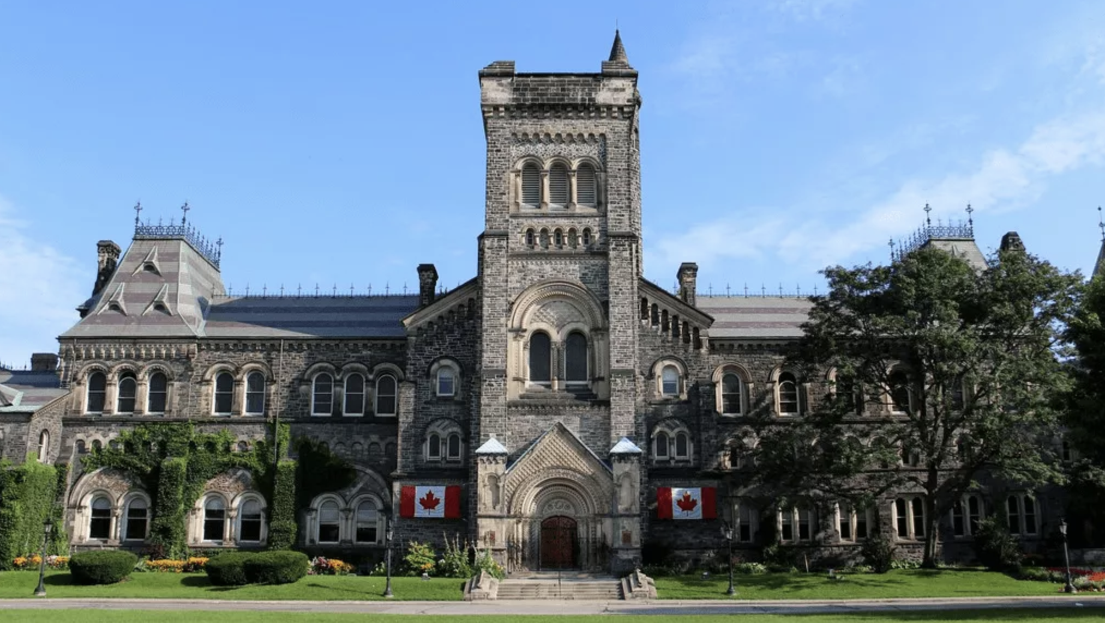
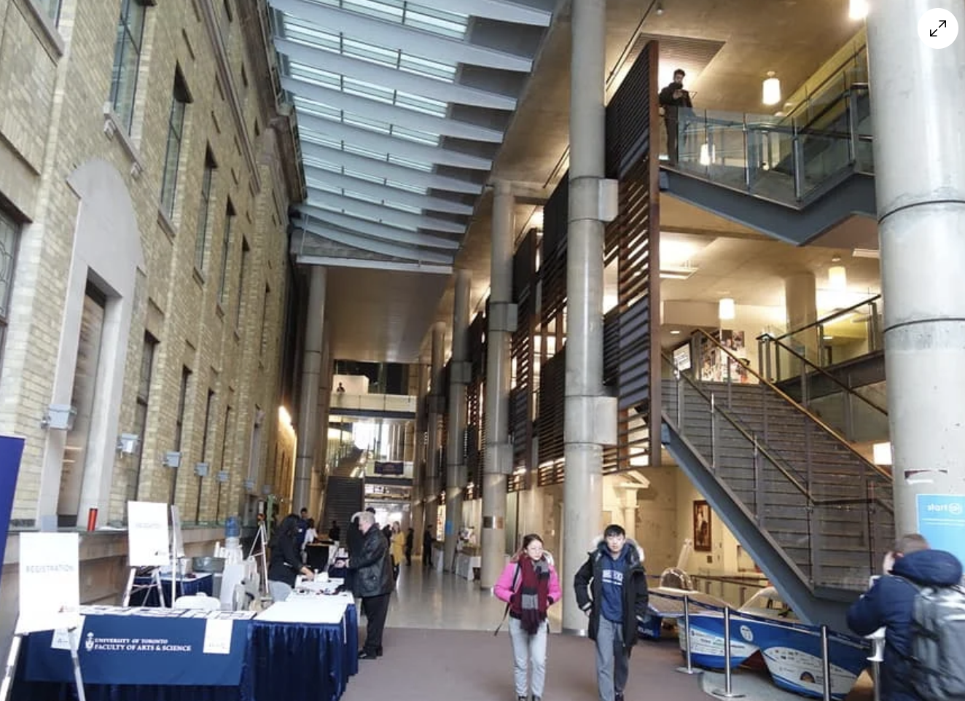
City of Toronto
> 50% born outside Canada
Best city in North America for quality of living
Ranked 'best place to live’ by Economist
Among top-10 list of world's most innovative cities
University of Toronto:
Over 70,000 students
Ranked 1st in Canada, 21st in the world (QS)
Ranked 2nd in Health Sciences Impact (Nature)
Notes:
These are some of the examples of what a versatile code—exposure-pixel image sensor can do - it can perform single-shot HDR imaging, single-shot multispectral imaging, depth-gated imaging, robust 3D triangulation and robust 3D time-of-flight imaging, high-speed imaging, subsurface imaging, as well as many other applications. All of these techniques can be implemented by the same camera with only a simple firmware reconfiguration.
In practice, all of these techniques require a camera that is not only fast and low-cost but is also very flexible in its functionality.

Slide 3
Genov Lab - Intelligent Sensory Microsystems Lab: Research Scope
UNDERSTANDING
SENSING
ML / COMPUTING
ACTUATION
COMMUNICATION
INTERFACING
INFERENCE
ACTING
Notes:
These are some of the examples of what a versatile code—exposure-pixel image sensor can do - it can perform single-shot HDR imaging, single-shot multispectral imaging, depth-gated imaging, robust 3D triangulation and robust 3D time-of-flight imaging, high-speed imaging, subsurface imaging, as well as many other applications. All of these techniques can be implemented by the same camera with only a simple firmware reconfiguration.
In practice, all of these techniques require a camera that is not only fast and low-cost but is also very flexible in its functionality.

Slide 4
MICROELECTRONIC SOLUTIONS SOLUTIONS THAT ARE:
ENABLING
ENERGY- & COST-EFFICIENT
SYNERGISTIC
GREATER THAN SUM OF ELEMENTS
DISRUPTIVE
NEW IC APPLICATIONS
NEW MARKETS
COMPACT, CHIP-SCALE
MULTI-DOMAIN SYSTEMS
Notes:
These are some of the examples of what a versatile code—exposure-pixel image sensor can do - it can perform single-shot HDR imaging, single-shot multispectral imaging, depth-gated imaging, robust 3D triangulation and robust 3D time-of-flight imaging, high-speed imaging, subsurface imaging, as well as many other applications. All of these techniques can be implemented by the same camera with only a simple firmware reconfiguration.
In practice, all of these techniques require a camera that is not only fast and low-cost but is also very flexible in its functionality.

Slide 5
Genov Lab - Intelligent Sensory Microsystems Lab: Research Thrusts
IMAGING SYSTEMS
OTHER ICs AND SYSTEMS
MEDICAL DEVICES
EXPLORATORY PROJECTS ON VARIOUS EMERGING SENSORY AND COMPUTING MODALITIES
IMAGE SENSORS AND CAMERAS FOR FUTURE COMPUTATIONAL IMAGING APPLICATIONS
INTEGRATED CIRCUITS (ICs) AND SYSTEMS INTERFACING WITH THE BRAIN AND PERIPHERAL NERVES
Notes:
These are some of the examples of what a versatile code—exposure-pixel image sensor can do - it can perform single-shot HDR imaging, single-shot multispectral imaging, depth-gated imaging, robust 3D triangulation and robust 3D time-of-flight imaging, high-speed imaging, subsurface imaging, as well as many other applications. All of these techniques can be implemented by the same camera with only a simple firmware reconfiguration.
In practice, all of these techniques require a camera that is not only fast and low-cost but is also very flexible in its functionality.

Slide 6
Genov Lab - Intelligent Sensory Microsystems Lab: Research Thrusts
RESEARCH THRUSTS
1. IMAGE SENSORS FOR COMPUTATIONAL IMAGING
3. OTHER: EXPLORATORY COMPUTING AND SENSING MODALITIES
2. INTERFACING WITH THE BRAIN AND PERIPHERAL NERVES
Notes:
These are some of the examples of what a versatile code—exposure-pixel image sensor can do - it can perform single-shot HDR imaging, single-shot multispectral imaging, depth-gated imaging, robust 3D triangulation and robust 3D time-of-flight imaging, high-speed imaging, subsurface imaging, as well as many other applications. All of these techniques can be implemented by the same camera with only a simple firmware reconfiguration.
In practice, all of these techniques require a camera that is not only fast and low-cost but is also very flexible in its functionality.

Slide 7
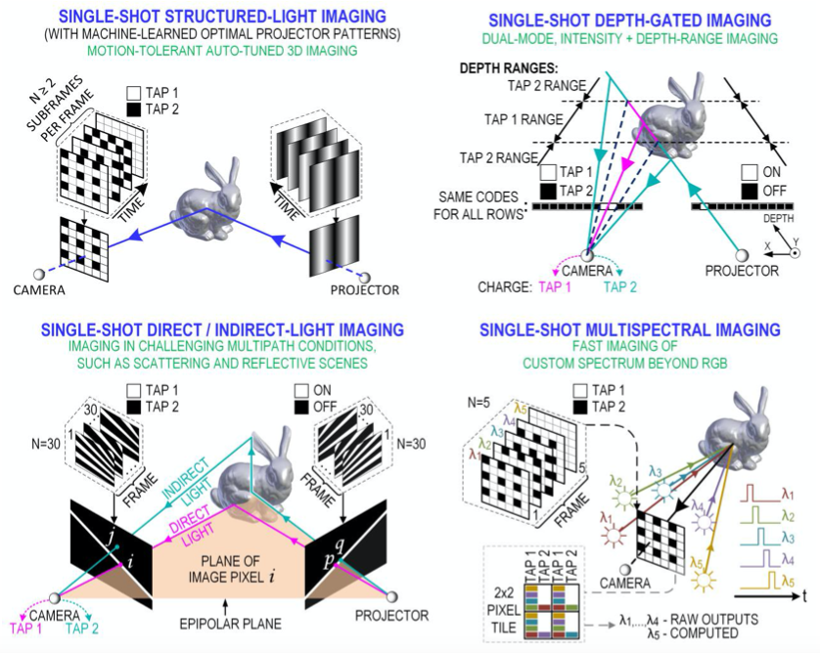
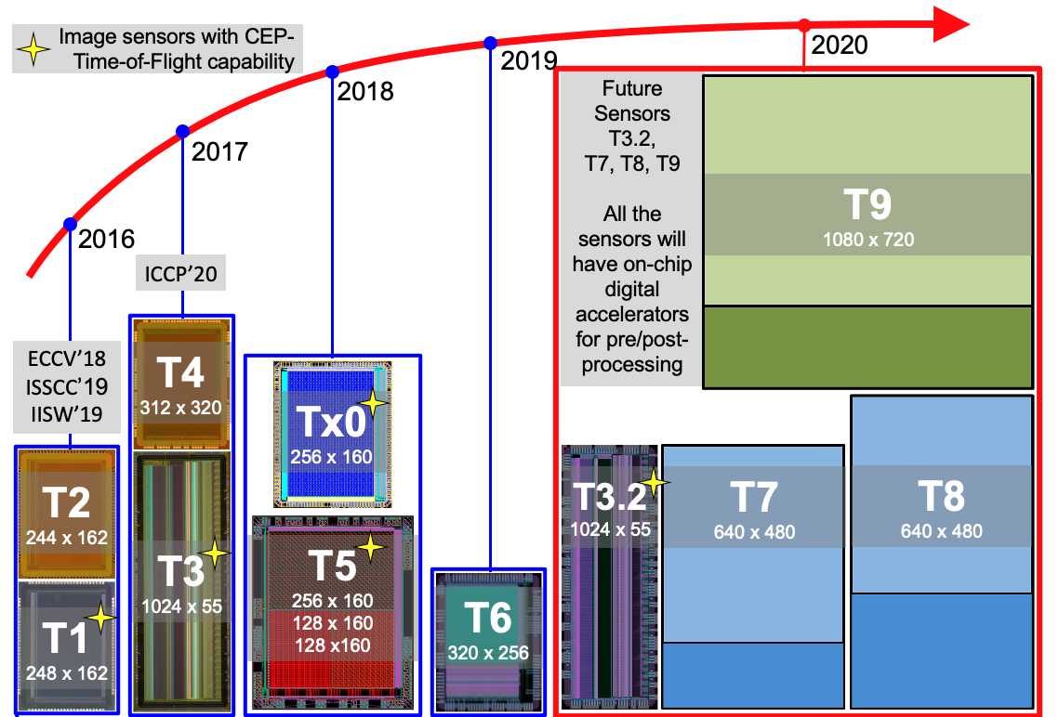
ISML Thrust 1: Fast Pixel-Programmable Image Sensors for Versatile Computational Imaging (ISSCC 19, 23; VLSI 22)
KEY ADVANTAGE: 1000x FASTER IMAGE CAPTURE
- AT LOW POWER AND
- LOW OUTPUT DATA RATE
Computer vision application examples
Image sensor design and fabrication roadmap
Image sensors with dynamically reconfigurable exposure time for every pixel: ie coded-exposure pixels
Multiple fast image captures and in-pixel charge-based processing → reduced motion artifacts
Single slow read out at video rate → power dissipation/data rate comparable to conventional imagers

Slide 8
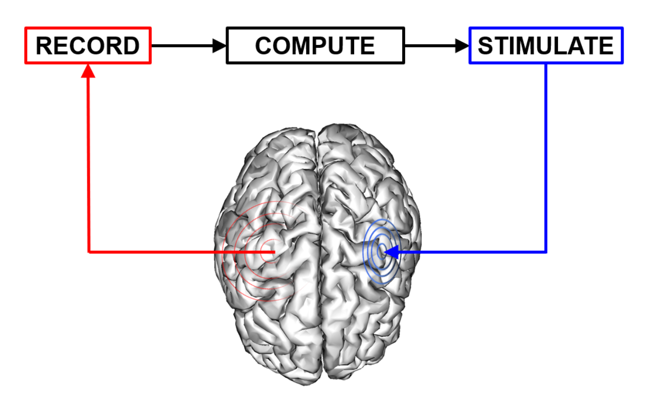
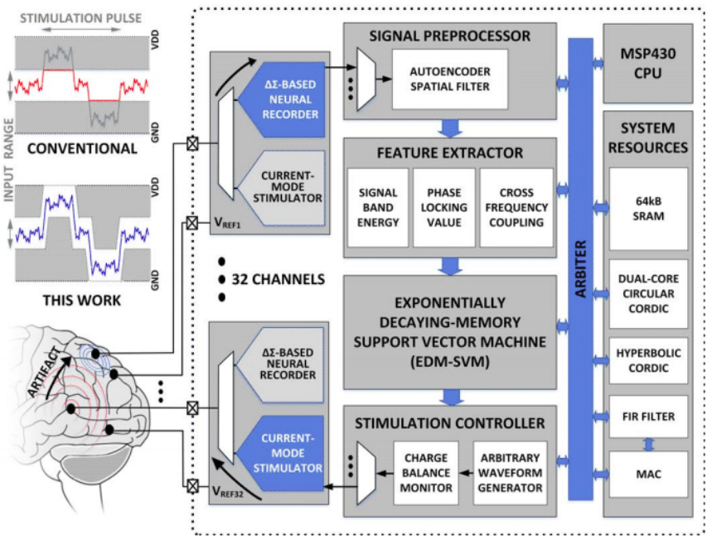
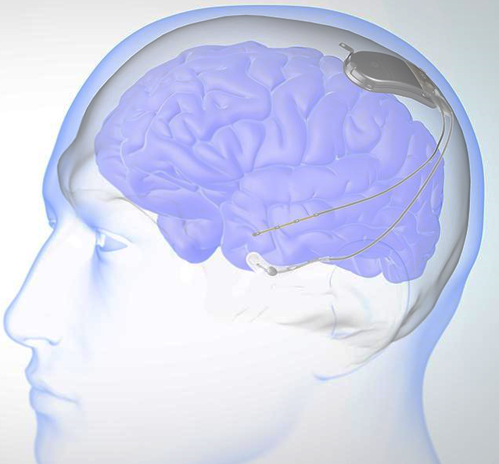
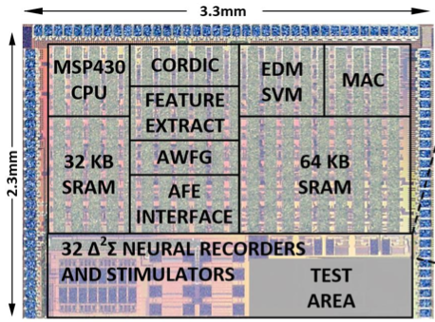
Thrust 2: Artificially Intelligent Brain Implants for Automated Therapy
(ISSCC 2017, 2018 x2, 2019, 2020)
Brain-interfacing ICs:
monitor brainwaves
identify brain pathological brain states (such as epileptic seizures)
trigger electrical stimulation to abort such states
for automated neuromodulation therapy (e.g., epilepsy)
The designs includes:
low-noise analog front-end
wireless comm / power
on-chip digital ML accelerator (SVM, decision trees)
Implantable brain implants to treat neurological disorders (eg epilepsy)

Slide 9
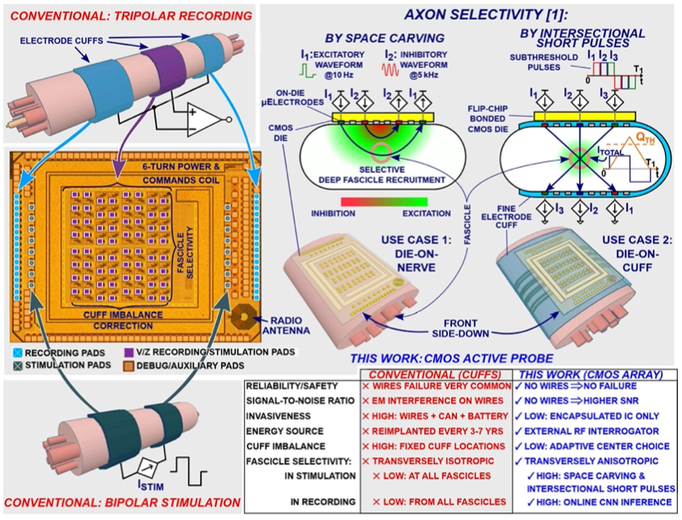
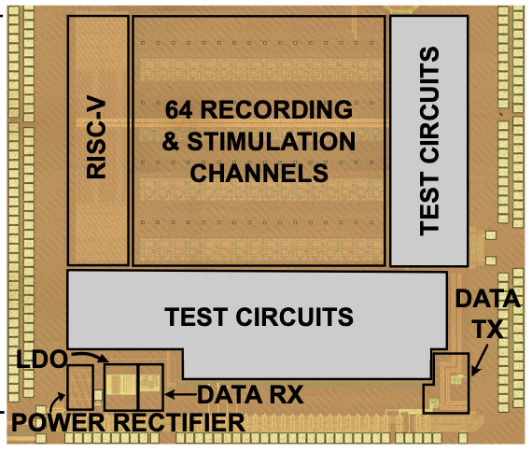
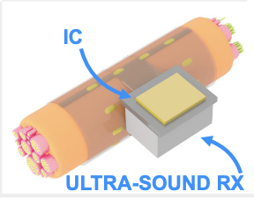
Thrust 3: Smart Interfaces with Human Organs via Peripheral Nerves (ISSCC 2021, 2023)
ISSCC 2021
Nerve-interfacing ICs:
listen to PNS nerves
interpret signals and
alter brain-organ communication
for automated neuromodulation therapy (e.g., spinal cord injury, chronic pain, autoimmune disorder, etc)
These designs include:
low-noise analog front-end
wireless comm / power
wearable digital ML accelerator (CNN)
.
ISSCC 2023

