Slide 1
Parallel CAD for FPGAs:
A Personal Retrospective and Thoughts for the Future
Vaughn Betz vaughn@eecg.utoronto.ca

Slide 2
Agenda
Altera: 2006 - 2011
      Motivation & constraints for parallel CAD
“High-Quality, Deterministic Parallel Placement for FPGAs on Commodity Hardware”, FPGA 2008
        First commercial parallel placement algorithm for FPGAs
        How does it work?
        How well does it work?
      Later Parallel Placement Enhancements
      Compile Time Past, Present & Future

Slide 3
Part I: Motivation & Constraints

Slide 4
Altera 2006
My team: responsible for most of Quartus II compile
Major progress in speeding up
Other SW directors: Good enough?
100%

Slide 5
The Challenge
4x gap
Logic Elements (Thousands)
Have to Sell Your Ideas!

Slide 6
How to Speed Up
Algorithm improvements
  Productive, but dangerous to rely on solely
Incremental compile
  Software-like flow: only recompile what changed
  Useful, but requires up-front planning and can hurt productivity
Go parallel
Did all 3 → Parallel Code Must Be Able To Evolve

Slide 7
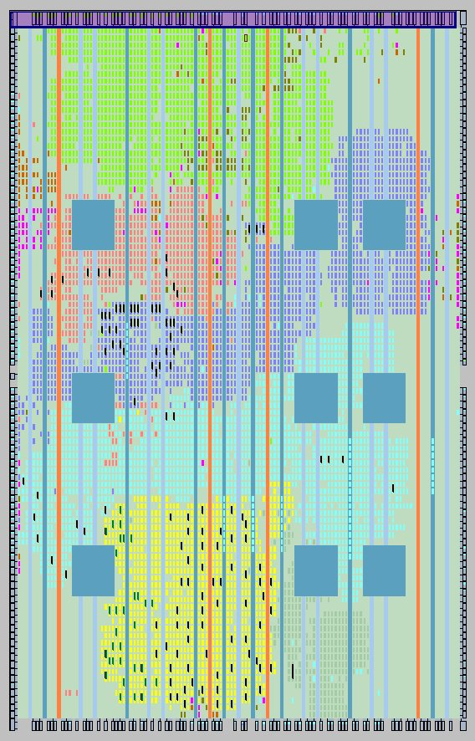
Aside: Incremental Compilation
Define partitions
  CAD will not optimize across partitions
  Can re-synthesize, place and route one partition alone
  Faster compile time
  Fewer iterations because other logic unchanged
“RapidRecompile”
  Incremental compile without the designer identifying partitions
  Figures out what changed automatically
  Challenge: global optimizations
Success
Failure

Slide 8
Parallel Constraints
Deterministic (required)
  Same results every run
  Means no race conditions
  Most prior work wasn’t deterministic
  Almost impossible to test non-deterministic code
  Many customers will not use it
    Can’t reproduce results
    Inherently insecure
Serial equivalency (desirable)
  Even better: same res3ult no matter how many cores

Slide 9
Parallel Constraints
Quality (required)
  Need to achieve quality comparable to current Quartus results
    Worse timing closure: designer productivity hurt
    IP timing closure: DDR, PCIe must close timing
    Increased wiring → unroutes?
    Power optimization?
  Rough annealing trade-off: 10% quality means 10X less runtime
    Small quality loss not worth it for a moderate compile time gain

Slide 10
Parallel Constraints
Maintainable (required)
  Quartus is big (~20 million lines of code)
  Place and route system over 1 million lines
  Don’t want to shut down new algorithm work
  Plus new devices, features need to be integrated
  Careful how you code, and only make key pieces parallel

Slide 11
Algorithm Runtimes (Quartus 2011)
Must Parallelize Multiple Algorithms, but Placement is Biggest

Slide 12
Part II:
High Quality, Deterministic Parallel Placement for FPGAs on Commodity Hardware
Overview of FPGA 2008 and TODAES 2011 Papers by Adrian Ludwin, Ketan Padalia and Vaughn Betz

Slide 13
Quartus Placement (2011)
Simulated annealing-based
Optimizes wire, timing, power, congestion
Based on academic VPR, but with many enhancements
  More complex cost functions
  Directed moves
  Multi-level placement
Spends ~50% of time at T = 0 (quench)

Slide 14
Algorithm Overview
P = InitialPlacement ();
T = InitialTemperature ();
while (ExitCriterion () == False) {
while (InnerLoopCriterion () == False) { /* One temperature */
Pnew = PerturbPlacementViaMove (P); /* Propose move */
ΔCost = Cost (Pnew) – Cost (P); /* Evaluate move */
r = random (0,1);
if (r < e^{-ΔCost/T}) {
P = Pnew; /* Accept (Finalize) move */
}
} /* End one temperature */
TimingAnalyze();
CongestionAnalyze();
T = UpdateTemp (T);
}
Dominate CPU Time
10K LoC in Propose + Evaluate

Slide 15
Placement Improvement via Moves
LAB 1
LAB 2
LAB 3
LAB 4
Move 2
LAB 5
LAB 6
Move 1
LAB 7
LAB 8
LAB 9
LAB 10

Slide 16
Move Evaluation & Acceptance
Quality change of move estimated with complex cost function
  Fast estimates of wiring, timing, power
  Blended together into overall cost
If cost decreases, move always accepted
  Placement state is updated
If costs increase, still have some chance of accepting if T > 0
  Hill climbing
  But not in the quench (T = 0)

Slide 17
PMoves stages (1)
move = propose(place);
cost = evaluate(place, move);
if(cost < 0) {
accept(place, move);
}
Processing
(propose and evaluate)
99%
time
Finalization
(resolve collisions and commit)
1%
time

Slide 18
Core 0 Propose & Evaluate View
LAB 1
LAB 2
LAB 3
LAB 4
LAB 5
LAB 6
Move 1
LAB 7
LAB 8
LAB 9
LAB 10

Slide 19
Core 1 Propose & Evaluate View
LAB 1
LAB 2
Move 2
LAB 3
LAB 4
LAB 5
LAB 6
LAB 7
LAB 8
LAB 9
LAB 10

Slide 20
Core 1 Finalize View
Collision
LAB 1
LAB 2
LAB 3
LAB 4
Move 2
LAB 5
LAB 6
Move 1
LAB 7
LAB 8
LAB 9
LAB 10

Slide 21
Resolving Collisions
Must detect collisions (avoid illegal placement)
When two moves have collided, we can:
  Abandon the later moves (non-deterministic)
  Or attempt to “fix” colliding moves
We fix it by reproposing it
  This gives the same move as in the serial flow
Therefore, the placer is not only deterministic but also serially equivalent
  Easier to test → results same no matter how many cores

Slide 22
Supervisor transition
Core 0
Process
(C0)
Core 1
Process
(C1)
Core 2
Process
(C2)
Core 3
Process
(C3)
Processing
(propose and evaluate)
Processing
(propose and evaluate)
Processing
(propose and evaluate)
Processing
(propose and evaluate)
Queue
Finalization
(resolve collisions and commit)
Finalize

Slide 23
Supervisor (1)
Process
(C0)
Process
(C1)
Process
(C2)
Process
(C3)
Move
0
Move
0
Move
1
Move
1
Move
4
Move
2
Move
3
Queue
Finalize
Finalize
(C0)

Slide 24
Supervisor (2)
Process
(C1)
Process
(C2)
Process
(C3)
Move
4
Move
2
Move
3
Queue
Move
1
Move
0
Finalize
Finalize
(C0)

Slide 25
Supervisor (3)
Process
(C0)
Process
(C1)
Process
(C2)
Process
(C2)
Process
(C2)
Process
(C3)
Move
5
Move
4
Move
2
Move
2
Move
7
Move
3
Move
3
Move
6
Queue
Finalize
Finalize
(C2)

Slide 26
Results Summary
Speedup higher in quench
  Fewer accepted moves
  Fewer collisions & reproposals
Cost of determinism?
    Modest: estimate ~12%
Memory subsystem a bigger limit
  Parallel CAD needs memory-friendly code
Cores | Quench Speedup | Full Anneal Speedup
4 | 2.9 | 2.1
8 | 4.0 | 2.4

Slide 27
Part III: Later Parallel Placement

Slide 28
Conflict Free Moves
Avoid conflicts by modifying move generators & cost functions
  Goeders, Lemieux & Wilton, “Deterministic Timing-Driven Parallel Placement by Simulated Annealing Using Half-Box Window Decomposition” Reconfig, 2011
Each core moves blocks in a different region
Cost function uses stale information for blocks outside region
  No need to track conflicts or repropose moves
Improves speedup (51x), reduces quality (10%)
Deterministic
Core 0
LAB 4
LAB 5
LAB 1
LAB 3
Core 1

Slide 29
Dependency Checker & Fewer Conflicts
Coding a dependency checker to repropose conflicting moves is hard
  Can hardware or software (compiler) transactional memory do it for us?
  Unfortunately, no (poor performance)
  An, Steffan & Betz, “Speeding Up FPGA Placement: Parallel Algorithms and Methods”, FCCM 2014
Tweaking cost functions (ignore high fanout nets) and move generators can reduce conflicts with no quality loss
  5X speedup at equal quality, deterministic
  Larger gains if you sacrifice determinism

Slide 30
Algorithm Changes + Parallelism
Combine analytic placement & quenching
  Gort and Anderson, “Analytic Placement for Heterogeneous FPGAs,” FPL 2012
Analytic placement to get global placement
  Parallelize x & y matrix solutions
  2X speedup
Quench (iterative refinement) to fine-tune
  Uses parallel moves
  Avoids high-temperature part of anneal (most conflicts)
  1.48X speedup
Overall parallel speedup 1.3X

Slide 31
Part IV: Compile Time Past, Present & Future

Slide 32

The Past: Parallel Success
Parallel Compile
Clustering, placement, routing & delay estimation all parallel by 2009

Slide 33
But Compile Time Challenge Has Grown
10X

Slide 34
The Present
Large, Stratix 10 2800 High Performance Design
48
Compile
Time
(h)
Finalize
Overall:
2.3X Speedup
Routing
24
Placement
Synthesis
0

Slide 35
The Present
Parallel compile very helpful
  42 hours → 18 hours
Placement longest single algorithm
  14 hours → 3.75 hours
But many important algorithms
  Extreme Amdahl’s law → must speed them all
Synthesis not parallel
  Lowest hanging fruit to attack (7 hours here)
  Little published parallel synthesis research

Slide 36
Observations
Algorithm speedups in 2x – 4x range on 8 cores
Large memory footprints, complex algorithms, data transfer between algorithms
  GPUs unlikely to help
Machines with moderate number of fast cores best fit to current CAD tools

Slide 37
What to Do?
Algorithm & parallelism co-optimization
  Find algorithm with best parallel time
Partition designs and compile incrementally
  Shell & role in datacenters
  But still not employed inside core of most designs
FPGA architecture to reduce compile time
  Larger logic blocks
  More routing? (but increases cost)
  Harden more
    E.g. Network-on-Chip

Slide 38
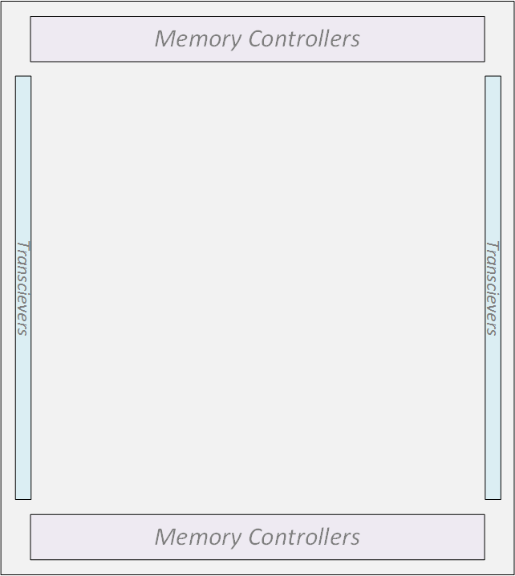
NoC: Pre-Wired & Timing Closed
Traditional: CAD tool builds
system-level interconnect
FPGA with Hard NoC: System-Level Interconnect Pre-Built
Difficult Timing Constraints
100s of bits
PCIe
PCIe
Module 4
Module 4
Bus 1
100’s of muxes
Packet
Module 3
Module 3
Bus 3
Links
Routers
Module 1
Module 2
Module 1
Module 2
PCIe
PCIe
Bus 2
38

Slide 39
Wrap Up

Slide 40
Wrap Up
FPGA capacity greatly outstripping serial CPU speed growth
Parallelize high-quality algorithms
  E.g. VPR 8 router 6x to 300x faster than earlier algorithms
Complex flow → many algorithms to speed up
Integrate / open-source
  Many parallel algorithms tested in VPR
  But only timing analysis integrated in current master
Flat compile productive, but may not scale
  Partition / incremental compile flows
  But increases planning for designers
  Do we need automatic floorplanners?
FPGA architecture for compile time
  Has not been a major architecture goal
  Should be in the future

