Slide 1

Spatial Architectures in the More-than-Moore and Deep Learning Era
Vaughn Betz
University of Toronto & Cerebras Systems with thanks to Andrew Boutros, Sean Lie and all my students for some slide content

Slide 2
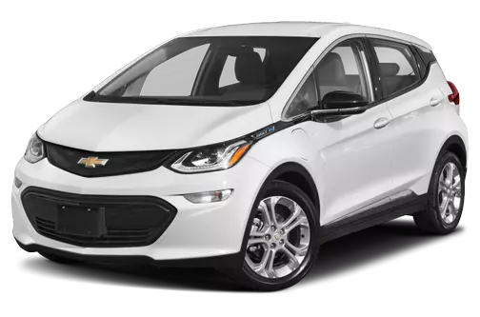
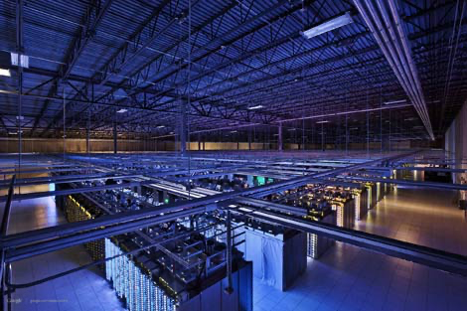
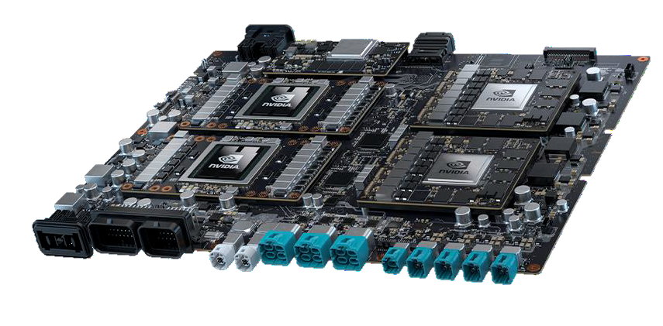
DL Inference: Energy Efficiency and Latency Matter
Key metric is
Perf / W / $
Power is ~30% of cost
Chevy Bolt
~6 kW in city
Nvidia Drive AGX
Pegasus (2022)
Up to 750W
~9% of US electricity demand by 2030 [1]
Low inference latency crucial for safety!
Low inference latency enables reasoning and cascade of AI algorithms/agents!
[1] R. Leppert, “What we know about energy US at U.S. data centers amid the AI boom,” Pew Research Center, Oct. 24, 2205.

Slide 3
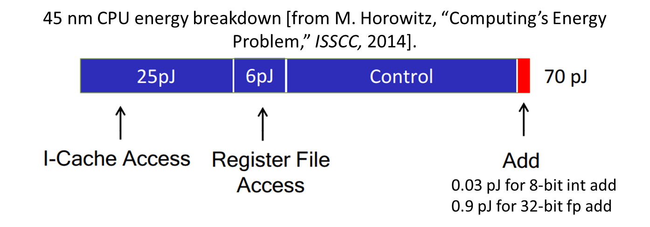
FPGA Strength: Specialize, Shrink Operands
Can reprogram FPGA to implement exact hardware needed by network
  Perform only necessary operation, w/o instruction stream
  Programmable routing: directly wire data from one unit to another
  Programmable logic: use minimum operand size/type needed for accuracy
A. Boutros, A. Arora and V. Betz, “Field-Programmable Gate Array Architecture for Deep Learning: Survey & Future Directions,” Proceedings of the IEEE, 2025,

Slide 4
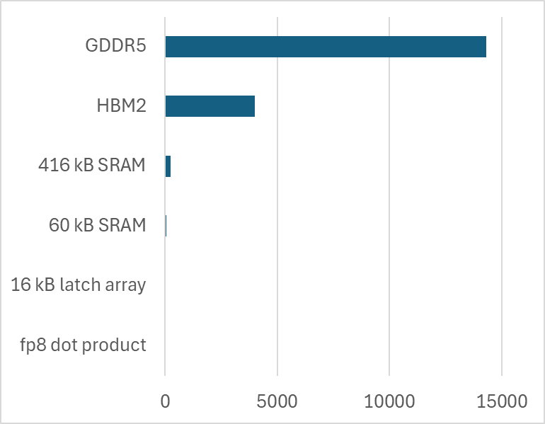
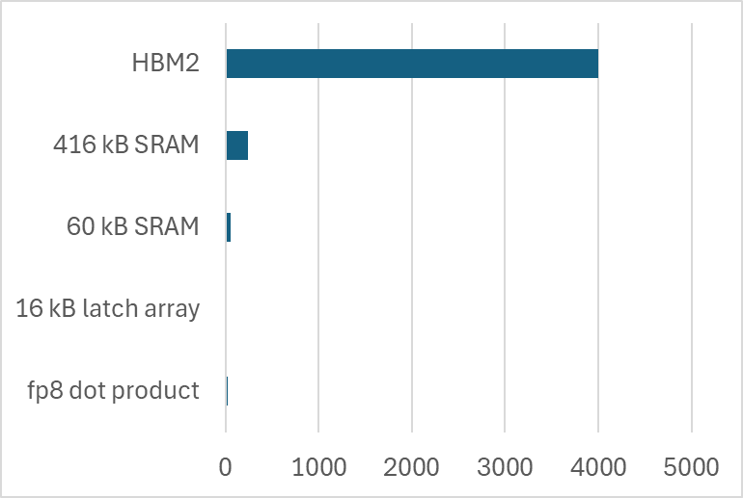
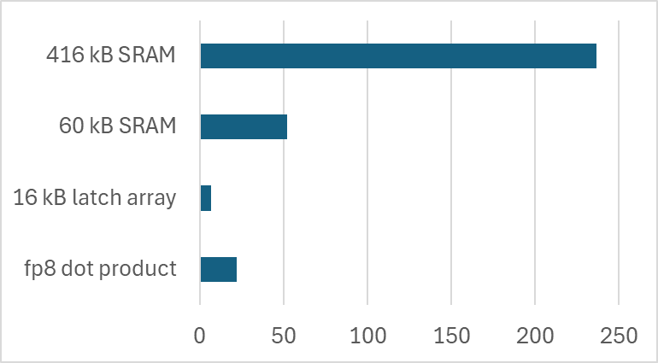
Spatial Compute Strength → Data Locality
PCB
Interposer
Interposer
128 byte reads
On chip (3 nm)
128 byte op
Need to keep data close to compute
Leaving chip very expensive!

Slide 5
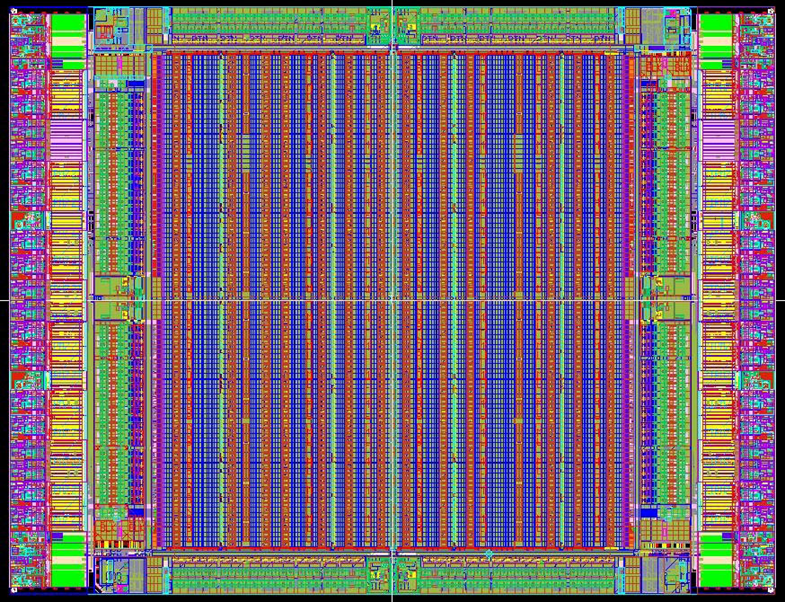
Spatial Compute Strength → Data Locality
Narrow & Deep
Huge flexibility in combining RAMs with programmable logic & routing
~Pb/s of on-chip bandwidth
Split into 10,000+ independent blocks
Can create right size of RAM
Can locate near operators
Integrate with logic, e.g. custom scatter/gather
to exploit sparsity
Challenge: largest networks → off-chip memory → weakens advantage
XBAR
Independent
Wide & Shallow
RAM Blocks
Logic
Blocks
DSP Blocks

Slide 6

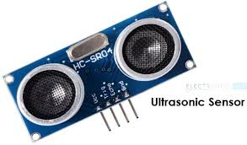
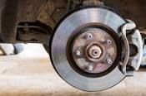
FPGA Strength: Low Latency, Highly Flexible I/O
Programmable
I/O (DDR, …)
Programmable Serial I/O (PCIe,...)
Embedded: low latency & custom I/O
Custom I/O
Preprocess & Feature Extract
DL
6
FPGA

Slide 7
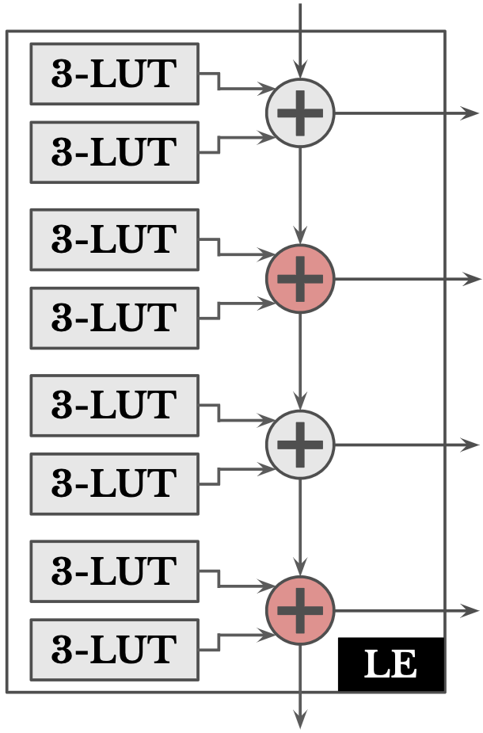
FPGA Weakness: Programmability Overhead
Programmability is expensive!
LEs and programmable routing larger & slower than gates & wires
Can we make soft fabrics more efficient for DL?
Harden key functions?
Connect with programmable routing,
dedicated interconnect, or NoC?
DSP Block

Slide 8
Example Accelerator Styles To Maximize FPGA Advantages

Slide 9
Dataflow: HPIPE
Efficient CNN Inference

Slide 10
HPIPE Design Philosophy
Commonly → Temporal mapping on PE arrays
Sequential processing of layers
PEs handle any layer → lower efficiency
Conv2D 7x7, stride 2
Conv2D 5x5, stride 1
Conv2D 3x3, stride 1
Map
Map
Map
PE
PE
PE
Buffer
Instead → Spatial mapping to specialized units
Per-layer custom HW → higher efficiency
Latency-insensitive interfaces between layers
Exploit pipeline parallelism
Conv2D 7x7, stride 2
Conv2D 5x5, stride 1
Conv2D 3x3, stride 1
Map
Map
Map
PE
PE
PE
M. Hall et al, “From TensorFlow Graphs to LUTs and Wires: Automated Sparse and Physically Aware CNN Hardware Generation“, FPT 2020

Slide 11
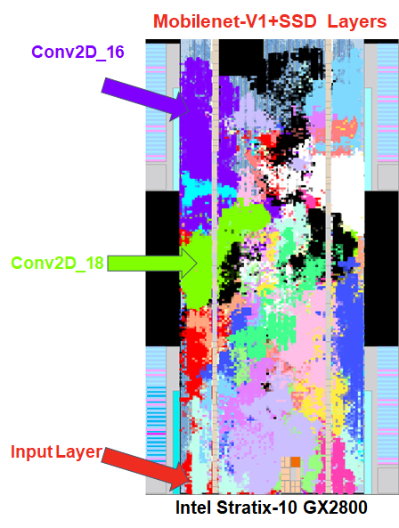
Specialized Hardware and Local Data Movement
Maximum specialization
No instruction decode overhead
Spatial layout → data is local
Needs different hardware for every
network
Build a domain-specific compiler

Slide 12
Auto Generation of Custom CNN HW (HPIPE)
HW Specifications
TensorFlow Model Description
Graph Optimization
Fuse layers for more efficient implementations
Resource Allocation
A pipeline is as slow as its slowest stage
Balance layer throughput to increase efficiency
RTL Generation
Generate specialized HW for each layer from highly optimized templates
Placement-Aware Pipelining and Memory Mapping
Spatial-aware memory structures, deep
pipelining and locality-optimized communication
HPIPE
FPGA Bitstream
M. Hall et al, “From TensorFlow Graphs to LUTs and Wires: Automated Sparse and Physically Aware CNN Hardware Generation“, FPT 2020

Slide 13
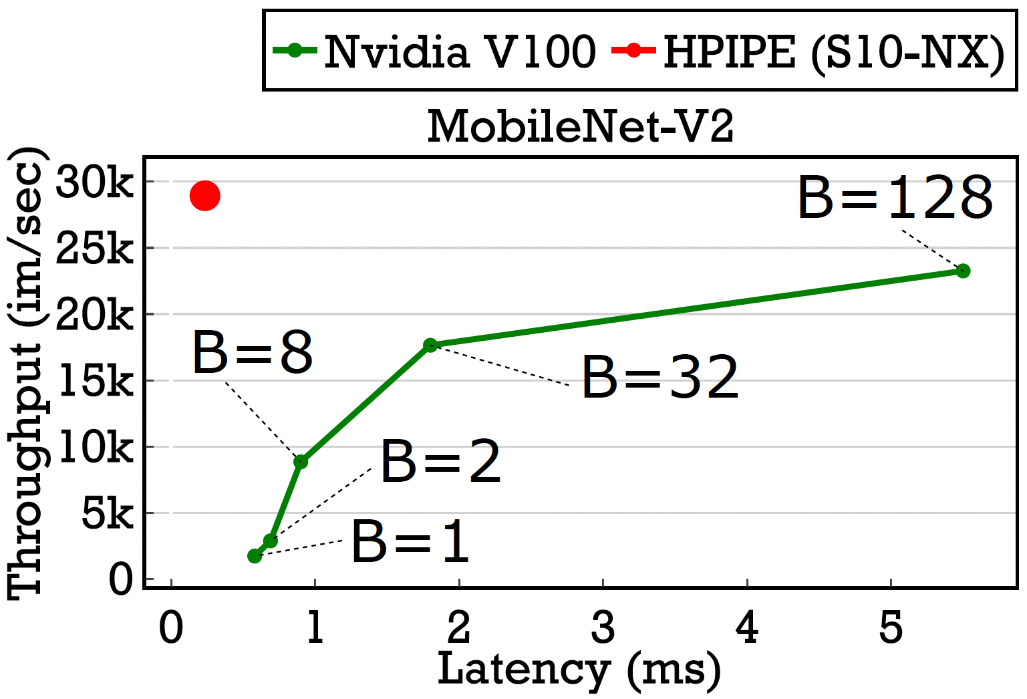
Results vs. GPU s(AI-Optimized Stratix 10 FPGA)
17x higher batch-1 throughput vs. V100 GPU at lower latency
1.3x higher batch-128 throughput vs. V100 GPU at 3x lower latency
Strength: latency, efficiency
Weakness: large models may
not fit in on-chip memory
M. Stan et al, “HPIPE NX: Boosting CNN Inference Acceleration Performance with AI-Optimized FPGAs“, FPT, 2022.

Slide 14
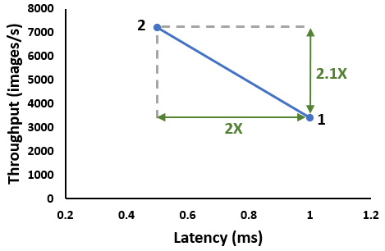
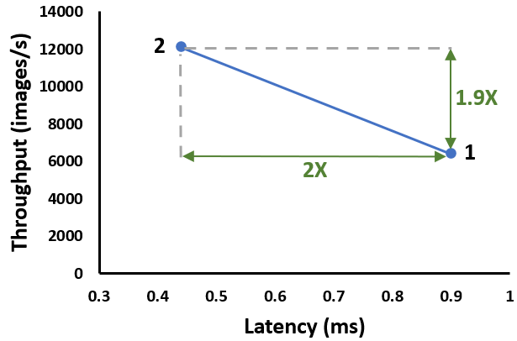
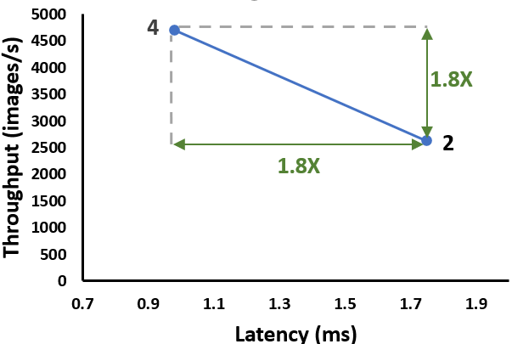
Supporting Very Large CNNs: Multi-FPGA Pipeline
More memory → fit parameters of large CNNs
More compute resources → higher throughput & lower latency
Moderate data between chips → easily fits on 100 Gb ethernet
Devices needed scales with model size → exceeds budget & compute needs of some embedded applications
100 Gb
Conv2D
BiasAdd
Conv2D
MaxPool
Ethernet
ReLU
Add
FPGA₁
FPGA₂
Conv2D
Near linear scaling in latency & throughput with device count
MobileNet-V1
MobileNet-V2
85% sparse ResNet-50
top-1: 72%
top-1: 72%
top-1: 72%
top-1: 72%
top-1: 72%
top-1: 72%
M. Doumet et al, “H2PIPE: High Throughput CNN Interfence on FPGAs with High Bandwidth Memory,” FPL, 2024

Slide 15
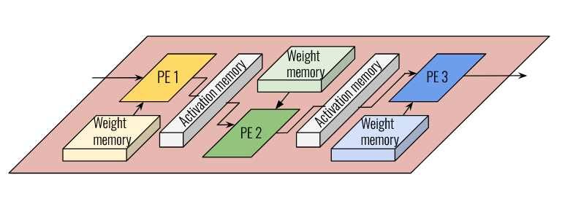
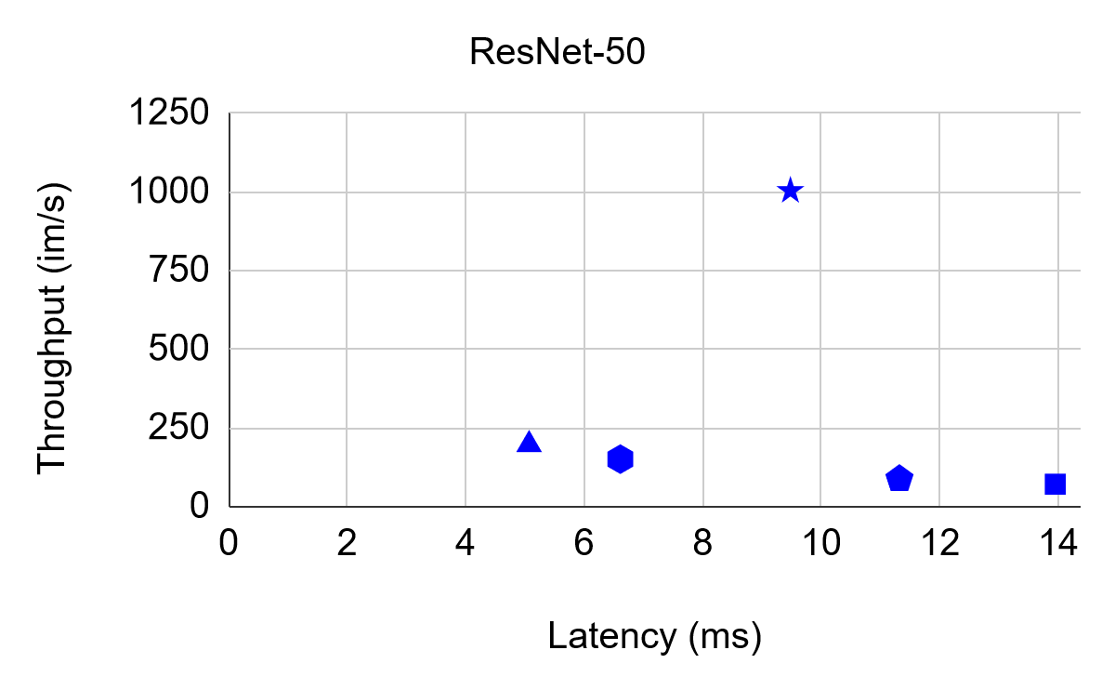
Supporting Very Large CNNs: Selective Weight Offload
HBM
Offload weights that free up maximum on-chip memory with minimum performance loss
Lose some performance,
but larger networks fit on one FPGA
Still higher throughput
than prior work
Cost / performance
trade-off vs. multi-FPGA
pipeline
H2PIPE
5.1x
Liu et al.
FTDL
DNNVM
Venieris et al.
M. Ibrahim et al, “Extending Data Flow Architectures for Convolutional Neural Networks to Multiple FPGAs,” FPT, 2023

Slide 16
Overlay: NPU
Software Programmable Inference

Slide 17


Overlay Design Flow
HW Experts
Data Scientist
App Expert
Traditional Flow
Overlay Flow
Applications
Domain Requirements
Applications
Implement in RTL
Design HW/SW Contract (ISA)
Implement in SW
N
FPGA CAD Tools
Develop SW Toolchain
Overlay Compiler
Perf?
Binaries
Y
Bitstreams
Develop overlay via traditional flow
Bitstream
Long compiles, Application experts designing HW
Fast compiles, Application experts write (custom) software

Slide 18
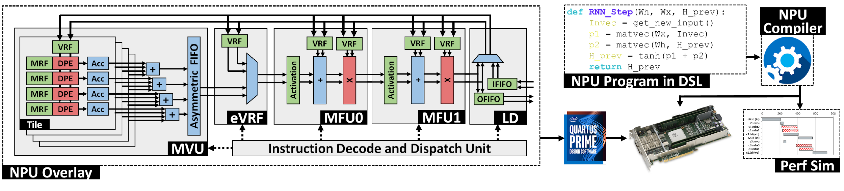
Neural Processing Unit (NPU)
Targets MLPs, RNNs, GRUs, LSTMs, GNNs
Very Long Instruction Word (VLIW) soft processor - 5 coarse grained stages
Amortize control → Single instruction executes 45,000 operations
Customize memory subsystem → Exploit tremendous on-chip memory BW
Data cascades from one stage to next → spatial locality
A. Boutros et al, “Beyond Peak Performance: Comparing the Real Performance of AI-Optimized FPGAs and GPUs“, FPT, 2020

Slide 19
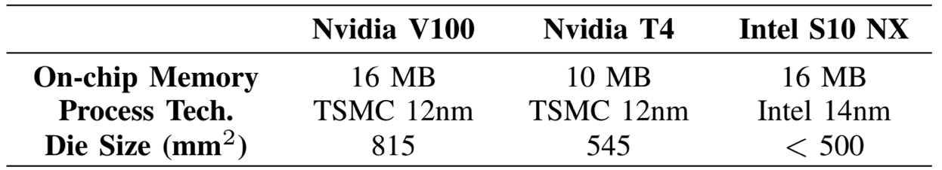
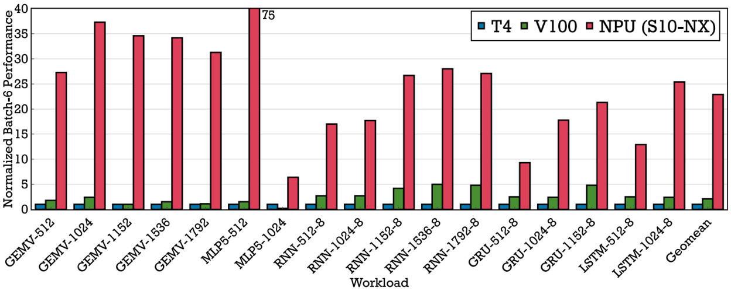
Results vs. Same-Generation DL-Optimized GPUs
AI-Optimized FPGA with Tensor Blocks
11x vs. V100
23x vs. T4
High performance, yet software programmable
A. Boutros et al, “Beyond Peak Performance: Comparing the Real Performance of AI-Optimized FPGAs and GPUs“, FPT, 2020

Slide 20

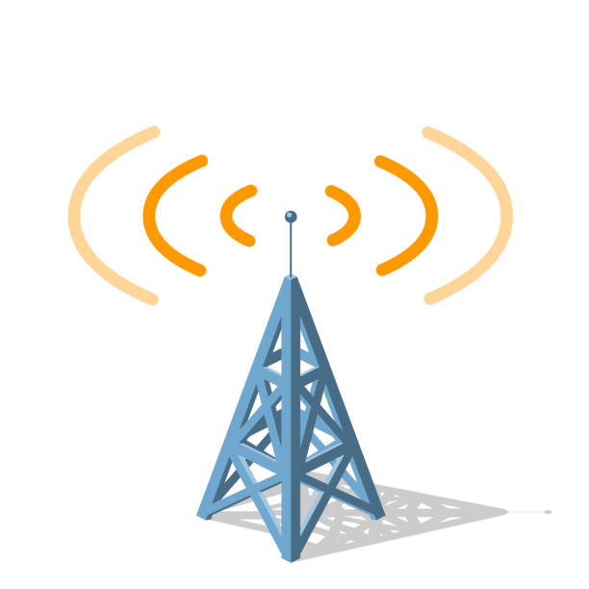
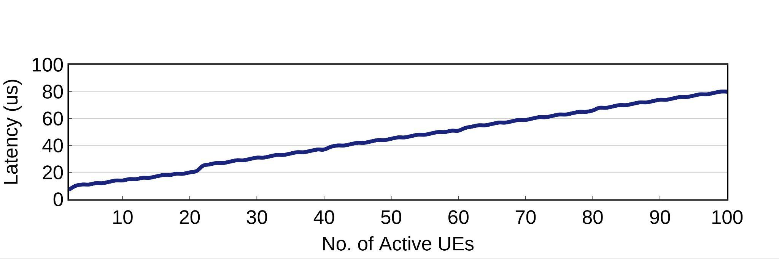
Application Case Study: 5G MIMO Scheduling
GCN layer
GCN layer
GAT layer
Sum + Update
Model as 3 coupled GNNs
< 80 μs for 100 users!
5G Networks: schedule freq. bands and antennas, with very low latency
Leverages FPGA strengths: low-latency, complete system, custom I/O
T. Zhang et al, “A Software-Programmable Neural Processing Unit for Graph Neural Network Inference on FPGAs,” FPL, 2024

Slide 21
Finding Better FPGA Architectures for Deep Learning
Ideas, Tools and Flows

Slide 22
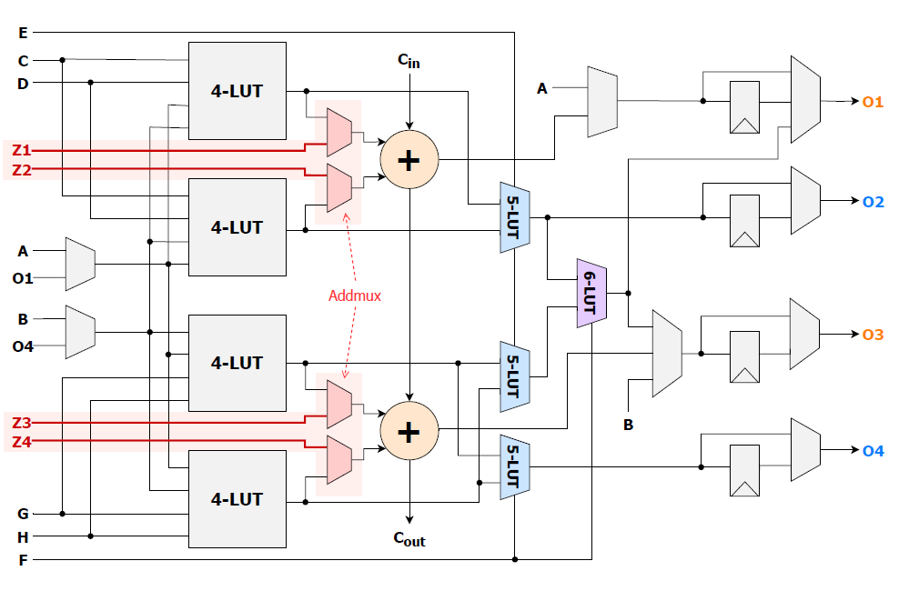
Logic Structures that Favour Arithmetic
4-bits of arithmetic per 6-LUT
50% density increase for soft MACs
<3% tile size increase
Independent use of 5-LUTs & adders
25% density increase unrolled DNNs
< 4% tile size increase
M. Eldafrawy et al, “FPGA Logic Block Architectures for Efficient Deep Learning Inference,” TRETS, 2020
J. Pun et al, “Double Duty: FPGA Architecture to Enable Concurrent LUT and Adder Chain Usage”, FPL 2025

Slide 23
Harden Key Computations?
DSP Block
Programmable logic vs. ASIC gates:
~30x area, ~3x speed
[Kuon & Rose, TCAD, 2007]
Gains lower once internal programmability and connectivity to routing added
E.g. DSP blocks fully used for FIR filters: 8.5x area, 2.5x speed
Must consider routing & range of uses in hardening choice
A. Boutros and V. Betz, “FPGA Architecture: Principles and Progression,” IEEE Circuits and Systems Magazine, May 2021

Slide 24
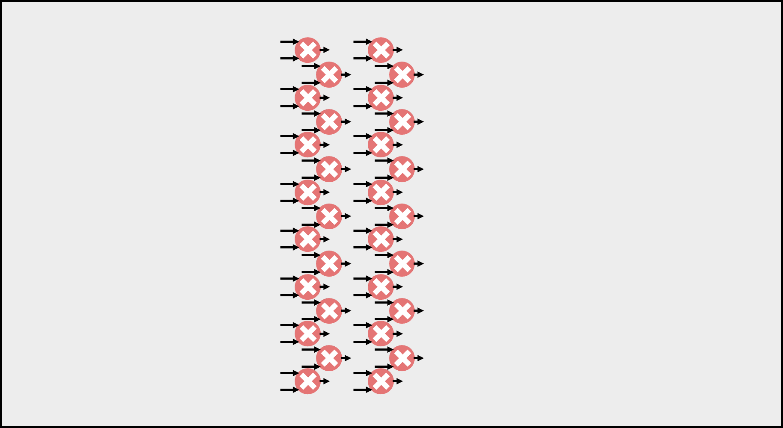
Example: Intel Stratix 10 NX Tensor Block
30x int8 multipliers instead of 2x int18 multipliers
Or 60x int4 multipliers
Focusing on this mode
30x int8
Multiplier area ∝ precision² → can fit many 8x8 within DSP footprint
Notes:
The int8 tensor mode implements 30 int8 multipliers in a single block, instead of 2 int18 multipliers.

Slide 25
Tensor Block int8
30x int8 multipliers instead of 2x int18 multipliers
480 inputs
480 outputs
DSP block: 96 inputs
DSP block: 72 outputs
Notes:
But, if you think about it, 30 int8 multipliers would require 480 input and output ports which would be significantly more expensive in terms of area.

Slide 26
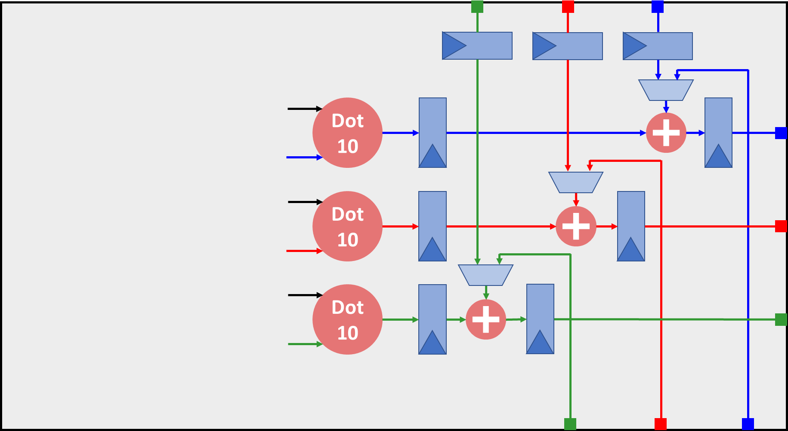
Tensor Block int8
30x int8 multipliers instead of 2x int18 multipliers
Limit Outputs: Arrange multipliers as 3x dot-10 engines + accumulators
Dedicated Cascades: Cheap
480 inputs
72 outputs
Notes:
To drive down the number of output ports, the 30 multipliers are arranged as three 10 element dot products with internal reduction and optional 24-bit accumulators which brings down the number of output ports to only 72 ports.

Slide 27
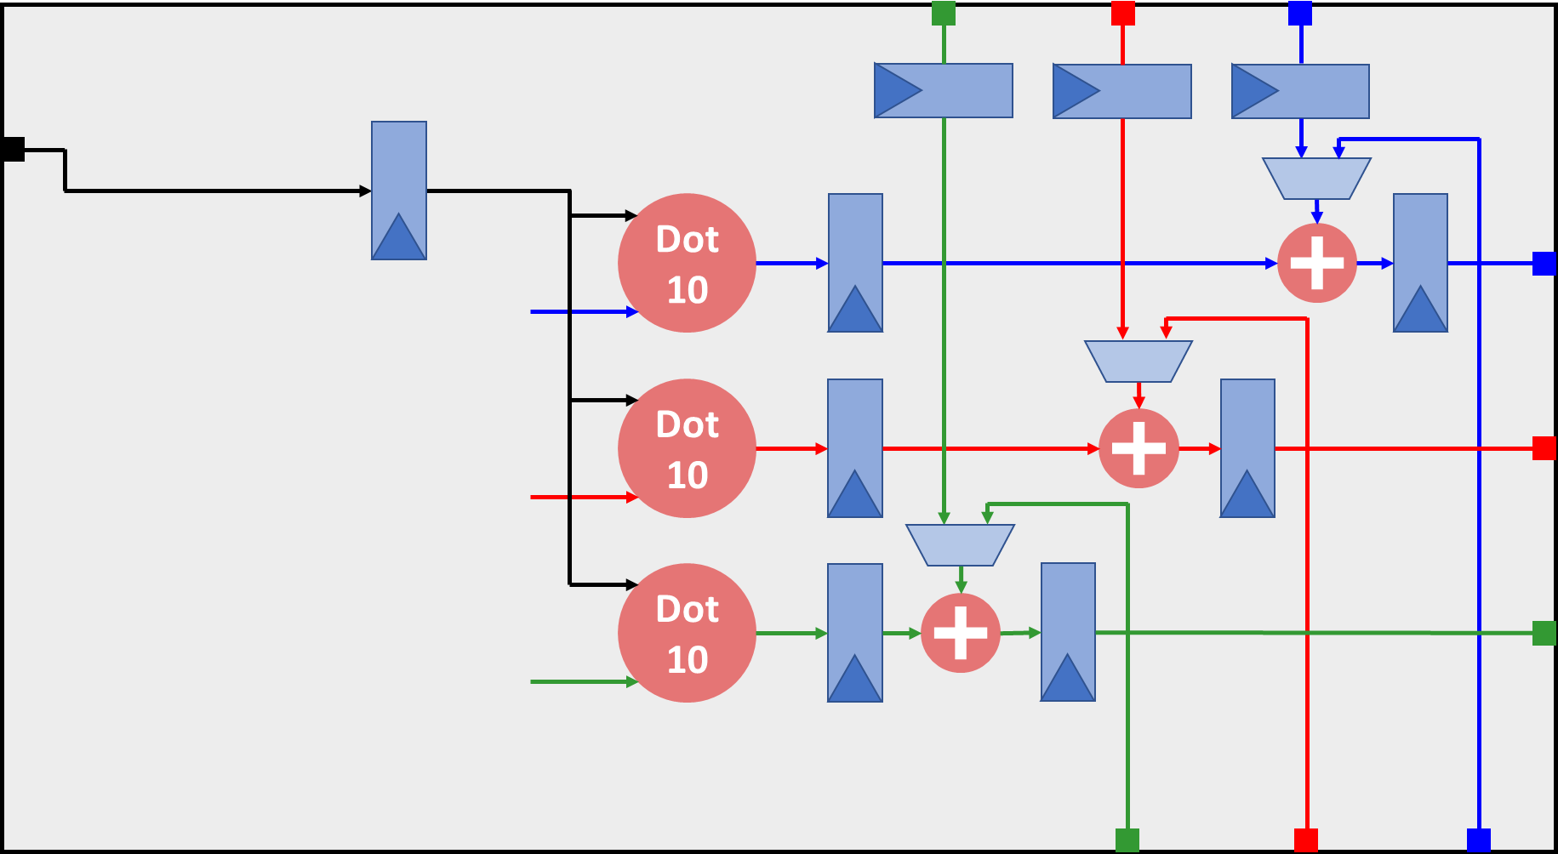
Tensor Block int8
30x int8 multipliers instead of 2x int18 multipliers
Limit Outputs: Arrange multipliers as 3x dot-10 engines + accumulators
Limit Inputs: Broadcast one set of inputs to all dot-10 engines
320 inputs
72 outputs
Notes:
Then to solve the inputs problem, one set of input is shared by broadcasting it to all 3 dot-10 engines …

Slide 28
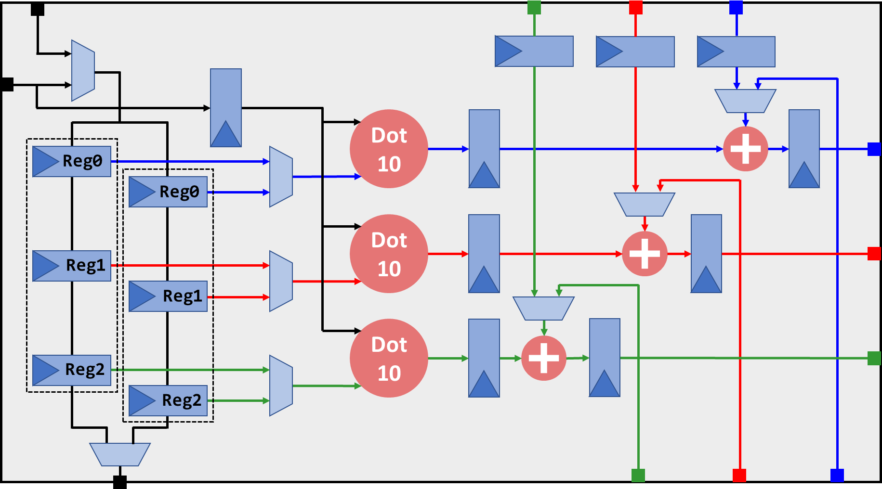
Tensor Block int8
30x int8 multipliers instead of 2x int18 multipliers
Limit Outputs: Arrange multipliers as 3x dot-10 engines + accumulators
Limit Inputs: Broadcast one set of inputs to all dot-10 engines
Limit Inputs: Ping-pong input reuse chain loaded from the block above
80 inputs
72 outputs
Notes:
And the other set of input is loaded from the tensor block above using a dedicated input reuse chain in which one set of registers can be loaded while the other is used for compute in a ping-pong fashion.
This brings the total number of needed input ports to only 80.

Slide 29
Tensor Block int8
30x int8 multipliers instead of 2x int18 multipliers
Limit Outputs: Arrange multipliers as 3x dot-10 engines + accumulators
Limit Inputs: Broadcast one set of inputs to all dot-10 engines
Limit Inputs: Ping-pong input reuse chain loaded from the block above
80 inputs
72 outputs
15x peak int8 TOPS in similar area to DSP block
with a more constrained dot-product with re-use unit
Notes:
And the other set of input is loaded from the tensor block above using a dedicated input reuse chain in which one set of registers can be loaded while the other is used for compute in a ping-pong fashion.
This brings the total number of needed input ports to only 80.

Slide 30
Tools to Explore the Next Generation of FPGAs
Verilog-to-Routing

Slide 31

FPGA Architecture Research Flow
Challenges:
Need representative application designs
Describe FPGA Architecture & Low
Level Circuit Area, Power, Delay
Need retargettable CAD flow
Designs
FPGA Architecture #1
FPGA Architecture #2
Need CAD Flow for Architecture #1
Need CAD Flow for Architecture #2
Speed/Area/
Power
Speed/Area/
Power

Slide 32
Verilog to Routing (VTR) Overall Flow
Architecture
Verilog Designs
Yosys
ODIN II
Open Source FPGA CAD Flow
Connect to Yosys, Odin-II or combination for synthesis
VPR for placement, routing, analysis
Approach:
Architecture Agnostic
Data-driven FPGA Architecture description
Parmys
ABC
ABC
Netlist
VPR
Pack
STA
Place
Route
Analysis
Fasm, fpga-bitstream, other bitstream gen.
QoR / Reports
M. Elgammal et al, “VTR 9: Open-Source CAD for Fabric and Beyond FPGA Architecture Exploration", TRETS, 2025.

Slide 33
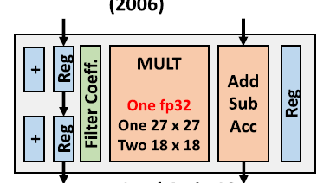
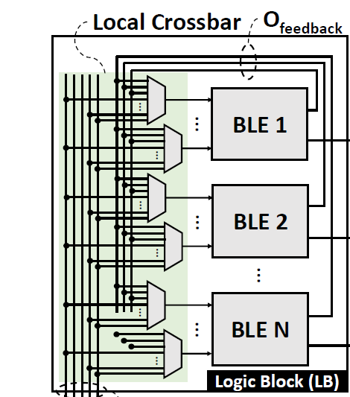
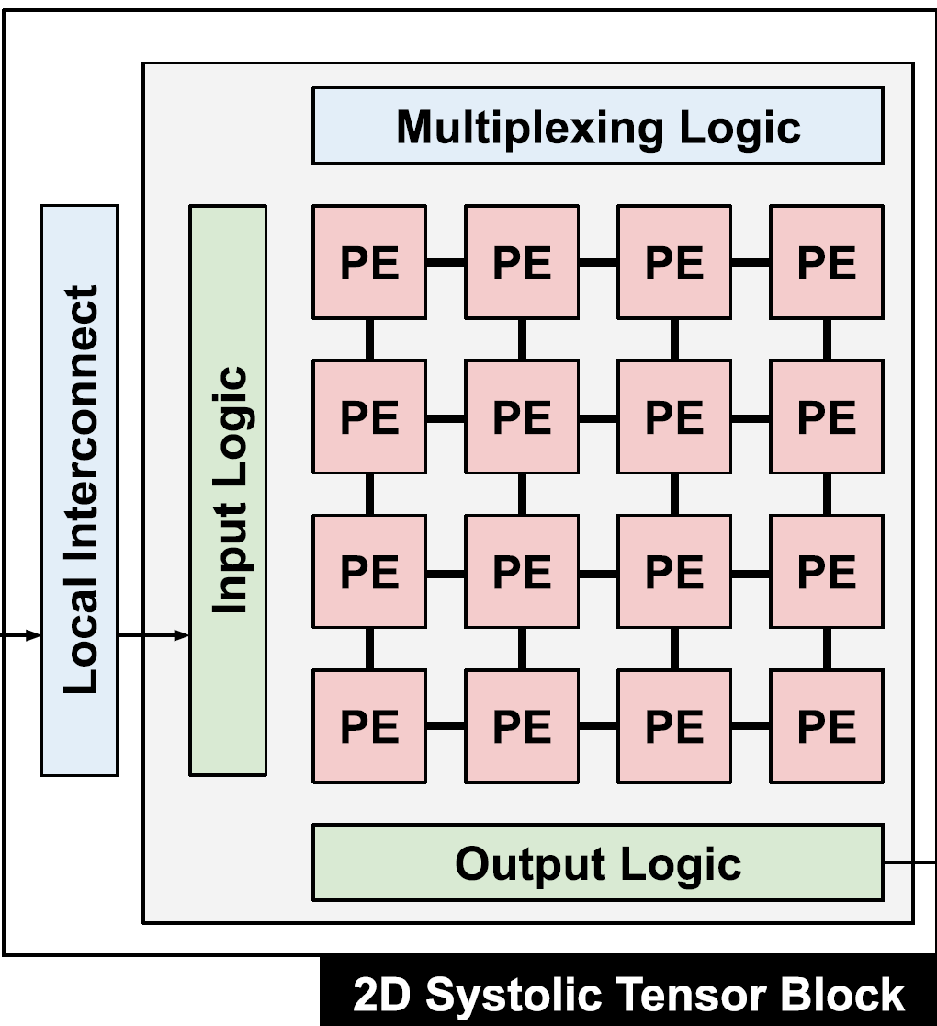
Architecture Flexibility: Blocks
6-LUT
+
4-LUT
?
Logic Primitive
Logic Element
Logic Block Size
DSP Block
Inter-Element Connectivity
Full Blocks

Slide 34
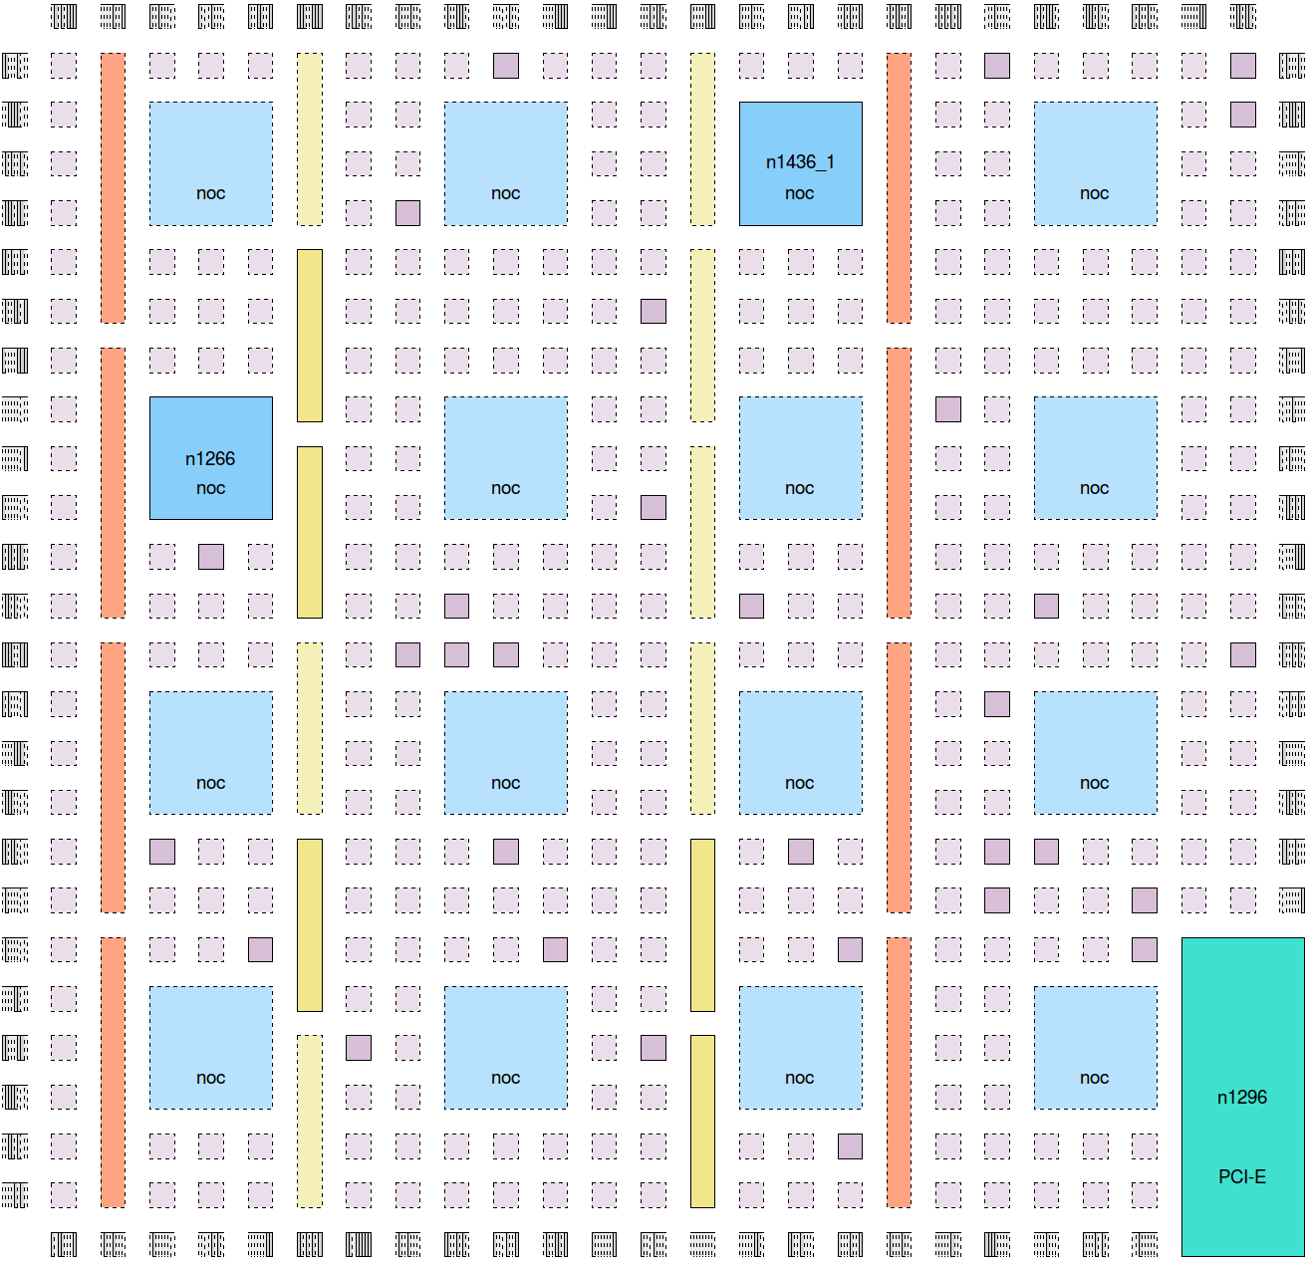
Architecture Flexibility: Block Arrangement
IOs
Logic Block
NoC
Router
DSP
Block RAM
Hard
Block

Slide 35
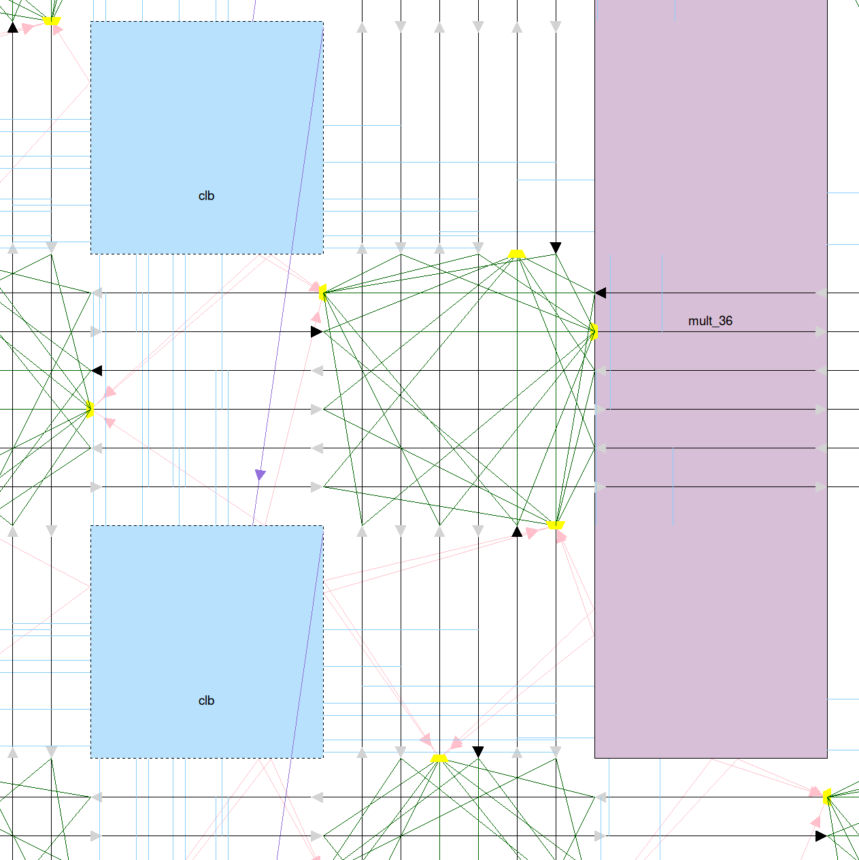
Architecture Flexibility: Routing
Block Input Connection
Direct Block-Block Connection
Routing
Wires
Wire-Wire Connections
(switch-block)
Block Output Connection

Slide 36
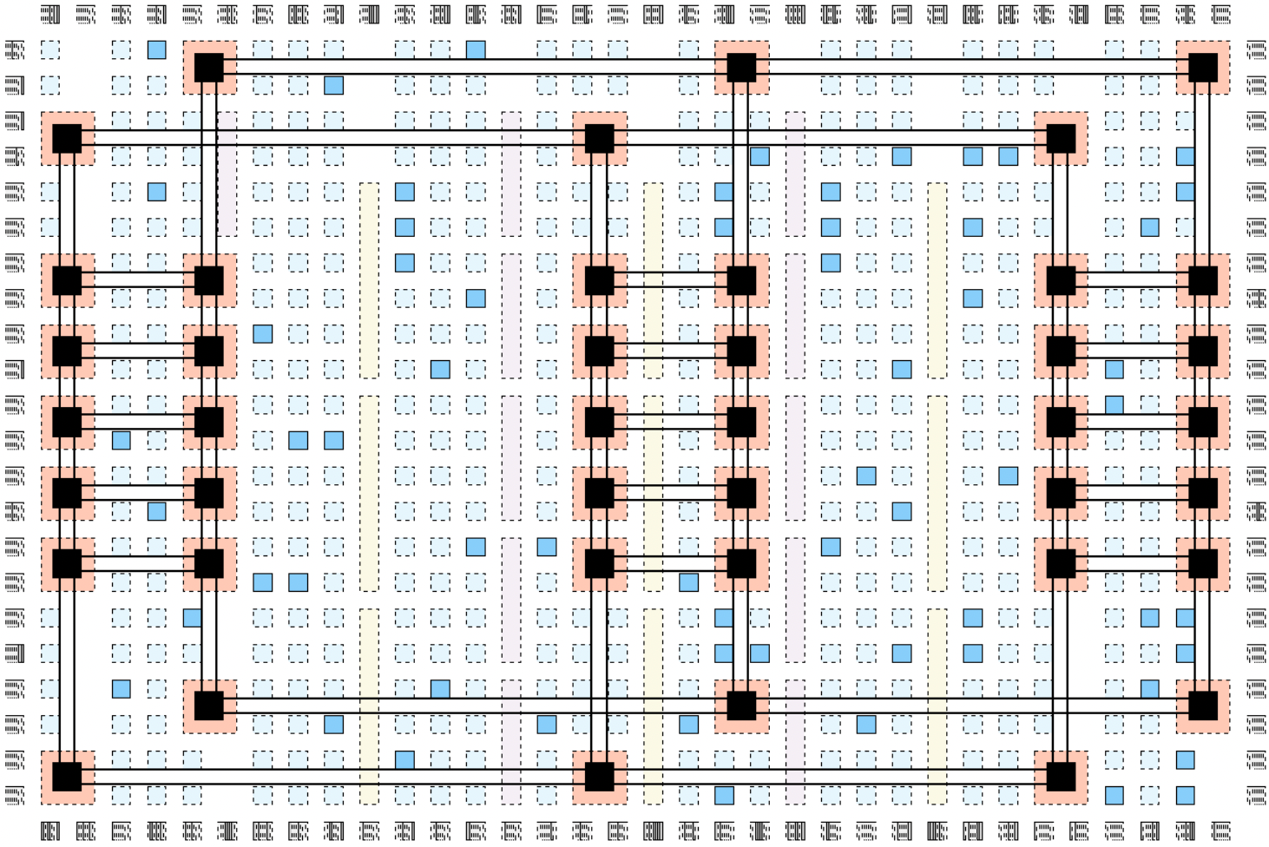
Hardened Networks on Chip
Packet-switched router
NoC Link
NoC for system-level communication (e.g. with DDR, HBM, PCIe)
Placement co-optimizes NoC and programmable routing usage
NoC-connected accelerators (e.g. matrix-matrix systolic array)?
S. Srinivasan et al, “Placement Optimization for NoC-Enhanced FPGAs“, FCCM, 2023

Slide 37
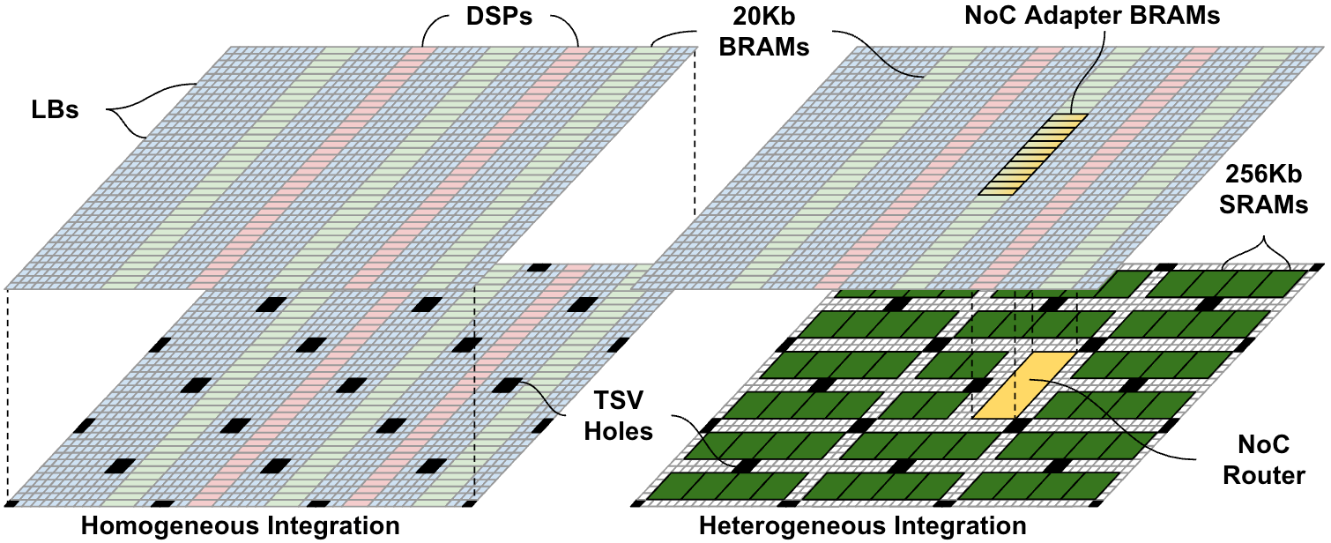
3D (Stacked Die) FPGAs
Feasible with hybrid bonding
Feasible with μbumps
Larger capacity FPGAs
More local communication
Integrate different technologies
Bring larger memory very close to compute
Separate out design of specific accelerator
3D Systems + Spatial Arch.: High Locality, Near Memory Compute
A. Boutros et al, “Into the Third Dimension: Architecture Exploration Tools for 3D Reconfigurable Acceleration Devices,” FPT, 2023

Slide 38
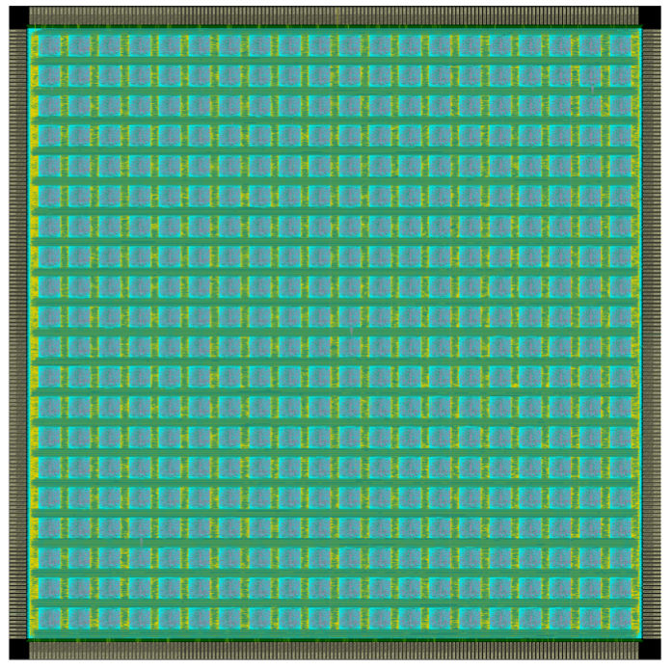
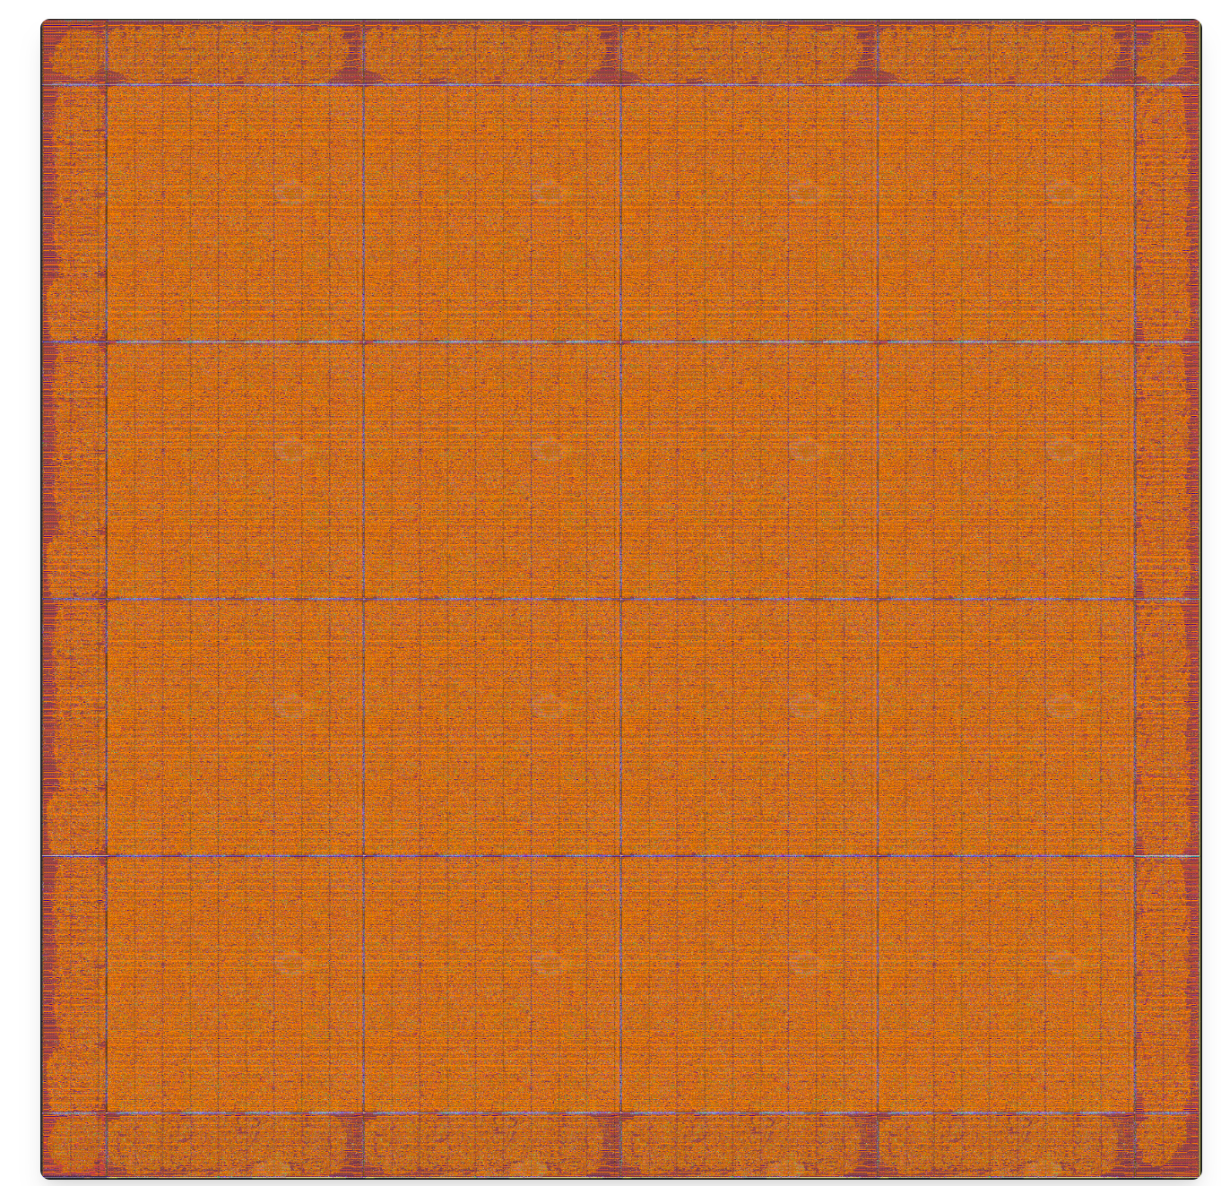
Beyond Exploration: Custom FPGA Implementation
OpenFPGA
(QuickLogic, RapidSilicon, RapidFlex)
ZeroASIC Platypus
Can now go from VTR arch file → standard cell layout automatically
Cost: ~60% more area and ~20% more delay for soft fabric than full custom
Massively reduces the NRE to create a unique FPGA system
    Blocks specialized for specific DL ops (e.g. fp4 matrix-vector)?
    NoCs connecting to systolic matrix-matrix multipliers?
    Mix FPGA/spatial logic for some operations with temporal (processor) logic for others?
X. Tang et al, "OpenFPGA: An Open-Source Framework for Agile Prototyping Customizable FPGAs," IEEE Micro, 2020
I. Youssef, “LaZagna: An Open-Source Framework for 3D FPGA Architectural Exploration,” ICCAD, 2025

Slide 39
Wafer-Scale Integration and the Cerebras Spatial-Temporal Architecture

Slide 40
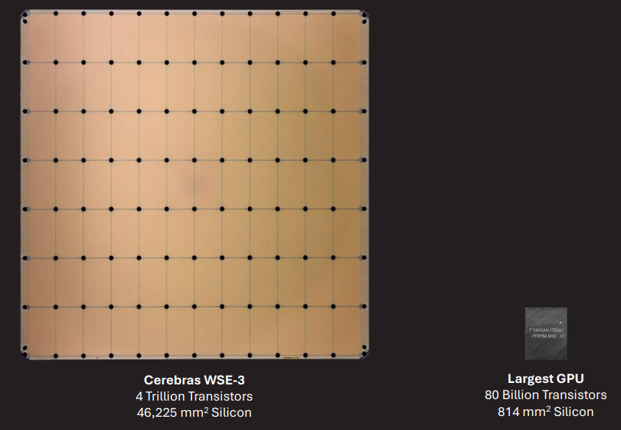
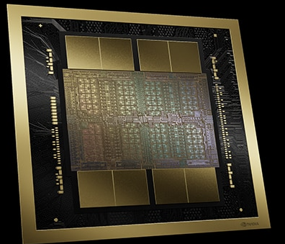
Why Wafer Scale?
Scale up to a very large parallel system, without bottlenecks and energy of multi-chip interconnect
NVIDIA GB300: two reticle limit
(~850 mm²) dice + 8 HBM stacks,
all on silicon interposer
Cerebras WSE-3:
46,000 mm² wafer-scale
WSE-3
Local SRAM
Distributed on-wafer
44 GB
Blackwell GB300 GPU
8x HBM3e
Interposer
192 GB
0.008 PB/s
21 PB/s
Keep your friends close and your data closer!

Slide 41
WSE-3 vs. Nvidia H100 Scale Comparison
S. Li, “Wafer-Scale AI: GPU Impossible Performance,” Hot Chips, 2024.

Slide 42
Temporal and Spatial Compute
High
High temporal flexibility
CPUs
GPUs
Cerebras WSE
Spatio-Temporal
architectures
Temporal:
Computation
Variability
Over Time
AMD
AIEs
Minimal control
overhead
CGRAs
FPGAs
Low
Hierarchical, Implicit
Spatial: Distribution of Data
Spatial,
Explicit

Slide 43
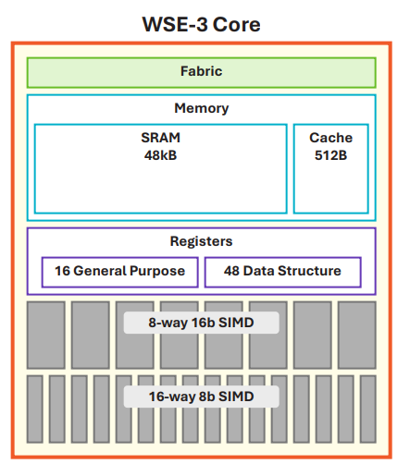
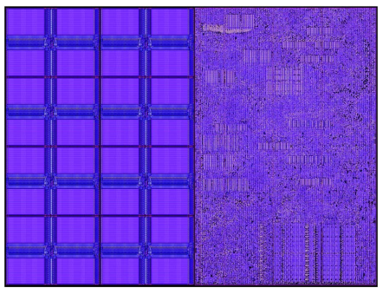
Throughput-Focused Spatio-Temporal Arch
Minimize instruction & control overhead
In-order core
SIMD (fp16 and fp8)
CISC instructions: up to 4D tensor operands
  Akin to DSP processors
  Issuing one instruction per cycle can keep all execution units busy
Temporal flexibility
Main thread & 8 μthreads
Switch to μthread cycle-by-cycle when main thread waiting for data
Spatial: Near memory computing
Half of core is SRAM
Compute + NoC
SRAM

Slide 44
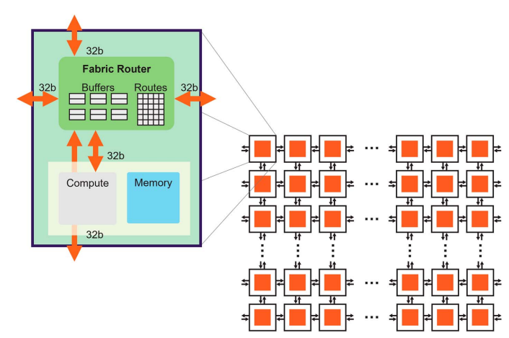
Spatial Communication
Mesh NoC, 32b links
Explicit data movement (no global address)
24 virtual channels (colors) enable traffic multiplexing over links
Static switching: each router programmed with per-colour table
Somewhat like registered & multiplexed FPGA interconnect
S. Li, “Cerebras Architecture Deep Dive: First Look Inside the Hardware/Software Co-Design for Deep Learning, IEEE Micro, 2023.

Slide 45
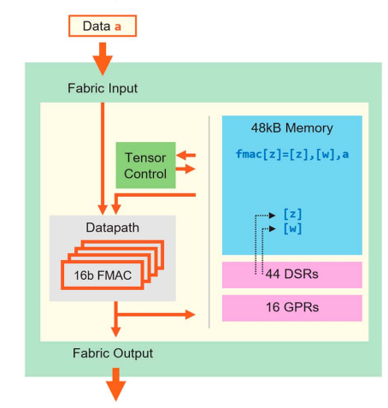
Streaming Dataflow Compute Model
Computation triggered by data arrival from NoC
Latency-insensitive communication
Output → local SRAM or NoC
Popular FPGA compute model, adapted to software-programmable cores
S. Li, “Cerebras Architecture Deep Dive: First Look Inside the Hardware/Software Co-Design for Deep Learning, IEEE Micro, 2023.

Slide 46
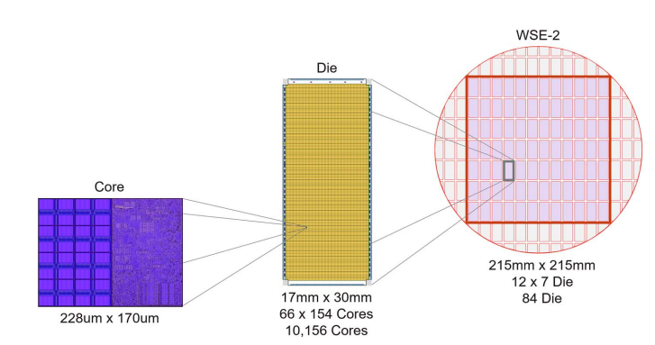
Scale to Wafer
Within reticle: fabric uses parallel links with registers at routers
Reticle crossing: fewer wires → use source-synchronous interface that provides full bandwidth
Modest number of cycles to cross → fabric not interrupted by reticle boundaries
S. Li, “Cerebras Architecture Deep Dive: First Look Inside the Hardware/Software Co-Design for Deep Learning, IEEE Micro, 2023.

Slide 47
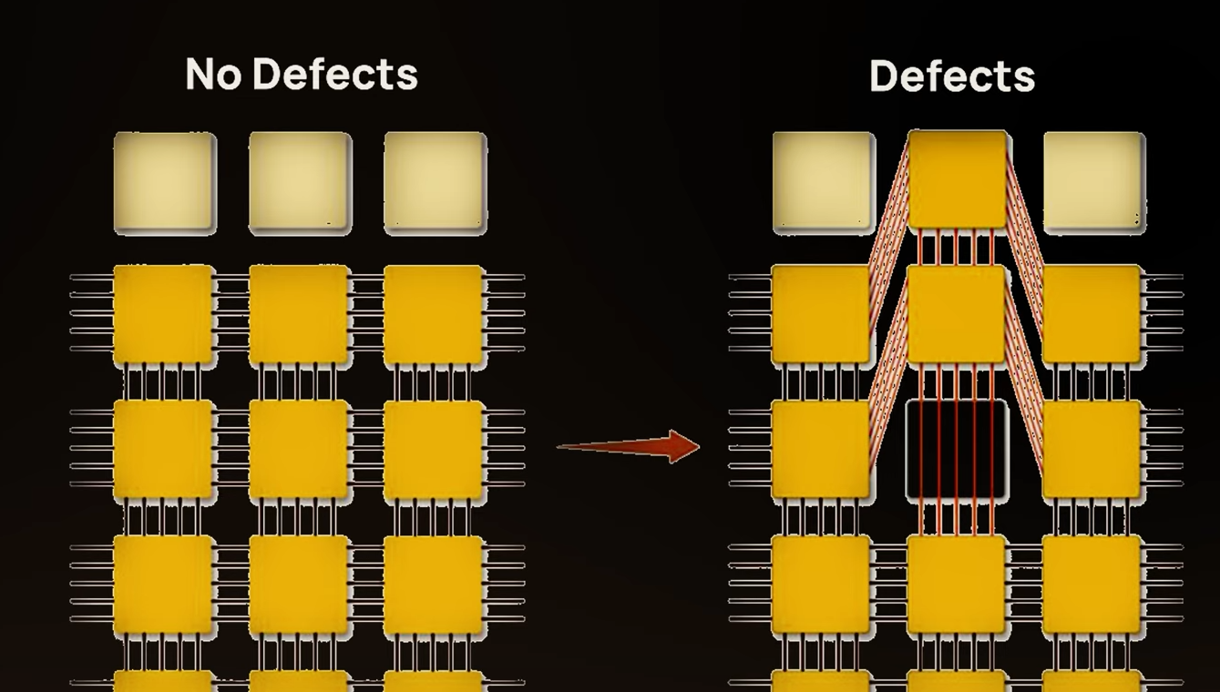
Redundancy for Yield
Image: Sean Lie, “How Cerebras Solved the Yield Problem,” YouTube
Similar idea to Altera FPGAs, but details different
Redundant links to route around broken PEs
Invisible to Cerebras SW: it can assume a slightly smaller perfect array

Slide 48
CAD Flow: Spatio-Temporal Mapping
Spatial: similarities to FPGA CAD
  Place 900,000 processors to minimize communication distance (wirelength) and latency (timing)
  Route traffic through mesh-based NoC
    Static routes; 24 colors per router
    Like an FPGA routing channel with 24 tracks
    But all time-domain multiplexed onto the same links
Temporal:
  Processors with local SRAM: temporal computation
  Can modify the ‘static’ routes over time → like partial reconfiguration

Slide 49
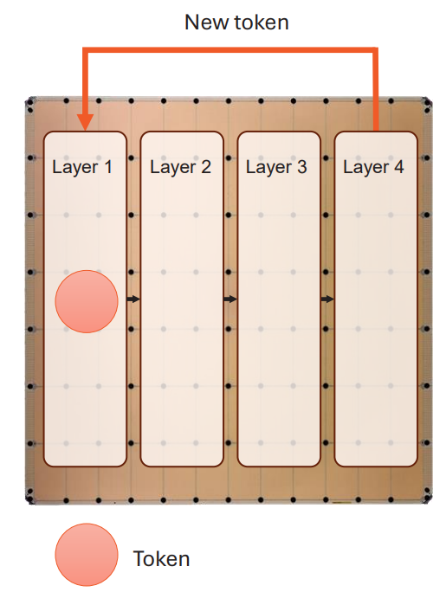
Large Language Model (LLM) Inference on the WSE
Many cores allocated to each layer of an LLM
  Distributed matrix-vector multiplication, attention, …
Output token vector passes to next layer in a spatial pipeline
All weights stored on wafer → near-memory computing
Good match to auto-regressive LLM inference
S. Li, “Wafer-Scale AI: GPU Impossible Performance,” Hot Chips, 2024.

Slide 50
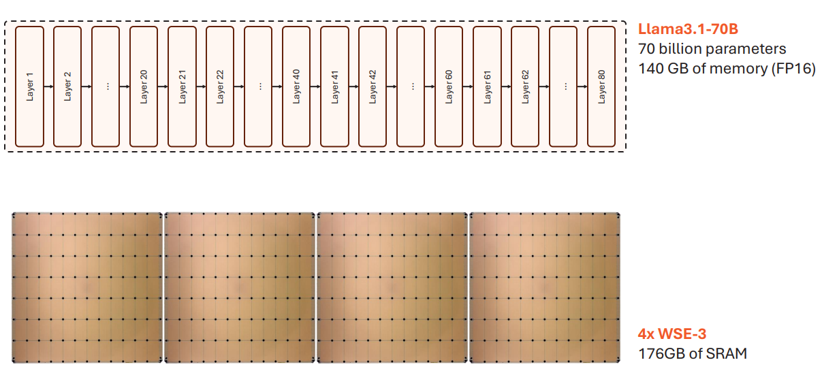
Bigger Models → Pipeline Across WSEs
Lower precisions benefit memory: fp8 weights → 2x WSE-3
S. Li, “Wafer-Scale AI: GPU Impossible Performance,” Hot Chips, 2024.

Slide 51
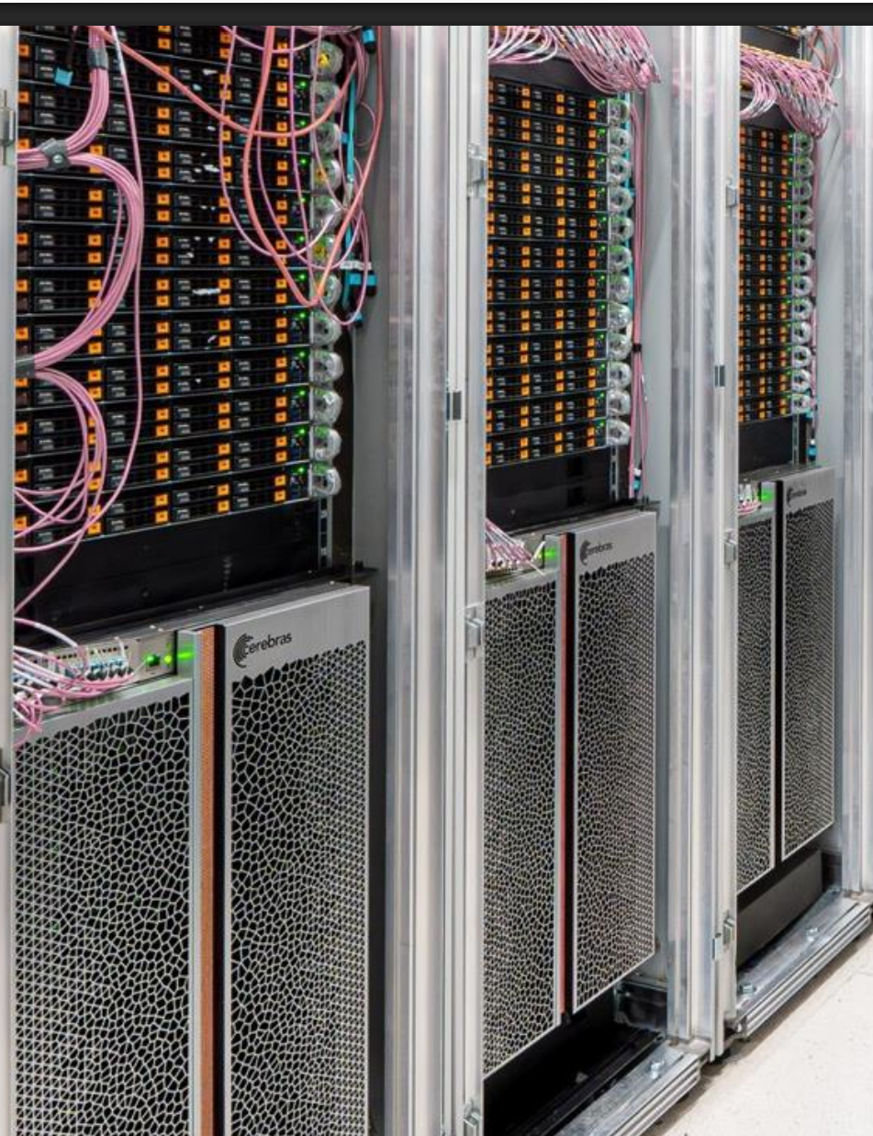
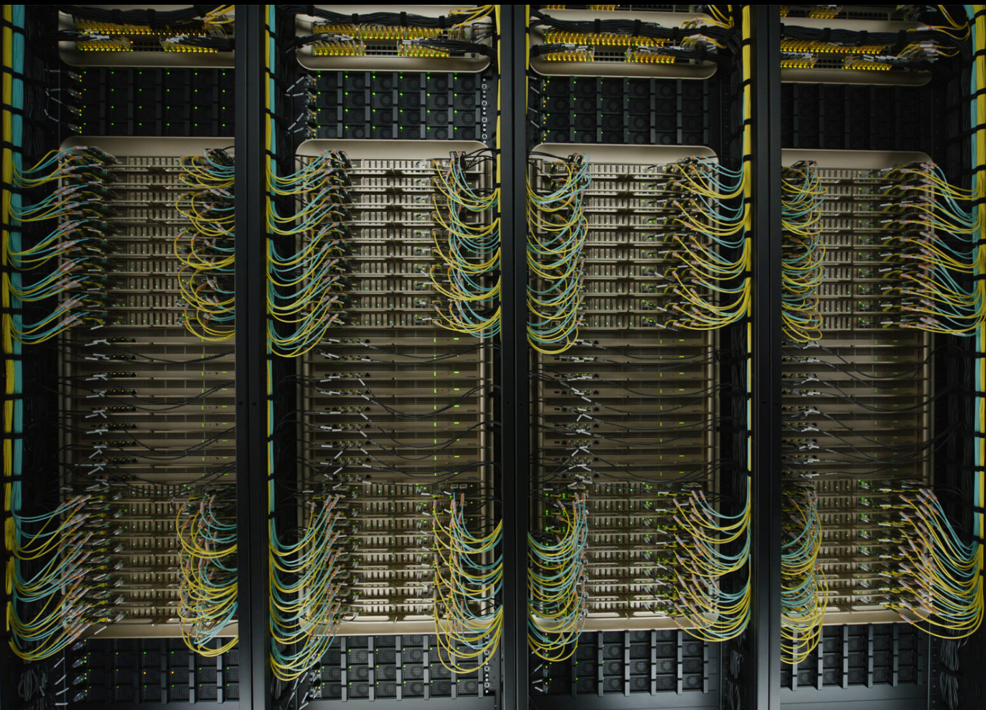
Datacenter-Scale Up Comparison
Multiple Cerebras WSE networked → can form a pipeline
Hierarchical composition: NVL72 is 72 GPUs (144 dice) + 36 CPUs + custom NVLink interconnect
Networking can connect multiple NVL72

Slide 52
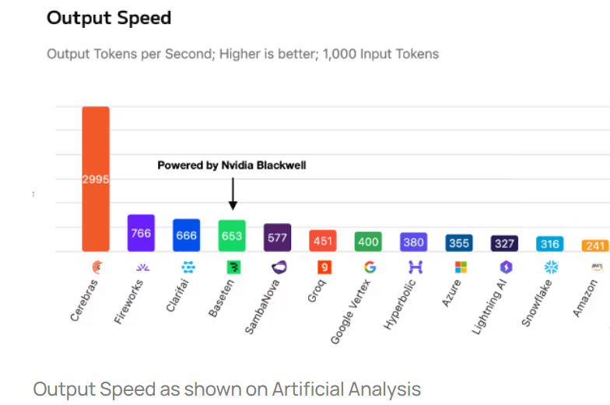
LLM Inference Performance (GPT-OSS-120B)
Tokens per second (each user): critical for reasoning models, large scale code generation, etc.
Tokens / sec
CGRA
https://www.cerebras.ai/blog/blackwell-vs-cerebras
Nov. 6, 2025

Slide 53
Wrap Up and Some Personal Lessons Learned

Slide 54
CAD and Architecture Challenges
Spatial computing & more-than-moore well suited to DL
Don’t be too programmable → much of DL is repetitive matrix-vector and matrix-matrix ops
Custom SoCs with FPGA logic, die-stacked FPGAs, unique accelerators
  Have tools to investigate (e.g. VTR)
  Tools to implement (e.g. OpenFPGA)
  Era of bespoke FPGAs?
Wafer-scale and spatio-temporal computation
  Cerebras arch, AMD AI engines, …
  Complex mapping problem: spatial & temporal
  Need new architecture evaluation tools
  Huge space to explore: many discoveries to make!

Slide 55
Personal Lessons Learned
Technical breadth is very useful
  I like learning how more things fit together
    Software, CAD, hardware, applications, more-than-Moore manufacturing, …
    Led to many of my biggest research and industrial successes
    And interesting!
Building to last / extend fits well with breadth
  VPR/VTR: has gone much farther than I ever expected
  Key was integrating features together, in a maintainable way

