Slide 1
Operating Systems
ECE344
Lecture 11: File System
Ding Yuan

Slide 2
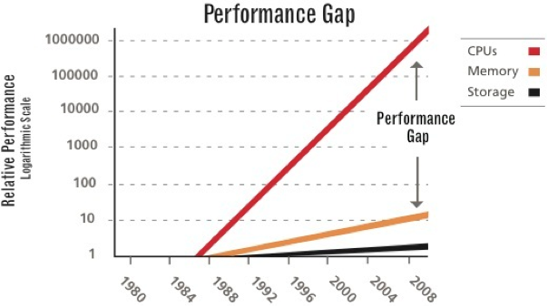
Big picture: performance gap

Slide 3
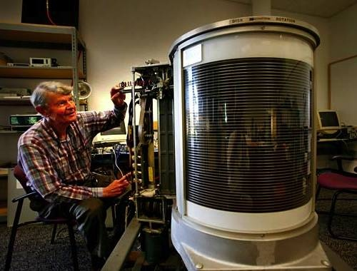
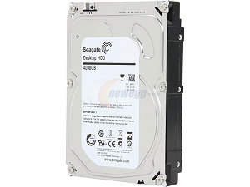
What problem are we solving?
Data storage & access
  Super important
One of the fastest growing industry
  Why?
  Driven by technology
1956, IBM, 24 inches, 3.75MB, 1KB/sec, > $150,000
2015, Seagate, 3.5 inches, 5TB, 6Gb/sec, < $200

Slide 4
What problem are we solving?
One of the fastest growing industry
  Why?
  Driven by technology
  Driven by demand
    Mainframe storage: IBM, Memorex
    PC storage: Seagate, DEC, Quantum, etc.
    Enterprise Storage: EMC, NetApp, etc.
    Cloud Storage: Dropbox, Google Drive, etc.

Slide 5
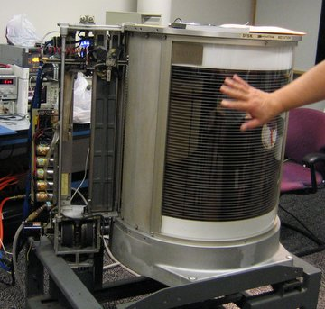
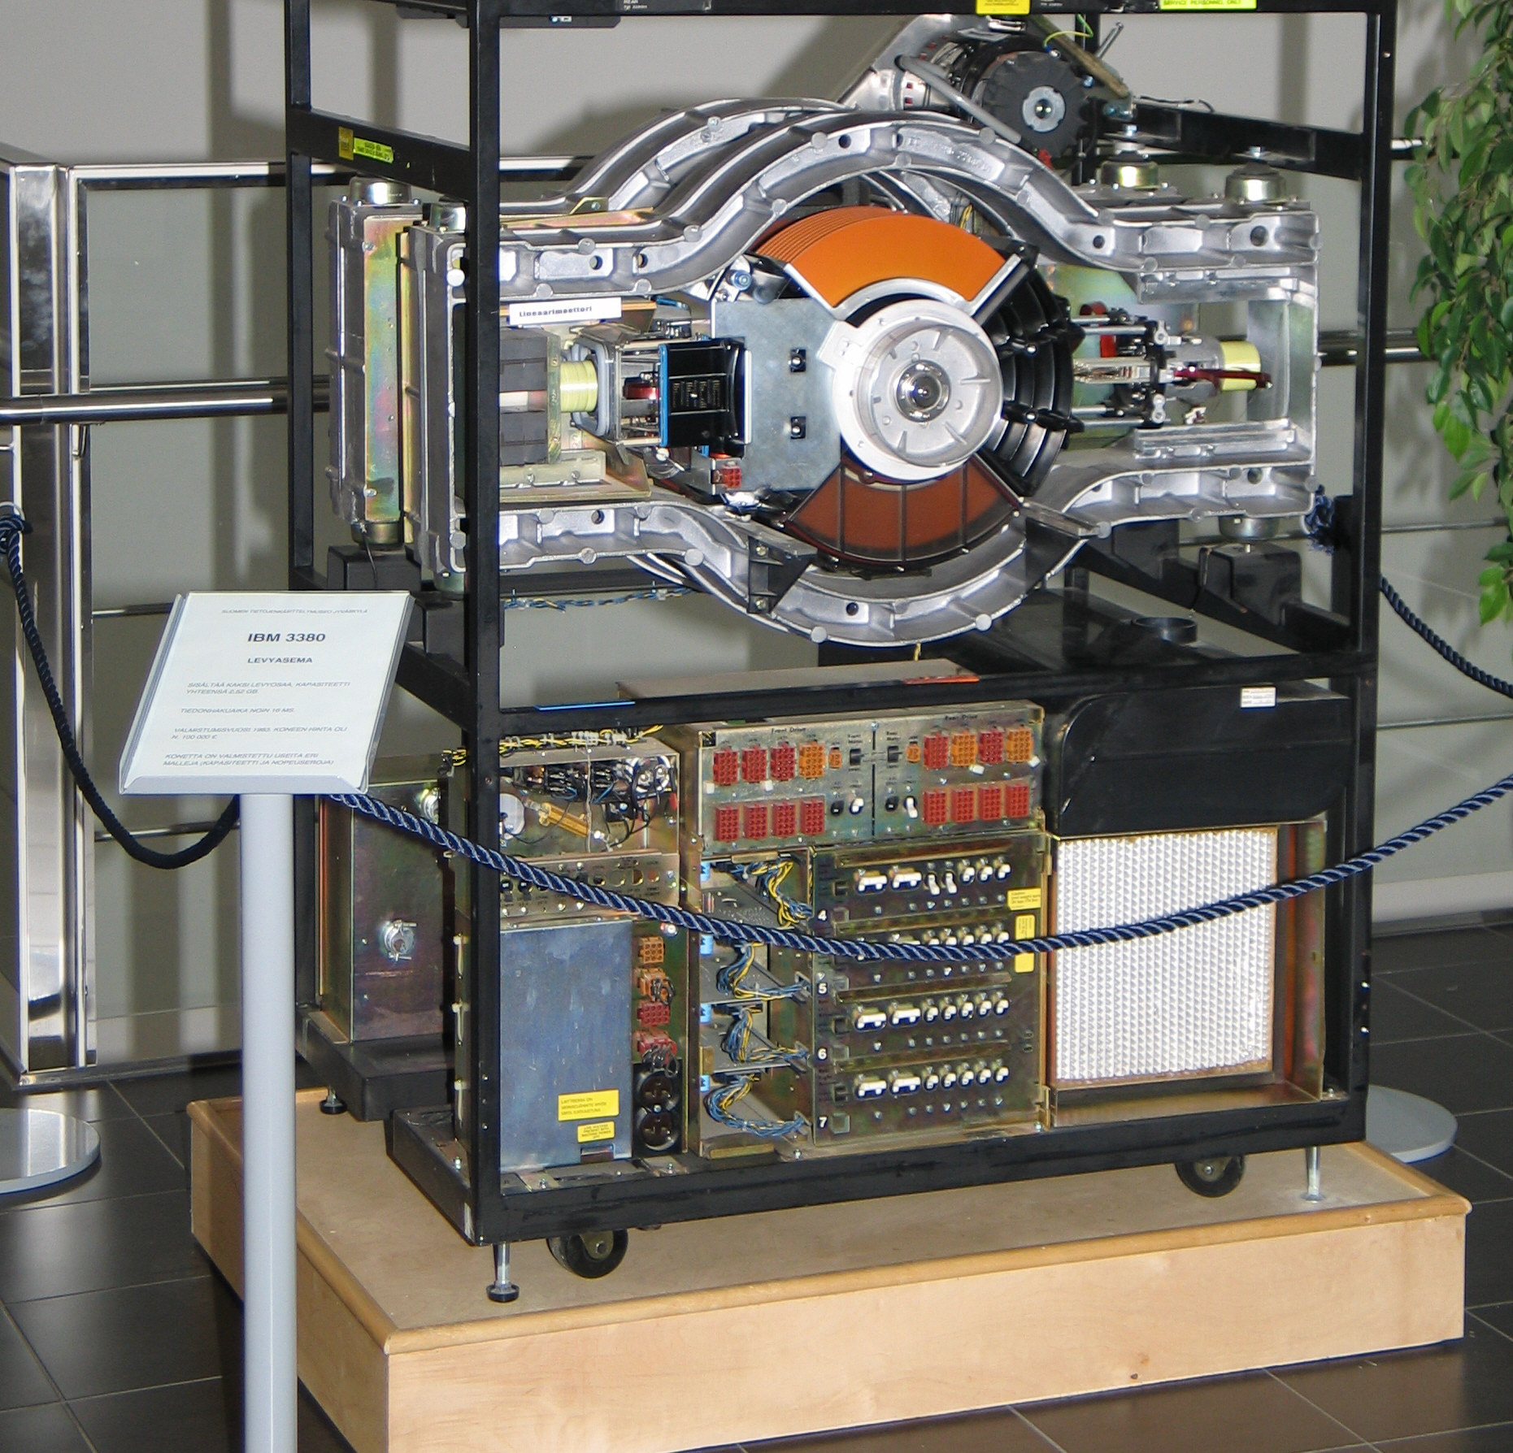
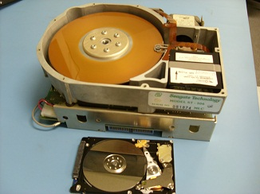
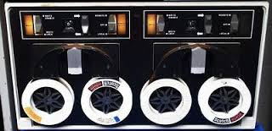

History of storage tech
1956: IBM 350, 24 inches,
3.75MB, 1KB/sec, > $150,000
1980: IBM 3380, first GB
disk (1.26G), > $100K
1980: ST-560, first 5.25
inch drive, 5MB, $1500
NextCom notebook 2006: first
laptop w/ SSD as storage
Tape (DECtape): primary storage for
main-frames and mini-computers (1950 ~ 70s)

Slide 6
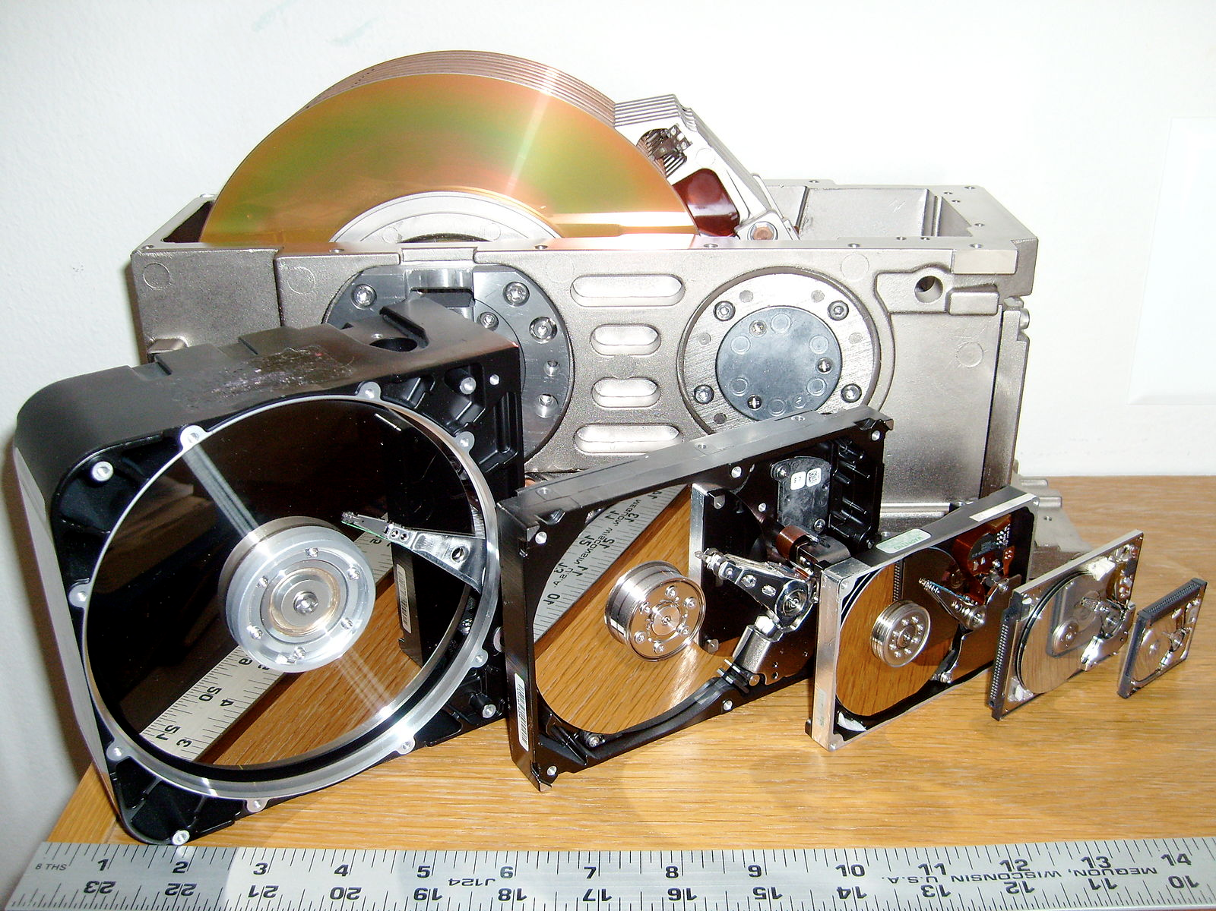
Image source: https://en.wikipedia.org/wiki/File:SixHardDriveFormFactors.jpg/

Slide 7
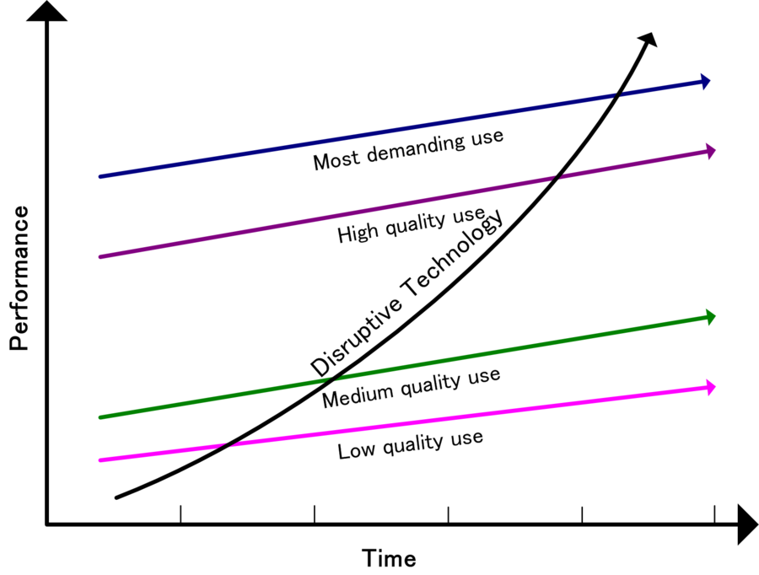

Storage Industry: The origin of “disruptive technology”
Image source: https://en.wikipedia.org/wiki/Disruptive_innovation
Image source: amazon.ca

Slide 8
File Systems
First we’ll discuss properties of physical disks
  Structure
  Performance
  Scheduling
Then we’ll discuss how we build file systems on them
  Files
  Directories
  Sharing
  Protection
  File System Layouts
  File Buffer Cache
  Read Ahead
Finally, we will discuss SSD

Slide 9
Disks and the OS
Disks are messy physical devices
  Errors, bad blocks, missed seeks, etc.
The job of the OS is to hide this mess from higher level software
  Low-level device control (initiate a disk read, etc.)
  Higher-level abstractions (files, databases, etc.)

Slide 10
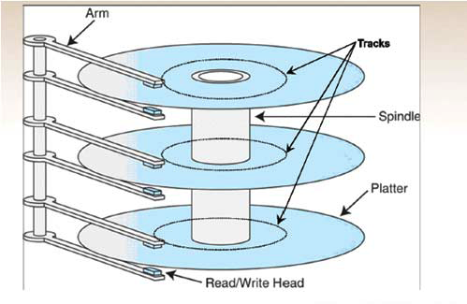
How hard disk work?
http://www.youtube.com/watch?v=kdmLvl1n82U
https://youtu.be/9eMWG3fwiEU?t=11
Disk components
  Platters
  Surfaces
  Tracks
  Cylinders
  Sectors
  Arm
  Heads

Slide 11
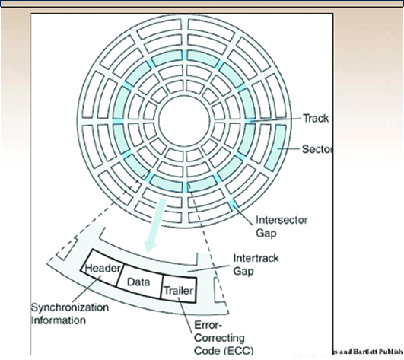
Another View of Disk

Slide 12
Disk Interaction
Specifying disk requests requires a lot of info:
  Cylinder #, surface #, sector #, transfer size…
Older disks required the OS to specify all of this
  The OS needed to know all disk parameters
Modern disks are more complicated
  Not all sectors are the same size, sectors are remapped, etc.
Current disks provide a higher-level interface (SCSI)
  The disk exports its data as a logical array of blocks [0…N]
    Disk maps logical blocks to cylinder/surface/track/sector
  Only need to specify the logical block # to read/write
  But now the disk parameters are hidden from the OS

Slide 13
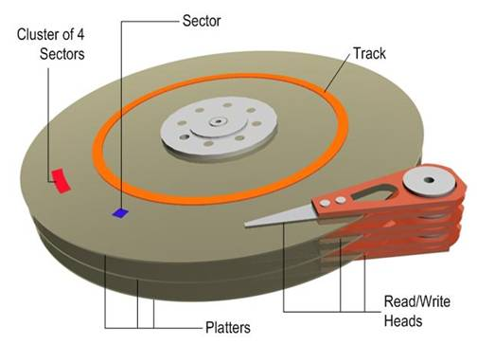
Disk Performance
Random disk access is SLOW!
Access data sequentially: only suffer one seek and rotational delay
Data
Rotational delay
Seek
Random disk access: suffers one seek and rotational delay every time!

Slide 14
Disk Performance
Disk request performance depends upon three steps
  Seek – moving the disk arm to the correct cylinder
    Depends on how fast disk arm can move (increasing very slowly)
  Rotation – waiting for the sector to rotate under the head
    Depends on rotation rate of disk (increasing, but slowly)
  Transfer – transferring data from surface into disk controller electronics, sending it back to the host
    Depends on density (increasing quickly)
When the OS uses the disk, it tries to minimize the cost of all of these steps
  Particularly seeks and rotation

Slide 15
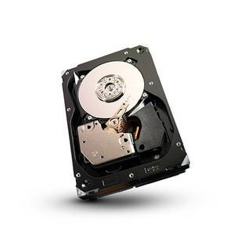
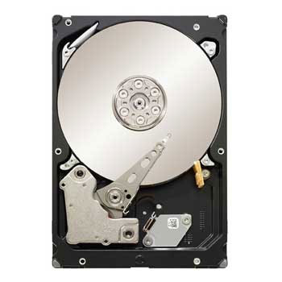
Disks: 2016
Seagate Cheetah 3.5" (server)
  capacity: 300 - 600 GB
  rotational speed: 15,000 RPM
  sequential read performance: 122 MB/s - 204 MB/s
  seek time (average): 3.4 ms
Seagate Barracuda 3.5" (desktop)
  capacity: 250 GB – 4TB
  rotational speed: 7,200 RPM
  sequential read performance: 125 MB/s - 146 MB/s
  seek time (average): 8.5 ms

Slide 16
Disk Scheduling
Because seeks are so expensive (milliseconds!), the OS tries to schedule disk requests that are queued waiting for the disk
  FCFS (do nothing)
    Reasonable when load is low
    Long waiting times for long request queues
  SSTF (shortest seek time first)
    Minimize arm movement (seek time), maximize request rate
    Favors middle blocks
  SCAN (elevator)
    Service requests in one direction until done, then reverse
  C-SCAN
    Like SCAN, but only go in one direction (typewriter)

Slide 17
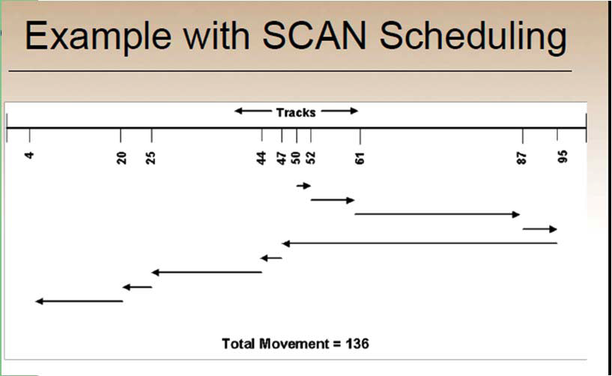

Slide 18
Disk Scheduling (2)
In general, unless there are large request queues, disk scheduling does not have much impact
  Important for servers, less so for PCs
Modern disks often do the disk scheduling themselves
  Disks know their layout better than OS, can optimize better
  Ignores, undoes any scheduling done by OS

Slide 19
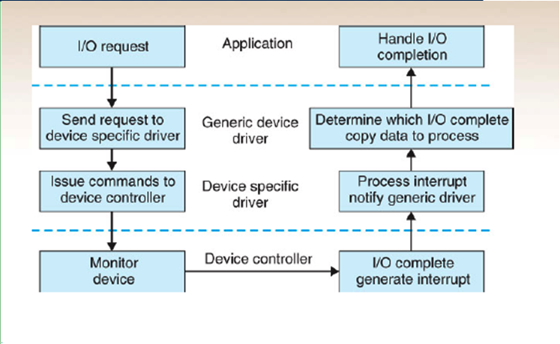
Stages of I/O Request

Slide 20
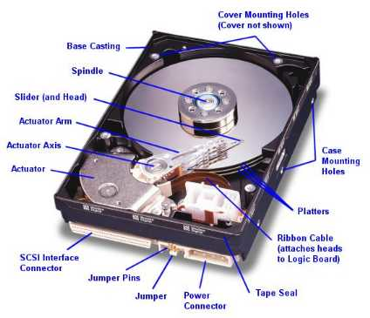

But do you directly program on “disk”?
Life with an OS
file = open (“test.txt”, O_WRONLY);
write (file, “test”, 4);
close (file);
Life without an OS
Where is this file on disk? Which platter, track, and sectors?
Code needs to change on a different system

Slide 21
File Systems
File systems
  Implement an abstraction (files) for secondary storage
  Organize files logically (directories)
  Permit sharing of data between processes, people, and machines
  Protect data from unwanted access (security)

Slide 22
Files
A file is data with some properties
  Contents, size, owner, last read/write time, protection, etc.
A file can also have a type
  Understood by other parts of the OS or runtime libraries
    Executable, dll, souce, object, text, etc.
  Understood by the file system
    Block/character device, directory, link, etc.
A file’s type can be encoded in its name or contents
  Windows encodes type in name
    .com, .exe, .bat, .dll, .jpg, etc.
  Unix encodes type in contents
    Magic numbers, initial characters (e.g., #! for shell scripts)

Slide 23
Basic File Operations
Unix
creat(name)
open(name, how)
read(fd, buf, len)
write(fd, buf, len)
sync(fd)
seek(fd, pos)
close(fd)
unlink(name)
Windows
CreateFile(name, CREATE)
CreateFile(name, OPEN)
ReadFile(handle, …)
WriteFile(handle, …)
FlushFileBuffers(handle, …)
SetFilePointer(handle, …)
CloseHandle(handle, …)
DeleteFile(name)
CopyFile(name)
MoveFile(name)
Notes:
open: transfer Access control list to capability based security model

Slide 24
Directories
Directories serve two purposes
  For users, they provide a structured way to organize files
  For the file system, they provide a convenient naming interface that allows the implementation to separate logical file organization from physical file placement on the disk
Most file systems support multi-level directories
  Naming hierarchies (/, /usr, /usr/local/, …)
Most file systems support the notion of a current directory
  Relative names specified with respect to current directory
  Absolute names start from the root of directory tree

Slide 25
Directory Internals
A directory is a list of entries
  <name, location>
  Name is just the name of the file or directory
  Location depends upon how file is represented on disk
List is usually unordered (effectively random)
  Entries usually sorted by program that reads directory
Directories typically stored in files

Slide 26
Basic Directory Operations
Unix
Directories implemented in files
  Use file ops to create dirs
C runtime library provides a higher-level abstraction for reading directories
  opendir(name)
  readdir(DIR)
  seekdir(DIR)
  closedir(DIR)
NT
Explicit dir operations
  CreateDirectory(name)
  RemoveDirectory(name)
Very different method for reading directory entries
  FindFirstFile(pattern)
  FindNextFile()

Slide 27
Path Name Translation
Let’s say you want to open “/one/two/three”
What does the file system do?
  Open directory “/” (well known, can always find)
  Search for the entry “one”, get location of “one” (in dir entry)
  Open directory “one”, search for “two”, get location of “two”
  Open directory “two”, search for “three”, get location of “three”
  Open file “three”
Systems spend a lot of time walking directory paths
  This is why open is separate from read/write
  OS will cache prefix lookups for performance
    /a/b, /a/bb, /a/bbb, etc., all share “/a” prefix

Slide 28
File System Layout
How do file systems use the disk to store files?
File systems define a block size (e.g., 4KB)
  Disk space is allocated in granularity of blocks
A “Master Block” determines location of root directory
  Always at a well-known disk location
  Often replicated across disk for reliability
A free map determines which blocks are free, allocated
  Usually a bitmap, one bit per block on the disk
  Also stored on disk, cached in memory for performance
Remaining disk blocks used to store files (and dirs)
  There are many ways to do this

Slide 29
Disk Layout Strategies
Files span multiple disk blocks
How do you find all of the blocks for a file?
  1. Contiguous allocation
    Fast, simplifies directory access
    Inflexible, causes fragmentation, needs compaction
  2. Linked structure
    Each block points to the next, directory points to the first
    Good for sequential access, bad for all others
  3. Indexed structure (indirection, hierarchy)
    An “index block” contains pointers to many other blocks
    Handles random better, still good for sequential
    May need multiple index blocks (linked together)

Slide 30
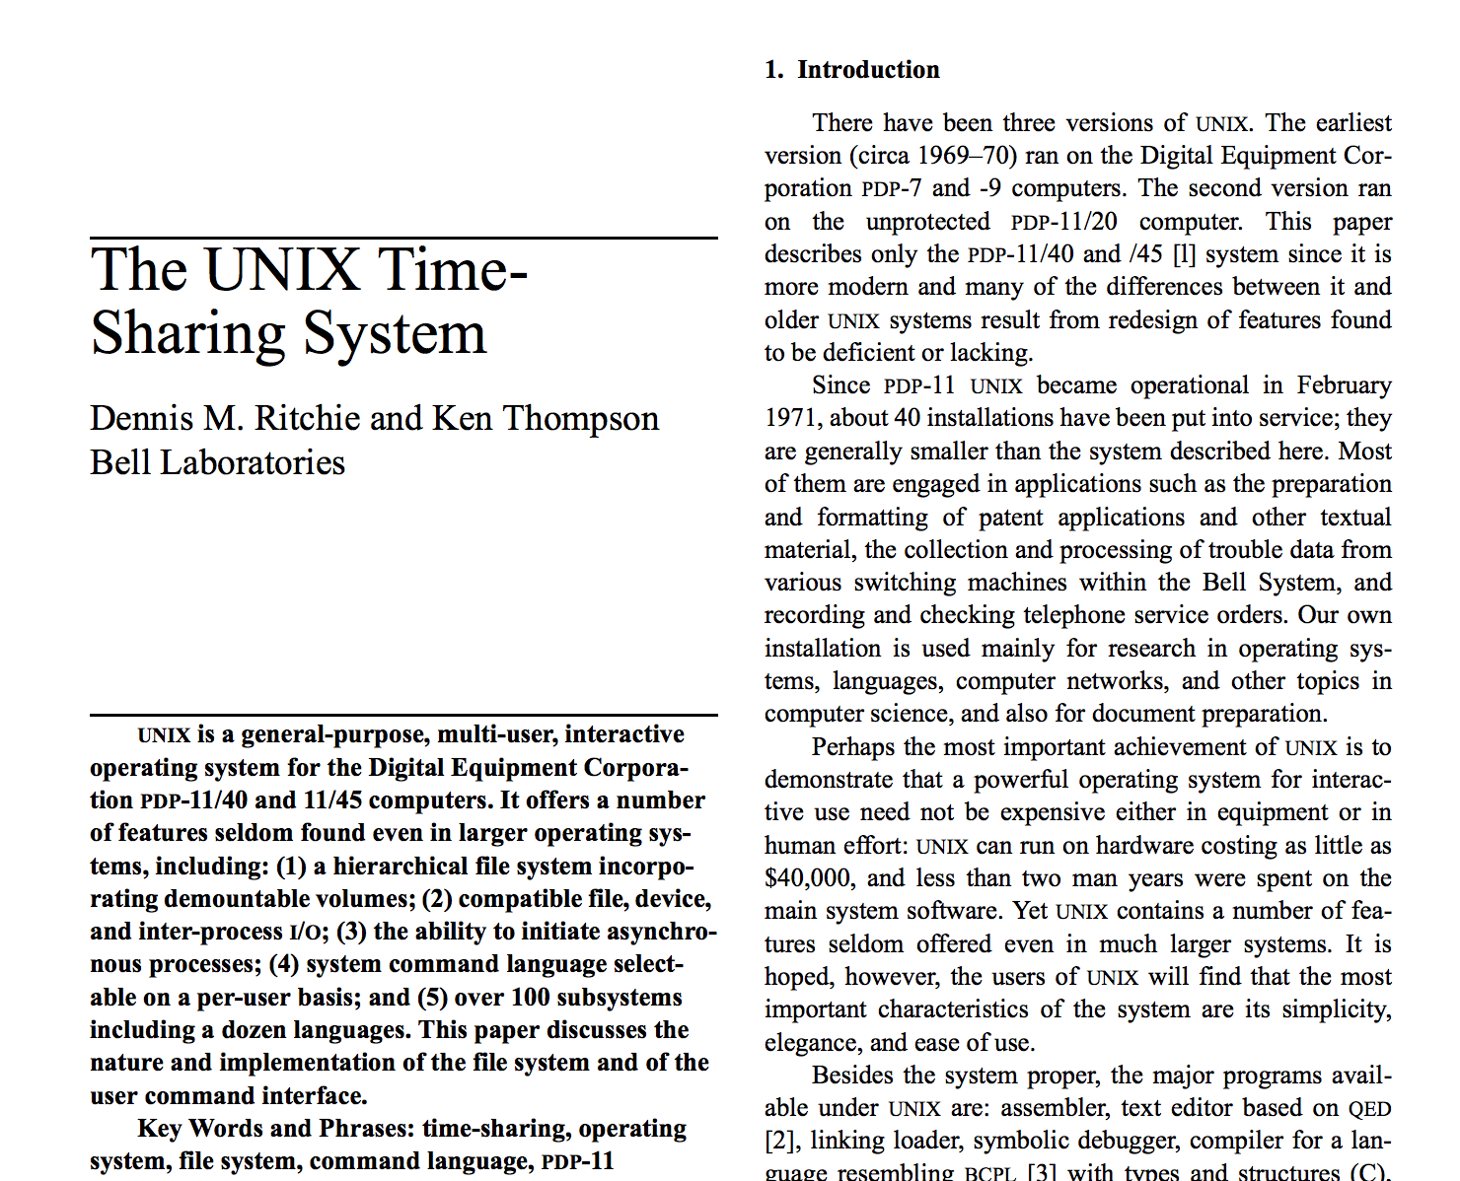
Logical layout: inode (index node)

Slide 31
Unix Inodes
Unix inodes implement an indexed structure for files
  Also store metadata info (protection, timestamps, length, ref count…)
Each inode contains 15 block pointers
  First 12 are direct blocks (e.g., 4 KB blocks)
  Then single, double, and triple indirect
(Metadata)
0
1
…
…
12
(1)
13
(2)
14
(3)
…
…

Slide 32
Unix Inodes and Path Search
Unix Inodes are not directories
Inodes describe where on the disk the blocks for a file are placed
  Directories are files, so inodes also describe where the blocks for directories are placed on the disk
Directory entries map file names to inodes
  To open “/one”, use Master Block to find inode for “/” on disk
  Open “/”, look for entry for “one”
  This entry gives the inode number for the inode for “one”
  Read the inode for “one” into memory
  The inode says where first data block is on disk
  Read that block into memory to access the data in the file

Slide 33
Example: read /bin/ls
/bin/ls
inode of /
inode of /bin
usr 2783
bin 3512
.. ..
inode of /bin/ls
cd 5193
ls 5728
.. ..
…
instructions
of ls.. ..
instructions
of ls.. ..

Slide 34
Sharing Files btw. Directories
Links (or hard links)
  ln source_file target_dir
    Simply create another link from target_dir to the inode of source_file (the inode is not duplicated)
    Now two directories have links to source_file
    What if we remove one?
    Now you understand why the system call to remove a file is named “unlink”?

Slide 35
File Buffer Cache
Applications exhibit significant locality for reading and writing files
Idea: Cache file blocks in memory to capture locality
  This is called the file buffer cache
  Cache is system wide, used and shared by all processes
  Reading from the cache makes a disk perform like memory
  Even a 4 MB cache can be very effective
Issues
  The file buffer cache competes with VM (tradeoff here)
  Like VM, it has limited size
  Need replacement algorithms again (LRU usually used)

Slide 36
Caching Writes
On a write, some applications assume that data makes it through the buffer cache and onto the disk
  As a result, writes are often slow even with caching
Several ways to compensate for this
  “write-behind”
    Maintain a queue of uncommitted blocks
    Periodically flush the queue to disk
    Unreliable
  Battery backed-up RAM (NVRAM)
    As with write-behind, but maintain queue in NVRAM
    Expensive

Slide 37
Performance Issues
Original Unix FS had two placement problems:
1. Data blocks allocated randomly in aging file systems
  Blocks for the same file allocated sequentially when FS is new
  As FS “ages” and fills, need to allocate into blocks freed up when other files are deleted
  Problem: Deleted files essentially randomly placed
  So, blocks for new files become scattered across the disk
2. Inodes allocated far from blocks
  All inodes at beginning of disk, far from data
  Traversing file name paths, manipulating files, directories requires going back and forth from inodes to data blocks
Both of these problems generate many long seeks

Slide 38
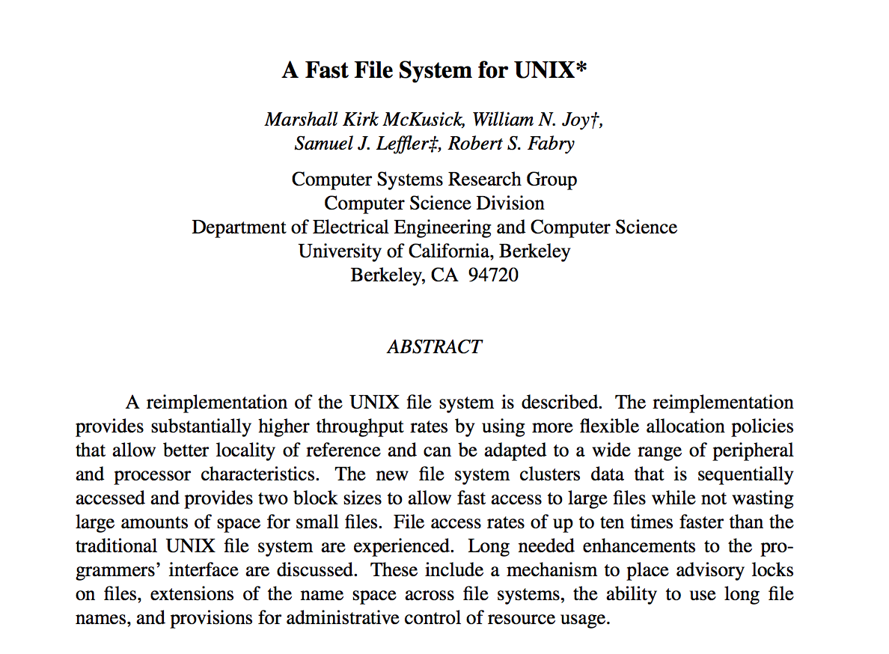
FreeBSD Fast File System

Slide 39
Fast File System
BSD FFS addressed these problems using the notion of a cylinder group
  Disk partitioned into groups of cylinders
  Data blocks in same file allocated in same cylinder
  Files in same directory allocated in same cylinder
  Inodes for files allocated in same cylinder as file data blocks
Free space requirement
  To be able to allocate according to cylinder groups, the disk must have free space scattered across cylinders
  10% of the disk is reserved just for this purpose

