Slide 1
Operating Systems
ECE344
Lecture 7: Memory Management
Ding Yuan

Slide 2
Memory Management
Next few lectures are going to cover memory management
Goals of memory management
  To provide a convenient abstraction for programming
  To allocate scarce memory resources among competing processes to maximize performance with minimal overhead
Mechanisms
  Physical and virtual addressing (1)
  Techniques: partitioning, paging, segmentation (1)
  Page table management, TLBs, VM tricks (2)
Policies
  Page replacement algorithms (3)

Slide 3
Lecture Overview
Virtual memory
Survey techniques for implementing virtual memory
  Fixed and variable partitioning
  Paging
  Segmentation
Focus on hardware support and lookup procedure
  Next lecture we’ll go into sharing, protection, efficient implementations, and other VM tricks and features

Slide 4
Why Virtual Memory?
The abstraction that the OS will provide for managing memory is virtual memory (VM)
  Enables a program to execute with less than its complete data in physical memory
    A program can run on a machine with less memory than it “needs”
    Many programs do not need all of their code and data at once (or ever) – no need to allocate memory for it
  Processes cannot see the memory of others’
  OS will adjust amount of memory allocated to a process based upon its behavior
  VM requires hardware support and OS management algorithms to pull it off
Let’s go back to the beginning…

Slide 5
In the beginning…
Rewind to the old days (generally before 1970s)
  Programs use physical addresses directly
  OS loads job, runs it, unloads it
Multiprogramming changes all of this
  Want multiple processes in memory at once
    Overlap I/O and CPU of multiple jobs
  Can do it a number of ways
    Fixed and variable partitioning, paging, segmentation
  Requirements
    Need protection – restrict which addresses jobs can use
    Fast translation – lookups need to be fast
    Fast change – updating memory hardware on context switch

Slide 6
Virtual Addresses
To make it easier to manage the memory of processes running in the system, we’re going to make them use virtual addresses (logical addresses)
  Virtual addresses are independent of the actual physical location of the data referenced
  OS determines location of data in physical memory
  Instructions executed by the CPU issue virtual addresses
  Virtual addresses are translated by hardware into physical addresses (with help from OS)
  The set of virtual addresses that can be used by a process comprises its virtual address space

Slide 7
Remember this example?
int myval;
int main(int argc, char *argv[])
{
myval = atoi(argv[1]);
while (1)
printf(“myval is %d, loc 0x%lx\n”, myval, (long) &myval);
}
Now simultaneously start two instances of this program
  Myval 5
  Myval 6
  What will the outputs be?

Slide 8
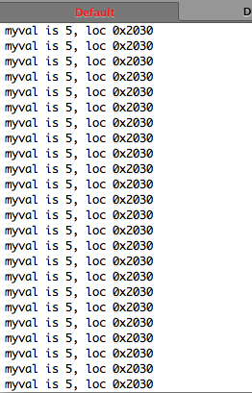
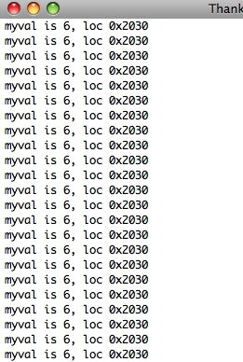

Slide 9
Virtual Addresses
virtual
addresses
physical
addresses
physical
memory
processor
vmap
Many ways to do this translation…
  Start with old, simple ways, progress to current techniques

Slide 10
Fixed Partitions
Physical memory is broken up into fixed partitions
  Hardware requirements: base register
  Physical address = virtual address + base register
  Base register loaded by OS when it switches to a process
  Size of each partition is the same and fixed
  How do we provide protection?
Advantages
  Easy to implement, fast context switch
Problems
  Internal fragmentation: memory in a partition not used by a process is not available to other processes
  Partition size: one size does not fit all (very large processes?)

Slide 11
Fixed Partitions
Physical Memory
Base Register
P1
P4’s Base
P2
Internal
fragmentation
P3
Virtual Address
Offset
+
P4
P5

Slide 12
Variable Partitions
Natural extension – physical memory is broken up into variable sized partitions
  Hardware requirements: base register and limit register
  Physical address = virtual address + base register
  Why do we need the limit register? Protection
    If (physical address > base + limit) then exception fault
Advantages
  No internal fragmentation: allocate just enough for process
Problems
  External fragmentation: job loading and unloading produces empty holes scattered throughout memory

Slide 13
Variable Partitions
Base Register
P3’s Base
P1
External
fragmentation
Limit Register
P2
P3’s Limit
Virtual Address
Yes?
Offset
<
+
P3
No?
Protection Fault

Slide 14
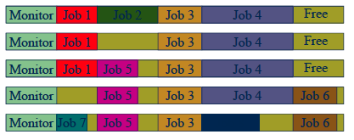
Variable Partitions and Fragmentation
Memory wasted by External Fragmentation
1
2
3
4
5
Do you know about disk de-fragmentation?
It can improve your system performance!

Slide 15
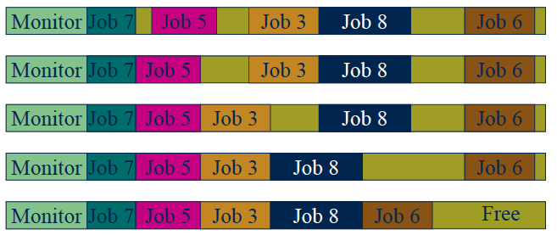
Compaction
Processes must be suspended during compaction
Need be done only when fragmentation gets very bad
5
6
7
8
9

Slide 16
Paging
Paging solves the external fragmentation problem by using fixed sized units in both physical and virtual memory
Physical Memory
Virtual Memory
Page 1
Page 2
Page 3
Page N

Slide 17
Internal vs. External fragmentation
How paging can solve fragmentation problems?
  External fragmentation: can be solved by re-mapping between VA and PA
  Internal fragmentation: can be solved if the page size is relatively small

Slide 18
User/Process Perspective
Users (and processes) view memory as one contiguous address space from 0 through N
  Virtual address space (VAS)
In reality, pages are scattered throughout physical storage
  Different from variable partition, where the physical memory for each process is contiguously allocated
The mapping is invisible to the program
Protection is provided because a program cannot reference memory outside of its VAS
  The address “0x1000” maps to different physical addresses in different processes

Slide 19
Question
Page size is always a power of 2
  Examples: 4096 bytes = 4KB, 8192 bytes = 8KB
  Why?
  Why not 1000 or 2000?

Slide 20
Paging
Translating addresses
  Virtual address has two parts: virtual page number and offset
  Virtual page number (VPN) is an index into a page table
  Page table determines page frame number (PFN)
  Physical address is PFN::offset
Page tables
  Map virtual page number (VPN) to page frame number (PFN)
    VPN is the index into the table that determines PFN
  One page table entry (PTE) per page in virtual address space
    Or, one PTE per VPN

Slide 21
Page Lookups
Physical Memory
Virtual Address
Page number
Offset
Physical Address
Page Table
Page frame
Offset
Page frame

Slide 22
Paging Example
Pages are 4K (Linux default)
  VPN is 20 bits (2²⁰ VPNs), offset is 12 bits
Virtual address is 0x7468 (hexadecimal)
  Virtual page is 0x7, offset is 0x468
Page table entry 0x7 contains 0x2000
  Page frame number is 0x2000
  Seventh virtual page is at address 0x2000 (2nd physical page)
Physical address = 0x2000 + 0x468 = 0x2468

Slide 23
Page Lookups
Example: how do we ‘load 0x00007468’?
Virtual Address
Physical Memory
0
0
0
0
7
4
6
8
Virtual page
number
Offset
Physical Address
0x0002467
0x0002468
.. .. .. ..
0x0002
468
‘A’
index
page frame
.. .. .. ..
0x00006
Questions:
How large is the RAM?
How big is the page table?
Besides page frame, what else
we need to store in the page table?
0x00007
.. .. .. ..
0x0002
Page Table

Slide 24
Page Table Entries (PTEs)
1
1
1
2
20 (determined by the size of physical memory)
M
R
V
Prot
Page Frame Number
Page table entries control mapping
  The Modify bit says whether or not the page has been written
    It is set when a write to the page occurs
  The Reference bit says whether the page has been accessed
    It is set when a read or write to the page occurs
  The Valid bit says whether or not the PTE can be used
    It is checked each time the virtual address is used
  The Protection bits say what operations are allowed on page
    Read, write, execute
  The page frame number (PFN) determines physical page
  If you’re interested: watch the OS lecture scene from “The Social Network” again, see if now you can understand
  http://www.youtube.com/watch?v=-3Rt2_9d7Jg

Slide 25
2-level page table
Single level page table size is too large
  4KB page, 32 bit virtual address, 1M entries per page table!

Slide 26
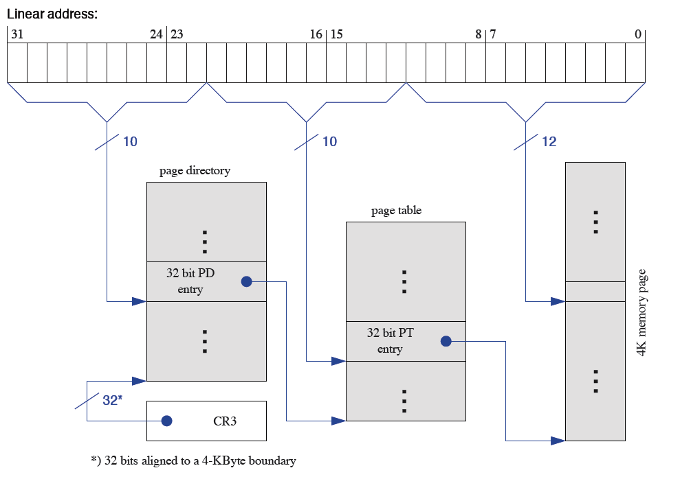

Slide 27
Two-Level Page Tables
Two-level page tables
  Virtual addresses (VAs) have three parts:
    Master page number, secondary page number, and offset
  Master page table maps VAs to secondary page table
  Secondary page table maps page number to physical page
  Offset indicates where in physical page address is located
Example
  4K pages, 4 bytes/PTE
  How many bits in offset? 4K = 12 bits
  Want master page table in one page: 4K/4 bytes = 1K entries
  Hence, 1K secondary page tables. How many bits?
  Master (1K) = 10, offset = 12, inner = 32 – 10 – 12 = 10 bits

Slide 28
Two-Level Page Tables
Physical Memory
Virtual Address
Master page number
Secondary
Offset
Physical Address
Page table
Page frame
Offset
Master Page Table
Page frame
Secondary Page Table

Slide 29
What is the problem with 2-level page table?
Hints:
  Programs only know virtual addresses
  Each virtual address must be translated
    Each program memory access requires several actual memory accesses
    Will discuss solution in the next lecture

Slide 30
Paging Advantages
Easy to allocate memory
  Memory comes from a free list of fixed size chunks
  Allocating a page is just removing it from the list
  External fragmentation not a problem
Easy to swap out chunks of a program
  All chunks are the same size
  Use valid bit to detect references to swapped pages
  Pages are a convenient multiple of the disk block size

Slide 31
Paging Limitations
Can still have internal fragmentation
  Process may not use memory in multiples of a page
Memory reference overhead
  2 references per address lookup (page table, then memory)
    Even more for two-level page tables!
  Solution – use a hardware cache of lookups (more later)
Memory required to hold page table can be significant
  Need one PTE per page
  32 bit address space w/ 4KB pages = 2²⁰ PTEs
  4 bytes/PTE = 4MB/page table
  25 processes = 100MB just for page tables!
    Remember: each process has its own page table!
  Solution – 2-level page tables

Slide 32
What if a process requires more memory than physical memory?
Swapping
  Move one/several/all pages of a process to disk
    Free up physical memory
    “Page” is the unit of swapping
  The freed physical memory can be mapped to other pages
  Processes that use large memory can be swapped out (and later back in)
Real life analogy?
  Putting things from your shelf to your parents’ house

Slide 33
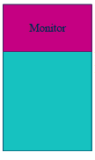
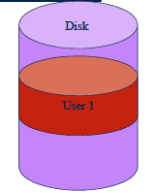
Swapping
Physical memory
Process 1

Slide 34
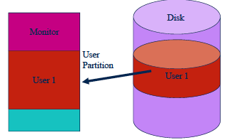
Swapping process 1’s data into memory
Physical memory
Process 1
Process 1

Slide 35
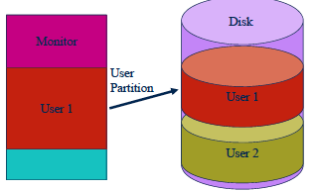
Swapping
Physical memory
Process 1
Process 1
Process 2

Slide 36
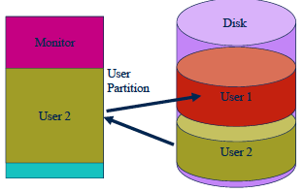
Swapping
Physical memory
Process 2
Process 1
Process 2

Slide 37
A variation of paging: Segmentation
Segmentation is a technique that partitions memory into logically related data units
  Module, procedure, stack, data, file, etc.
  Virtual addresses become <segment #, offset>
  Units of memory from user’s perspective
Natural extension of variable-sized partitions
  Variable-sized partitions = 1 segment/process
  Segmentation = many segments/process
Hardware support
  Multiple base/limit pairs, one per segment (segment table)
  Segments named by #, used to index into table

Slide 38
Segment Lookups
Segment Table
Physical Memory
limit
base
Segment #
Offset
Virtual Address
Yes?
<
+
No?
Protection Fault

Slide 39
Segment Table
Extensions
  Can have one segment table per process
    Segment #s are then process-relative
  Can easily share memory
    Put same translation into base/limit pair
    Can share with different protections (same base/limit, diff prot)
Problems
  Large segment tables
    Keep in main memory, use hardware cache for speed
  Large segments
    Internal fragmentation, paging to/from disk is expensive

Slide 40
Segmentation and Paging
Can combine segmentation and paging
  The x86 supports segments and paging
Use segments to manage logically related units
  Module, procedure, stack, file, data, etc.
  Segments vary in size, but usually large (multiple pages)
Use pages to partition segments into fixed size chunks
  Makes segments easier to manage within physical memory
    Segments become “pageable” – rather than moving segments into and out of memory, just move page portions of segment
  Need to allocate page table entries only for those pieces of the segments that have themselves been allocated
Tends to be complex…

Slide 41
Summary
Virtual memory
  Processes use virtual addresses
  OS + hardware translates virtual address into physical addresses
Various techniques
  Fixed partitions – easy to use, but internal fragmentation
  Variable partitions – more efficient, but external fragmentation
  Paging – use small, fixed size chunks, efficient for OS
  Segmentation – manage in chunks from user’s perspective
  Combine paging and segmentation to get benefits of both

