Slide 1
Operating Systems
ECE344
Lecture 8: Paging
Ding Yuan
Notes:
Question: java thread?

Slide 2
Lecture Overview
Today we’ll cover more paging mechanisms:
Optimizations
  Managing page tables (space)
  Efficient translations (TLBs) (time)
  Demand paged virtual memory (space)
Recap address translation
Advanced Functionality
  Sharing memory
  Copy on Write
  Mapped files

Slide 3
Review: Page Lookups
Example: how do we ‘load 0x00007468’?
Virtual Address
Physical Memory
0
0
0
0
7
4
6
8
Virtual page
number
Offset
Physical Address
0x0002467
0x0002468
.. .. .. ..
0x0002
468
‘A’
index
page frame
.. .. .. ..
0x00006
0x00007
.. .. .. ..
0x0002
Page Table
Notes:
Ram: 7 digits = 28 bits, 2^28 = 256MB
pagetable size: 2^20 entries = 1M entries. If each entry needs 4 bytes, then 4MB for page table!

Slide 4
Review: Two-Level Page Tables
Physical Memory
Virtual Address
Master page number
Secondary
Offset
Physical Address
Page table
Page frame
Offset
Master Page Table
Problem: each memory access requires several actual memory accesses
Page frame
Secondary Page Table

Slide 5
Problems with Efficiency
If OS is involved in every memory access for PT look up --- too slow (user<->kernel mode switch)
Every look-up requires multiple memory access
  Our original page table scheme already doubled the cost of doing memory lookups
    One lookup into the page table, another to fetch the data
  Now two-level page tables triple the cost!
    Two lookups into the page tables, a third to fetch the data
    And this assumes the page table is in memory

Slide 6
Solution to Efficient Translation
How can we use paging but also have lookups cost about the same as fetching from memory?
Hardware Support
  Cache translations in hardware
  Translation Lookaside Buffer (TLB)
  TLB managed by Memory Management Unit (MMU)

Slide 7
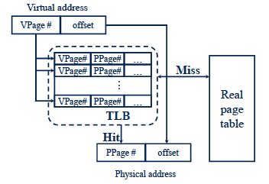
Translation Look-aside Buffer (TLB)

Slide 8
TLBs
Translation Lookaside Buffers
  Translate virtual page #s into PTEs (not physical addrs)
  Can be done in a single machine cycle
TLBs implemented in hardware
  Fully associative cache (all entries looked up in parallel)
  Cache tags are virtual page numbers
  Cache values are PTEs (entries from page tables)
  With PTE + offset, can directly calculate physical address
TLBs exploit locality
  Processes only use a handful of pages at a time
    16-48 entries/pages (64-192K)
    Only need those pages to be “mapped”
  Hit rates are therefore very important

Slide 9
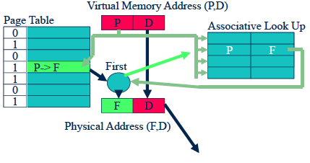
TLB Example
(VPN,Offset)
VPN
Offset
VPN
PPN
VPN->PPN
PPN
Offset
TLB
(PPN,Offset)

Slide 10
TLB Example
(VPN,Offset)
7
246
1
12
7
2
19
3
7->2
3
7
2
246
TLB
(PPN,Offset)

Slide 11
TLB Example: next reference
(VPN,Offset)
7
248
1
12
7
2
19
3
7->2
3
7
2
248
TLB
(PPN,Offset)

Slide 12
Managing TLBs
Address translations for most instructions are handled using the TLB
  >99% of translations, but there are misses (TLB miss)…
Who places translations into the TLB (loads the TLB)?
  Hardware (Memory Management Unit) [x86]
    Knows where page tables are in main memory
    OS maintains tables, HW accesses them directly
    Tables have to be in HW-defined format (inflexible)
  Software loaded TLB (OS) [MIPS, Alpha, Sparc, PowerPC]
    TLB faults to the OS, OS finds appropriate PTE, loads it in TLB
    Must be fast (but still 20-200 cycles)
    CPU ISA has instructions for manipulating TLB
    Tables can be in any format convenient for OS (flexible)

Slide 13
Managing TLBs (2)
OS ensures that TLB and page tables are consistent
  When it changes the protection bits of a PTE, it needs to invalidate the PTE if it is in the TLB
Reload TLB on a process context switch
  Invalidate all entries (called TLB flush)
  Why? What is one way to fix it?
When the TLB misses and a new PTE has to be loaded, a cached PTE must be evicted
  Choosing PTE to evict is called the TLB replacement policy
  Implemented in hardware (for hardware controlled TLBs), often simple (e.g., Last-Not-Used)

Slide 14
Bits in a TLB entry
Common (necessary) bits
  Virtual page number
  Physical page number
  Valid
  Access bits: kernel and user, read/write/execute
Optional (useful) bits
  Process tag
  Reference
  Modify

Slide 15
Now we switch gear
We’ve mentioned before that pages can be moved between memory and disk
  This process is called demand paging
OS uses main memory as a page cache of all the data allocated by processes in the system
  Initially, pages are allocated from memory
  When memory fills up, allocating a page in memory requires some other page to be evicted from memory
  Evicted pages go to disk (where? the swap file/backing store)
  The movement of pages between memory and disk is done by the OS, and is transparent to the application
Notes:
Question to ask students: does it make sense to use hardware to control swapping?

Slide 16
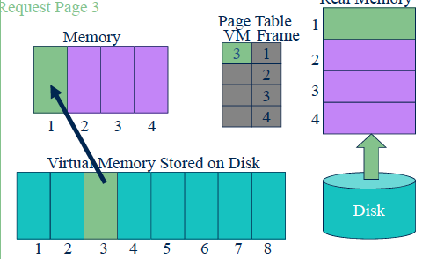
Demand paging
Real Memory

Slide 17
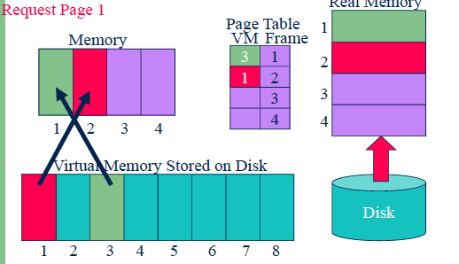
Demand paging
Real Memory

Slide 18
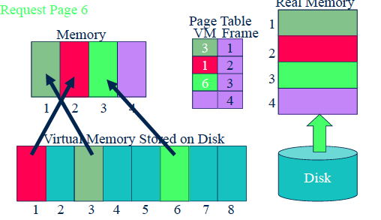
Demand paging
Real Memory

Slide 19
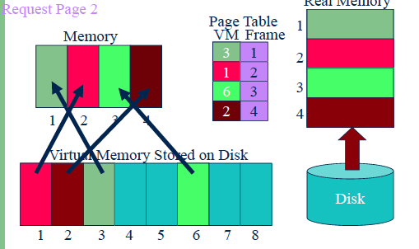
Demand paging
Real Memory

Slide 20
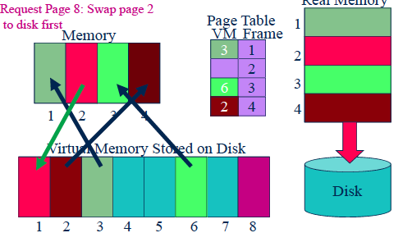
Demand paging
Real Memory
Notes:
if not modified, no need to swap!

Slide 21
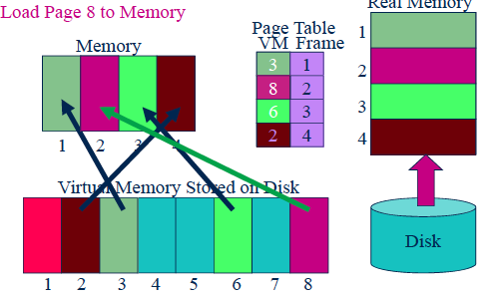
Demand paging
Real Memory

Slide 22
Page Faults
What happens when a process accesses a page that has been evicted?
  1. When it evicts a page, the OS sets the PTE as invalid and stores the location of the page in the swap file in the PTE
  2. When a process accesses the page, the invalid PTE will cause a trap (page fault)
  3. The trap will run the OS page fault handler
  4. Handler uses the invalid PTE to locate page in swap file
  5. Reads page into a physical frame, updates PTE to point to it
  6. Restarts process
But where does it put it? Have to evict something else

Slide 23
Address Translation Redux
We started this topic with the high-level problem of translating virtual addresses into physical addresses
We’ve covered all of the pieces
  Virtual and physical addresses
  Virtual pages and physical page frames
  Page tables and page table entries (PTEs), protection
  TLBs
  Demand paging
Now let’s put it together, bottom to top

Slide 24
The Common Case
Situation: Process is executing on the CPU, and it issues a read to an address
  What kind of address is it? Virtual or physical?
The read goes to the TLB in the MMU
  1. TLB does a lookup using the page number of the address
  2. Common case is that the page number matches, returning a page table entry (PTE) for the mapping for this address
  3. TLB validates that the PTE protection allows reads (in this example)
  4. PTE specifies which physical frame holds the page
  5. MMU combines the physical frame and offset into a physical address
  6. MMU then reads from that physical address, returns value to CPU
Note: This is all done by the hardware

Slide 25
TLB Misses
At this point, two other things can happen
  1. TLB does not have a PTE mapping this virtual address
  2. PTE exists, but memory access violates PTE protection bits
We’ll consider each in turn

Slide 26
Reloading the TLB
If the TLB does not have mapping, two possibilities:
  1. MMU loads PTE from page table in memory
    Hardware managed TLB, OS not involved in this step
    OS has already set up the page tables so that the hardware can access it directly
  2. Trap to the OS
    Software managed TLB, OS intervenes at this point
    OS does lookup in page table, loads PTE into TLB
    OS returns from exception, TLB continues
A machine will only support one method or the other
At this point, there is a PTE for the address in the TLB

Slide 27
Page Faults
PTE can indicate a protection fault
  Read/write/execute – operation not permitted on page
  Invalid – virtual page not allocated, or page not in physical memory
TLB traps to the OS (software takes over)
  R/W/E – OS usually will send fault back up to process, or might be playing games (e.g., copy on write, mapped files)
  Invalid
    Virtual page not allocated in address space
      OS sends fault to process (e.g., segmentation fault)
    Page not in physical memory
      OS allocates frame, reads from disk, maps PTE to physical frame
Notes:
On mips machine, do you need a page fault handler?

Slide 28
Advanced Functionality
Now we’re going to look at some advanced functionality that the OS can provide applications using virtual memory tricks
  Copy on Write
  Mapped files
  Shared memory

Slide 29
Copy on Write
OSes spend a lot of time copying data
  System call arguments between user/kernel space
  Entire address spaces to implement fork()
Use Copy on Write (CoW) to defer large copies as long as possible, hoping to avoid them altogether
  Instead of copying pages, create shared mappings of parent pages in child virtual address space
  Shared pages are protected as read-only in parent and child
    Reads happen as usual
    Writes generate a protection fault, trap to OS, copy page, change page mapping in client page table, restart write instruction
  How does this help fork()?

Slide 30
Copy-On-Write
Lazy copy
Proc. A’s address space
Proc. B’s address space
a = 10
fork()
a = 10
b = 20
b = 20
c = 30
c = 30
Physical memory
(RAM)
10
20
30

Slide 31
Copy-On-Write
Lazy copy
Proc. A’s address space
Proc. B’s address space
a = 10
fork()
a = 10
b = 20
b = 20
c = 30
c = 40
Physical memory
(RAM)
10
20
30
40

Slide 32
Mapped Files
Mapped files enable processes to do file I/O using loads and stores
  Instead of “open, read into buffer, operate on buffer, …”
Bind a file to a virtual memory region (mmap() in Unix)
  PTEs map virtual addresses to physical frames holding file data
  Virtual address base + N refers to offset N in file
Initially, all pages mapped to file are invalid
  OS reads a page from file when invalid page is accessed
  OS writes a page to file when evicted, or region unmapped
  If page is not dirty (has not been written to), no write needed
    Another use of the dirty bit in PTE

Slide 33
Sharing
Private virtual address spaces protect applications from each other
  Usually exactly what we want
But this makes it difficult to share data (have to copy)
  Parents and children in a forking Web server or proxy will want to share an in-memory cache without copying
We can use shared memory to allow processes to share data using direct memory references
  Both processes see updates to the shared memory segment
    Process B can immediately read an update by process A
  How are we going to coordinate access to shared data?

Slide 34
Sharing (2)
How can we implement sharing using page tables?
  Have PTEs in both tables map to the same physical frame
  Each PTE can have different protection values
  Must update both PTEs when page becomes invalid
Can map shared memory at same or different virtual addresses in each process’ address space
  Different: Flexible (no address space conflicts), but pointers inside the shared memory segment are invalid (Why?)
  Same: Less flexible, but shared pointers are valid (Why?)

Slide 35
Summary
Paging mechanisms:
Optimizations
  Managing page tables (space)
  Efficient translations (TLBs) (time)
  Demand paged virtual memory (space)
Recap address translation
Advanced Functionality
  Sharing memory
  Copy on Write
  Mapped files
Next time: Paging policies

