Slide 1
HW5: Parallelization

Slide 2
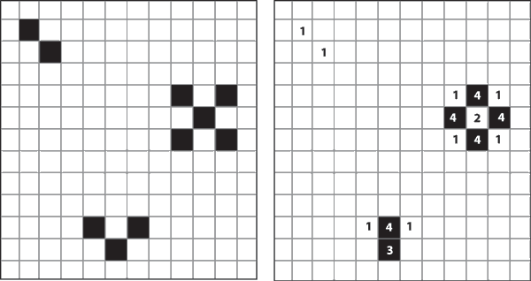
Conway’s Game of Life
Simple 2D universe with simple rules, complex results!
1. Any live cell with fewer than two live neighbors dies
2. Any live cell with more than three live neighbors dies
3. Any live cell with two or three live neighbors lives on
4. Any dead cell with three live neighbors becomes alive

Slide 3
Interesting Stable Patterns
Glider
LightWeight
Space Ship
Pulsar

Slide 4
“Gosper’s glider gun”

Slide 5
Typical Random Initial Universe
DEMO
NOTE: board wraps around (top/bottom, L/R)

Slide 6
Key Part of the Code:
for (curgen = 0; curgen < gens_max; curgen++)
for (i = 0; i < nrows; i++){
for (j = 0; j < ncols; j++){
int inorth = mod (i-1, nrows); int isouth = mod (i+1, nrows);
int jwest = mod (j-1, ncols); int jeast = mod (j+1, ncols);
const char neighbor_count =
BOARD (inboard, inorth, jwest) + BOARD (inboard, inorth, j) +
BOARD (inboard, inorth, jeast) + BOARD (inboard, i, jwest) +
BOARD (inboard, i, jeast) + BOARD (inboard, isouth, jwest) +
BOARD (inboard, isouth, j) + BOARD (inboard, isouth, jeast);
BOARD(outboard, i, j) = alivep (neighbor_count, BOARD (inboard, i, j));
}
}
SWAP_BOARDS( outboard, inboard );
}

Slide 7
HW5: Your Goal
Improve performance via parallelization
use pthreads
use at least 2 threads (probably 4 since 4 CPUs on UG*)
Further improve performance via other optimizations by putting what we learnt all together
hand code optimizations
cache optimizations
locks/synchronization
better cell representation
eliminating redundancy and/or unnecessary work
compiler flags

