Slide 1
ECE 454 Computer Systems Programming Big data analytics
Ding Yuan
ECE Dept., University of Toronto
http://www.eecg.toronto.edu/~yuan

Slide 2
Big picture
Sequential program optimization:
Parallel programming on single machine:
CPU architecture
Compiler optimization
Cache optimization
Dynamic memory
Threads
Synchronization
Parallel architecture
and performance
Exec.
Time

P
C
P
P
P
P
C
C
C
C
Ram
Ram
But how can we program on
data of internet-scale?

Slide 3
Internet-scale data
1.19 billion active users.
3.5 billion pieces of content shared per day.
10.5 billion minutes spent on Facebook worldwide every day
“Millions of Terabytes of data.”
“Google indexed roughly 200 Terabytes, or .004% of the emtire internet”
-- Eric Schmidt, former Google CEO
How to:
Index the data?
Store the data?
Serve the data with short latency?
☞
Big-data analytics: this lecture
How Facebook works: next lecture

Slide 4
Big data analytics
How do we perform (simple) computation on internet-scale data?
Grep
Indexing
Log analysis
Reverse web-link
Sort
Word-count
etc.
Notes:
“pressure cooker”, “bomb”, “backpack” – google search, hours after.

Slide 5
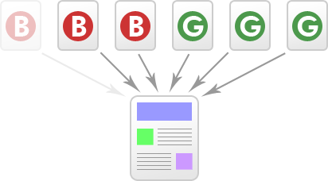
Two examples
Web page indexing
Analyzing all crawled web pages
Output pair: <word, list(URLs)>
Example: <“NBA”, (www.nba.com, www.espn.com, …)>
Reverse web-link
Output pair: <target, list(URL_source)>
Example: <www.nba.com, (www.espn.com, www.cnn.com, www.wikipedia.org, …)>
Needed by PageRank
www.nba.com

Slide 6
void index_sequential (List webpages) {
Hash output = new Hash<string word, List<string url>>;
for each page p in webpages {
for each word w in p {
if (!output.exists (w))
output{w} = new List<string>;
output{w}.push(URL(p));
}
}
}
What if we have billions of web pages?
- Fearless hacker: parallelize on multiple machines
server
server
Parse espn.com and nba.com
output:
<“nba”, (espn.com, nba.com)>
<“nfl”, (espn.com)>
Parse yahoo.com and wsj.com
output:
<“nba”, (yahoo.com, wsj.com)>
<“Obama”, (yahoo.com, wsj.com>)
server
Merge:
<“nba”, (espn.com, nba.com, yahoo.com, wsj.com)>

Slide 7
void index_parallel (List webpages) {
Hash output = new Hash<string word, List<string url>>;
for each page p in webpages {
for each word w in p {
if (!output.exists (w))
output{w} = new List<string>;
output{w}.push(URL(p));
}
}
// send to merge servers
for each word w in keys output {
if (w in range [‘a’ – ‘d’])
send_to_merger (output{w}, serverA);
else if (w in range [‘e’ – ‘h’]
send_to_merger (output{w}, serverB);
.. ..
}
}
void index_merger () {
while (true) {
for each index server i {
if (status(i) == complete) {
copy_output_from_indexer ();
completed++;
}
if (i failed or
we’ve been waiting for too long)
restart its job on another node;
}
if (completed == INDEXER_TOTAL)
break;
}
group_output_by_word();
for each output with the same key w
final_output{w}.push(output{w});
}
copy the data from network
Partition the data: need multiple mergers
Handle node failures
(common in large cluster)
Synchronization
Send the data via network
Can we only ask programmers to write these code?

Slide 8
Solution: MapReduce
Programming model for big data analytics
Programmer writes two functions
map (in_key, in_value) -> list(out_key, intermediate_value)
Processes input key/value pair
Produces set of intermediate pairs
reduce (out_key, list(intermediate_value)) -> list(out_key, outvalue)
Processes a set of intermediate key-values
Widely used
In google: indexing and many analytic jobs
Hadoop (open source version)
> 50% of the Fortune 50 companies
Facebook analyzes half a PB per day using hadoop
NSA…
More details in “MapReduce: Simplified Data Processing
on Large Clusters”. Jeff Dean and Sanjay Ghemawat, OSDI’04

Slide 9
index:map () {
// input: <url, content>
// output: <word, url>
// for each <url, content> pair {
for each word w in content {
Emit(<w, url>);
}
// }
}
<“nba”, espn.com>
<“nba”, nba.com>
<“nba”, yahoo.com>
<“nba”, wsj.com)>
Underlying system:
Mapper:
partition the intermediate output
Send the same keys to the same reducer
Reducer:
Receive the data
Sort and group
Mater:
Error handling
index:reduce () {
// input: <word, url> (sorted)
// final_output: <word, list(url)>
// for each <word, url> pair {
if (!final_output.exists (word))
final_output{word} = new List<url>;
final_output{word}.push(url);
}
<“nba”, (espn.com, nba.com, yahoo.com, wsj.com, ..)>
<“nfl”, (espn.com)>

Slide 10
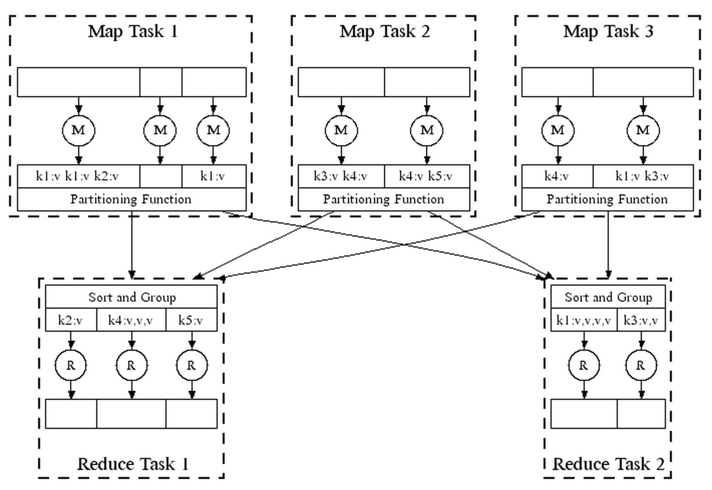

Slide 11
<www.espn.com, “<!DOCTYPE html><html xmlns:fb=..”><head>..”>
<www.nba.com, “<!DOCTYPE html><head>..”>
<yahoo.com, “<!DOCTYPE html><html xmlns:fb=..”><head>..”>
<wsj.com, “<!DOCTYPE html><head>..”>
<“nba”, espn.com>
<“nba”, yahoo.com>
<“nba”, wsj.com)>
<“nba”, nba.com>
<“nfl”, espn.com>
<“Obama”, yahoo.com>
<“Obama”, wsj>

Slide 12
<www.espn.com, “<!DOCTYPE html><html xmlns:fb=..”><head>..”>
<www.nba.com, “<!DOCTYPE html><head>..”>
<yahoo.com, “<!DOCTYPE html><html xmlns:fb=..”><head>..”>
<wsj.com, “<!DOCTYPE html><head>..”>
<“nba”, espn.com>
<“nba”, yahoo.com>
<“nba”, wsj.com)>
<“nba”, nba.com>
<“nfl”, espn.com>
<“Obama”, yahoo.com>
<“Obama”, wsj>
<“nba”, espn.com>
<“Obama”, yahoo.com>
<“nba”, nba.com>
<“Obama”, wsj>
<“nba”, yahoo.com>
<“nba”, wsj.com)>
<“nfl”, espn.com>
<“nba”, (espn.com, nba.com, yahoo.com, wsj.com)>
<“nfl”, ..>

Slide 13
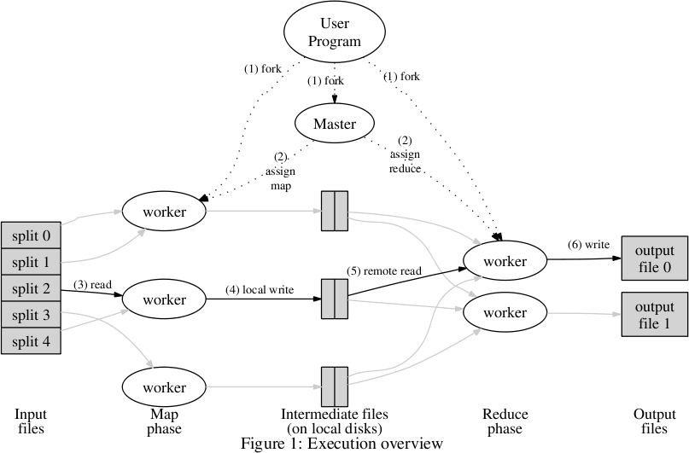

Slide 14
Handling failures
Machine failures are common in large distributed systems
“One node crashes per day in a 10K node cluster” - Jeff Dean
Distributed systems must be designed to tolerate component failures

Slide 15
Handling worker failures
Master detect failures via periodic heartbeat
Re-execute completed and in-progress map tasks
Need re-execution for completed tasks b/c the failed machine might not be accessible
Re-execute in-progress reduce tasks
No need to re-execute completed reduce tasks b/c results are written to shared file system
Task completion committed through master

Slide 16
Refinement: redundant execution
Slow workers significantly lengthen completion time
Called “Stragglers”
Maybe caused by
other jobs consuming resources on machine
bad disks with soft errors transfer data very slowly
software bugs
Solution: near end of phase, spawn backup copies of tass
Whichever one finishes first “wins”

Slide 17
Refinement: saving network bandwidth
<“nba”, espn.com>
<“nba”, nba.com>
<“nba”, espn.com, nba.com>
index:map () {
// input: <url, content>
// output: <word, url>
// for each <url, content> pair {
for each word w in content {
Emit(<w, url>);
}
// }
}
<“nba”, yahoo.com>
<“nba”, wsj.com)>
<“nba”, yahoo.com, wsj.com>
Problem: too many key-value pairs
to send over network!
Solution: run “reduce” function locally first!
index:reduce () {
// input: <word, url> (sorted)
// final_output: <word, list(url)>
// for each <word, url> pair {
if (!final_output.exists (word))
final_output{word} = new List<url>;
final_output{word}.push(url));
}
<“nba”, espn.com, nba.com, yahoo.com, wsj.com>

Slide 18
Recent advancements
Master can become bottleneck
Split its functionality
Scheduling, monitoring, recovery, etc.
Only scheduling task is centralized
I/O on intermediate results can be too slow
Buffer entire intermediate result in memory
Other programming models
E.g., SQL on distributed systems

