Slide 1
ECE 454
Computer Systems Programming
Threads and Synchronization
Ding Yuan
ECE Dept., University of Toronto
http://www.eecg.toronto.edu/~yuan

Slide 2
Overall progress of the course
What we have learnt: sequential program performance
  CPU architecture
  Compiler optimization
  Optimize for cache
  Dynamic memory performance
Next: optimize by parallelization
  Single machine parallelization (threads and processes)
  Multi-machine parallelization (modern data-intensive distributed computing)
    e.g., cloud computing, big data, etc.

Slide 3
Contents
Threads and processes
pthreads and thread management
Synchronizations
  Locks
  Barriers
  Condition Variables

Slide 4
Threads and Processes

Slide 5
Process
Process = process context + code, data, and stack
Process context
Code, data, and stack
Program context:
Data registers
Condition codes
Stack pointer (SP)
Program counter (PC)
stack
SP
shared libraries
brk
run-time heap
Kernel context:
Virt. mem. structures
Descriptor table
brk pointer
read/write data
PC
read-only code/data
0

Slide 6
Performance overhead in process management
Creating a new process is costly because of all of the data structures that must be allocated and initialized
Communicating between processes is costly because most communication goes through the OS
  Overhead of system calls and copying data
  Switching between processes are also expensive
    Why?

Slide 7
Rethinking Processes
What is similar in these cooperating processes?
  They all share the same code and data (address space)
  They all share the same privileges
  They all share the same resources (files, sockets, etc.)
What don’t they share?
  Each has its own execution state: PC, SP, and registers
Key idea: Why don’t we separate the concept of a process from its execution state?
  Process: address space, privileges, resources, etc.
  Execution state: PC, SP, registers
Exec state also called thread of control, or thread

Slide 8
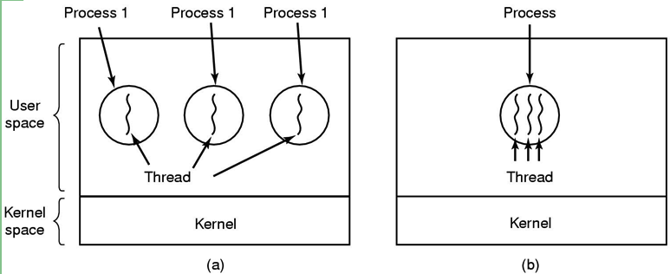
Threads: lightweight processes
execution
environment (resource)
(a) Three processes each with one thread
(b) One process with three threads

Slide 9
Process with Two Threads
Thread 1
Program context:
Data registers
Condition codes
Stack pointer (SP)
Program counter (PC)
Code, data, and kernel context
shared libraries
brk
run-time heap
read/write data
stack
PC
read-only code/data
SP
0
Thread 2
Program context:
Data registers
Condition codes
Stack pointer (SP)
Program counter (PC)
Kernel context:
VM structures
Descriptor table
brk pointer
stack
SP

Slide 10
Threads vs. Processes
Threads and processes: similarities
  Each has its own logical control flow
  Each can run concurrently with others
Threads and processes: differences
  Threads share code and data, processes (typically) do not
  Threads are much less expensive than processes
    Process control (creating and reaping) is more expensive than thread control
    Context switches for processes much more expensive than for threads

Slide 11
Pros and Cons of Thread-Based Designs
+ Easy to share data structures between threads
  e.g., logging information, file cache
+ Threads are more efficient than processes
– Unintentional sharing can introduce subtle and hard-to-reproduce errors!
  The ease with which data can be shared is both the greatest strength and the greatest weakness of threads

Slide 12
pthreads

Slide 13
Pthreads: the programmer’s job:
Pthreads: Standard interface for ~60 functions that manipulate threads from C programs
The Programmer’s job:
  Decide how to decompose the computation into parallel parts.
  Create (and destroy) threads to support that decomposition.
  Add synchronization to make sure dependences are satisfied.

Slide 14
Posix Threads (Pthreads) Interface
  Creating and reaping threads
    pthread_create(pthread_t *tid, …, func *f, void *arg)
    pthread_join(pthread_t tid, void **thread_return)
  Determining your thread ID
    pthread_self()
  Terminating threads
    pthread_cancel(pthread_t tid)
    pthread_exit(void *thread_return)
    return (in primary thread routine terminates the thread)
    exit() (terminates all threads)
  Synchronizing access to shared variables
    later

Slide 15
Example of Thread Creation
main()
pthread_create(func)
func()

Slide 16
Thread Joining Example
  void *func(void *) { ….. }
  pthread_t id;
  int X;
  pthread_create(&id, NULL, func, (void *)&X);
  …..
  pthread_join(id, NULL); // awaits func to return
  …..

Slide 17
Example of Thread Creation (contd.)
main()
pthread_create(func)
func()
pthread_join(id)
(awaits other thread to complete)
return NULL;

Slide 18
The Pthreads “Hello, world" Program
/*
* hello.c - Pthreads "hello, world" program
*/
#include "csapp.h"
void *thread(void *vargp);
int main() {
pthread_t tid;
Pthread_create(&tid, NULL, &thread, NULL);
Pthread_join(tid, NULL);
exit(0);
}
/* thread routine */
void thread(void *vargp) {
printf("Hello, world!\n");
return NULL;
}
Thread attributes
(usually NULL)
Thread arguments
(if any)
(void *p)
assigns return value
(if any)
(void **p)

Slide 19
Example: Matrix Multiply
    for( i=0; i<n; i++ ){
    for( j=0; j<n; j++ ) {
    for( k=0; k<n; k++ )
    c[i][j] += a[i][k]*b[k][j];
    }
    }
All i- or j-iterations can be run in parallel.
If we have p processors:
  give n/p rows to each processor.
Corresponds to partitioning the i-loop.

Slide 20
Matrix Multiply
    int main(){
    pthread_t thrd[p];
    int index[p];
    for( i=0; i<p; i++ ){
    index[i] = i;
    pthread_create(&thrd[i], NULL,
    mmult, (void*) &(index[i]));
    }
    for( i=0; i<p; i++ )
    pthread_join(thrd[i], NULL);
    }
    }
    void mmult (void* s) {
    int slice = *((int *)s);
    // convert to (int *),
    // then deref
    int from = (slice*n)/p;
    int to = ((slice+1)*n)/p;
    for(i=from; i<to; i++){
    for(j=0; j<n; j++) {
    for(k=0; k<n; k++)
    c[i][j] +=
    a[i][k]*b[k][j];
    }
    }
    }

Slide 21
Synchronization Basics

Slide 22
Synchronization
Mutual exclusion
  Ensure certain operations on certain data can be performed by only one thread at a time
    aka critical section
  Does not provide any guarantees on ordering
Event synchronization
  Ordering of events to preserve dependences
    All threads at same point in the program (aka barrier)
      Eg., doing pthread_join for all threads
    producer —> consumer of data
      Eg thread1 writing a stream of samples, thread2 reading them

Slide 23
Mutual Exclusion: Locks and Critical Sections
p₁
p₂
p₃
Overview
Lock
stall
Load X
execution time
critical
section
…
Store X
Unlock
size of critical sections can impact execution time
Notes:
within a threads with a forwarded value, this is the code between the synchronized load and the corresponding store and signal.
and the value flows through the threads like so,
If we can reduce the size of the critical forwarding path by moving code out of it,
we can decrease execution time
But we can do better still if the value is predictable---
rather than wait for synchronization, we can instead predict the value.

Slide 24
Goals for Locks
Mutual Exclusion
Low Latency
Low Traffic
Scalability
Size (small)
Fairness

Slide 25
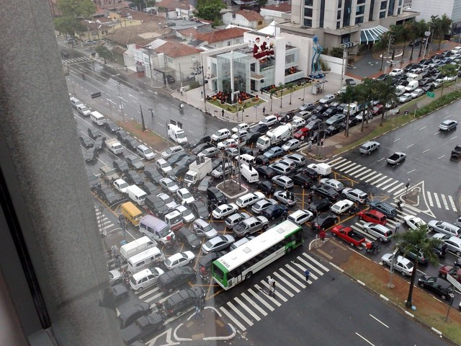
Parallelization Pathologies

Slide 26
One worry: data races
A race occurs when correctness of the program depends on one thread reaching point x before another thread reaches point y

Slide 27
Data Race Example
/* a threaded program with a race */
int main() {
pthread_t tid[N];
int i;
for (i = 0; i < N; i++)
pthread_create(&tid[i], NULL, thread, &i);
for (i = 0; i < N; i++)
pthread_join(tid[i], NULL);
exit(0);
}
/* thread routine */
void *thread(void *vargp) {
int myid = *((int *)vargp);
printf("Hello from thread %d\n", myid);
}

Slide 28
Output: why?
diyuan@ug137:~/ece454/demo/race$ ./race
Hello from thread 1
Hello from thread 2
Hello from thread 6
Hello from thread 3
Hello from thread 7
Hello from thread 5
Hello from thread 9
Hello from thread 4
Hello from thread 9
Hello from thread 0

Slide 29
Another worry: Deadlock
Threads wait for condition that will never be true
/* a threaded program with a potential deadlock*/
Thread1(){
lock(a);
lock(b);
do_work();
unlock(b);
unlock(a);
}
Thread2(){
lock(b);
lock(a);
do_work();
unlock(a);
unlock(b);
}

Slide 30
Challenges with Locks

Slide 31
Coarse-Grain Locking (a.k.a. global lock)
lock
lock
… = A
…
A = …
… = A
…
A = …
Time
unlock
unlock
C
C
easy ☺

Slide 32
Coarse-Grain Locking (a.k.a. global lock)
lock
lock
… = A
…
A = …
… = B
…
B = …
Time
unlock
unlock
P
P
easy ☺ slow ☹
Question: is it a big problem on single core machines?

Slide 33
Fine-Grain Locking
lock A
lock B
… = A
…
A = …
… = B
…
B = …
Time
unlock A
unlock B
c
c
harder 😐 fast ☺

Slide 34
HUGE impact
(Unnecessarily) Serialize the execution
  Cancel any performance gains from parallelization
Unnecessary cache misses from coherent protocol
  Making performance even worse than single core
Example 1: Linux kernel scalability
  “An Analysis of Linux Scalability to Many Cores” [OSDI’10]
  Linux 2.6.39 (2011): “removed the last instance of the big kernel lock”

Slide 35
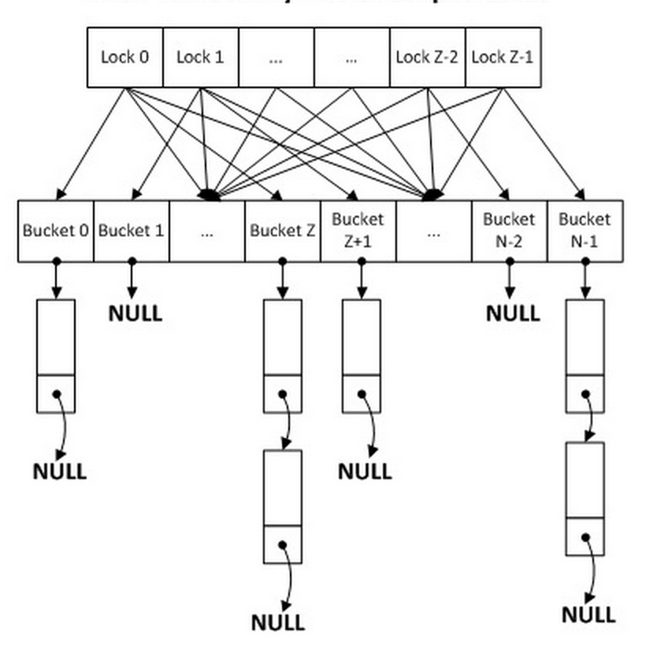
Example 2: Facebook’s memcache
Big lock to protect shared data-structure
Fine-grained, per-bucket lock
“Scaling Memcache at Facebook” [NSDI’13]
“Enhancing the Scalability of Memcached” [Intel@ Developer Zone’12]

Slide 36
Transactional Memory (TM)

Slide 37
Review: Hand Parallelization Options
Coarse-grained locking
  Easy to program ☺
  Limited parallelism ☹
Fine-grained locking
  Good parallelism ☺
  Hard to get right ☹
    eg., deadlock, priority inversion, etc.
The promise of Transactional Memory
  As easy to program as coarse-grained locking ☺
  Provides the parallelism of fine-grained locking ☺

Slide 38
Transactional Memory (TM): the Basic Idea
Source Code:
Transactions:
...
atomic {
...
access_shared_data();
...
}
...
...
atomic {
...
access_shared_data();
...
}
...
...
atomic {
...
access_shared_data();
...
}
...
TM System
✓
✓
✗
Exploits available parallelism
while maintaining correctness!
?
?
Programmer:
Specifies transactions in source code
TM System:
Executes transactions optimistically in parallel
1) Checkpoints execution
2) Detects conflicts
3) Commits or aborts and re-executes

Slide 39
TM Example
atomic {
atomic {
… = A
…
if (...){
B = …
}
…
A = …
… = B
…
if (...){
A = …
}
…
B = …
Time
P
P
}
}
easy ☺ fast ☺

Slide 40
Using Transactional Memory

Slide 41
TM Implementations
Software TM (STM)
  Implemented entirely in software
  Often integrated in a compiler
Hardware TM (HTM)
  Some/all TM mechanisms implemented in hardware
gcc-4.7
  Supports STM: use compiler flag -fgnu-tm
  Wrap critical section with: __transaction_atomic {}

Slide 42
Barriers

Slide 43
Event Synchronization: Barriers
t₁
t₂
t₃
Overview
Barrier arrive
stall
execution time
Barrier leave
want all threads to be at same program point before continuing

Slide 44
Barriers in Pthreads
pthread_barrier_t *barrier;
pthread_barrier_init(
  pthread_barrier_t *barrier,
  pthread_barrier_attr_t *barrier_attr,
  unsigned int count)
  Initializes a barrier.
  Attribute: we’ll ignore this (advanced features)
  Count: the total number of threads
pthread_barrier_wait(pthread_barrier_t *barrier)
  Wait for all threads to reach the barrier before continuing.

Slide 45
Condition Variables

Slide 46
Use of Condition Variables
To implement producer/consumer synchronization
pthread_cont_t *cond;
pthread_cond_init(
  pthread_cond_t *cond,
  pthread_cond_attr *attr)
  Creates a new condition variable cond.
  Attribute: we’ll ignore this (advanced features)
pthread_cond_destroy(
  pthread_cond_t *cond)
  Destroys the condition variable cond.

Slide 47
Condition Variables (cont’d)
pthread_cond_wait(
  pthread_cond_t *cond,
  pthread_mutex_t *mutex)
  Blocks the calling thread, unlocks the mutex, waits on cond.
pthread_cond_signal(
  pthread_cond_t *cond)
  Unblocks one thread waiting on cond.
  The scheduler decides which thread.
  If no thread waiting, then signal does nothing
pthread_cond_broadcast(
  pthread_cond_t *cond)
  Unblocks all threads waiting on cond.
  If no thread waiting, then broadcast does nothing.

Slide 48
Example: Parallelize this code
a[3] = …;
a[4] = …;
a[5] = …;
  for( i=1; i<100; i++ ) {
  a[i] = …;
  …;
  … = a[i-1];
  }
Problem: each iteration
depends on the previous:
…
…
…
… = a[2];
… = a[3];
… = a[4];
a[4] = …;
…
… = a[3];
a[3] = …;
a[5] = …;
…
…
… = a[2];
… = a[4];

Slide 49
Example: synchronized w cond var
need a cond variable for each iteration
  for( i=...; i<...; i++ ) {
  a[i] = …;
  signal(e_a[i]);
  …;
  wait(e_a[i-1]);
  … = a[i-1];
  }-
  PROBLEM: signal does
  nothing if corresponding
  wait hasn’t already executed
  ---i.e., signal gets “lost”
signal is lost because wait didn’t execute yet
a[3] = …;
a[4] = …;
signal
…
…
wait
… = a[2];
… = a[3];
wait waits forever---deadlock!

Slide 50
How to Remember a Signal
  semaphore_signal(i) {
  pthread_mutex_lock(&mutex_rem[i]);
  arrived [i]= 1; // track that signal(i) has happened
  pthread_cond_signal(&cond[i]);//signal next (in case it’s waiting)
  pthread_mutex_unlock(&mutex_rem[i]);
  }
  semaphore_wait(i) {
  pthreads_mutex_lock(&mutex_rem[i]);
  if( arrived[i] = 0 ) { // if signal didn’t happen yet
  pthreads_cond_wait(&cond[i], mutex_rem[i]);
  }
  arrived[i] = 0; // reset for next time
  pthreads_mutex_unlock(&mutex_rem[i]);
  }

Slide 51
Example (fixed)
  for( i=...; i<...; i++ ) {
  a[i] = …;
  semaphore_signal(e_a[i]);
  …;
  semaphore_wait(e_a[i-1]);
  … = a[i-1];
  }
  // Now it doesn’t matter if waits happen after the
  // corresponding signals

