Slide 1
ECE 454 Computer Systems Programming Parallel Architectures and Performance Implications (II)
Ding Yuan
ECE Dept., University of Toronto
http://www.eecg.toronto.edu/~yuan

Slide 2
Putting it all together [1]
Performance implications for parallel architecture
Background: architecture of the two testing machines
Cache-coherence performance and implications to parallel software design
[1] Everything you always wanted to know about synchronization
but were afraid to ask. David, et. al., SOSP’13

Slide 3
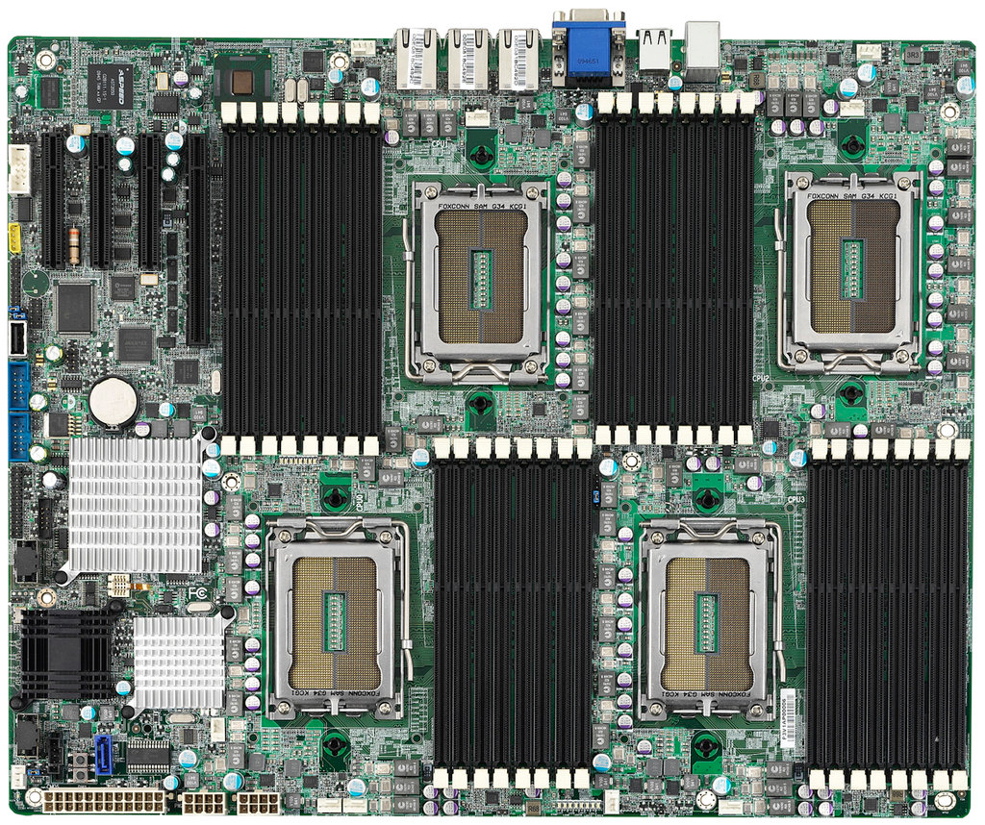
Two case studies
48-core AMD Opteron
80-core Intel Xeon

Slide 4
48-core AMD Opteron
C
C
C
C
C
C
L1
L1
…6x…
L1
L1
L1
…6x…
L1
…8x…
(motherboard)
Last Level Cache
Last Level Cache
cross-socket!
6-cores per die
6-cores per die
RAM
LLC NOT shared
Directory-based cache coherence

Slide 5
80-core Intel Xeon
C
C
C
cross-socket
C
C
C
L1
L1
…10x…
L1
L1
L1
…10x…
L1
…8x…
(motherboard)
Last Level Cache
10-cores per die
10-cores per die
RAM
LLC shared
Snooping-based cache coherence

Slide 6
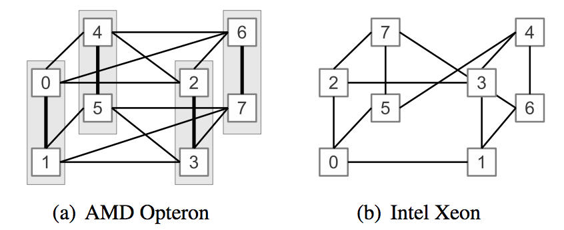
Interconnect between sockets
Cross-sockets communication can be 2-hops

Slide 7
Performance of memory operations

Slide 8
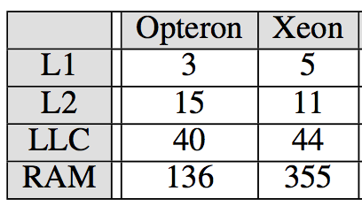
Local caches and memory latencies
Memory access to a line cached locally (cycles)
Best case: L1 < 10 cycles
Worst case: RAM 136 – 355 cycles

Slide 9
Latency of remote access: read (cycles)
Ignore
“State” is the MESI state of a cache line in a remote cache.
Cross-socket communication is expensive!
Xeon: loading from Shared state is 7.5 times more expensive over two hops than within socket
Opteron: cross-socket latency even larger than RAM
Opteron: uniform latency regardless of the cache state
Directory-based protocol
Xeon: load from “Shared” state is much faster than from “M” and “E” states
“Shared” state read is served from LLC instead from remote cache

Slide 10
Latency of remote access: write (cycles)
Ignore
“State” is the MESI state of a cache line in a remote cache.
Cross-socket communication is expensive!
Opteron: store to “Shared” cache line is much more expensive
Directory-based protocol is incomplete
Does not keep track of the sharers
Equivalent to broad-cast and have to wait for all invalidations to complete
Xeon: store latency similar regardless of the previous cache line state
Snooping-based coherence

Slide 11
How about synchronization?

Slide 12
Synchronization implementation
Hardware support is required to implement sync. primitives
In the form of atomic instructions
Common examples include: test-and-set, compare-and-swap, etc.
Used to implement high-level synchronization primitives
e.g., lock/unlock, semaphores, barriers, cond. var., etc.
We will only discuss test-and-set

Slide 13
Test-And-Set
The semantics of test-and-set are:
Record the old value
Set the value to TRUE
This is a write!
Return the old value
Hardware executes it atomically!
When executing test-and-set on “flag”
What is value of flag afterwards if it was initially False? True?
What is the return result if flag was initially False? True?
Hardware implementation:
bool test_and_set (bool *flag){
bool old = *flag;
*flag = True;
return old;
}
Read-exclusive (invalidations)
Modify (change state)
Memory barrier
completes all the mem. op.
before this TAS
cancel all the mem. op.
after this TAS
atomic!

Slide 14
Using Test-And-Set
Here is our lock implementation with test-and-set:
When will the while return? What is the value of held?
Does it work? What about multiprocessors?
struct lock {
int held = 0;
}
void acquire (lock) {
while (test-and-set(&lock->held));
}
void release (lock) {
lock->held = 0;
}

Slide 15
TAS and cache coherence
acquire(lock)
Thread A:
Thread B:
Processor
Processor
Cache
Cache
State
Data
State
Data
Read-Exclusive
Shared Memory (lock->held = 0)

Slide 16
TAS and cache coherence
acquire(lock)
Thread A:
Thread B:
Processor
Processor
Cache
Cache
State
Data
State
Data
Dirty
lock->held=1
Fill
Read-Exclusive
Shared Memory (lock->held = 0)

Slide 17
TAS and cache coherence
acquire(lock)
acquire(lock)
Thread A:
Thread B:
Processor
Processor
Cache
Cache
State
Data
State
Data
Dirty
lock->held=1
Read-Exclusive
invalidation
Shared Memory (lock->held = 0)

Slide 18
TAS and cache coherence
acquire(lock)
acquire(lock)
Thread A:
Thread B:
Processor
Processor
Cache
Cache
State
Data
State
Data
Invalid
lock->held=1
update
Read-Exclusive
invalidation
Shared Memory (lock->held = 1)

Slide 19
TAS and cache coherence
acquire(lock)
acquire(lock)
Thread A:
Thread B:
Processor
Processor
Cache
Cache
State
Data
State
Data
Invalid
lock->held=1
Dirty
lock->held=1
Fill
Read-Exclusive
Shared Memory (lock->held = 1)

Slide 20
What if there are contentions?
while(TAS(lock))
;
while(TAS(lock))
;
Thread A:
Thread B:
Processor
Processor
Cache
Cache
State
Data
State
Data
Shared Memory (lock->held = 1)

Slide 21
How bad can it be?
TAS
Ignore
Store
Recall: TAS essentially is a Store + Memory Barrier

Slide 22
How to optimize?
When the lock is being held, a contending “acquire” keeps modifying the lock var. to 1
Not necessary!
void test_and_test_and_set (lock) {
do {
while (lock->held == 1)
; // spin
}
} while (test_and_set(lock->held));
}
void release (lock) {
lock->held = 0;
}

Slide 23
What if there are contentions?
Thread A:
Thread B:
Thread B:
holding lock
while(lock->held==1)
;
Processor
Processor
Processor
Cache
Cache
Cache
State
Data
State
Data
State
Data
Dirty
lock->held=1
Read request
Read
Shared Memory (lock->held = 0)

Slide 24
What if there are contentions?
Thread A:
Thread B:
Thread B:
holding lock
while(lock->held==1)
;
Processor
Processor
Processor
Cache
Cache
Cache
State
Data
State
Data
State
Data
Shared
lock->held=1
Shared
lock->held=1
update
Read request
Read
Shared Memory (lock->held = 1)

Slide 25
What if there are contentions?
Thread A:
Thread B:
Thread B:
holding lock
while(lock->held==1)
;
while(lock->held==1)
;
Processor
Processor
Processor
Cache
Cache
Cache
State
Data
State
Data
State
Data
Shared
lock->held=1
Shared
lock->held=1
Shared
lock->held=1
Repeated read to “Shared” cache line: no cache coherence traffic!
Shared Memory (lock->held = 1)

Slide 26
Let’s put everything together
TAS
Ignore
Load
Write
Local access

Slide 27
Implications to programmers
Cache coherence is expensive (more than you thought)
Avoid unnecessary sharing (e.g., false sharing)
Avoid unnecessary coherence (e.g., TAS -> TATAS)
Clear understanding of the performance
Crossing sockets is a killer
Can be slower than running the same program on single core!
pthread provides CPU affinity mask
pin cooperative threads on cores within the same die
Loads and stores can be as expensive as atomic operations
Programming gurus understand the hardware
So do you!

