Slide 1
ECE 244
Programming Fundamentals
Final Review
Ding Yuan
ECE Dept., University of Toronto
http://www.eecg.toronto.edu/~yuan

Slide 2
Final exam coverage
Everything we discussed in the class, except for advanced topics
  Debugging
  Typing
Hash table is part of the exam

Slide 3
What we learnt after midterm
Copy constructor
Linked list
Recursion
  Quick sort
Binary Search Tree
Inheritance
Complexity
Hash table

Slide 4
Copy constructor
Prototype:
  MyClass ( const MyClass& other );
Why pass by reference?

Slide 5
When is copy constructor called?
When instantiating one object from another of the same type
  MyClass a(b); // b is an object of MyClass
When an object is passed into a function by value
When an object is returned from a function by value

Slide 6
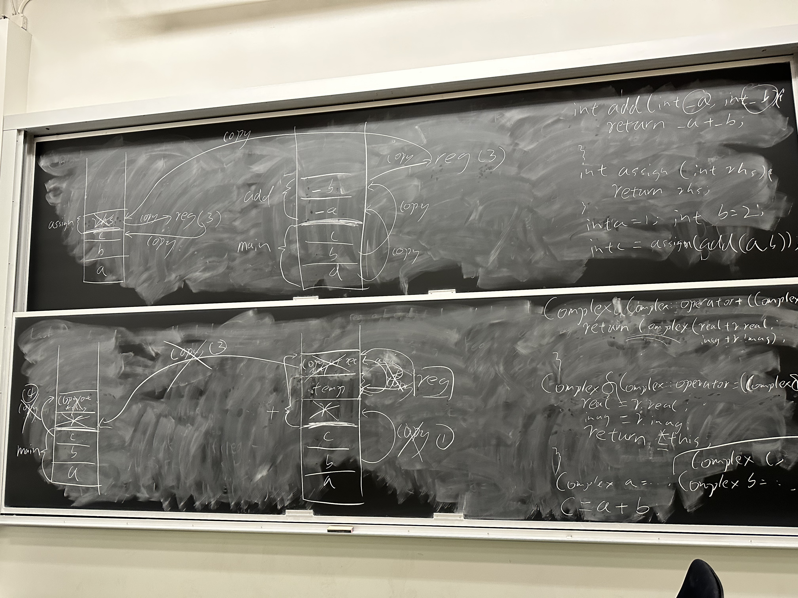

Slide 7
Deep vs. shallow copy
Compiler provides a default copy constructor that performs member-wise copy
Pointers in your class → you likely need:
  custom copy constructor
  custom assignment operator
  custom destructor
  Why?

Slide 8
Example: Final 2014, Q2

Slide 9
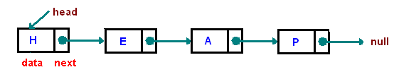
Linked list
Two member vars.: data and next
Unordered link list
Ordered link list
5
23
187
3
3
5
23
187

Slide 10
Linked list (cont.)
Insert: complexity T(n) =
  O(1): unordered
  O(n): ordered
Search: complexity T(n) =
  O(n): unordered
  O(n): ordered
Need to be very familiar w/ the concept & implementation of common operations

Slide 11
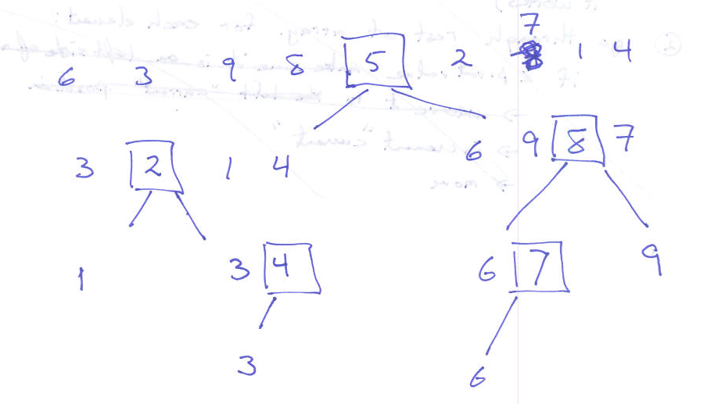
Quick sort
An application of recursion
Best case complexity: O(n*log(n))
Worst case complexity: O(n^2)

Slide 12
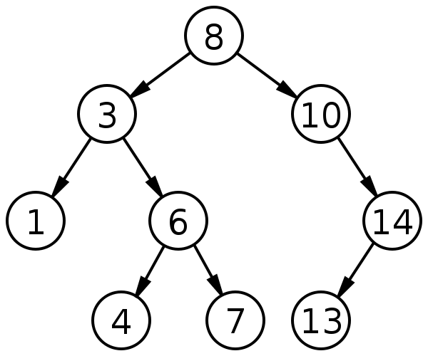
Binary Search Tree
Need to be very familiar w/ the algorithm and its implementation
Need to understand three traversals
  Pre-order: NLR
  In-order: LNR
  Post-order: LRN

Slide 13
Q7@2014 Final

Slide 14
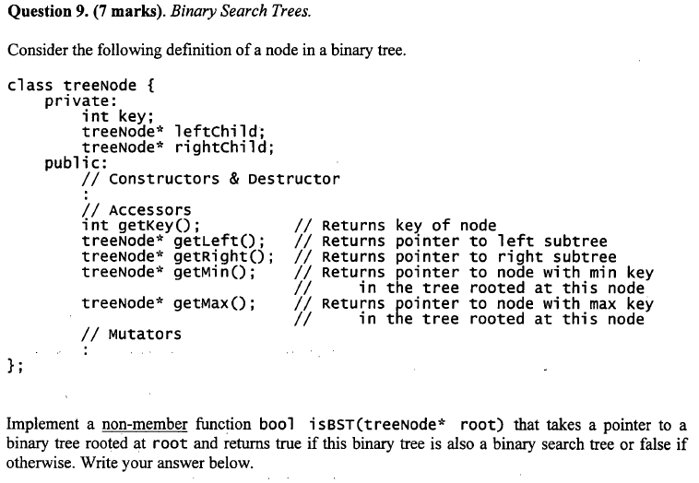

Slide 15
Solution
bool isBST(treeNode *root) {
if (root == NULL) return true;
treeNode * left = root->getLeft();
treeNode * right = root->getRight();
int key = root->getKey();
if (left == NULL && right == NULL) return true;
if (left == NULL && right != NULL)
if (right->getMin()->getKey() > key)
return isBST(right);
else return false;
if (left != NULL && right == NULL)
if (left->getMax()->getKey() < key)
return isBST(left);
else return false;
if (left->getMax()->getKey()<key && right->getMin()->getKey()>key)
return isBST(left) && isBST (right);
return false;
}

Slide 16
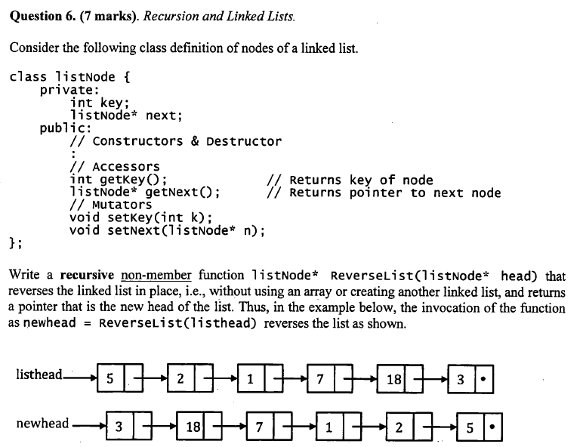
2014F Q6 (Solution)
2014F

Slide 17
2014F Q6 (Solution)
listhead
null
5
23
187
3
1 listNode* ReverseList (listNode *head) {
2 if (head == NULL) return NULL;
3 if (head->getNext() == NULL)
4 return head;
5 listNode* newhead = ReverseList (head->getNext());
6 head->getNext()->setNext(head);
7 head->setNext(NULL);
8 return newhead;
9 }

Slide 18
Complexity: Big-Oh notation
2014 Final Q13

Slide 19
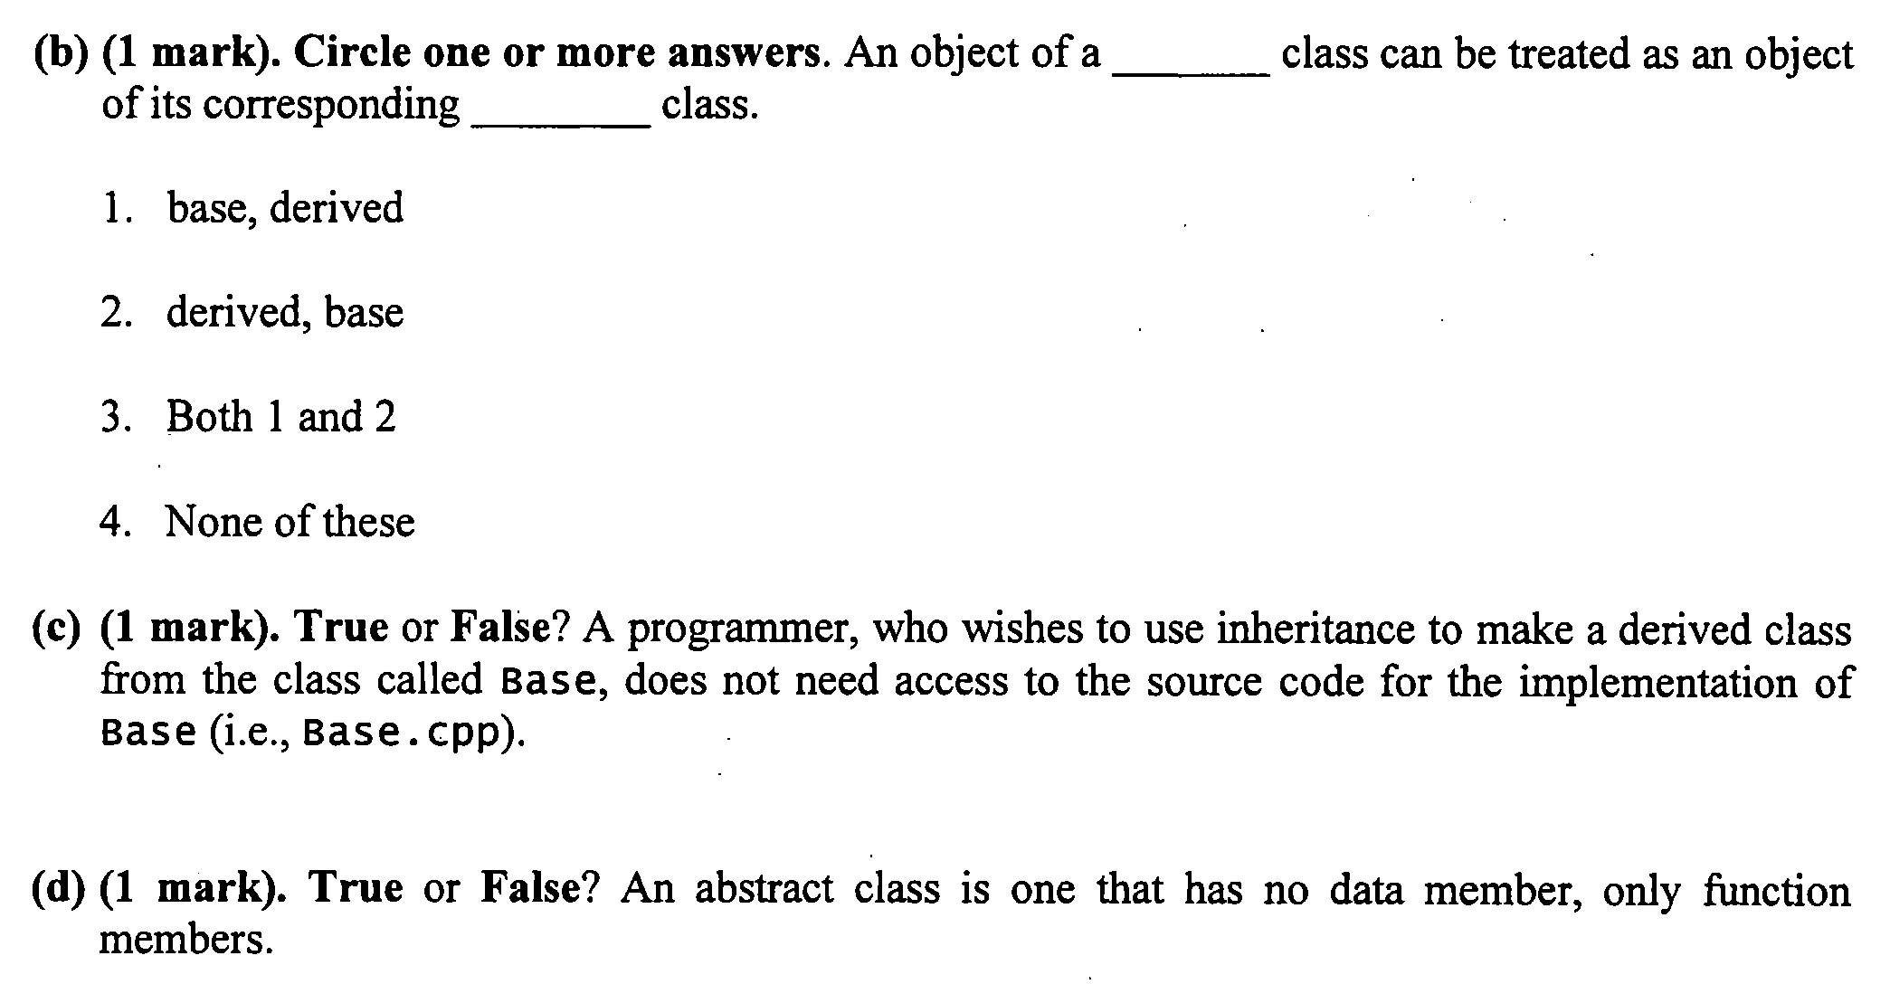
Inheritance
True
False

Slide 20
Inheritance (cont.)
True or false
  a derived class inherits a private member of the base class?
  a derived class inherits a protected member of the base class?
  Inheritance can form a hierarchy
Sequence of invocation
  Constructor: from base to derived
  Destructor: from derived to base
  Like a stack
Staff
Employee
Manager

Slide 21
Hash Table
O(1) insertion/search/deletion
Large array
index = hash_function(key)
Chaining for collision
  Linked list
0
1
2
3
4
5
6
77
7
16
25

