Slide 1
ECE 244 Programming Fundamentals Lec.25: Complexity 2: recursion
Ding Yuan
ECE Dept., University of Toronto
http://www.eecg.toronto.edu/~yuan

Slide 2
How to analyze the complexity of recursive programs?
int fact(int n) {
if (n == 1) return 1;
return (n * fact (n - 1));
}
T(n) = 2 + T(n-1)
= 2 + 2 + T(n-2)
= 2 x 3 + T(n-3)
= 2 x (n-1) + T(n – (n-1)) = 2 x (n-1) + T(1) = 2n – 2
Complexity: O(n)

Slide 3
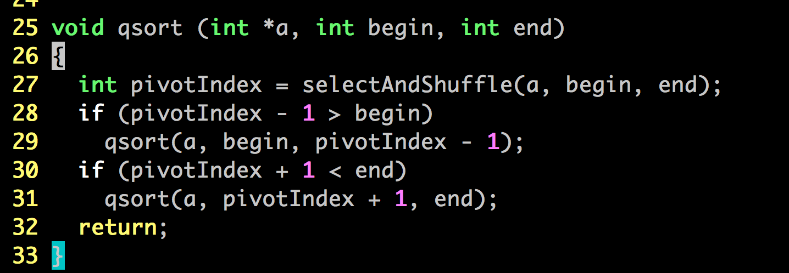
QuickSort
T(n) = T_{selectAndShuffle}(n) + T(k) + T(n - k - 1)
Notes:
selectAndShuffle() returns the *new* index of the pivot value

Slide 4
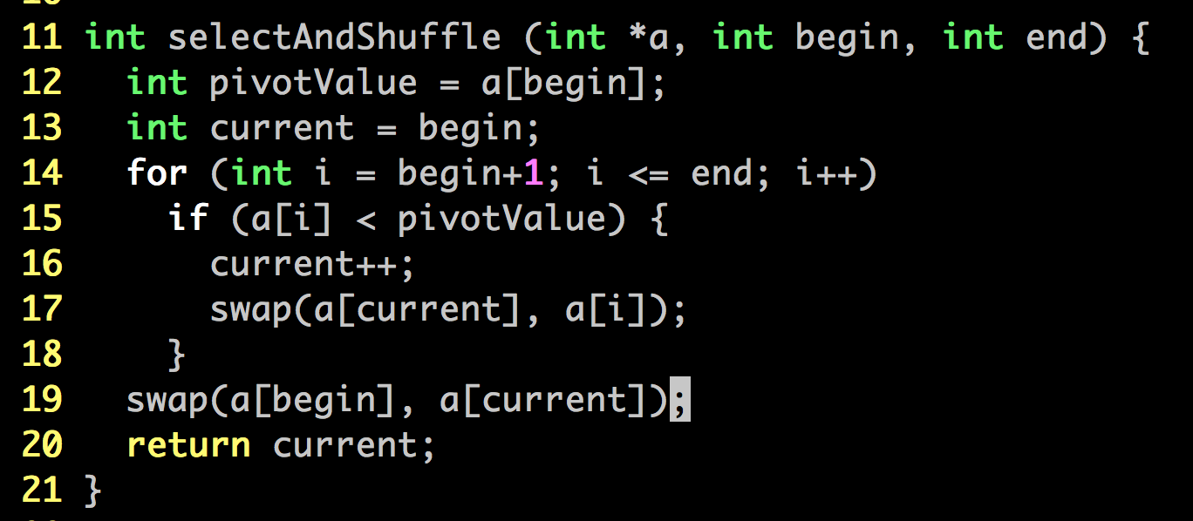
selectAndShuffle
T(n) ≈C × n

Slide 5
QuickSort: worst case
T(n) ≈ T_{selectAndShuffle}(n) + T(k) + T(n - k - 1)
≈ C×n + T(k) + T(n-k-1)
Worst case: k = 0, i.e., pivotIndex == begin
T(n) ≈ C×n + T(n-1)
≈ C×(n + n-1) + T(n-2)
..
≈ C×(n + n-1 + n-2 + … 1) = C×n×(n+1)/2 = O(n²)

Slide 6
QuickSort: best/avg. case
k = n/2, i.e., evenly split the array
T(n) ≈ C×n + 2×T(n/2)
≈ C×(n + n) + 4T(n/4))
≈ C×(n + n + n) + 8T(n/8)
≈ O(n×log(n))
also the avg case complexity
log(n)
n elements
~log₂(n)

Slide 7
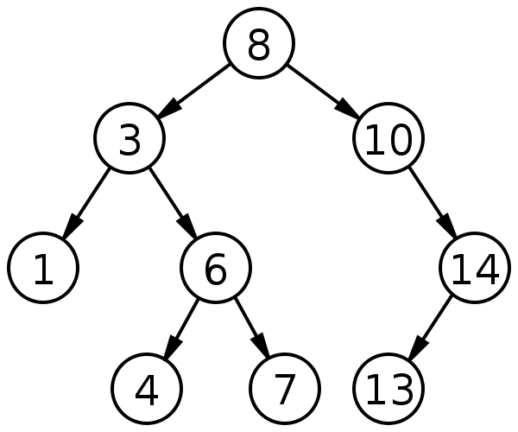
Search on binary search tree
If the tree is balanced, e.g., every non-leaf node has two children
T(n) = C + T(n/2) = 2C + T(n/4) = .. = C * log₂(n)
bool TreeNode::valueExists(int v) {
if (v == value)
return true;
if (v < value) {
if (left != NULL)
return left->valueExists(v);
return false;
}
if (right != NULL)
return right->valueExists(v);
return false;
}
O(log(N))

