Slide 1
Operating Systems
ECE344
A brief history of OS
Ding Yuan
ECE Dept., University of Toronto
http://www.eecg.toronto.edu/~yuan

Slide 2
Content of this lecture
The dark age (1945 – 55): no OS
Batch systems (1955 – 65)
Multiprogramming (1965 – 80)
PC (and mobile) era (1980 – present)

Slide 3
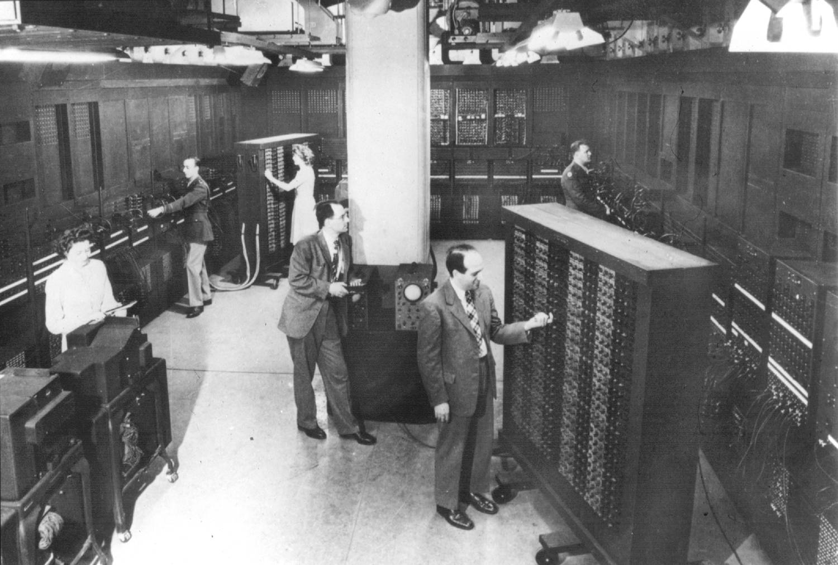
The dark age
ENIAC (1946): the first computer
Only a single group of people designed and used it
  Protection and virtualization are not needed!
How to Allocate and Reclaim computation time?
  Sign-up sheet on the wall!
Notes:
Electronic Numerical Integrator And Computer

Slide 4
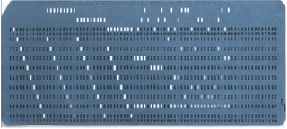
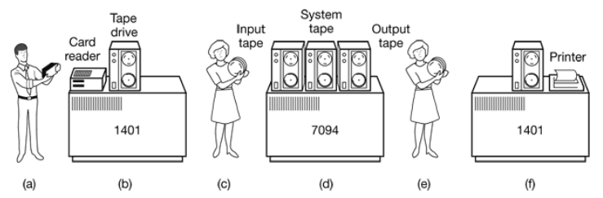
Batch systems (1955-65)
Background:
  At that time, computers are used only to “compute” (instead of entertainments, etc.)
  Users write program using “punch card”
    Punch your program into cards
    Bring the cards to computer operators
    Come back after a day to get result

Slide 5
Batch systems (1955-65)
OS:
  Read the first job from the tape
  Run it
  Write the output to another tape
  Read the next job and repeat the process
  Similar to the “sign-up sheet on the wall”, only now this process is automated

Slide 6
Multiprogramming (1965-80)
Problems with Batch systems?
  Responsiveness
    Do you want to wait for a day just to find out your program doesn’t compile?
  Multiple users cannot concurrently access the computer
  Efficiency
    CPU is idle while the computer is doing I/O
Multiprogramming
  Multiple tasks are performed during the same period of time
  As if they are executed concurrently
  Now multiple users can use the same machine simultaneously
Notes:
Note I say “as if”. why?

Slide 7
MULTICS
MULTiplexed Information and Computing Service
  Initiated by MIT, Bell Labs, and General Electric
Designed to support hundreds of users on a machine far less powerful than iPhone 6
  People knew how to write small, efficient programs in those days
Technically successful, but not so much commercially
  Bell Labs and GE dropped out before it was released
Notes:
computing as utility --- cloud computing.

Slide 8
UNIX
Written by Ken Thompson and Dennis Ritchie from Bell Labs on PDP-11 (1971)
  Project started because Ken wanted to play the “Space Travel” game without MULTICS
  Originally named as “Unics” by Brian Kernighan
In 1973, Ritchie invented C programming language to ease the development of Unix
AT&T gave it for free (involuntarily)
  Bell Labs started selling it after AT&T divested itself in 1984
Notes:
dropped out from the multics project, so they needed to pay to play the game. GE-645
Brian Kernighan is an alumni from U of T
PDP-11: 24KB of Memory, Unix only uses 12KB.
Unics: the first version was too sloppy.

Slide 9
Linux
In 1991, Linus Torvalds, then a student of Univ. of Helsinki, wanted to learn OS
  But at that time, no free, open-source OS is available
  Decided to write his own OS and “open-source” it
  Open-source is the key behind its popularity today

Slide 10
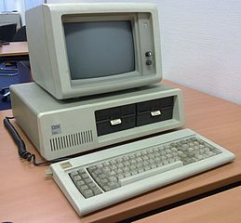
PC-era (1980-present)
IBM introduces PC in 1981, using Intel processors
  Looking for an OS for its PC
At that time, an OS called CP/M is already working on Intel CPUs
  Bill Gates initially suggested IBM to contract CP/M
  CP/M founder refused to meet with IBM
  IBM came back to Bill Gates, and Microsoft purchased an OS named DOS (Disk Operating System), modified it, and renamed it MS-DOS
Notes:
multiprogramming era marks most of the technalogy breakthroughs in OS, the PC era really sees the drastic commercial success of OS vendors.
CP/M is an OS from a company named “digital research”. Its founder is Gary Kildall.

Slide 11
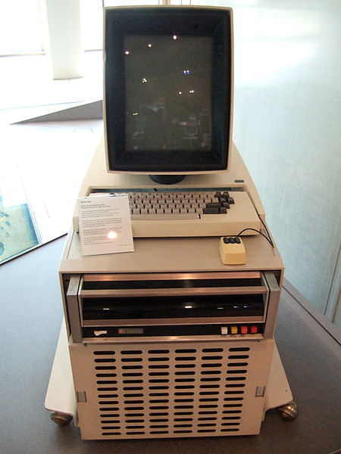
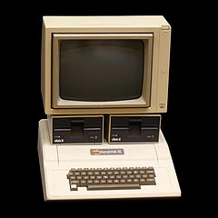
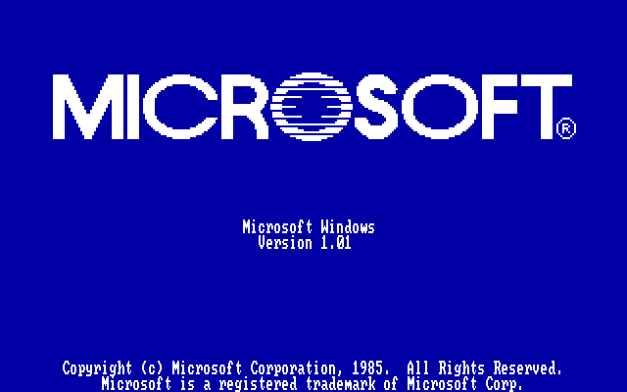
Graphical User Interface (GUI)
The interface of the early OSes is command-line
Researchers in Xerox-PARC built the first OS with graphic user interface
  Steve Jobs visited PARC, saw the GUI, and used it in Apple’s Lisa (1983), later Macintosh (1984)
  Microsoft introduced Windows in 1985
  https://www.youtube.com/watch?v=ZM_I2uwOfXw
Notes:
Lisa: first PC sold in public with a GUI
alto, apple II, windows 1.0
“Well, Steve, I think there’s more than one way of looking at it. I think it’s more like we both had this rich neighbor named Xerox and I broke into his house to steal the TV set and found out that you had already stolen it.”

