Slide 1
Operating Systems ECE344 Introduction
Ding Yuan
ECE Dept., University of Toronto
http://www.eecg.toronto.edu/~yuan
slides courtesy: Ashvin Goel, Yuanyuan Zhou, Geoff Voelker

Slide 2
Content of this lecture
Course information (personnel, policy, prerequisite, agenda, etc.)
Why learning OS?
What is an OS? What does it do?
Summary

Slide 3
Why learning OS?
Fulfill requirement?
Operating System training is important
http://www.youtube.com/watch?v=-3Rt2_9d7Jg
What course is this?
http://matt-welsh.blogspot.ca/2010/10/in-defense-of-mark-zuckerberg.html
Software companies love OS students
Most big software companies have system positions
Academic research in OS is very influential

Slide 4
Goals of this course
Understand operating system concepts
How OS works, and more importantly, why?
What are the reasons motivated each design?
Basis for future learning
Get hands dirty
You will implement a real OS
Write efficient & scalable programs!
Notes:
Face a problem, and solve it, instead

Slide 5
Who am I
Ding Yuan (call me Ding)
Research: operating system, systems software
Brief BIO:
Ph.D. University of Illinois (UIUC), 2012
Founder of YScope Inc.
Canada Research Chair in Systems Software
Technique invented are requested by many large companies

Slide 6
Personnel
Instructor:
Ding Yuan (yuan@eecg.toronto.edu)
Homepage: http://www.eecg.toronto.edu/~yuan
Teaching Assistants:
Ruibin Li, Yi Fan Yu, Zongxing Liu, Xiaochong Wei, Sitao Wang

Slide 7
Prerequisite (must have)
Programming experiences (e.g., ECE244)
You will be programming in C (it’s OK if you only know Java)
Computer organizations (e.g., ECE243)
What is an Instruction (e.g., load, store)?
What is CPU? Memory? Registers?
What is Stack? Stack pointer?
What is Program Counter (PC)?

Slide 8
Course Contents
Overview of computer hardware
Threads and processes
Synchronization and concurrency
Scheduling
Memory Management, Virtual Memory
Disk Management and File Systems
Cloud computing and virtualization

Slide 9
Class Web Site
Class web site available from instructor’s home page
http://www.eecg.toronto.edu/~yuan/teaching/ece344/
Provides slides, agenda, grading policy, etc.
All information regarding the labs
Piazza (link from course homepage) used for discussion
UoT Quercus is used for grades only

Slide 10
Grading
Mid-term - 25
Final - 45
4 Labs – 30
2, 7, 9, 12 for each lab
First 2 labs: individual
Lab 3 and 4: work in group of two
Make sure you know what your partner is implementing
Learn to coordinate and be efficient

Slide 11
Lab Assignments
We will be using the OS161 system
Uses a simple MIPS emulator (sys161)
Initially, we provide a barebones OS
You write a simple Unix-like OS by the end of the course!
Runs on Linux machines in ECE Workstation Labs
Can also download and install on any Linux machine
Not mandatory to go to the lab session
It is hard!
Start your assignment early!

Slide 12
What to Expect From Lab Assignments
Building an OS is difficult
You will spend a lot of time on the lab assignments
The labs give specifications, not implementations
Allows for imagination
Allows for errors and frustration
Lab instructions ask that you design well, before you code
Assume that you will do the design/coding outside lab hours
Notes:
12

Slide 13
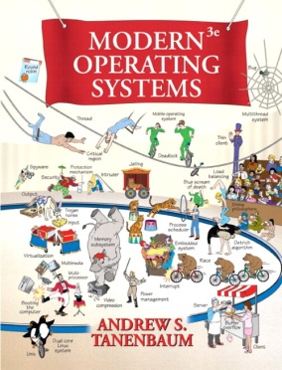
Suggested Textbooks
Operating Systems: Three Easy Pieces
Remzi H. Arpaci-Dusseau and Andrea C. Arpaci-Dusseau
Modern Operating Systems, 4th Edition
Andrew S. Tanenbaum and Herbert Bos

Slide 14
Cheating policy
Academic integrity
Your work in this class must be your own – we have zero tolerance policy towards cheating of any kind and any student who cheats will get a failing grade in the course
Both the cheater and the student who aided the cheater will be held responsible for the cheating

Slide 15
How NotTo pass ECE344
Do not attend lecture
It’s nice out, the slides are online, and material in the book anyway
TRUTH: Lecture material is the basis for exams
It is much more efficient to learn through discussion
Copy other people’s project
It is cheating!
How can you answer the questions in exams?

Slide 16
How NotTo pass ECE344 (2)
Do not ask questions in lecture, office hours, or piazza
It’s scary, I don’t want to embarrass myself
TRUTH: asking questions is the best way to clarify lecture material at the time it is being presented
“There is no such things as stupid question…”
Wait until the last couple of days to start a project
The project cannot be done in the last few days
Repeat: the project cannot be done in the last few days!

Slide 17
Before we start
Any questions?
Do you think this will be a hard class?

Slide 18
What is an OS?
Anyone?
Give a few names of an OS?
Desktops?
Smart phones?

Slide 19
What is an OS?
“Code” that:
Sits between programs & hardware
Sits between different programs
Sits between different users
But what does it do?
Managing the hardware resource
Provide a clean set of interface to programs
Real life analogy?
Government

Slide 20
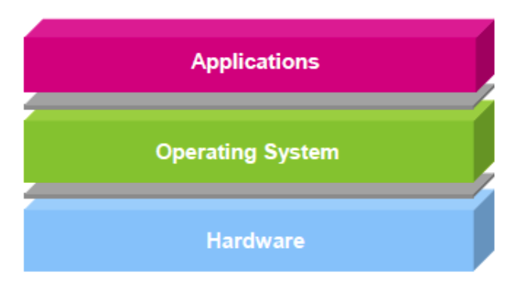
OS is…
Software layer between hardware and applications
The OS is “all the code that you didn’t have to write” to implement your application
Or, OS is a piece of software that you shouldn’t notice its existence, but you’ll feel the pain if it disappears or goes wrong

Slide 21
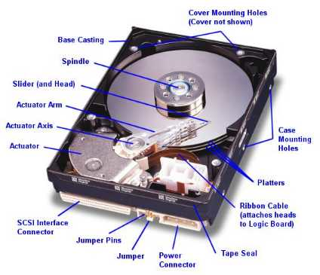
An example comparing life with/without OS
Life with an OS
file = open (“test.txt”, O_WRONLY);
write (file, “test”, 4);
close (file);
Life without an OS
Where is this file on disk? Which block? Which platter, track, and sectors?
Code needs to change on a different system

Slide 22
OS and hardware
The OS abstracts/controls/mediates access to hardware resources (what resources?)
Computation (CPUs)
Volatile storage (memory) and persistent storage (disk, etc.)
Communication (network, modem, etc.)
Input/output devices (keyboard, display, printer, etc.)

Slide 23
Benefits to Applications
Simpler
no tweaking device registers
Device independent
all disks look the same
Portable
same program runs on Windows95/98/ME/NT/2000/XP/Vista/7/8/10
Worry less about interference from other applications

Slide 24
What does an OS do?
Manage Resources
Allocation
Protection
Reclamation
Virtualization
Among many running programs

Slide 25
What does an OS do?
Resources
Allocation
Protection
Reclamation
Virtualization
Finite resources
Competing demands
Examples:
CPU
Memory
Disk
Network
Government:
Limited budget, Land,
Natural resources

Slide 26
What does an OS do?
Resources
Allocation
Protection
Reclamation
Virtualization
You can’t hurt me,
I can’t hurt you.
Some degrees of
safety and security
Government:
Law and order

Slide 27
What does an OS do?
Resources
Allocation
Protection
Reclamation
Virtualization
The OS gives,
The OS takes away
Some times involun-
tarily
Government:
Income Tax

Slide 28
What does an OS do?
Resources
Allocation
Protection
Reclamation
Virtualization
Illusion of infinite, private resources
Memory vs. disk
Time-shared CPU
Government:
Social welfare and insurance

Slide 29
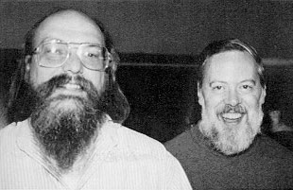
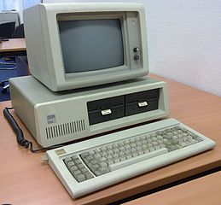
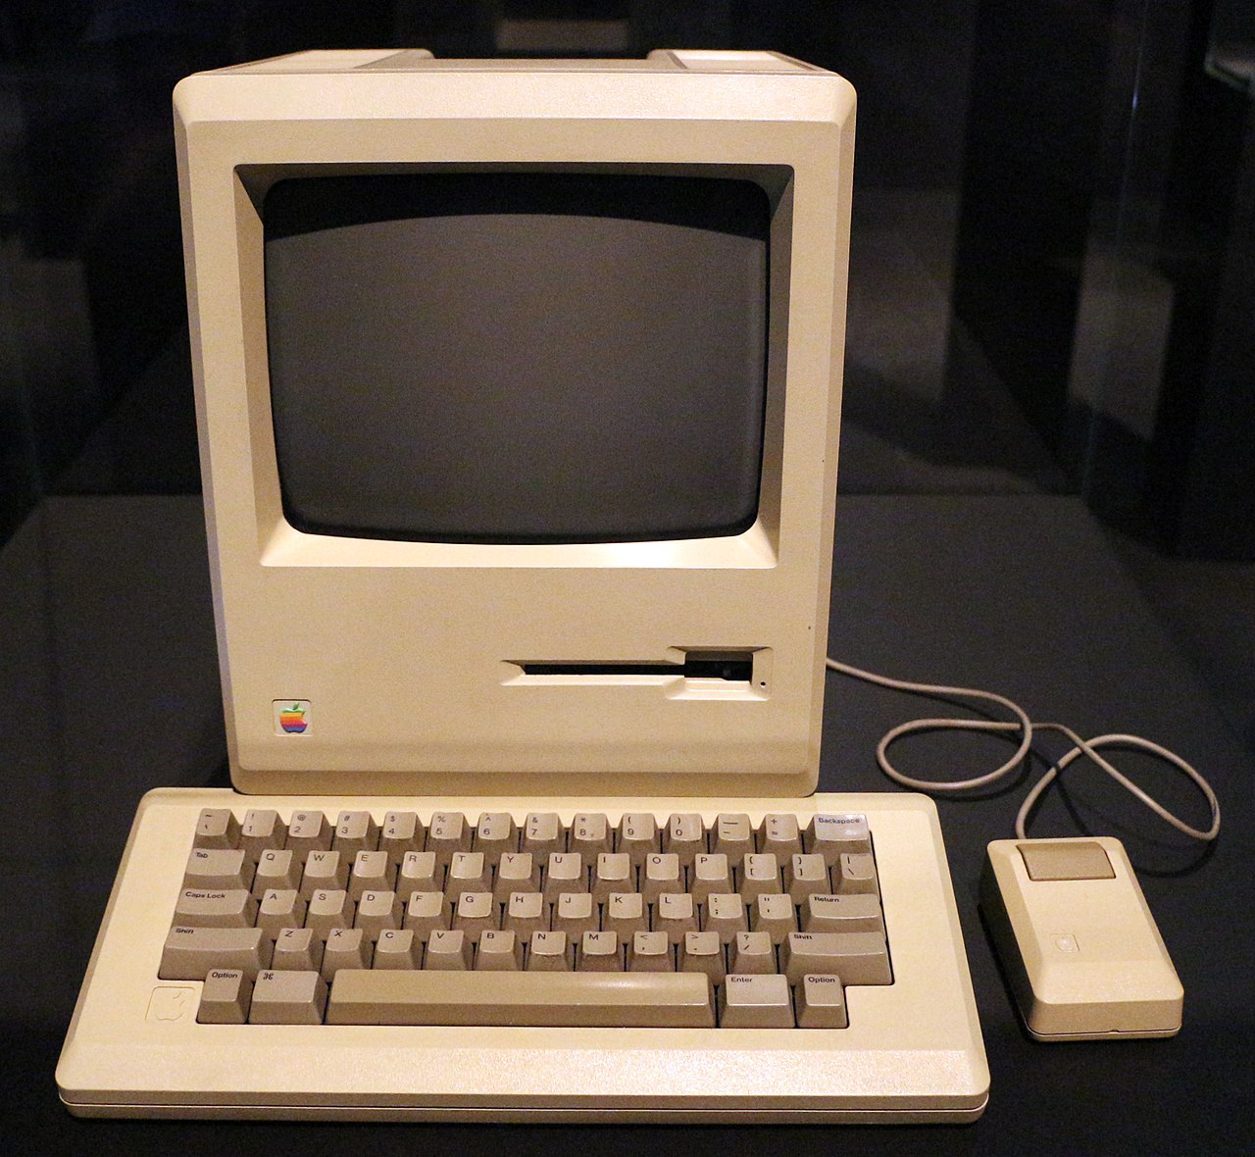
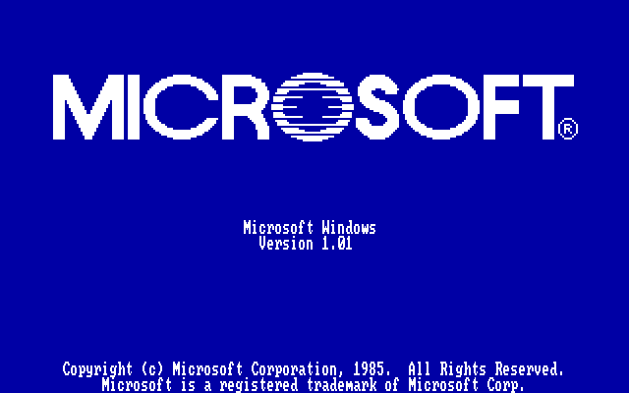
OS History
1967
Multics
1971
Unix
1981
IBM PC + MS-DOS
1983-84
Apple Lisa, Macintosh
1985
Windows
1991
Linux
1998
vmware
2008
Android
Hobbyist
PC
Mobile &
Cloud

Slide 30
Why you want to learn OS?
Foundation to other software
Databases, Browsers, Computational software, … …
OS is one of the hardest software piece to write & debug
Directly talks to hardware (very ugly interfaces)
Abstract into clean interfaces
They are BIG
Lines of code:
Windows Vista (2006): 50M (XP + 10M)
Linux 3.6: 15.9 M
Android 4.0: > 1M

Slide 31
Why you want to learn OS?
Many OS concepts (e.g., protection, resource management) is needed in other places
E.g., browser
OS is used everywhere
Your car is running Linux/Windows

Slide 32
Before the next class
Browse the course web site
http://www.eecg.toronto.edu/~yuan/teaching/ece344/
Enroll yourself on Piazza
Contact me if you have any questions
Let the fun begin!

Slide 34
Prerequisite (nice to have)
You will need these knowledge in this course
Not covered in the lectures
Don’t panic, I trust you are able to learn them on your own
Google and Wikipedia are your friends
C programming language
Compiler basics
What is “compile”? What is a linker?
MIPS Instruction Set Architecture
You will need to understand MIPS assembly in programming assignments

